Slide 1
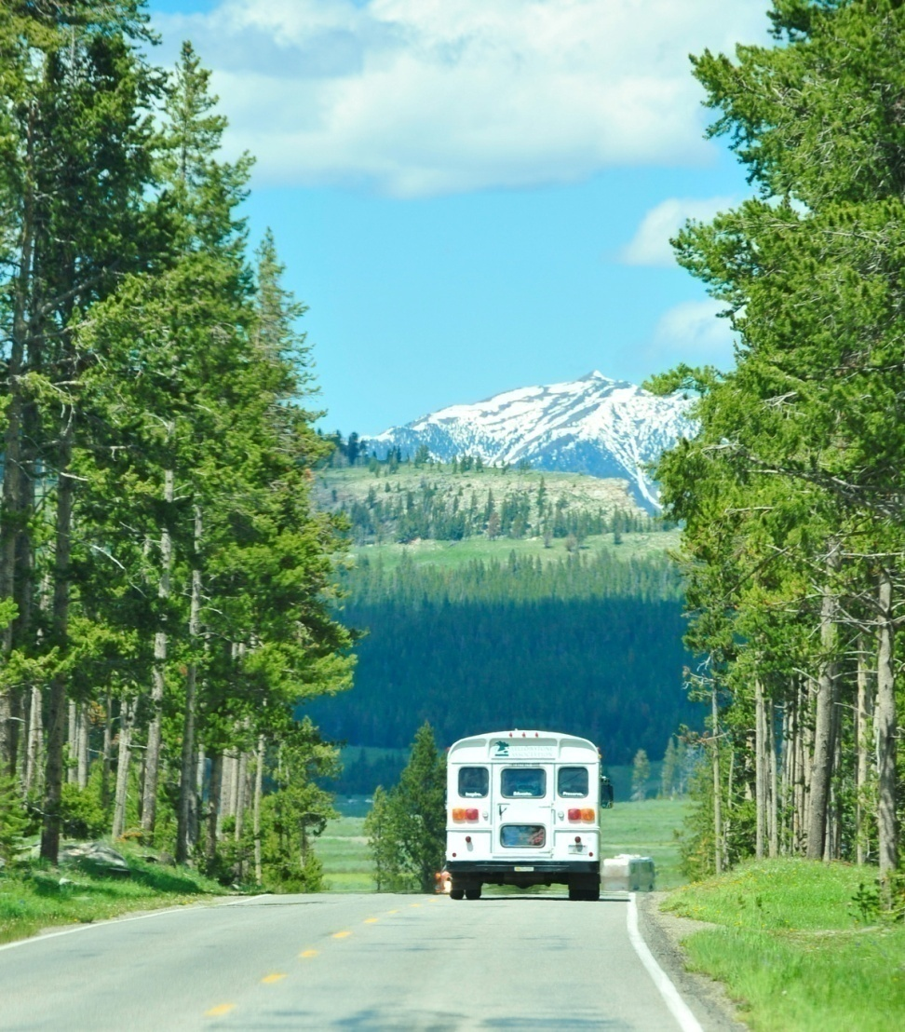
Natural Resources and Public Choice: Land Use Conflicts in Yellowstone
2009 American Democracy Project National Meeting
Stewardship of Public Lands
John Conant
Charles Amlaner
June 13, 2009
Indiana St. Univ.

Slide 2
Presentation Outline
Introduction to the project on “Land Use Conflicts”
Workshop at ISU
Field Work at YNP
Expectations for teacher
participants
Teaching materials
created in course
http://www1.indstate.edu/publiclanduse/index.htm

Slide 3
The Natural and Social Sciences at Work in Yellowstone
Middle and High School science and social science teachers
Integrating academic content with public choice processes
Partnering – Biology, Economics, Center for Economic Ed, IN DoE, CPSCE, and local school corporations.

Slide 4
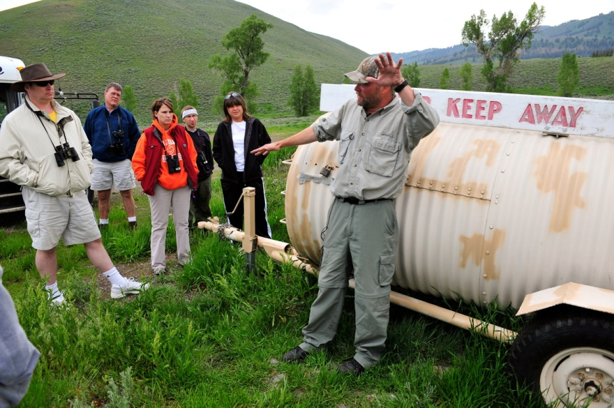
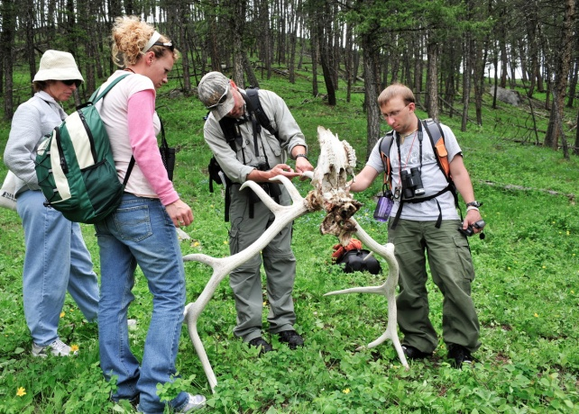
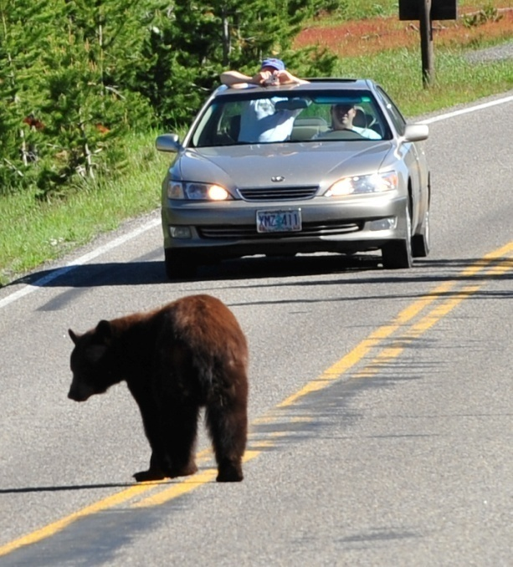
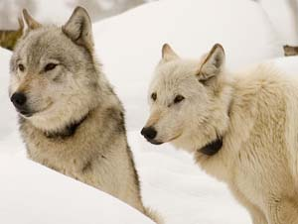
The Natural and Social Sciences at Work in Yellowstone
Middle and High School science and social science teachers
Integrating academic content with public choice processes
Partnering – Biology, Economics, Center for Economic Ed, IN DoE, CPSCE, and local school corporations.

Slide 5
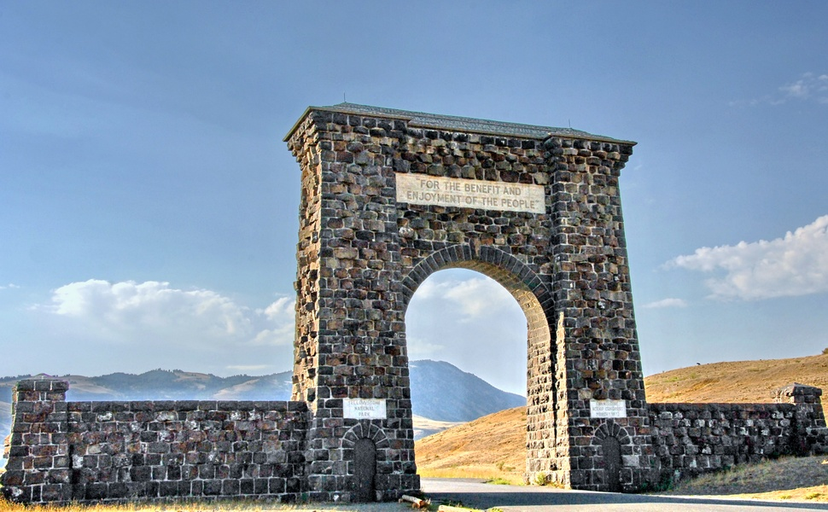
The Natural and Social Sciences at Work in Yellowstone
Middle and High School science and social science teachers
Integrating academic content with public choice processes
Partnering –Biology, Economics, Center for Economic Ed, IN DoE, CPSCE, and local school corporations

Slide 6
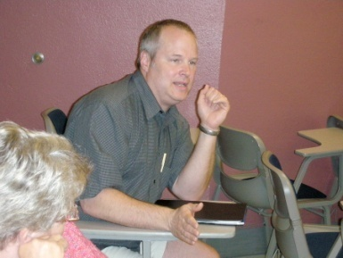
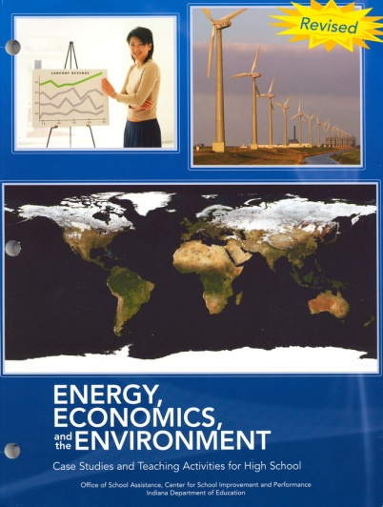
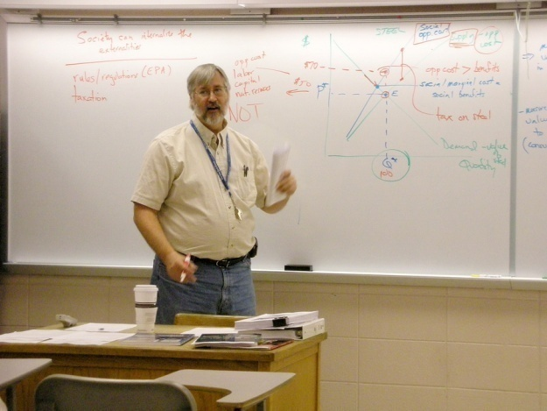
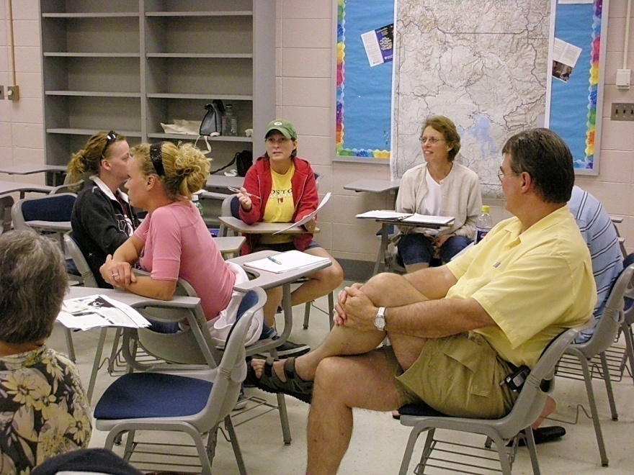
Pre-Departure Workshop
IN Academic Standards: biology, ecology, economics, government
Integrative lesson plans and participative pedagogy
Simulations in science and economics conflicts
Public Choice Mechanisms and political systems, (State Senator)
Content based introduction to issues and advocates

Slide 7
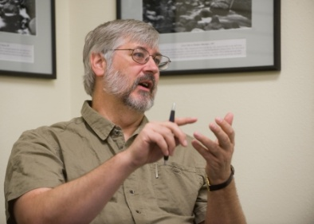
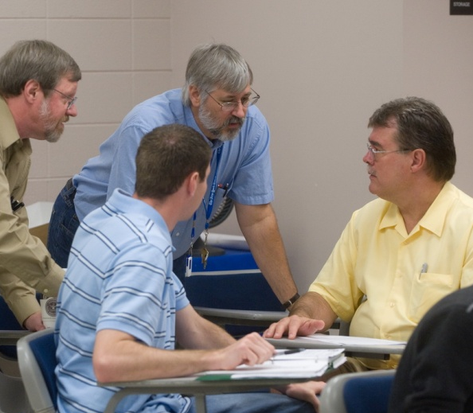
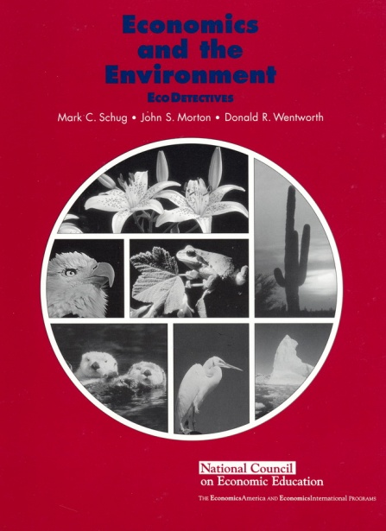
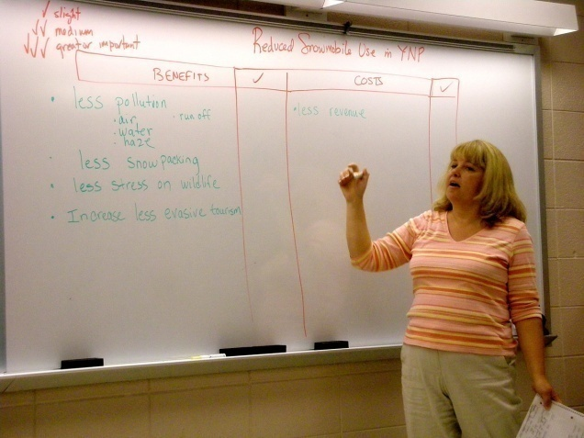
Pre-Departure Workshop
IN Academic Standards: biology, ecology, economics, government
Integrative lesson plans and participative pedagogy
Simulations in science and economics conflicts
Public Choice Mechanisms and political systems, (State Senator)
Content based introduction to issues and advocates

Slide 8
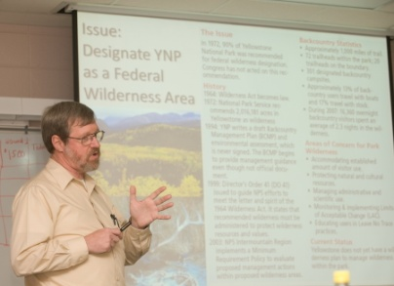
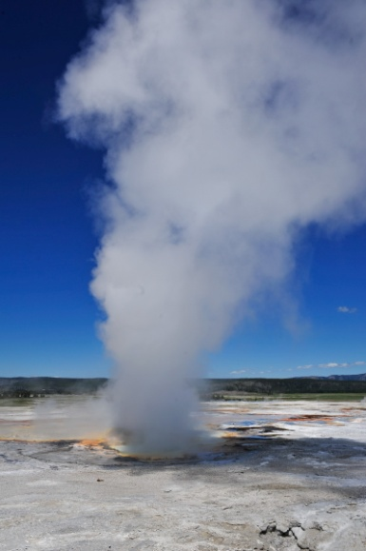
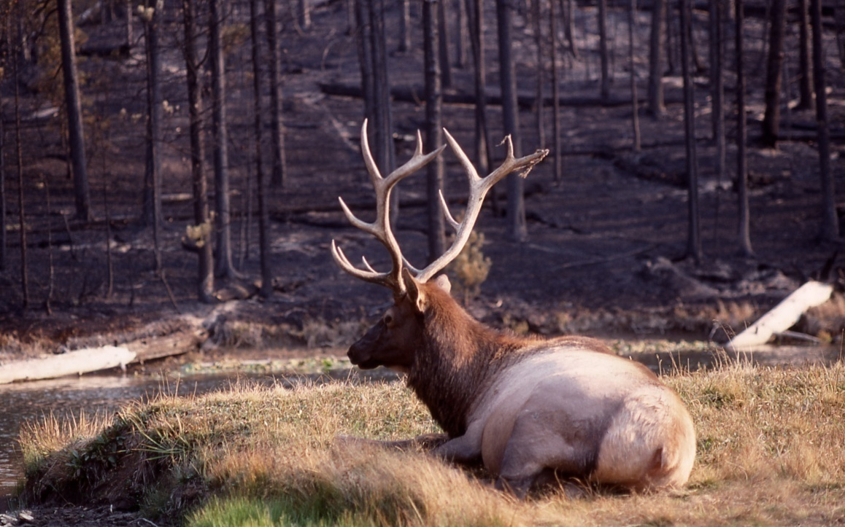
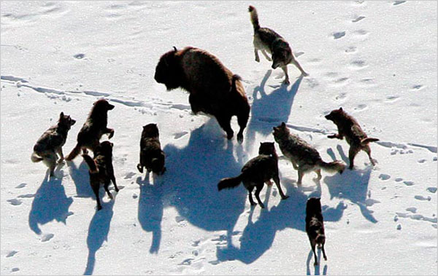
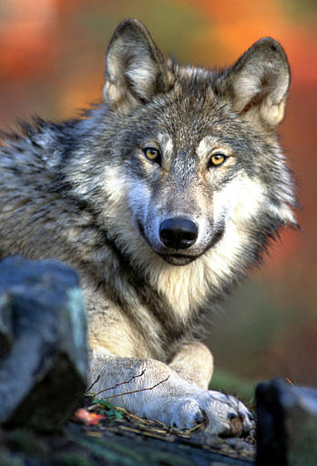
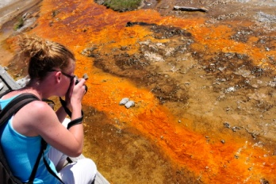
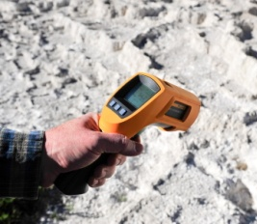
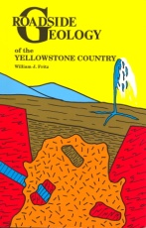
Pre-Departure Workshop
IN Academic Standards: biology, ecology, economics, government
Integrative lesson plans and participative pedagogy
Simulations in science and economics conflicts
Public Choice Mechanisms and political systems, (State Senator)
Content based introduction to issues and advocates

Slide 9
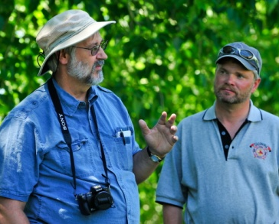
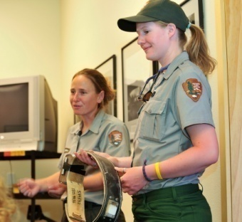
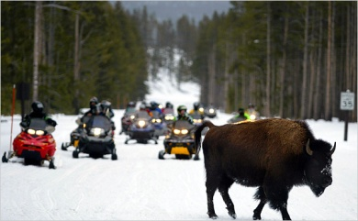
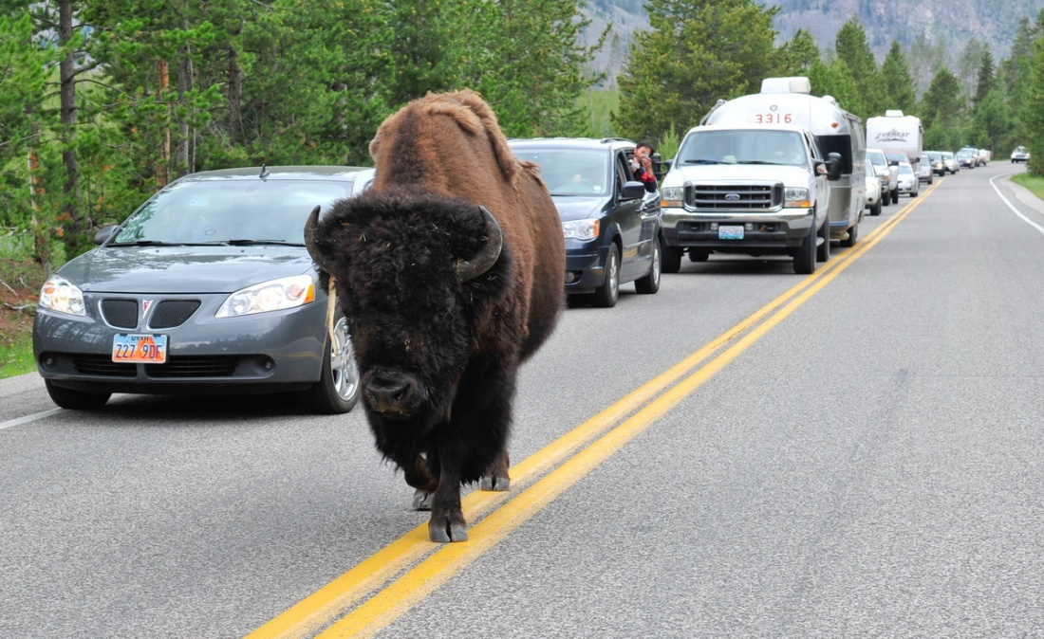
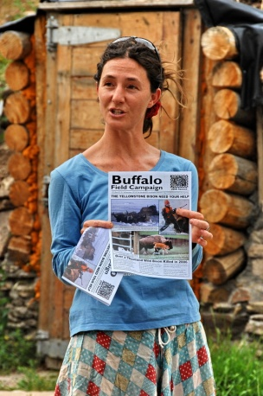
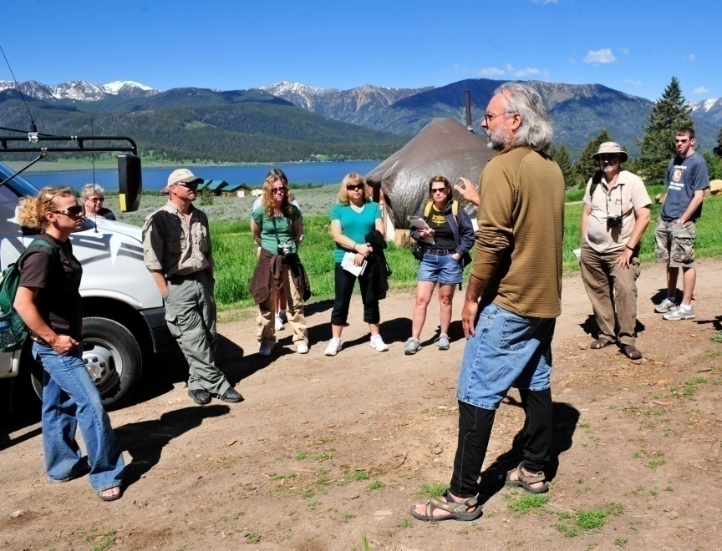
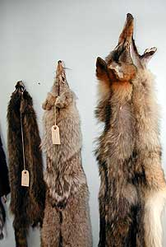
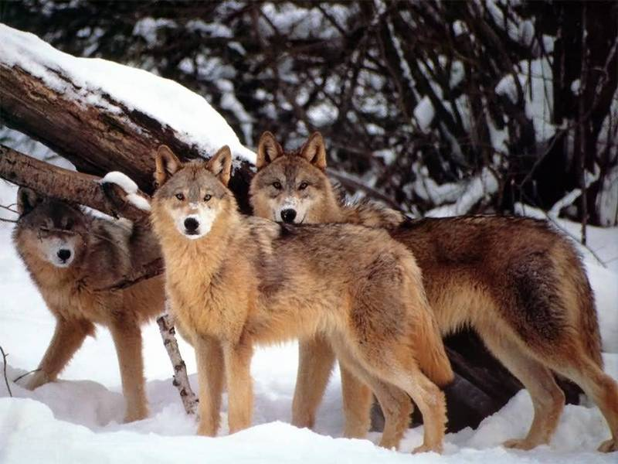
In the Field at Yellowstone
Special interest and advocacy speakers chosen and preparation
Reflection time for participants
Teambuilding

Slide 10
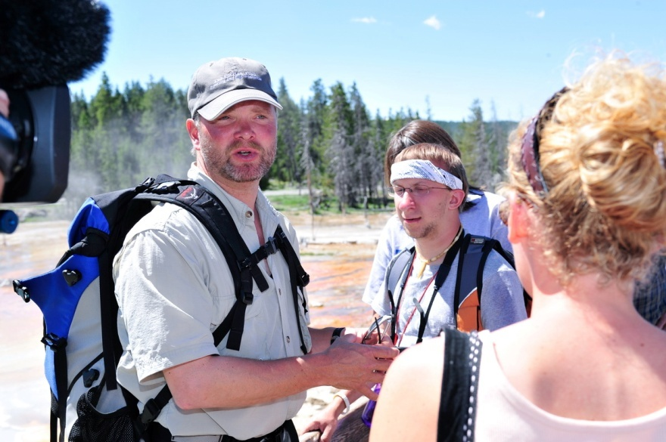
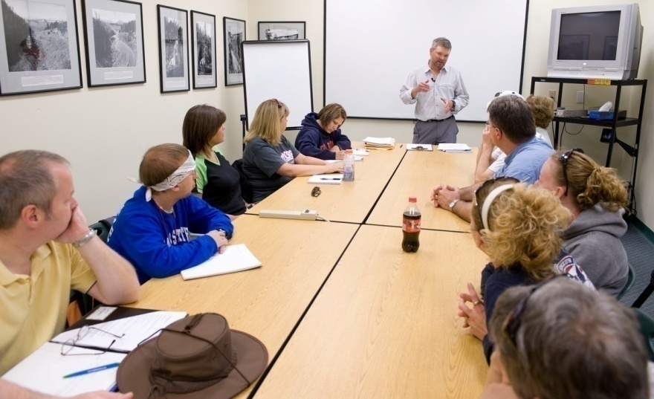
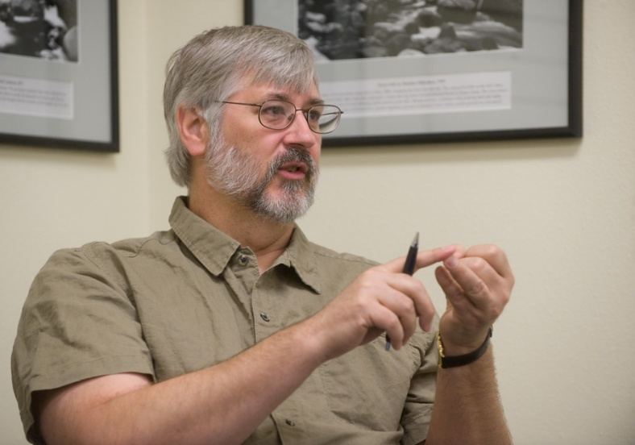
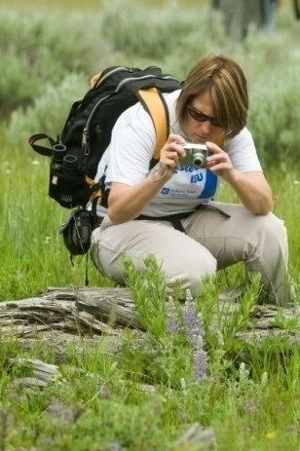
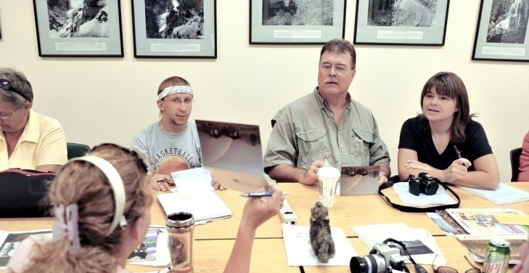
In the Field at Yellowstone
Special interest and advocacy speakers chosen and preparation
Reflection time for participants
Teambuilding

Slide 11
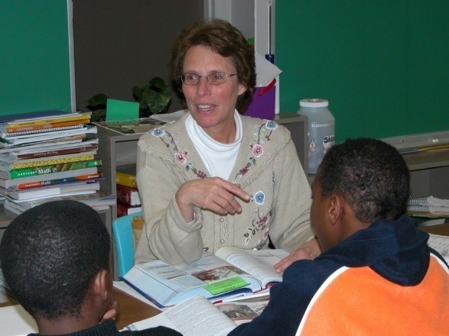
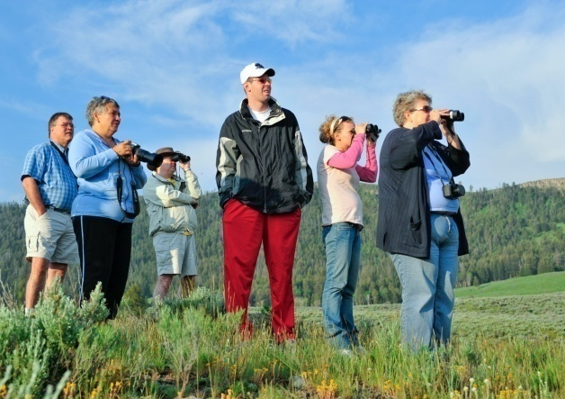
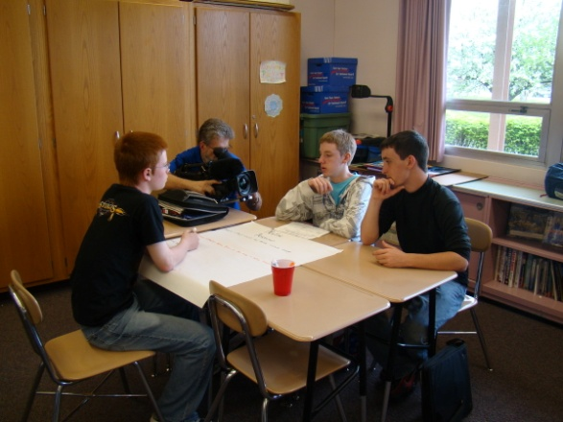
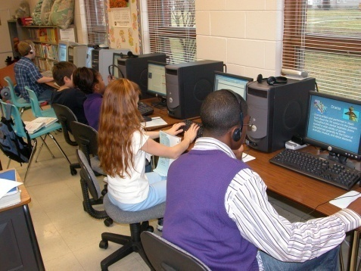
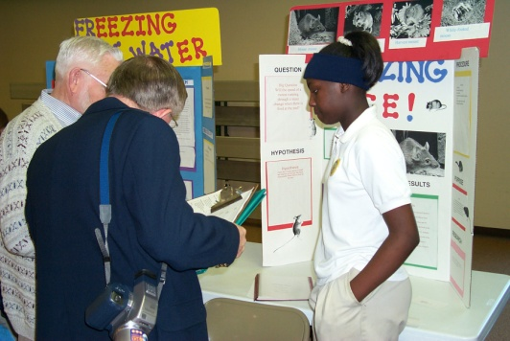
In the Field at Yellowstone
Special interest and advocacy speakers chosen and preparation
Reflection time for participants
Teambuilding

Slide 12
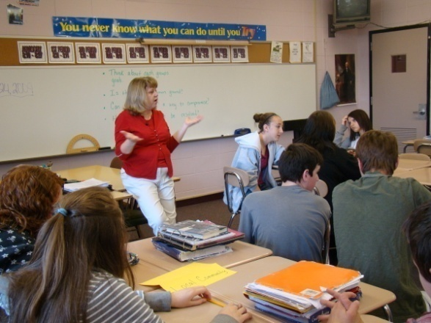
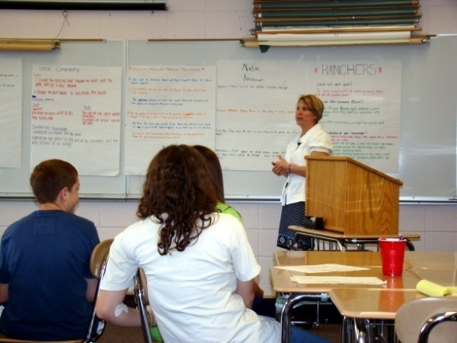
Expectations for Teacher-Participants
Reflections
PowerPoint
Lesson plans
Observation in classroom
Extension as local field experience

Slide 13
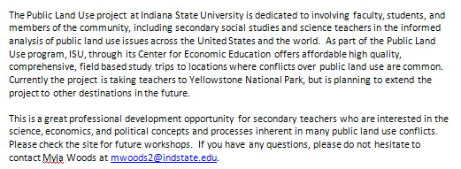
Materials Generated
ISU project website
Video overviews
Photographs
Speaker transcripts
Lesson Plans
Resource Materials

Slide 14
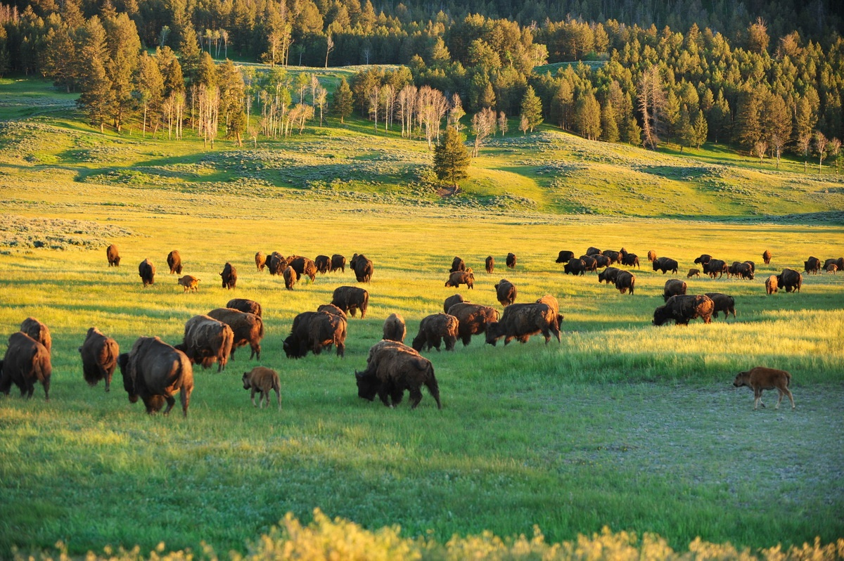
Future Directions
Middle School – High School teacher teams
School Corporation teams
Teacher – student teams
Involvement in local public choice issues
Taking YNP model to local public lands

