Slide 1
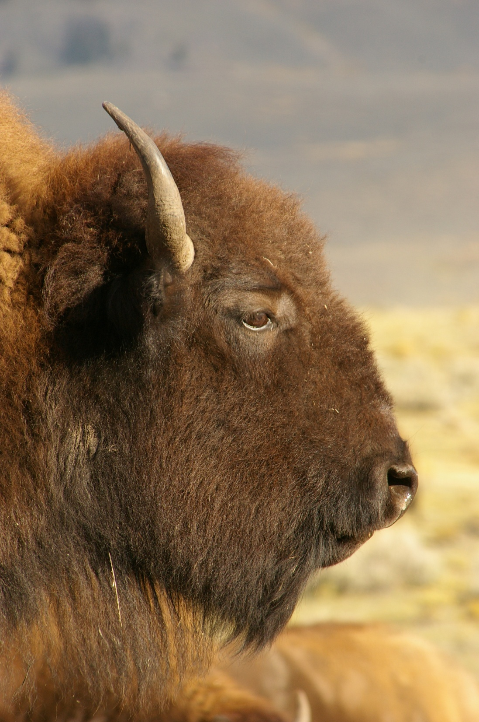
American Bison
Then and Now
By: Tim Curts
Molly Shover
Courtney Symons

Slide 2
Bison and Native Americans: A Symbol of Culture
To the Native Americans, the bison represent a large part of their culture.
Bison and Native Americans share a connection deeper than simply providing food and clothing.
Bison played a large role not only in Native American day to day life, but also in their religious foundations as well.
Without the bison, much of what the Native Americans believed and stood for lost its foundations.

Slide 3
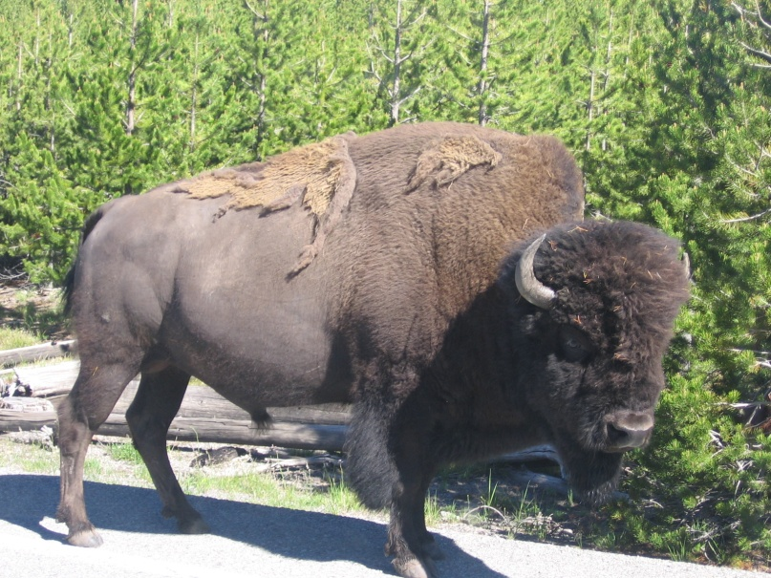
What is a bison?
Bison is the genetically pure species commonly known as the American Buffalo.
There is a difference between Bison and Yellowstone Bison.
Bison outside of Yellowstone have been cross-bred with cattle at some point.
Yellowstone bison are genetically pure and are direct descendents of the animals that roamed the earth hundreds of years ago.
Yellowstone bison are not only genetically pure, but they are also wild and have never been domesticated.
The scientific name for Bison is Bison Bison.
Bison are large, wild animals. Bull Bison generally weigh around 2,000 lbs and a cow bison weighs around half of that.
While Bison seem docile and slow moving, they are wild creatures who can move pretty fast and fight pretty hard.
Information: “Bison Facts”

Slide 4
History
The North American buffalo traces its origins to a similar Eurasian bison species, which crossed the Bering Strait in prehistoric times.
From two ice age bison ancestors, the plains bison was evolved
It is estimated that at the peak of the North American bison's existence, nearly sixty million bison roamed the grasslands of North America in massive herds ; their range roughly formed a triangle between Canada's far northwest, south to Northern Mexico and east along the western boundary of the Appalachian Mountains.
Population estimates range from 20 to 75 million

Slide 5
What do the bison mean to the Native Americans?
The bison (buffalo as referred to by many tribes) served many purposes for many Native Americans.
Food:
When a buffalo was killed, tribes used all parts of it.
Its’ meat would be used to feed the many members of the tribe.
Clothing:
Once the meat was salvaged, the hides were also used.
Buffalo hide is very strong and made for incredibly durable clothing.
Shelter:
Buffalo hides were not only good for clothing.
Teepees greatly benefited from the use of Buffalo hides.
Trade:
As European settlers increased, so did the demand for Buffalo hide.
Native Americans could benefit greatly from the sale of buffalo hide to desirous settlers.
Religion:
Buffalo play an integral role in many Native American religious practices.
Many Sun Dances utilize Buffalos and Buffalo hides still to this day in their ceremonies.
Information: “Buffalo or Bison and Native Americans.”

Slide 6
More Than Just an Animal
To the Native Americans, the Buffalo was much more than just an animal. Buffalo were thought to personify many human-like characteristics and were given the dignity of a human.
The Buffalo represented many positive qualities.
Buffalo became symbolic for gratitude, abundance, and prayer.
It was thought that the wisdom of buffalo included: courage, strength, giving for the greater good, challenge, abundance, knowledge, generosity, hospitality, survival, earthly creativity, feminine courage, and sharing work.
“When you are attracted to a buffalo, you are being asked to renew your connection to higher power through prayer and thankfulness for all you have. In doing so, you will attract more into your life. Buffalo teaches that what you need will always be provided”
~ Snow Owl.
Information: Snow Owl

Slide 7
To Crow Patrick Hill, Buffalo still retain this historic and cultural meaning, as they do for many Native Americans.
For him, when he looks at a buffalo, and it looks back at him; it is a spiritual experience as well. The buffalo doesn’t just look at him, but he sees him and is therefore seeing all that is there. It brings his past and connects it with his present and looks into his future.
Whenever Patrick Hill is involved in a Buffalo kill, there is a thank you process given for the buffalo’s life. The buffalo has given his life to him (he has not necessarily taken it) so that he will be successful in his future endeavors. Therefore, he pays homage to the buffalo and gives him thanks.

Slide 8
As Seen in Literature
Buffalo are often personified and used as characters in Native American traditional stories originally passed down orally.
Examples:
Creation Myths – “Buffalo Woman”
Trickster Tales – “The Coyote and the Buffalo”
Memoirs – “The Way to Rainy Mountain” by N. Scot Momoday
Picture from http://www.firstpeople.us/pictures/buffalo/ls/a-dear-born-one-last-look.html

Slide 9
Bison, Native Americans, and the US Government
Until the late 1800’s, bison roamed freely throughout the United States.
They roamed from the eastern seaboard to the west and from Canada to Mexico.
Bison were natural to the Great Plains area and to the West.
Bison are naturally migratory animals and move to where there is food.
It is impossible to know exactly how many bison roamed throughout the land.
Estimates for Bison numbers range between 25 and 50 million
Information: “Buffalo or Bison and Native Americans.”

Slide 10
What Happened?
Though at one point bison ruled the Great Plains and the West, during the 1800’s this status changed dramatically.
The depletion and slaughter of Buffalo was not an overnight process, nor did it occur as a result of simply one entity.
There are many different theories that impacted the depletion of the Buffalo.
Both the American government and the Native Americans contributed to the depletion of the Bison.
The 1870’s were the worst decade for the slaughter of bison ever recorded. Some records claim up to 4.5 million Bison were killed in a 3 year period.
By 1890 there were less than 1000 bison left.
Information: “Buffalo or Bison and Native Americans.”

Slide 11
Native American’s Role
While the Native Americans were not the cause of the eradication of the
Bison, their overhunting and other uses beyond their means definitely had an
impact on the bison’s existence.
Hunting:
With the settling of the West came many new means and reasons for Native Americans to hunt the Bison.
Now Native Americans were not only hunting bison for their own food and shelter, but they were often hunting them for trade and competition as well.
European settlers brought with them a variety of new accoutrements, including the gun. With the gun, the Native Americans could shoot the bison from farther away, causing the hunt to increase exponentially.
Also, horses were brought to the area from South, who had received them from the Spanish. This made following and hunting Bison much easier as well.
Picture: http://www.firstpeople.us/pictures/buffalo/ls/Indians-Hunting-Buffalo.html
Information: “Buffalo or Bison and Native Americans.”

Slide 12
Native American’s Role Cont.
Trade:
In the 1820’s, the demand and market for Bison hide began to increase thus requiring Native Americans to increase their trade of the animal.
As the economy boomed, so did the desire for Bison meat, hides, tallow, and horns.
Native Americans found that it was economical to keep up with the demands for such goods.
Competition
Competition for Bison increased and therefore the demand to hunt bison became higher.
The mentality soon became “If we do not kill the bison, someone else will” causing bison to be killed in increasing numbers.
Picture: http://www.firstpeople.us/pictures/buffalo/ls/Harry-Schaare-Buffalo-Runners-1150x752.html
Information: “Buffalo or Bison and Native Americans.”

Slide 13
Role of the Government
While the Native Americans played a role in the eradication of the Bison, the American government played an even bigger role. Not only did it help to rid the Great Plains and the West of bison, but they helped to rid the area of a culture that had reigned for centuries.
The middle and upper classes began to grow following the civil war and began to have an appetite for beef that was hard to appease.
To keep up with the demands, cattle ranchers decided to ranch in the Great Plains area, a land that was roamed by bison. They went here since they knew this area would obviously be able to support the amount of ungulates they wanted to graze there.
However, in order for this to work out, both the bison and the Native Americans had to leave. Bison could not be roaming in the same area as the cattle ranchers wanted to graze their cattle. Cattle ranchers especially felt that if bison were allowed to remain, they would out graze the cattle for food causing economic problems. Therefore, one had to leave.
Thankfully, this fit in with the governments ideas of wanting to “civilize” the Native Americans and removing them to reservations.
Information: “Buffalo or Bison and Native Americans.”
Picture: http://www.firstpeople.us/pictures/buffalo/ls/Passengers-Shooting-Buffalo.html

Slide 14
Role of Government cont.
The American government did not understand or agree with the Native American’s nomadic way of life.
Up until this point, most Native American tribes were nomadic following the migration of bison, elk, and deer.
The government wanted to “civilize” and assimilate the Native Americans essentially changing who they are and what they believe.
This caused a lot of tension and distrust between Native American tribes and US government.
The government’s ultimate goal was for the Native American’s to be established on reservations.
Information: “Buffalo or Bison and Native Americans.”

Slide 15
Role of Government cont.
“The civilization of the Indian is impossible while the buffalo remains upon the plains. I would not seriously regret the total disappearance of the buffalo from our western prairies, in its effect upon the Indians, regarding it as a means of hastening their sense of dependence upon the products of the soil and their own labors.” ~ Annual Report of the Department of the Interior – Secretary of the Interior Columbus Delano
Many viewed the survival of the bison as a means of continuing the lives of the Native Americans, with which they did not agree.
If the bison remained, the civilization of the Native Americans was nearly impossible.
But, if the government were to rid the Native Americans of their main source of food, shelter, and income, then they would have little choice but to follow the wishes of the government.
Therefore, the government began a policy to get rid of the bison, thus eliminating the Native American’s ability to survive. Doing so would force them to move onto the reservations in order to produce for themselves and to live.
Reservations are lands specifically designated for a particular tribe. The tribe and the government enter a treaty for the land and other agreements.
By doing so, the Native Americans would, in theory, be “civilized.”
“Buffalo or Bison and Native Americans.”
“Bison Slaughter History”

Slide 16
Two Opposing Viewpoints
“The buffalo gave us everything we needed. Without it we were nothing. Our tipis were made of his skin. His hide was our bed, our blanket, our winter coat. It was our drum, throbbing through the night, alive, holy. Out of his skin we made our water bags. His flesh strengthened us, became flesh of our flesh. Not the smallest part of it was wasted. His stomach, a red-hot stone dropped into it, became our soup kettle. His horns were our spoons, the bones our knives, our women's awls and needles. Out of his sinews we made our bowstrings and thread. His ribs were fashioned into sleds for our children, his hoofs became rattles. His mighty skull, with the pipe leaning against it, was our sacred altar. The name of the greatest of all Sioux was Tatanka Iyotake--Sitting Bull. When you killed off the buffalo you also killed the Indian--the real, natural, "wild" Indian (Fire, 130).”
~John Fire Lame Deer
“These men have done more in the last two years, and will do more in the next year, to settle the vexed Indian question, than the entire regular army has done in the last forty years. They are destroying the Indians' commissary. And it is a well known fact that an army losing its base of supplies is placed at a great disadvantage. Send them powder and lead, if you will; but for a lasting peace, let them kill, skin, and sell until the buffaloes are exterminated. Then your prairies can be covered with speckled cattle (Cook, 164).”
~ General Phil Sheridan – Texas Legislature, 1875
Picture: http://en.wikipedia.org/wiki/File:Bison_skull_pile,_ca1870.png#file
Information: “Buffalo or Bison and Native Americans.”

Slide 17
What Happened Next?
By the early 1900’s, there were only a couple dozen bison left. These bison were discovered in the Pelican Valley of Yellowstone National Park.
Conservation efforts began prior to this, but few people had supported these efforts.
The small herd was protected within Yellowstone and attempts were made to develop the population.
By the 1980’s the population reached 2000 and by the 1990’s the bison population had reached 3000 animals.
However, with the larger population bison began to leave the park more regularly during the winter in search of food and warmer climates.

Slide 18
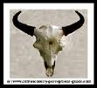
Extinction Issues
The American bison is a relative newcomer to North America,
About 10,000 years ago it replaced the steppe bison (Bison priscus), a previous immigrant that was much larger. It is thought that the long-horned bison became extinct due to a changing ecosystem and hunting pressure following the development of the Clovis point and related technology, and improved hunting skills.
During this same period, other mega fauna vanished and were replaced to some degree by immigrant animals that were better adapted to predatory humans. The American bison, was one of these animals.

Slide 19
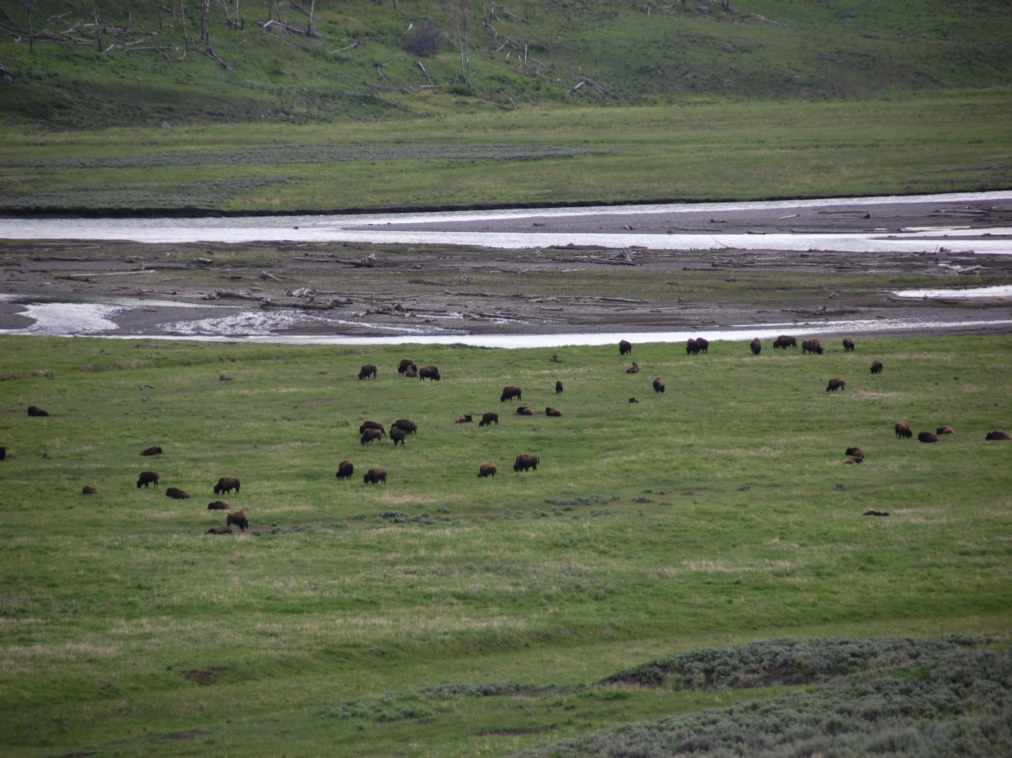
Bison Overpopulation Theory
Native Americans not only created (by selective use of fire) the large grasslands that provided the bison's ideal habitat but also kept the bison population regulated.
In this theory, it was only when the original human population was devastated by epidemics (from diseases of Europeans) after the 16th century that the bison herds propagated wildly.
The seas of bison herds that stretched to the horizon were a symptom of an ecology out of balance, only rendered possible by decades of heavier-than-average rainfall.
Bison were the most numerous single species of large wild mammal on Earth

Slide 20
After the animals rotted, their bones were collected and shipped back east in large quantities. The crushed bones were used widely as fertilizer
The main reason for the bison's near-demise, much like the actual demise of the passenger pigeon, was commercial hunting.
Professional hunters were happy to oblige both the government and the railroads because bison hides were valuable at the time in making commercial items such as robes and rugs.

Slide 21
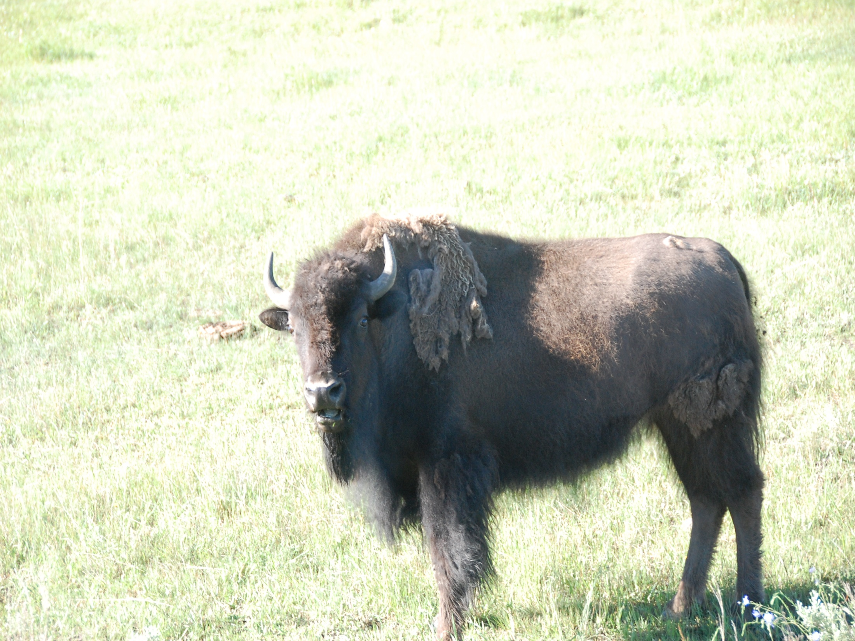
The railroad industry wanted bison herds culled or eliminated.
Herds of bison on tracks could damage locomotives when the trains failed to stop in time.
Herds often took shelter in the artificial cuts formed by the grade of the track winding though hills and mountains in harsh winter conditions.
As a result, bison herds could delay a train for days.

Slide 22
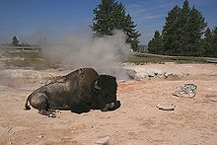
Ecological Effects of Bison
Bison change the structure and composition of vegetation
• Bison prefer grasses to forbs (small broad-leaved plants)
• No bison ⇒ grasses dominate
• Bison eat grasses, makes space for forbs.
• Bison urine provides nitrogen faster than decomposing leaf litter ⇒ faster plant growth

Slide 23
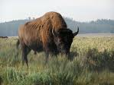
Effects of Grazing
One of bison’s greatest impacts on mixed-grass prairie ecosystems is grazing.
Bison tend to graze in patches, revisiting areas throughout the season and therefore leaving a mosaic of grazed and ungrazed areas.
Because bison selectively graze on dominant grasses while avoiding most forbs and woody species, the resulting patchy distribution of vegetation favors increased plant species diversity by allowing forbs to flourish
The nature of bison grazing allows the productivity of grasses to recover while the presence of diverse forbs enhances gas exchange, aboveground biomass, density and plant cover
Photosynthesis rates are also increased by bison grazing patterns due to increased light availability and reduced water stress.

Slide 24
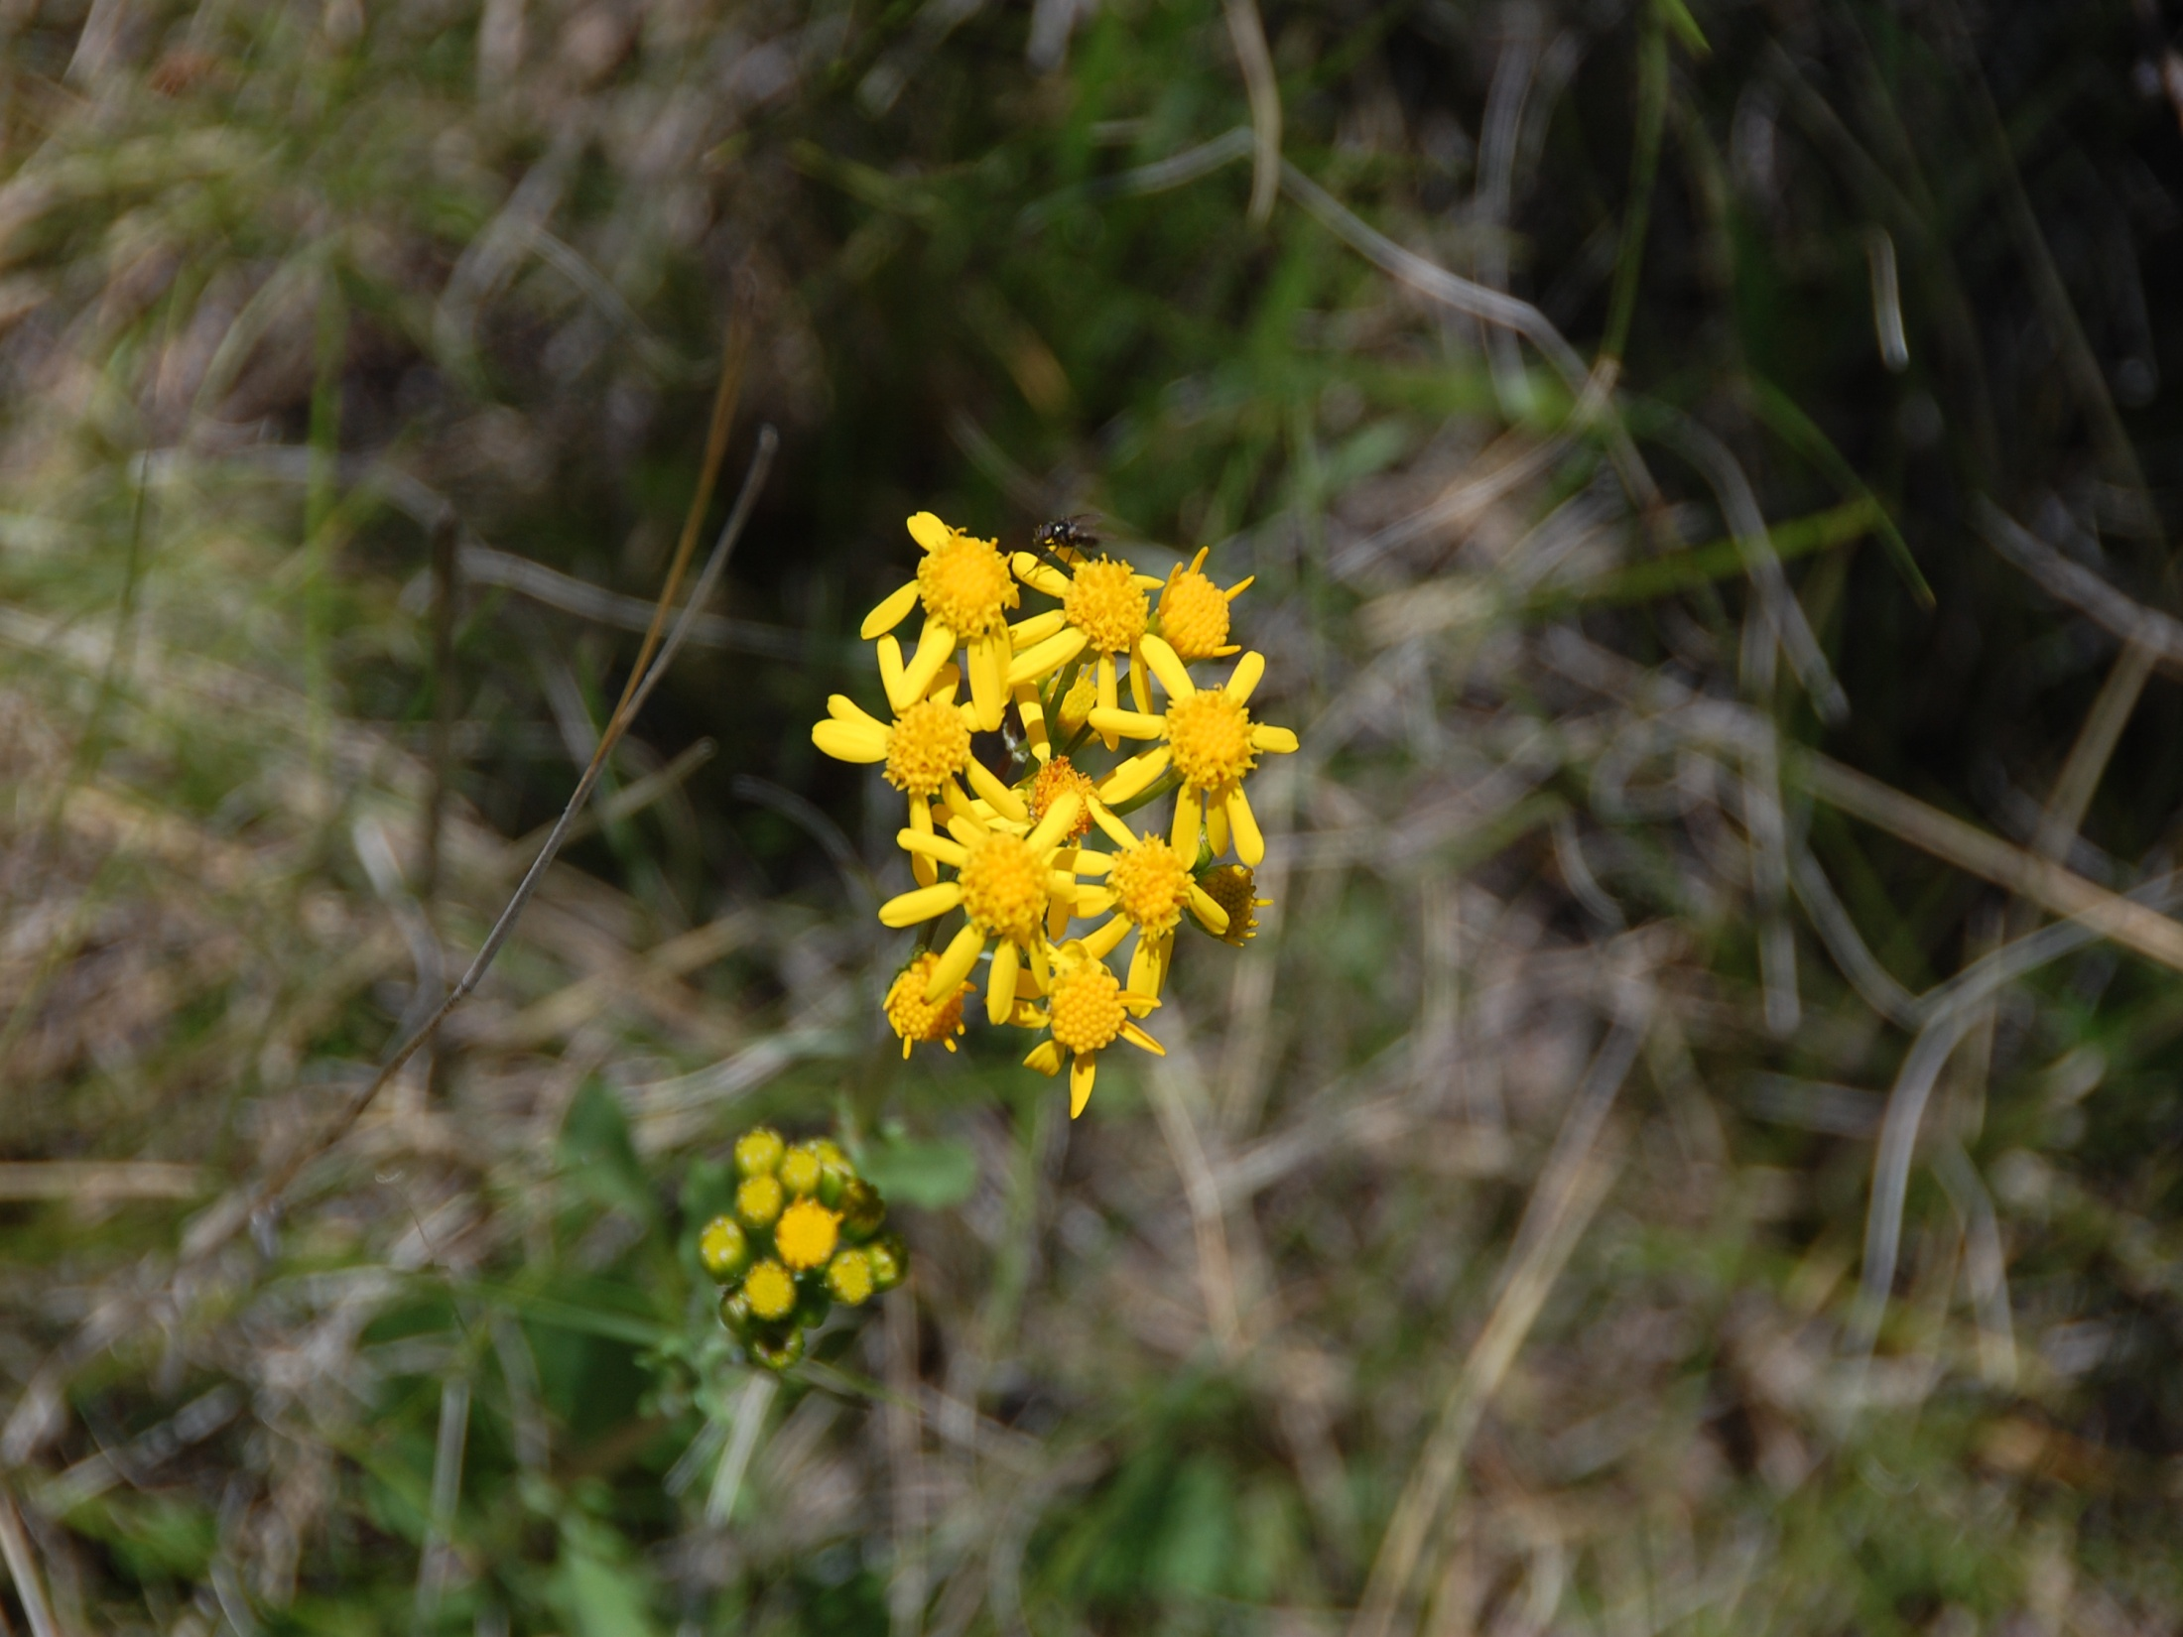
Bison grazing increases animal diversity on the landscape.
Bison grazed areas increase the foraging efficiency of prairie dogs which in turn are the main food source of ferrets.
Prairie dogs also provide food for foxes, hawks and eagles and their colonies are home to other small mammals and reptiles.

Slide 25
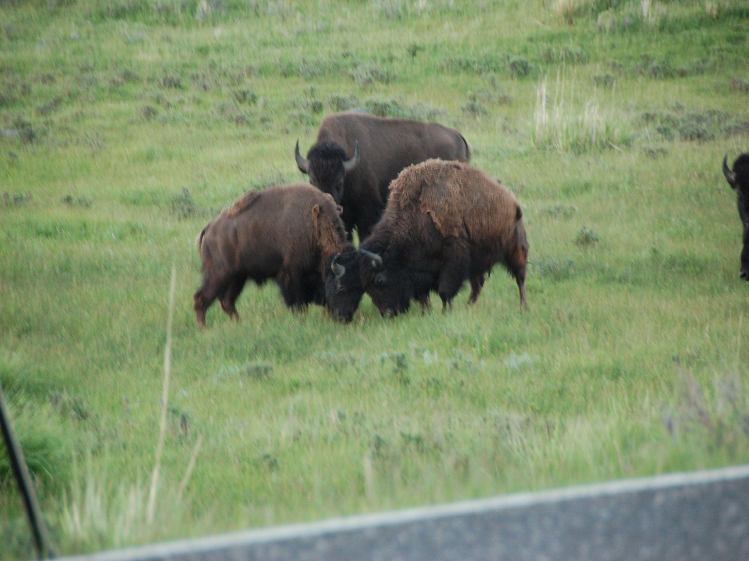
Bison also affect the nutrient cycling in prairie ecosystems.
Nitrogen is an essential element for plant productivity that is found in both plant material and soils.
By consuming plant biomass, bison then return labile nitrogen to the soils in the form of urine which is more effective than the slower mineralization of nitrogen from plant litter breakdown
At the same time, grazing increases the amount and quality of plant litter that is returned to the soil as well as the plant uptake of nutrients

Slide 26
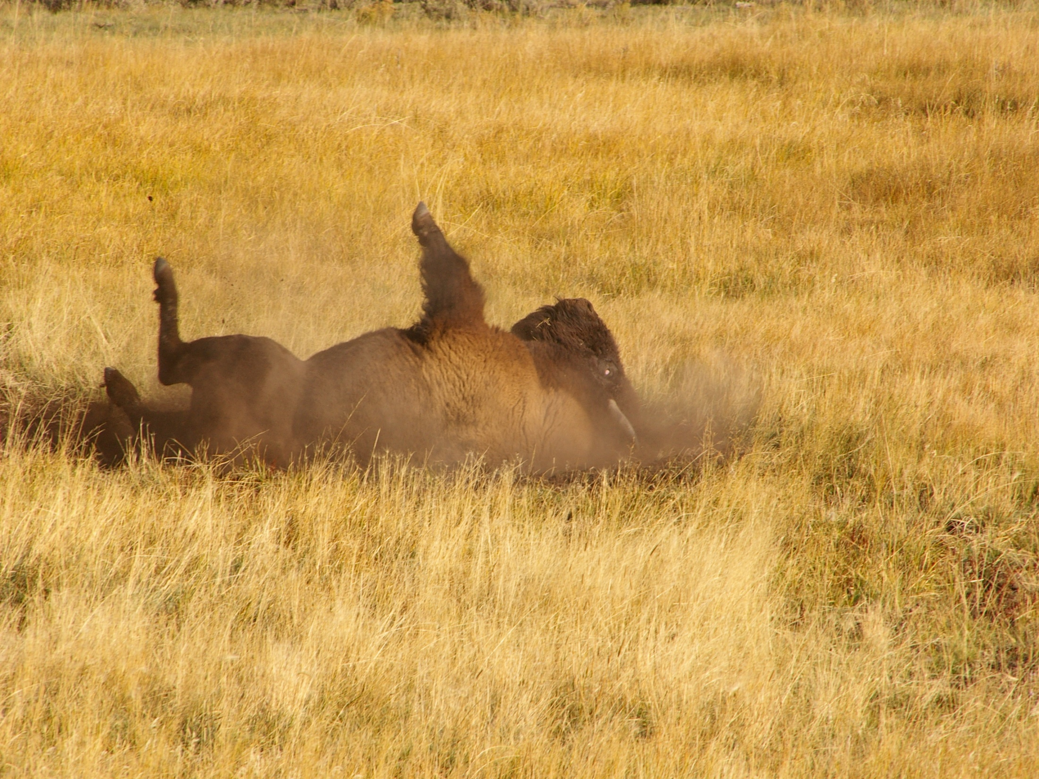
Bison Wallows as Microclimates
Wallows are a unique ecological feature of prairie ecosystems created by bison.
By rolling repeatedly in exposed soil, bison increase soil compaction in certain areas which aids in water retention.
In the spring, these wallows produce temporary pools that can support ephemeral wetland species
In the summer, the wallows support a different vegetation structure and composition that is more drought and fire resistant
The combined effect of bison wallows is an increase in environmental heterogeneity and local and regional biodiversity

Slide 27
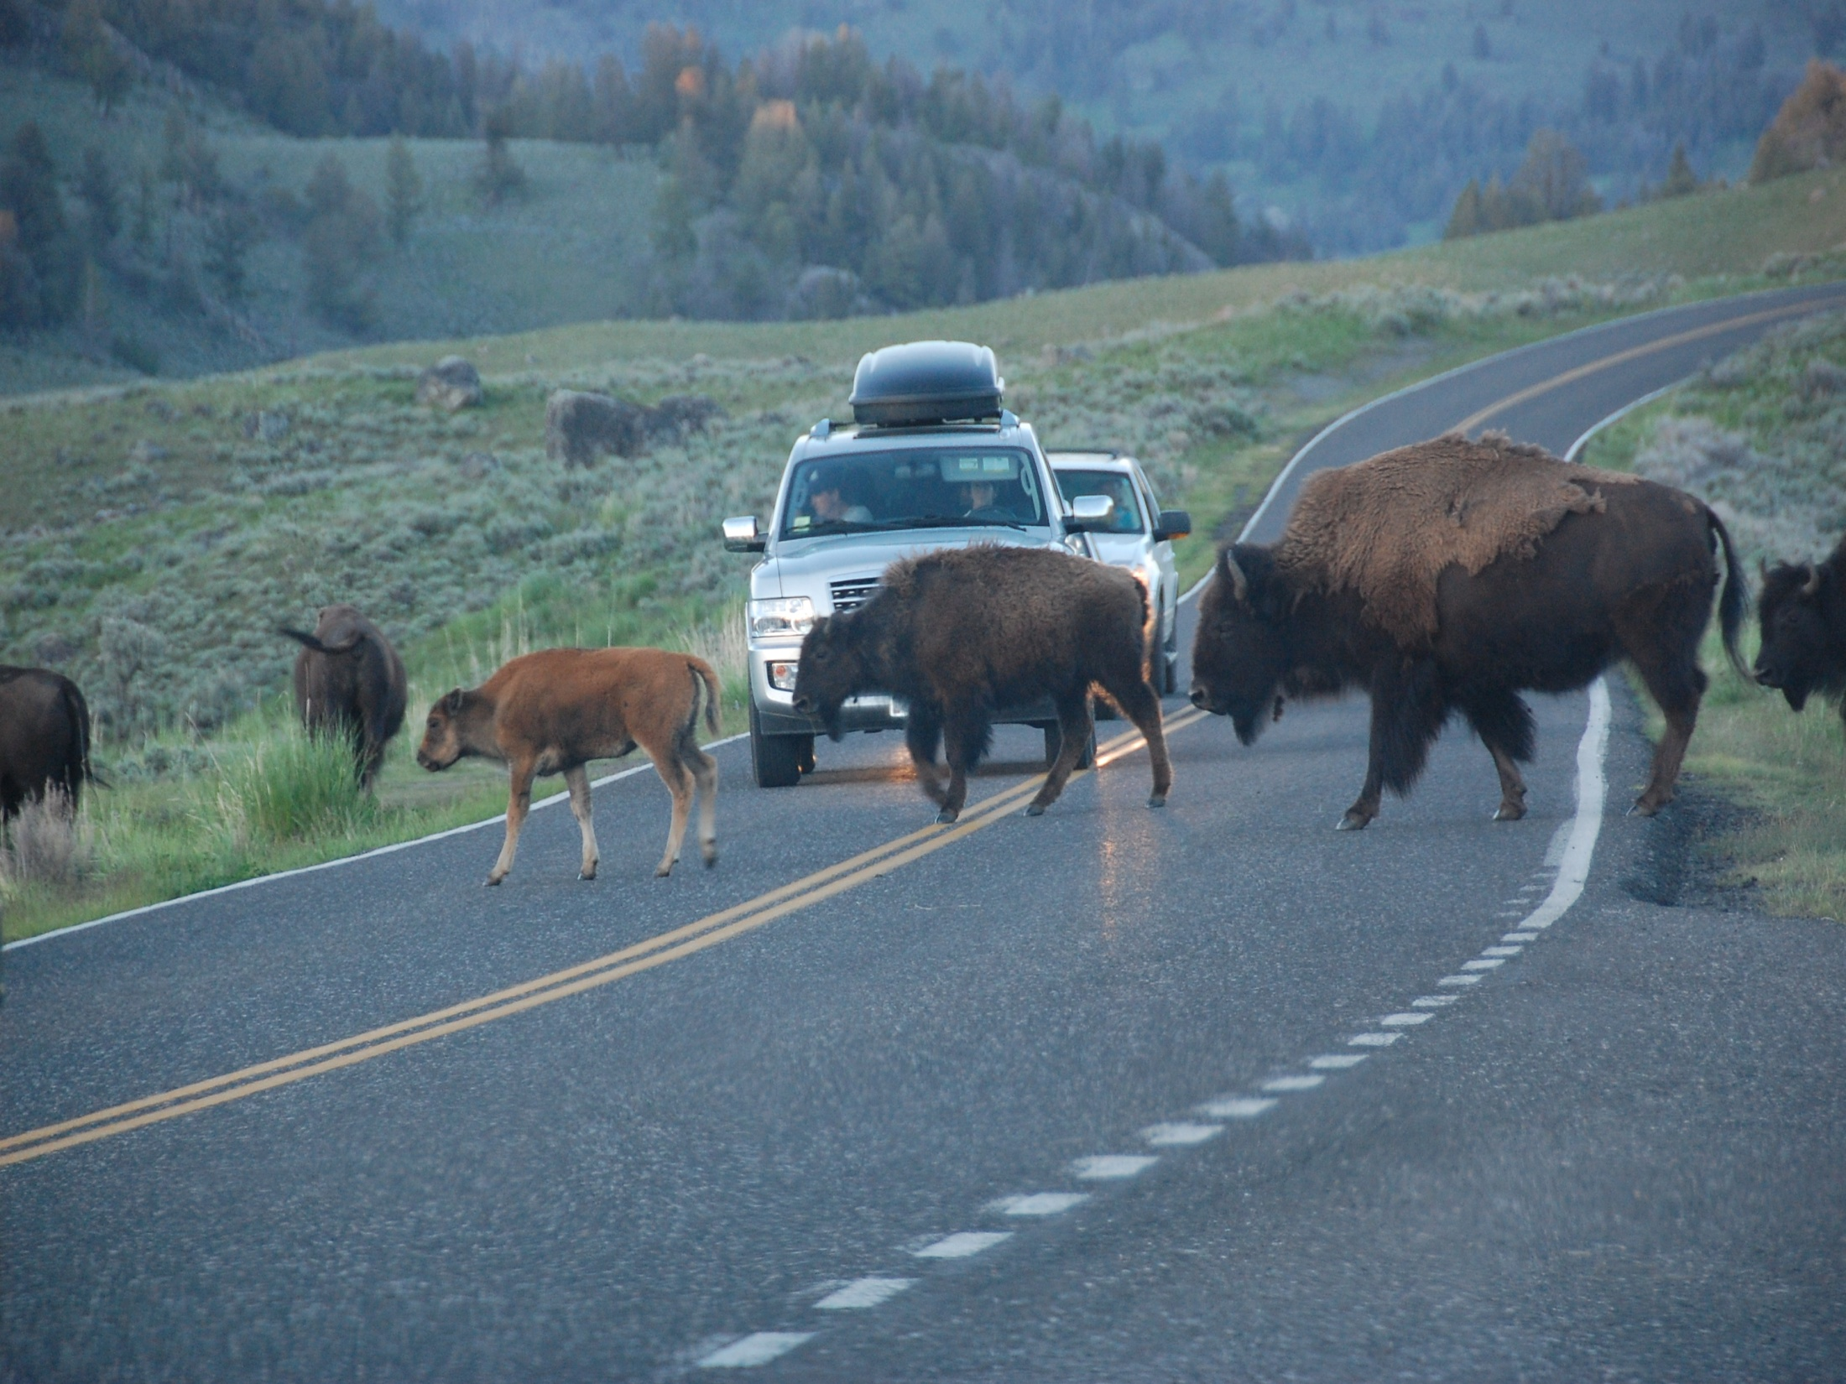
Current Bison Issues
Resource allocation – bison versus cattle
The demand for land on the Great Plains for farming and grazing dramatically affected the bison by reducing the carrying capacity of the habitat
Cattlemen historically drove range cattle through the heart of bison country
Settlers moved in and began farming across the plains through the late 1860s.
Not only did cattle directly compete for grass, their presence limited bison movement and the bison’s ability to exploit variations in the habitat (e.g., water sources, grass at different elevations)
thus agriculture reduced the carrying capacity of the land
Even if the bison could have escaped the hunters, they would have had no viable habitat because of competition from farmers and ranchers.

Slide 28
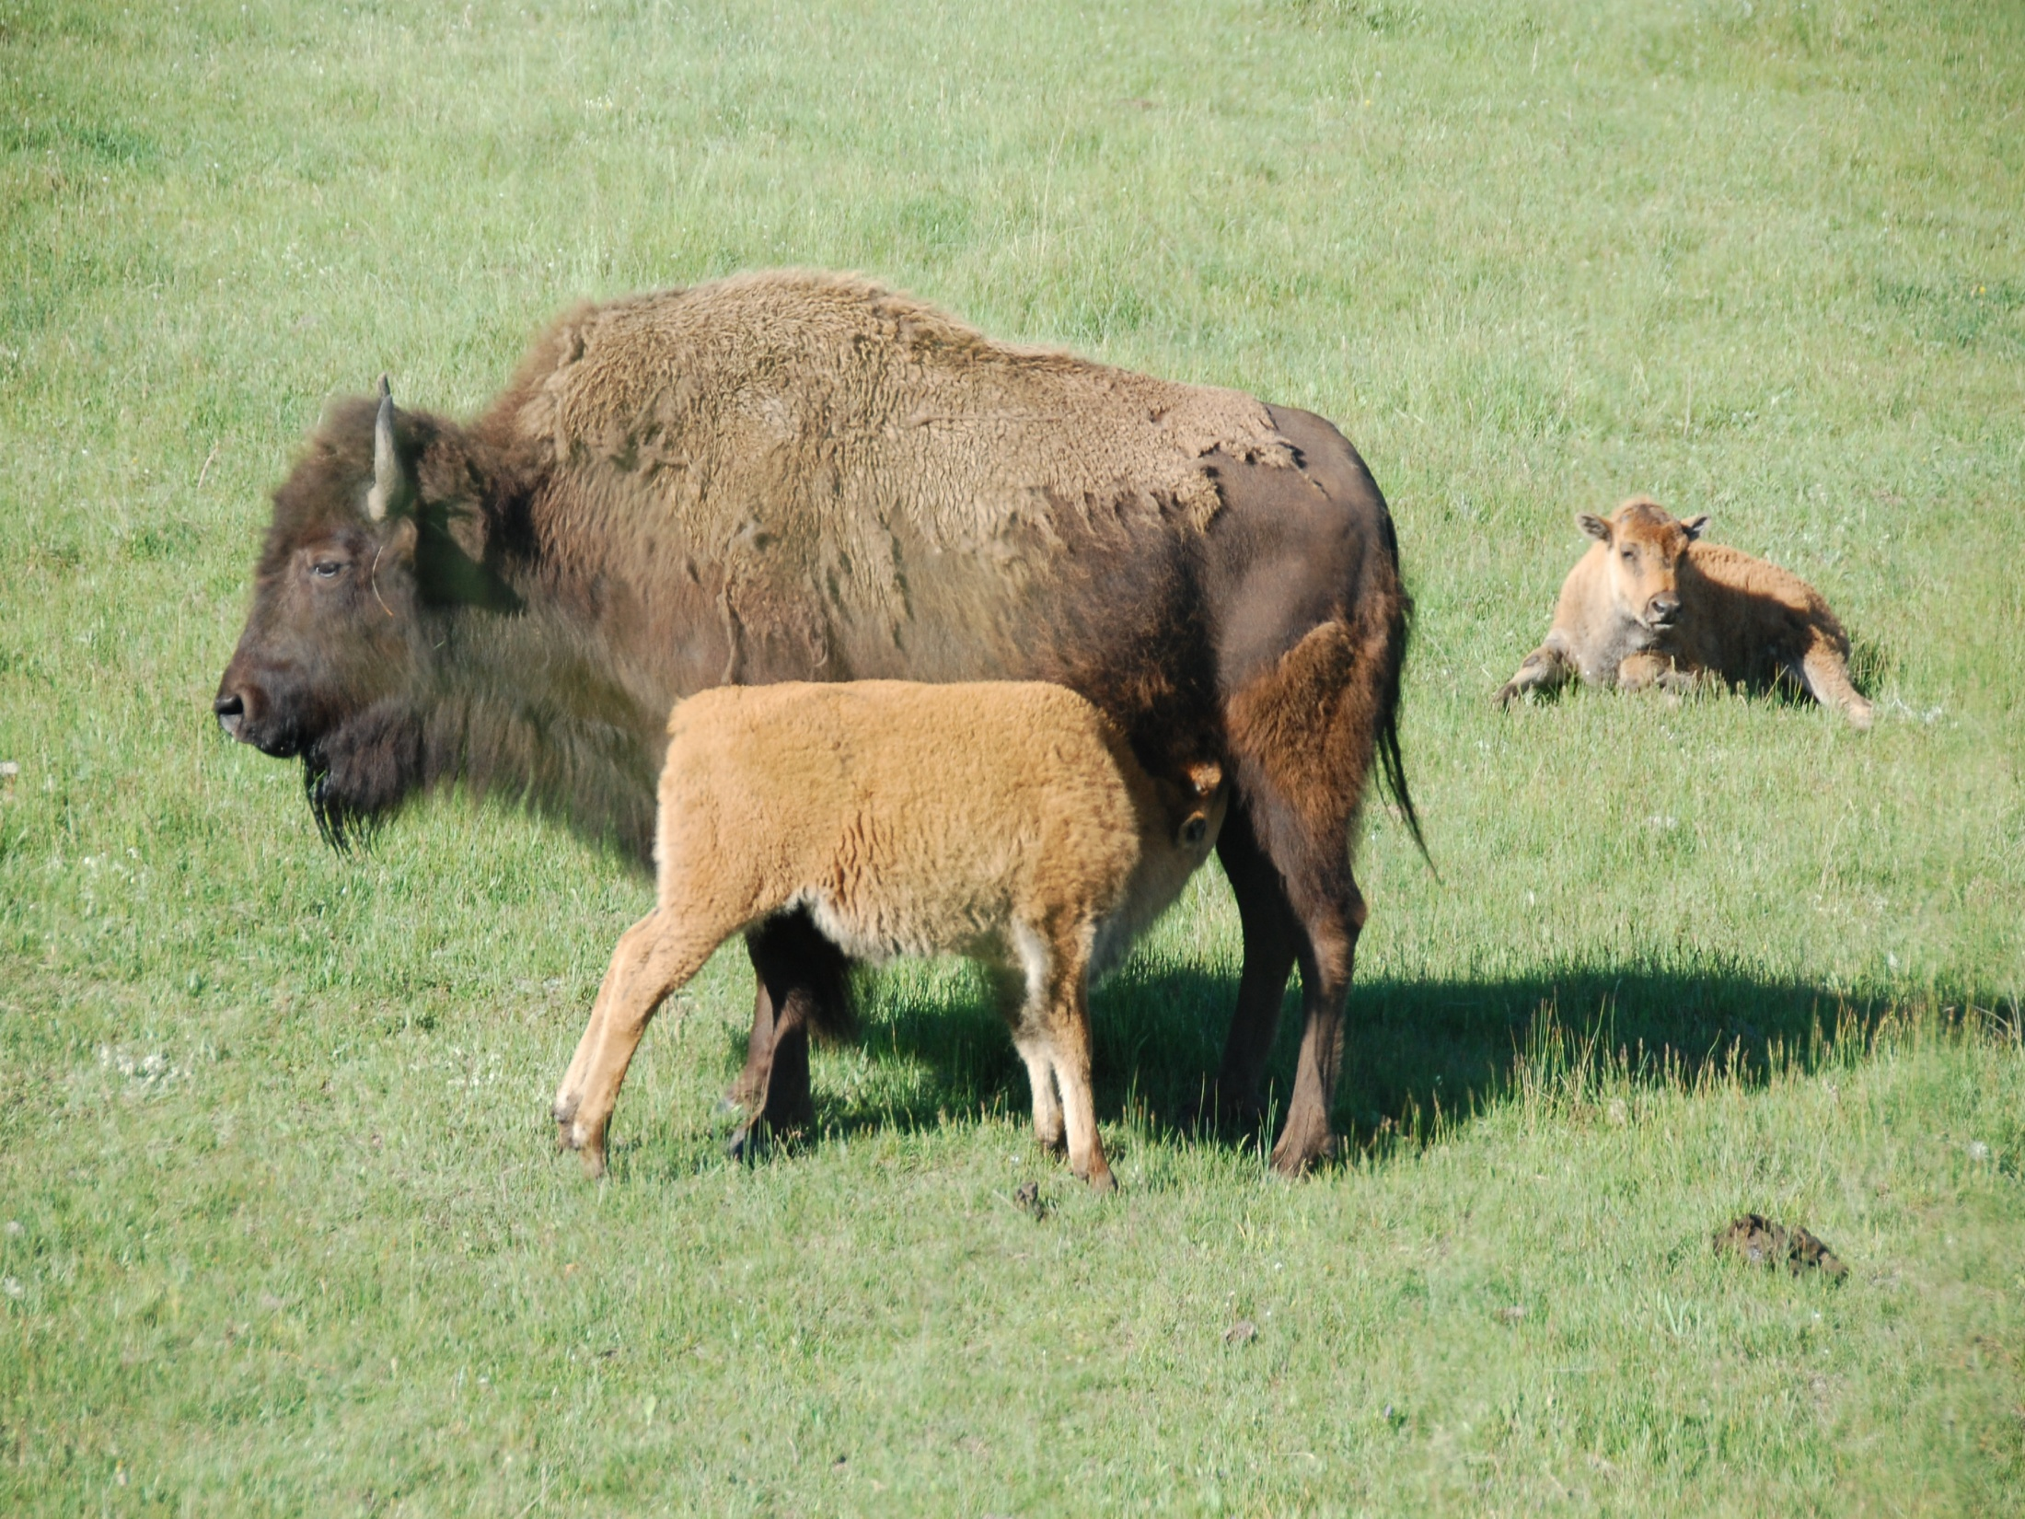
Brucellosis in Bison
Brucellosis has caused severe losses to farmers in the United States over the last century.
It has cost the Federal Government, the States, and the livestock industry billions of dollars in direct losses as well as the cost of efforts to eliminate the disease.
Brucellosis causes abortions, infertility, and lowered milk production in cattle and bison and is transmissible to humans as undulant fever.

Slide 29
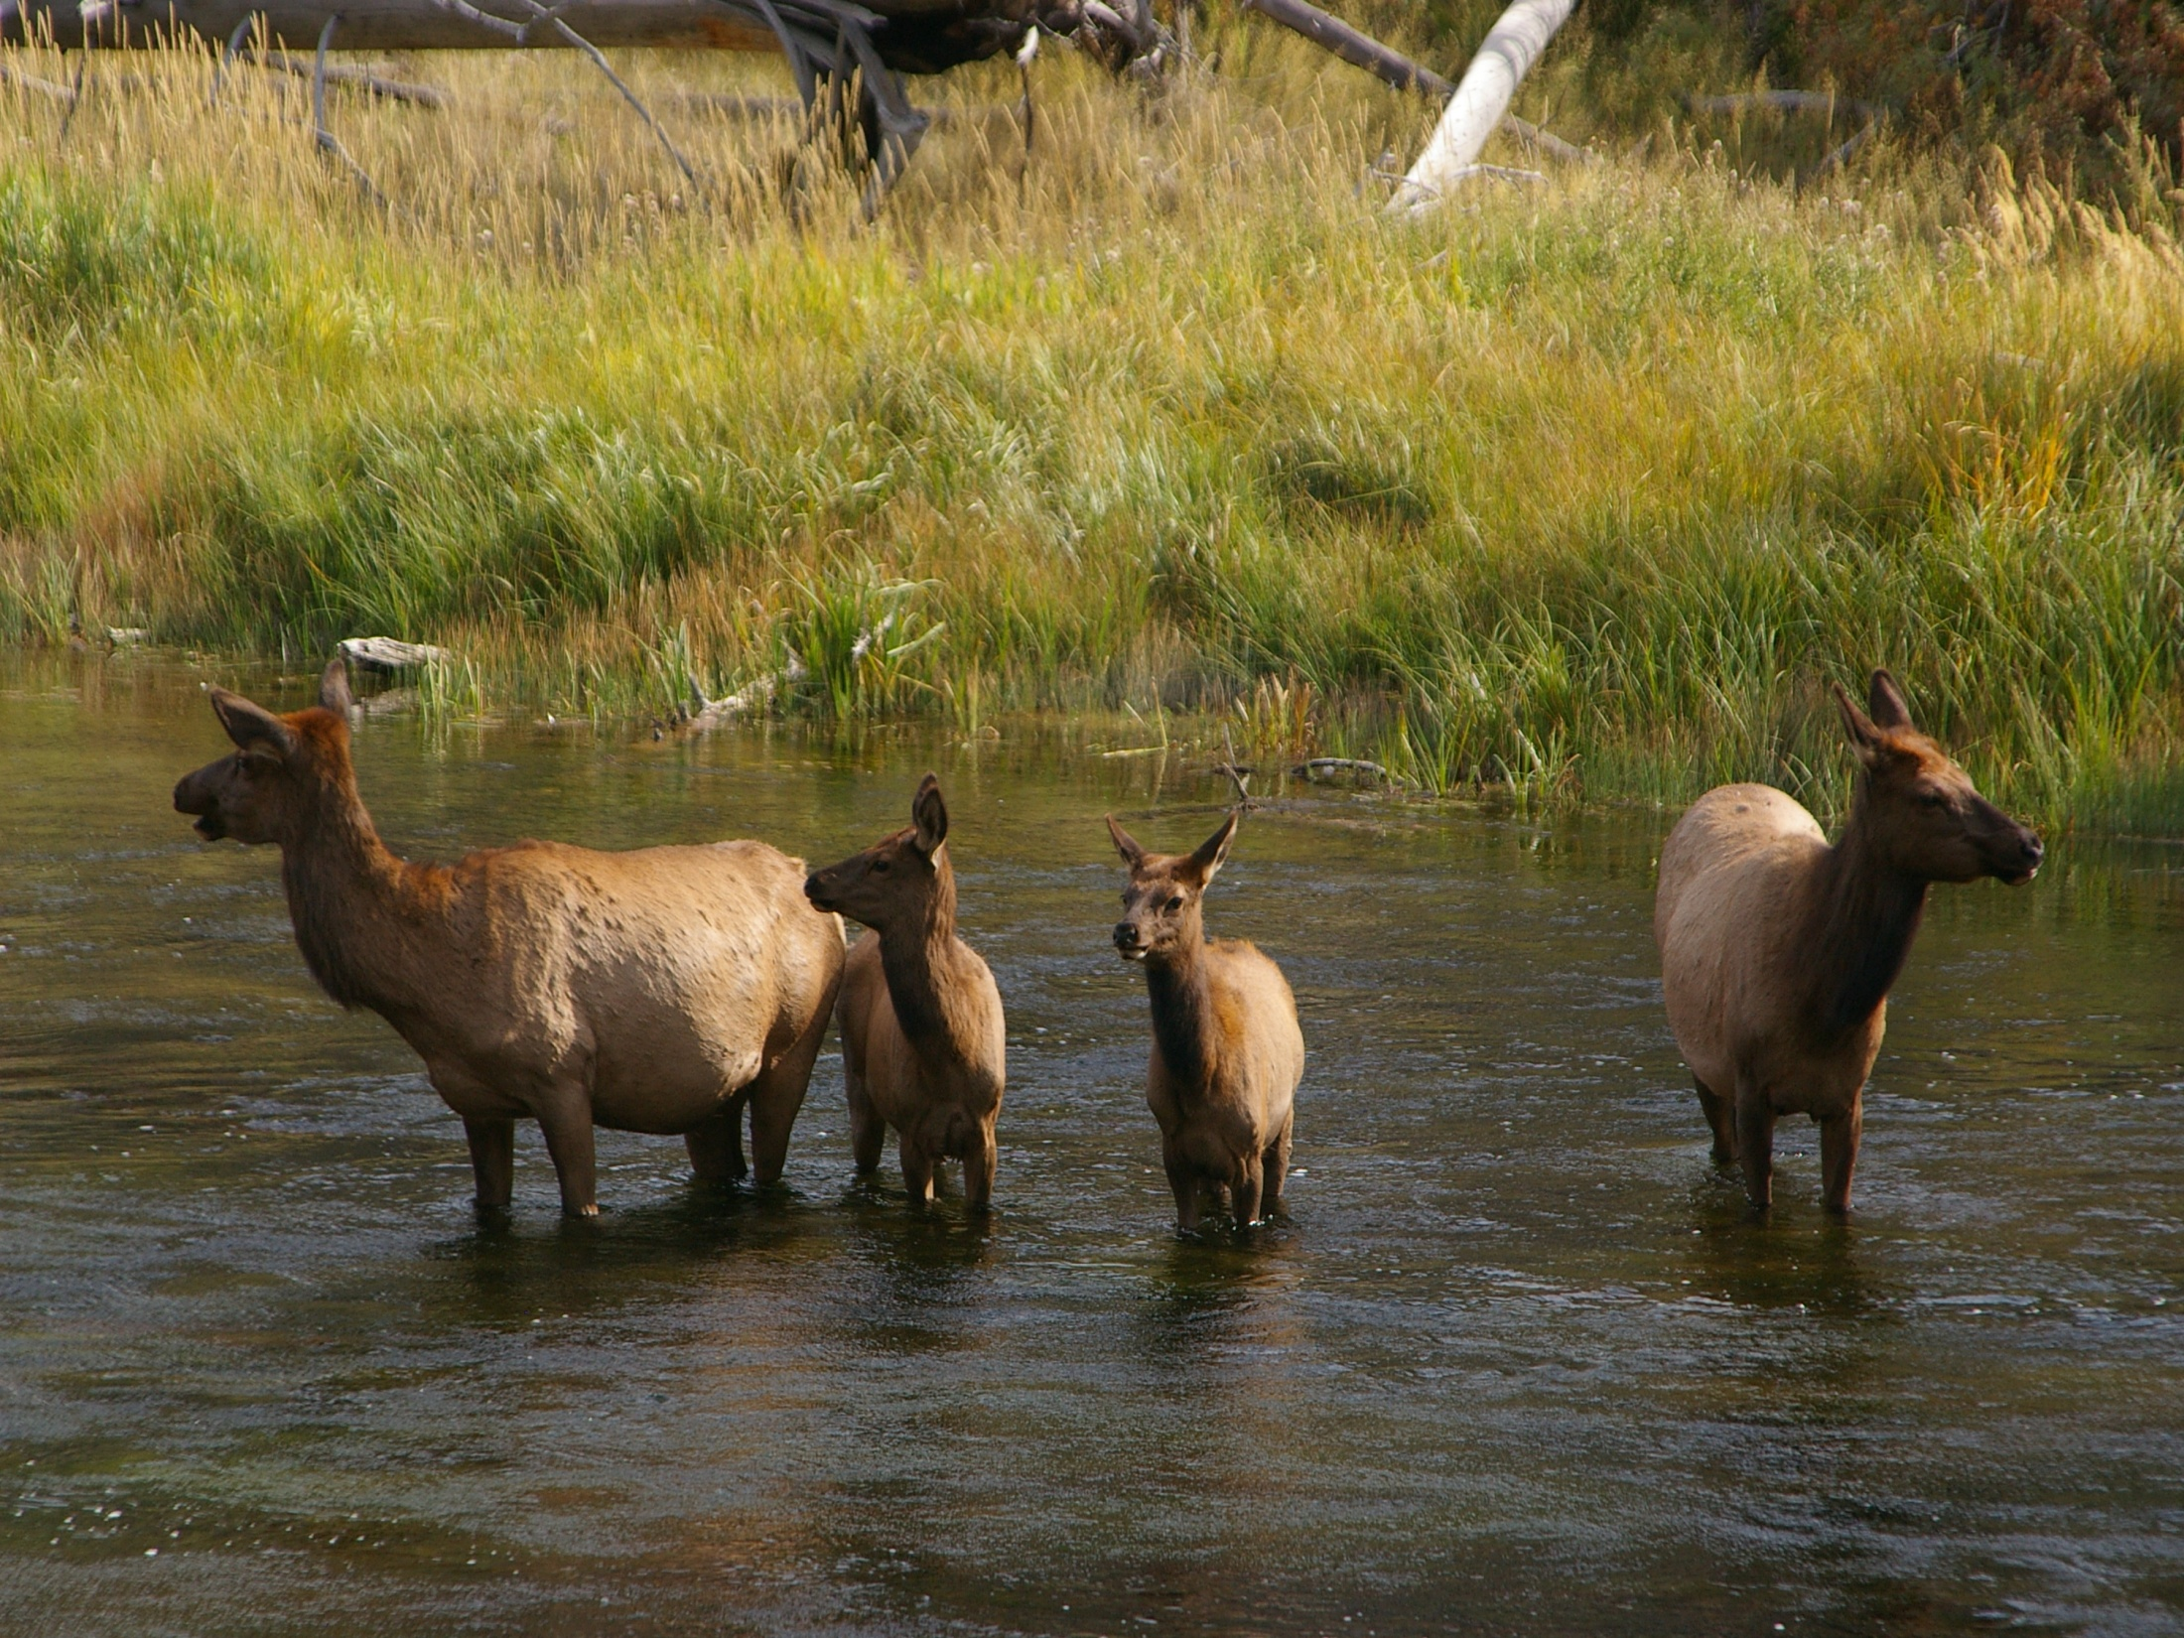
The only known focus of Brucella abortus infection left in the nation is in bison and elk in the Greater Yellowstone Area
More than 50 percent of the bison in YNP test positive for brucellosis. A positive test indicates that animals have been exposed and are most likely infected.
The concern is that when these bison leave YNP, they may transmit brucellosis to cattle in the surrounding States.

Slide 30
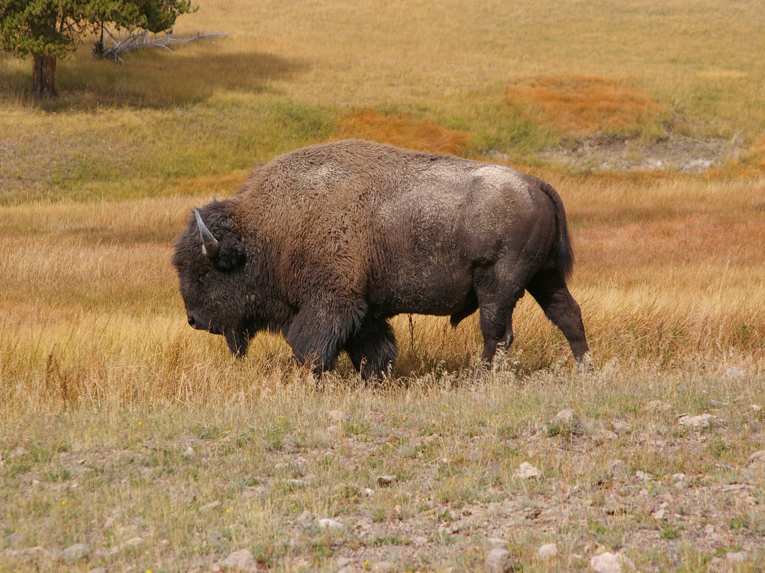
In 1990, researchers at Texas A&M demonstrated that bison infected with Brucella abortus could spread the disease to cattle through contact under controlled conditions
In order to document this, a researcher would need to be present when the transmission occurred and collect samples for tissue culturing.
Also, the animals would have to have been previously tested before the transmission had occurred to verify that the event was caused by the bacterial transmission at the observed time.

Slide 31
The Brucella abortus bacterium is spread through direct contact with birthing fluids and contaminated soil and vegetation during calving
Bison are considered a threat because of brucellosis, a disease originally given to bison by the infected cattle of settlers brought to America from Europe

Slide 32
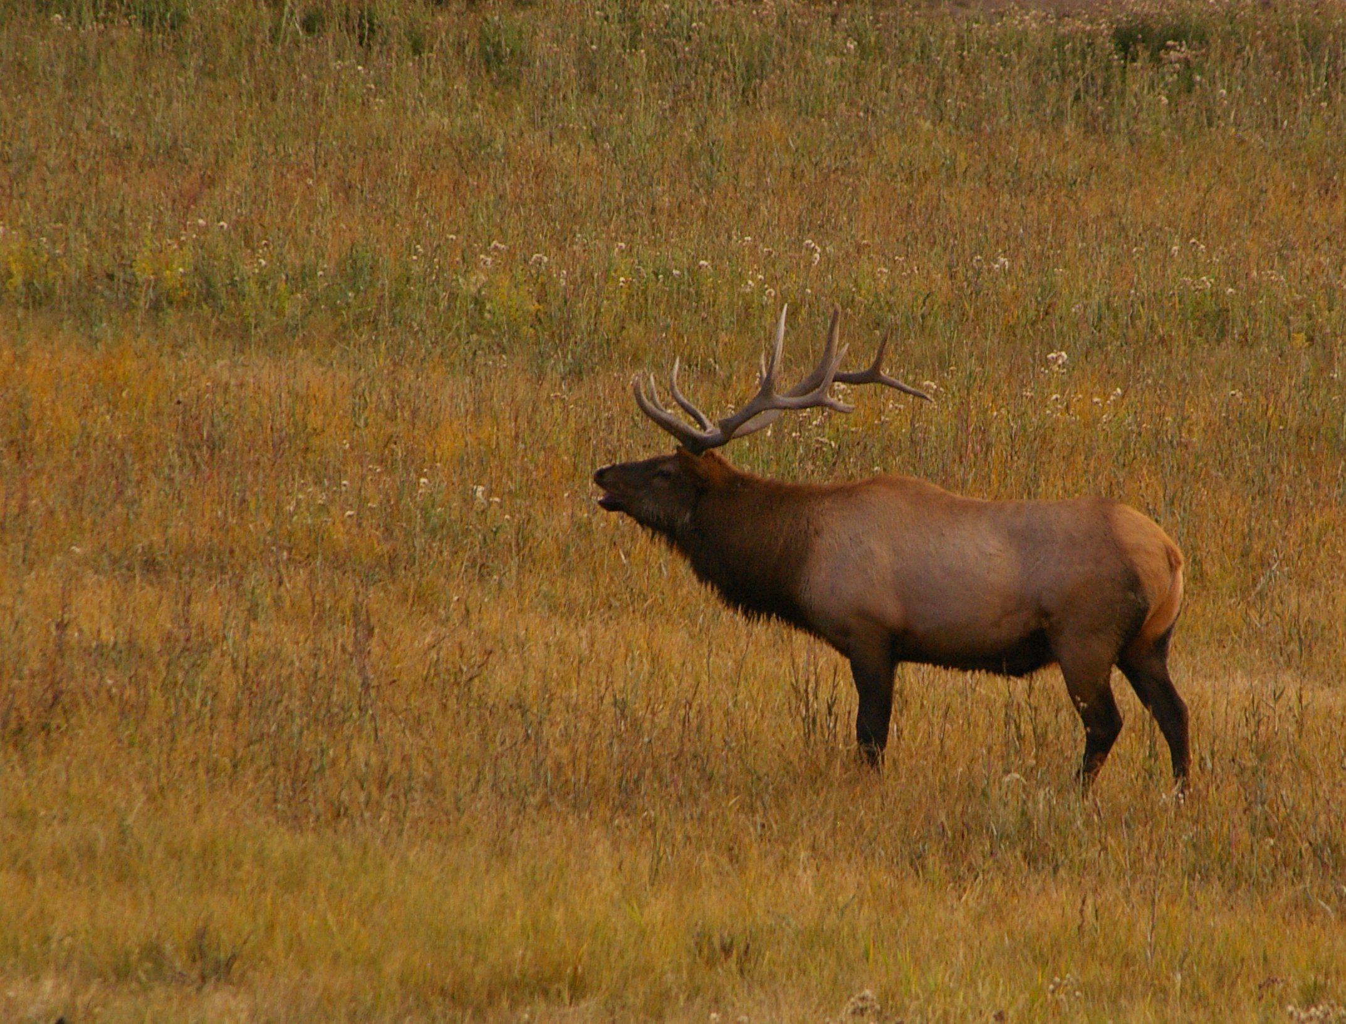
No documented cases of wild bison spreading the disease to cattle exist thus far, but those whose livelihoods are directly affected are reluctant to take unnecessary risks
In cases where cattle have tested positive, the serology has pointed to elk as the carrier
In 2000, the federal government and Montana state agencies created a plan to slaughter bison as they leave Yellowstone National Park in search of food. The agreement is meant to prevent the spread of brucellosis
Since the agreement was signed, more than 3,200 bison have been killed

Slide 33
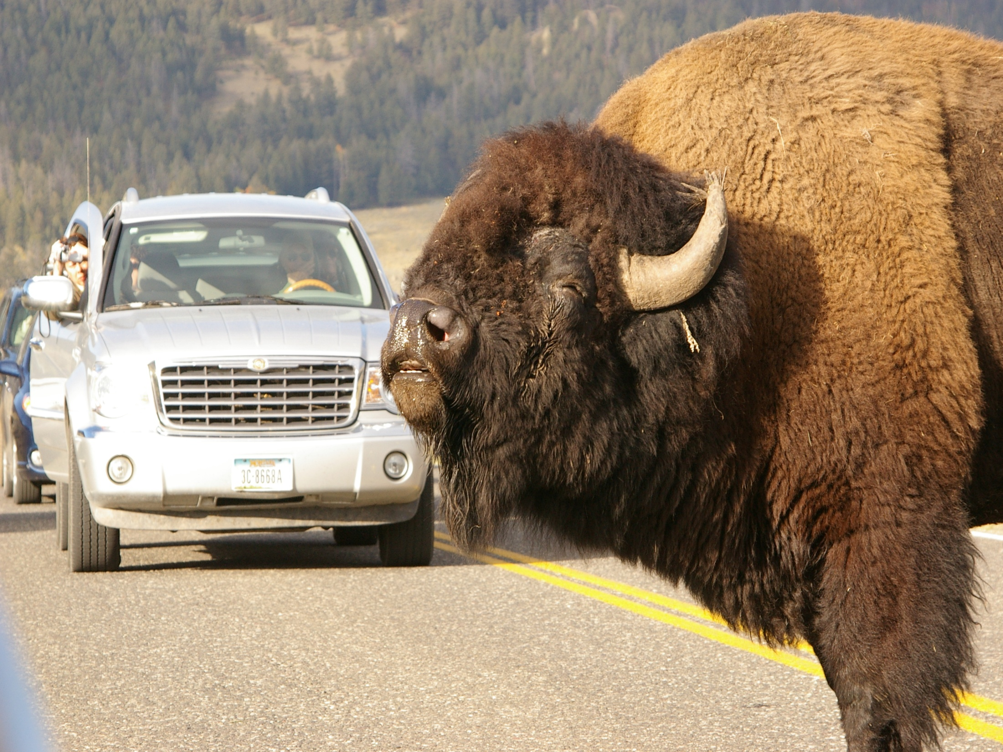
Brucellosis vaccine is about 65 percent effective in preventing infection in cattle and bison under field exposure.
The current vaccine can cause an animal to produce antibodies to brucellosis blood tests and, therefore, produce false-positive results when tested causing the animals to be slaughtered
The US Government has committed in excess of $3 million toward research on the brucellosis problem in the GYA.
The vaccination program could take up to 30 years to succeed.

Slide 34
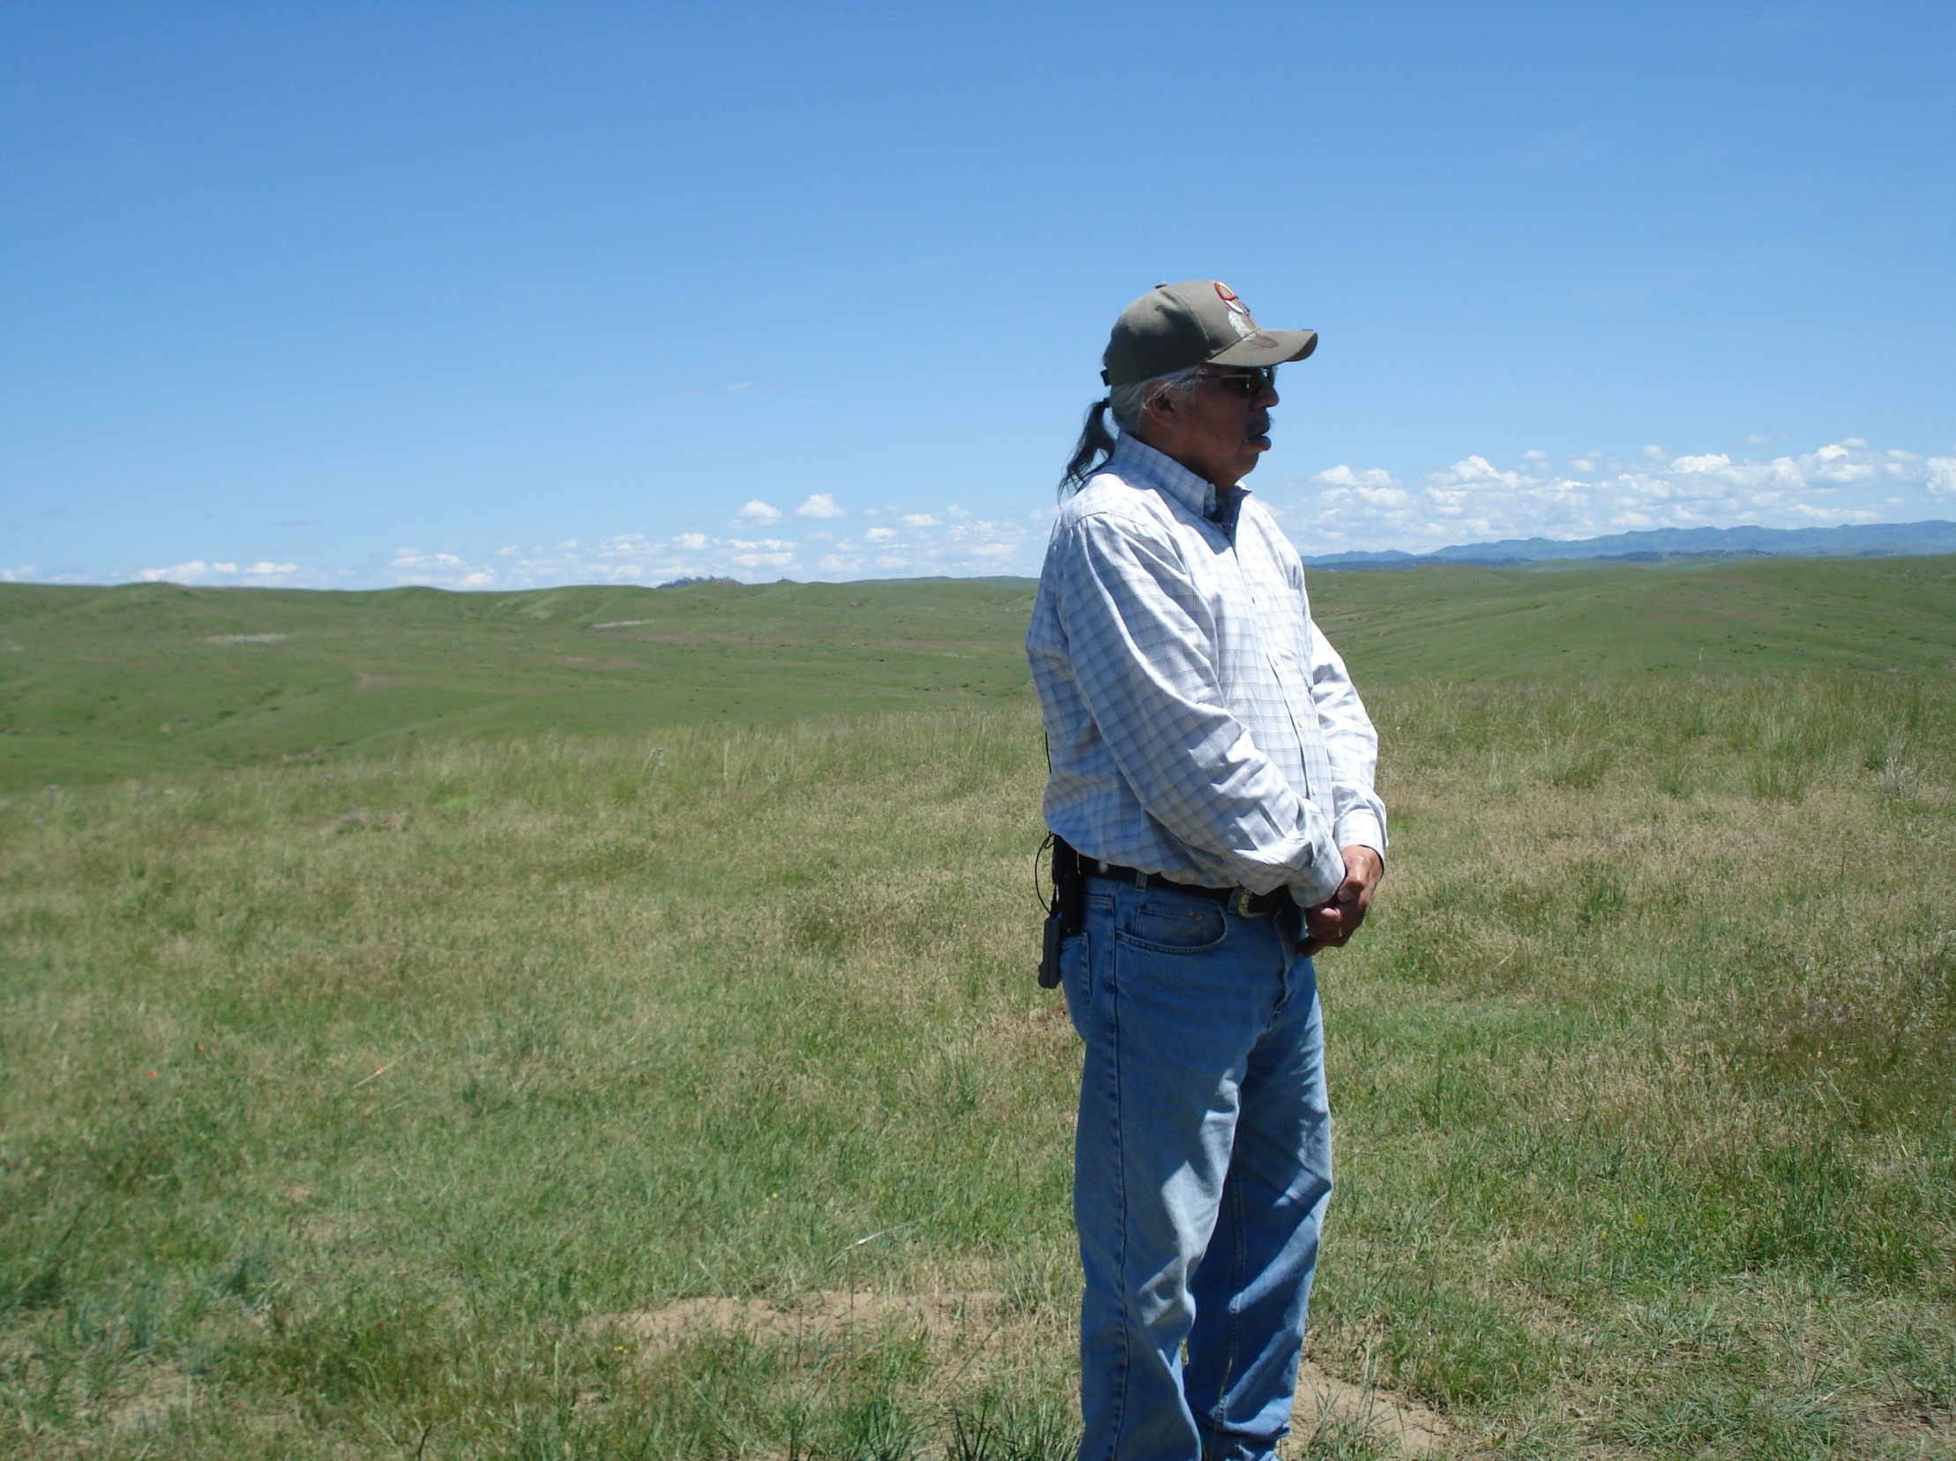
Commons
Common property is an economic term that describes property that is owned by everyone and thus no one.
Since wild bison are a common property, who gets to decide their fate?

Slide 35
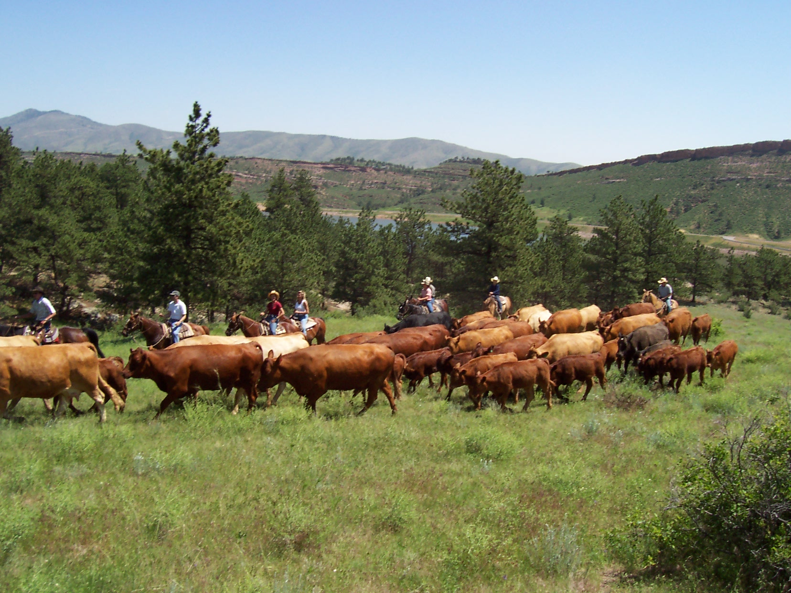
Cattle Ranchers
States need “brucellosis class-free” status in order that they can export livestock without restrictions
Brucellosis infections in two herds within the state downgrades class status
When one cow in infected the entire herd is quarantined and usually slaughtered
Brucellosis costs cattle ranchers money
Picture from http://www.sylvandale.com/activities/horses_and_cattle/horses_cattle_work.html

Slide 36
Cattle Ranchers
Ranchers vaccinate cattle, but the vaccine is only 65% effective
Wyoming, Idaho, and Montana have all lost and regained brucellosis-free status in recent years
Historically cattle have been allowed to graze in National Forest land that is now wanted for bison
Current plan focuses on separation
Picture from http://www.sylvandale.com/activities/horses_and_cattle/horses_cattle_work.html

Slide 37
Cattle Ranchers
Fear
Disease
Loss of money and herds
Loss of grazing land
Damage to fences and private building
Want
Bison off of park land hazed back in or killed
Brucellosis vaccine in bison population
Picture from http://www.sylvandale.com/activities/horses_and_cattle/horses_cattle_work.html

Slide 38
Native Americans
Feel a connection to the bison
Relate to the plight of the bison; desire to roam freely
Value the bison religiously
26 tribes have a direct connection to Yellowstone and the Yellowstone bison; 56 expressed interest in bison even though they have no direct connection to Yellowstone

Slide 39
Native Americans
Fear
Destruction and disregard of bison
Removal of “Wild” from the Yellowstone bison
Harm to their way of life
Want
Increase of the bison population to a more sustainable level
Freedom for the bison to roam
Owning and hunting bison for religious beliefs

Slide 40
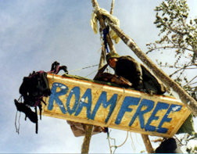
Buffalo Field Campaign
Elk, not bison, are responsible for brucellosis transmission to cattle
Brucellosis is just an excuse to exert control over the bison's land use
The Plains ecology does not naturally sustain cattle—too harsh on grasses, not enough water
Bison were given brucellosis from cattle; now they are being killed to avoid giving it back
Picture from www.buffalofieldcampaign.org

Slide 41
Buffalo Field Campaign
Bison only live on 1% of their history range
Free-roaming bison are necessary for the plain's ecology
Migratory patterns
Irrigation of the land
Plenty of land owners wouldn't mind the bison on their land
Picture from www.buffalofieldcampaign.org

Slide 42
Buffalo Field Campaign
Fear
The killing off of an animal with great genetic resistance
Industry winning over the plains ecology
Want
A spread of knowledge, rather than incorrect information and fear
Restoring the historic migration of the bison
Picture from www.buffalofieldcampaign.org

Slide 43
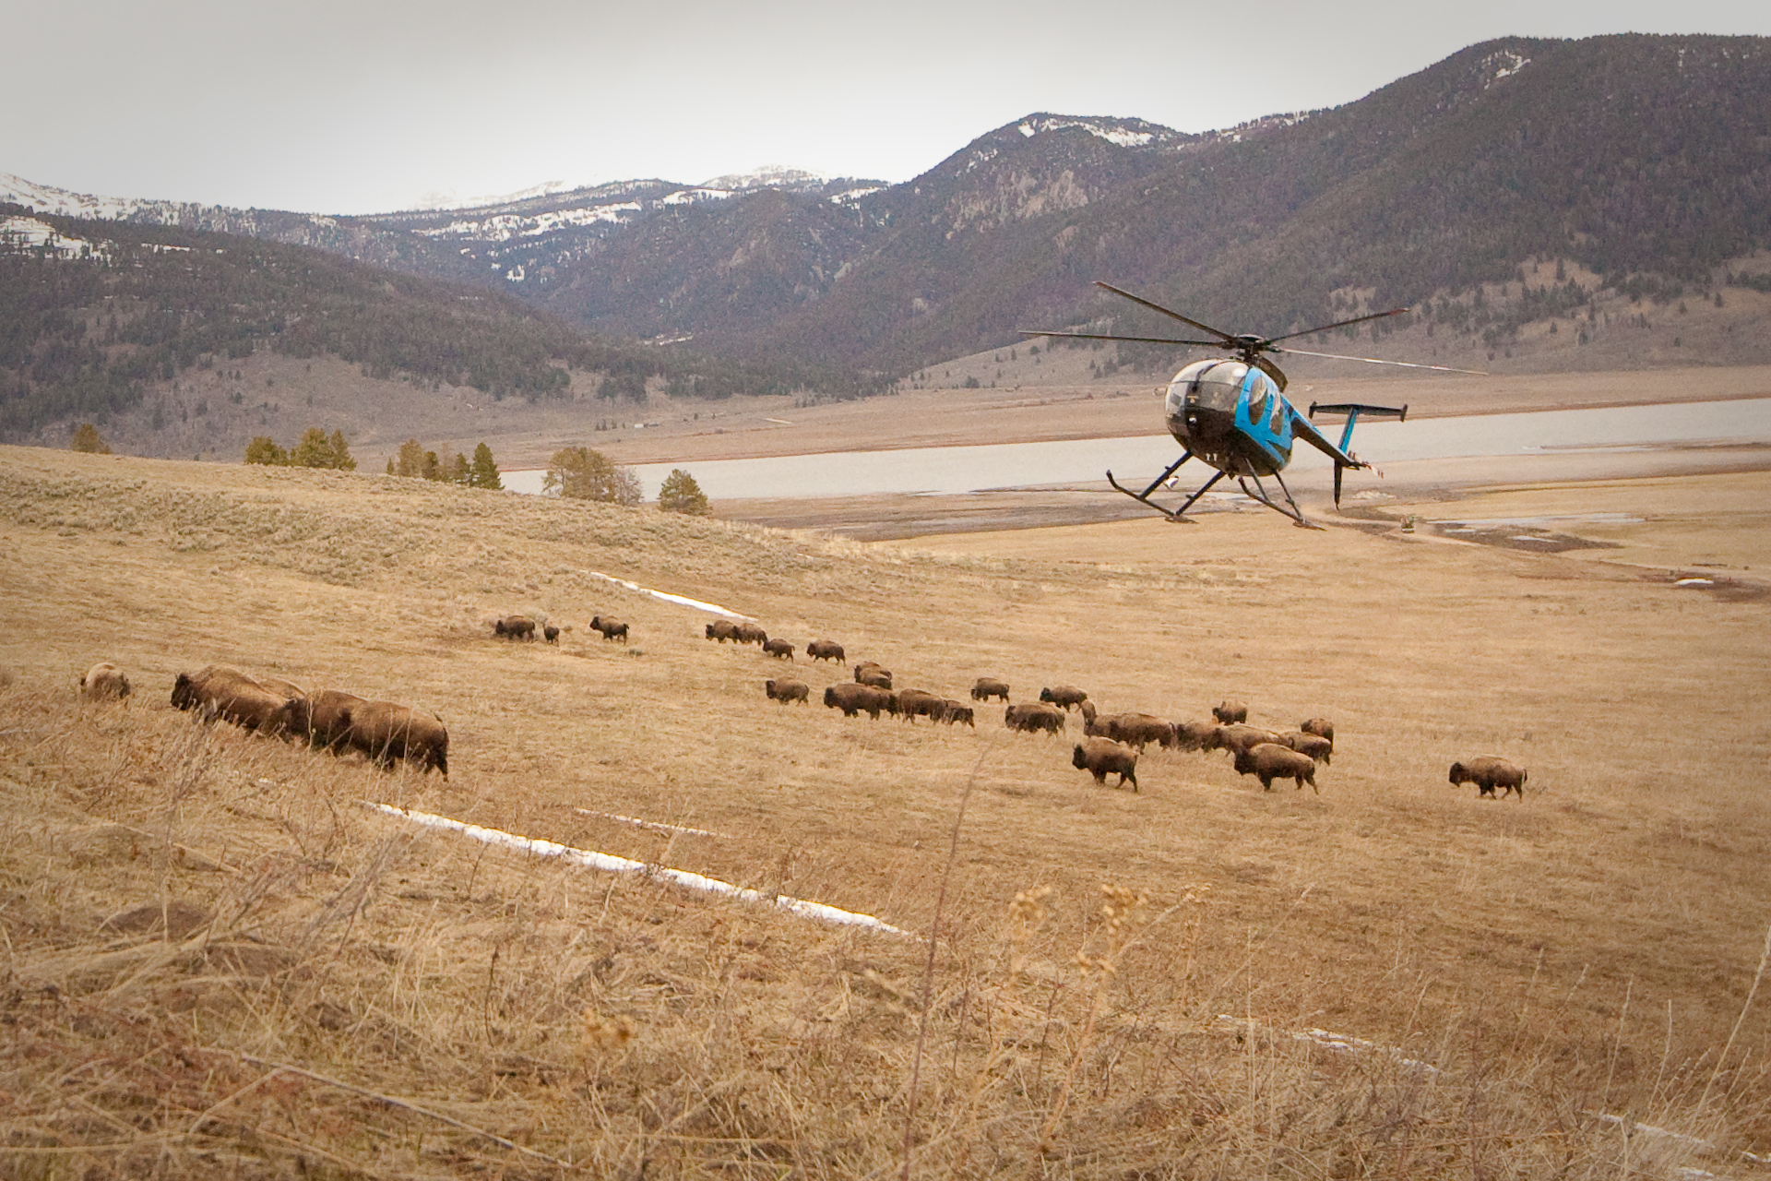
National Park Service
Must follow the laws placed on them; haze and kill bison
Must somehow make everyone happy
Preserving the park vs enjoyment of the people
Bison are given protection on the park land, but no where else because they are not an endangered species (farmed bison considered same population)
There will always be some sort of boundary issue
Picture from www.buffalofieldcampaign.org

Slide 44
National Park Service
Fear
Harm to bison population
Want
Greater tolerance for bison outside of park
Balance between allowing bison to migrate and cattle ranchers fear
Protection for this valued population
Picture from www.buffalofieldcampaign.org

Slide 45
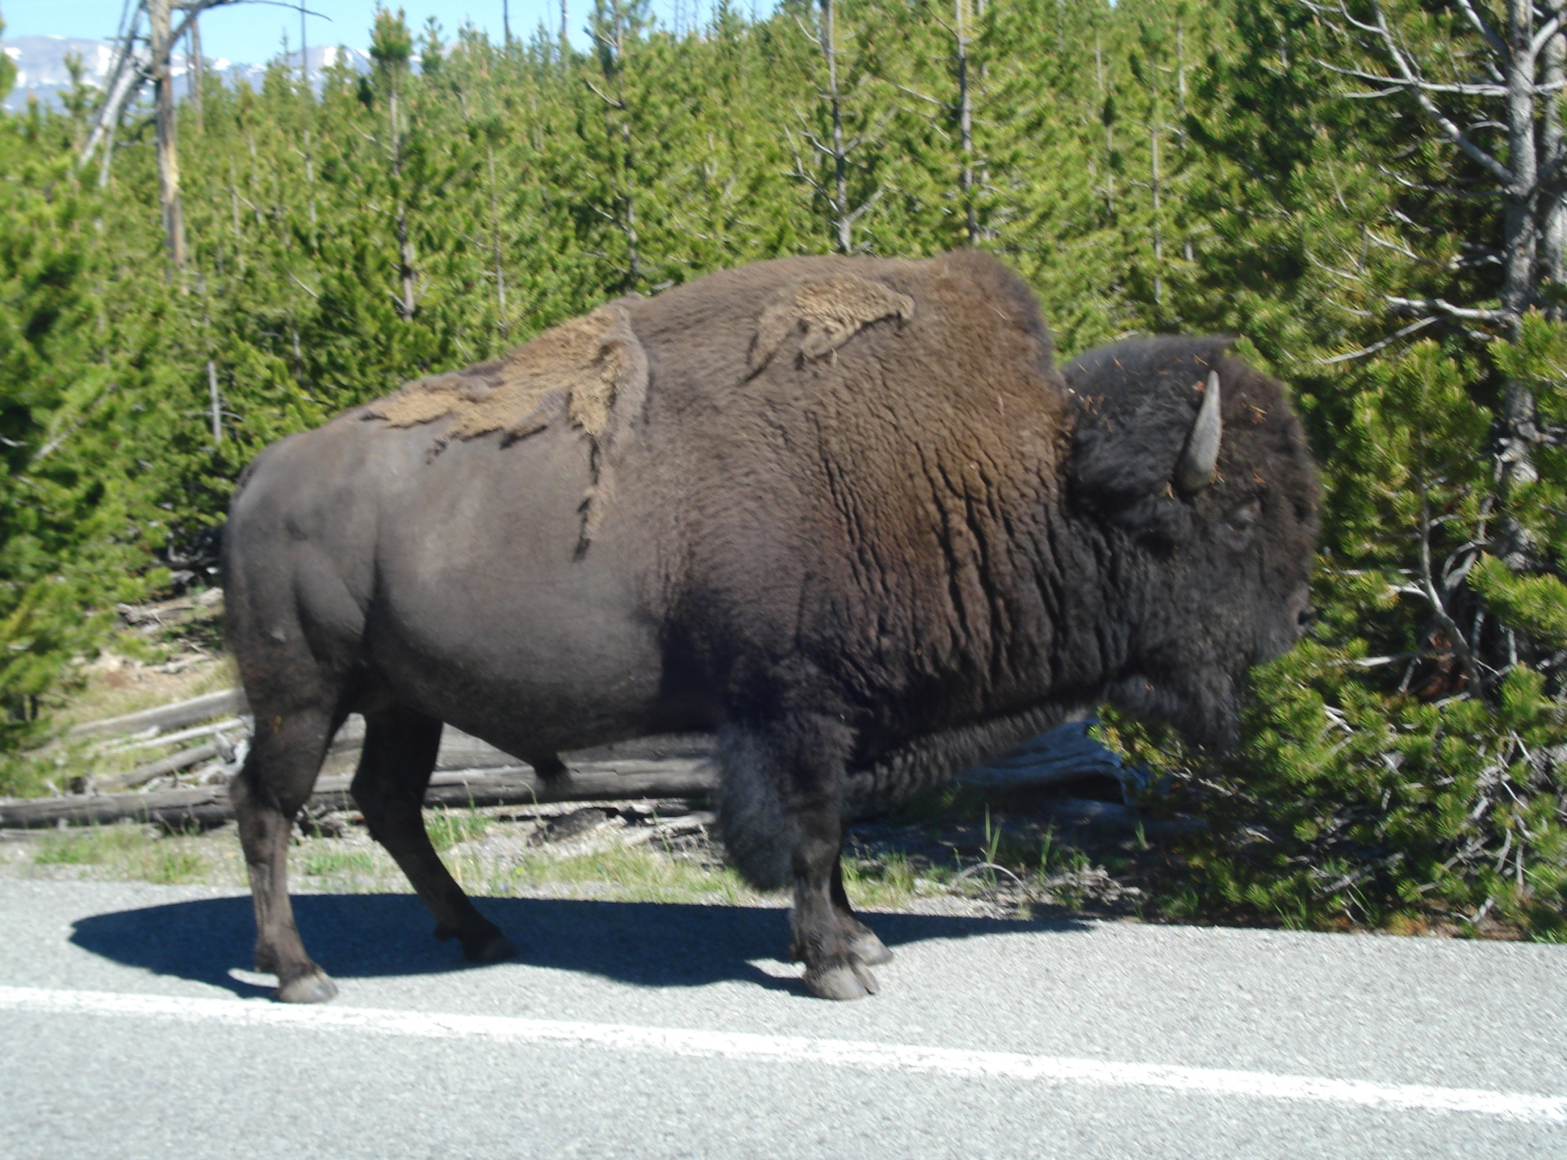
Big Question
Is what is happening now, killing and slaughtering of bison for economic benefit of others, similar to what happened originally between the Native Americans and the American government?

Slide 46
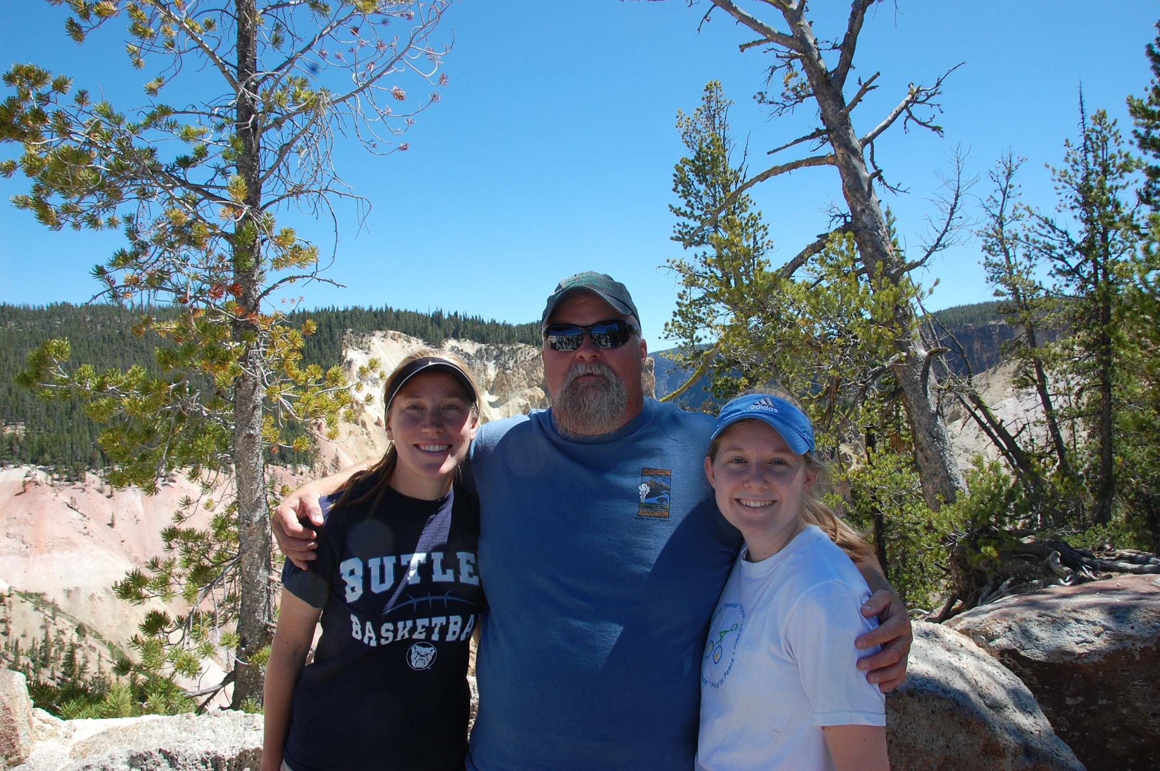
Works Cited
“Bison Facts.” US Fish and Wildlife Services. 30 April 2008. web. 20 July 2010.
“Buffalo or Bison and Native Americans.” Buffalo Field Campaign. 2008. web. 20 July 2010.
Snow Owl. “Animal Powers and Lore: Buffalo.” The Nest of Snow Owl. 2007. web. 20 July 2010.
“Yellowstone Buffalo Slaughter History.” Buffalo Field Campaign. 2008. web. 20 July 2010.

