Slide 1
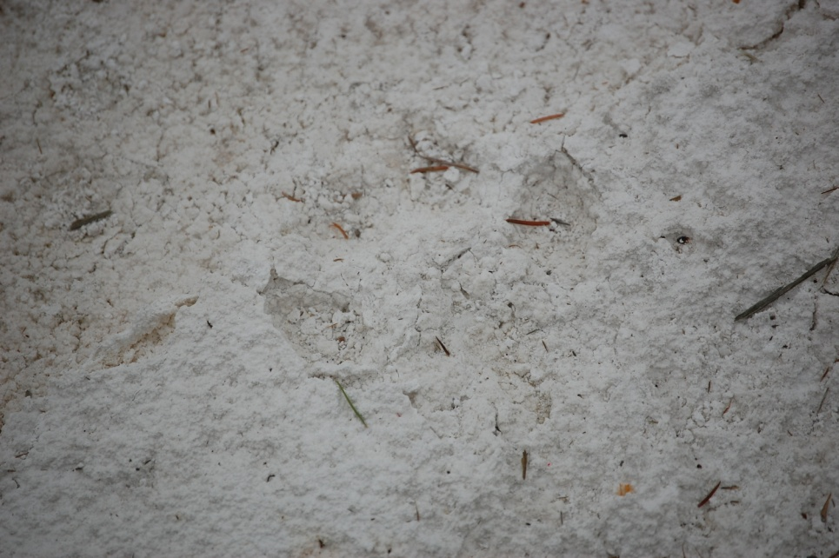
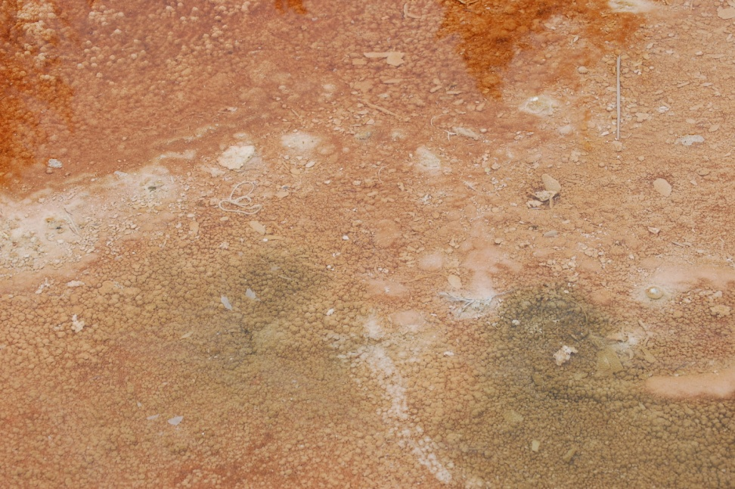
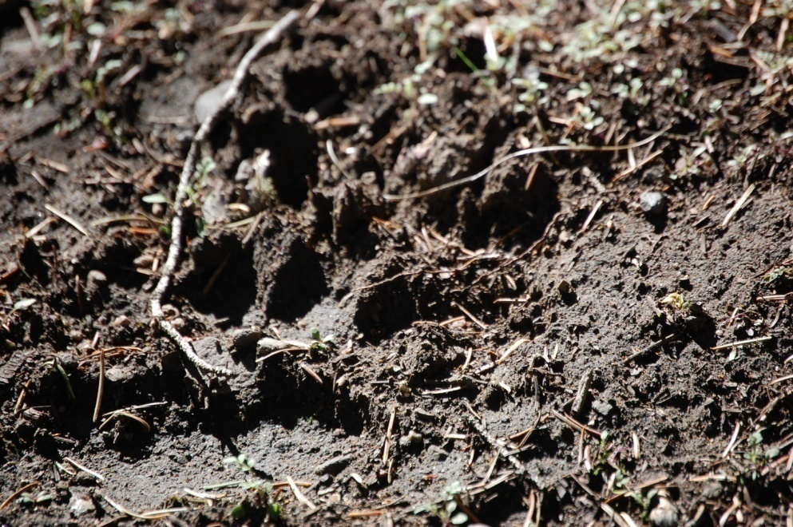
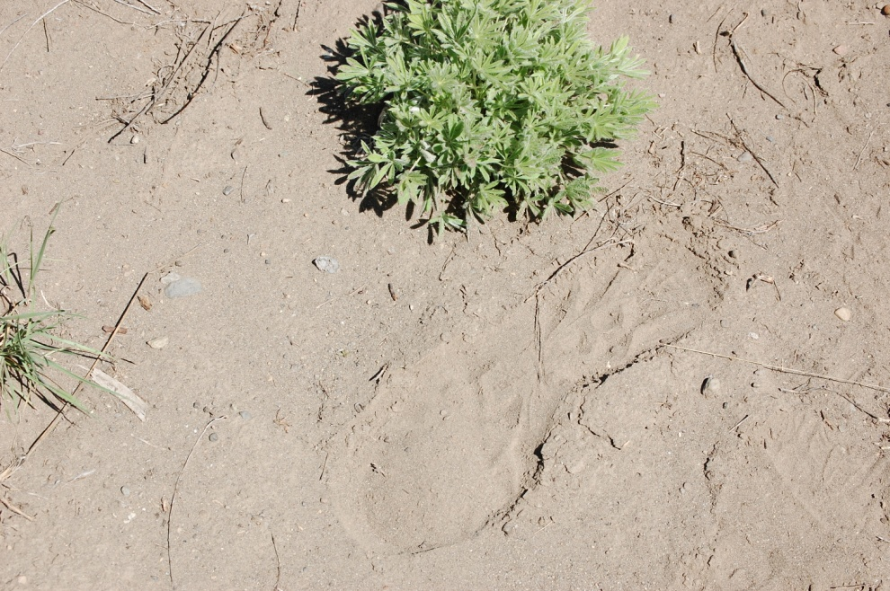
Bio Prospecting
Whose Footprint Should be Largest?

Slide 2
Bioprospecting
The collection of samples from plants, animals, and
microorganisms to search for commercially valuable
biochemical or genetic resources

Slide 3
Where to look? How to look?
Design of sampling strategies and impact
Recovery of organisms: development of cultivation and isolation methods
Maximize range of novelty and molecular diversity (80 to 90% undiscovered)
Discovery of compounds for further development

Slide 4
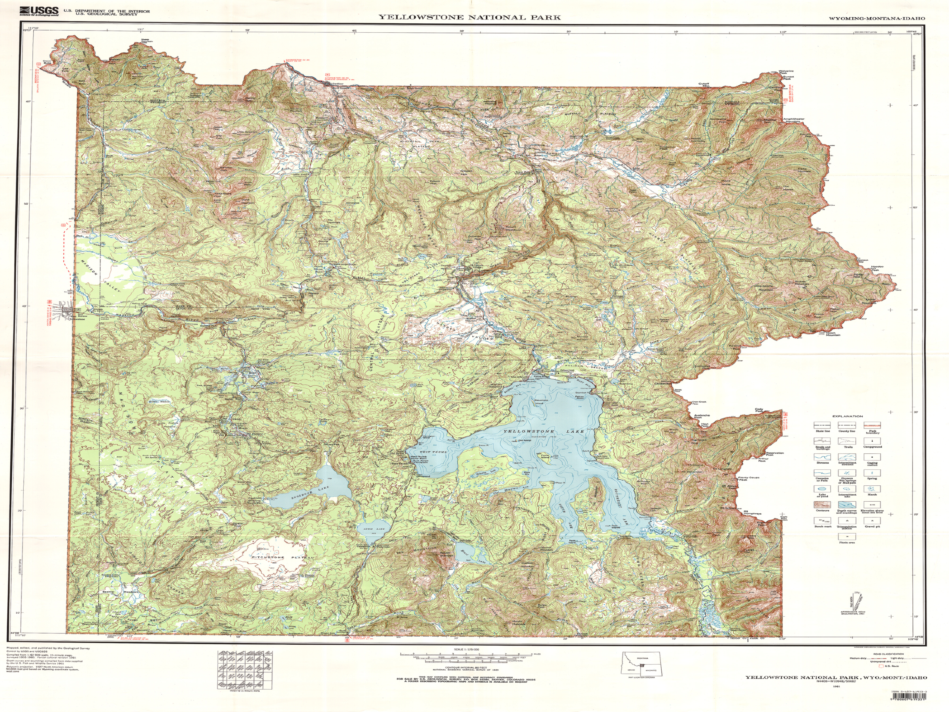
The Greater Yellowstone Ecosystem
a dramatic setting composed of lands
that vary widely in terms of their elevation,
soils, and habitat features.
There is no place like Yellowstone on Earth
Unique Thermal Properties are the result of geologic events past and present
Central Part of Yellowstone is one of the world’s largest active volcanoes
The nearly ten thousand geologic features play a role in developing seemingly impossible life forms

Slide 5
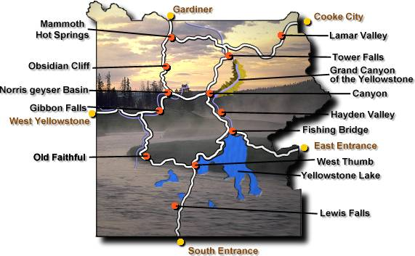
Hydrothermal Features
Hot Springs
Mud Pot
Geyser
Fumaroles

Slide 6
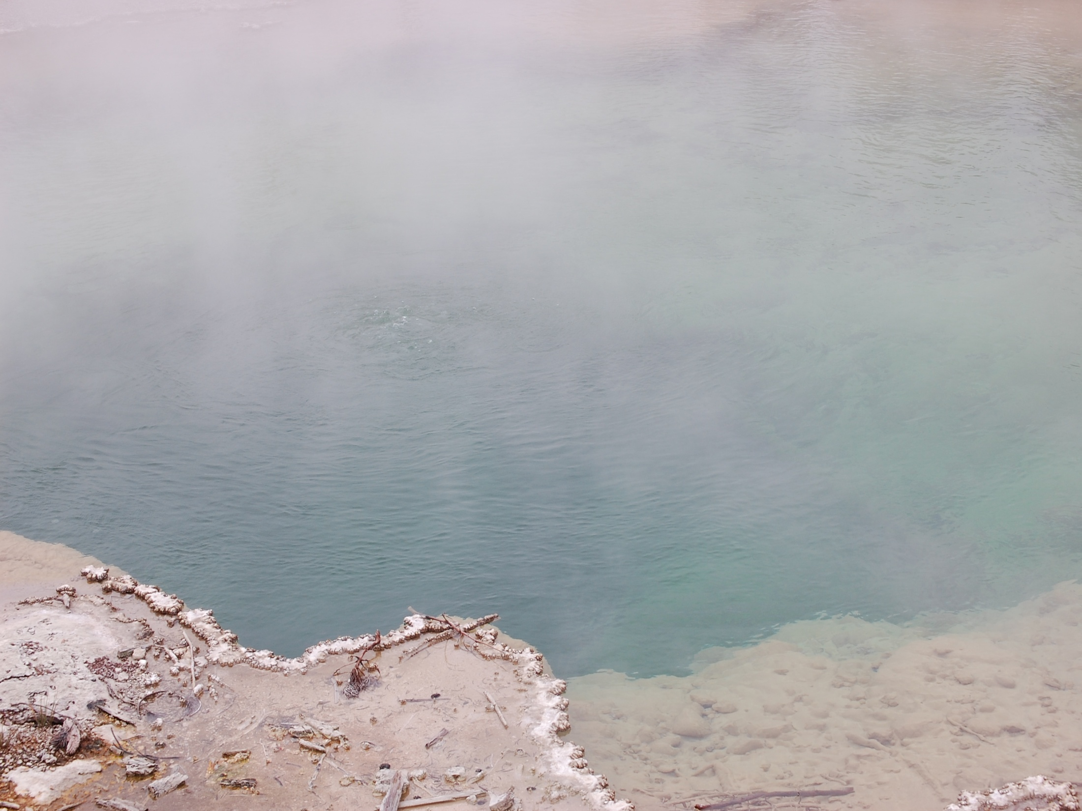
Hot Springs
spring with temperature above body temperature (98.6 F)

Slide 7
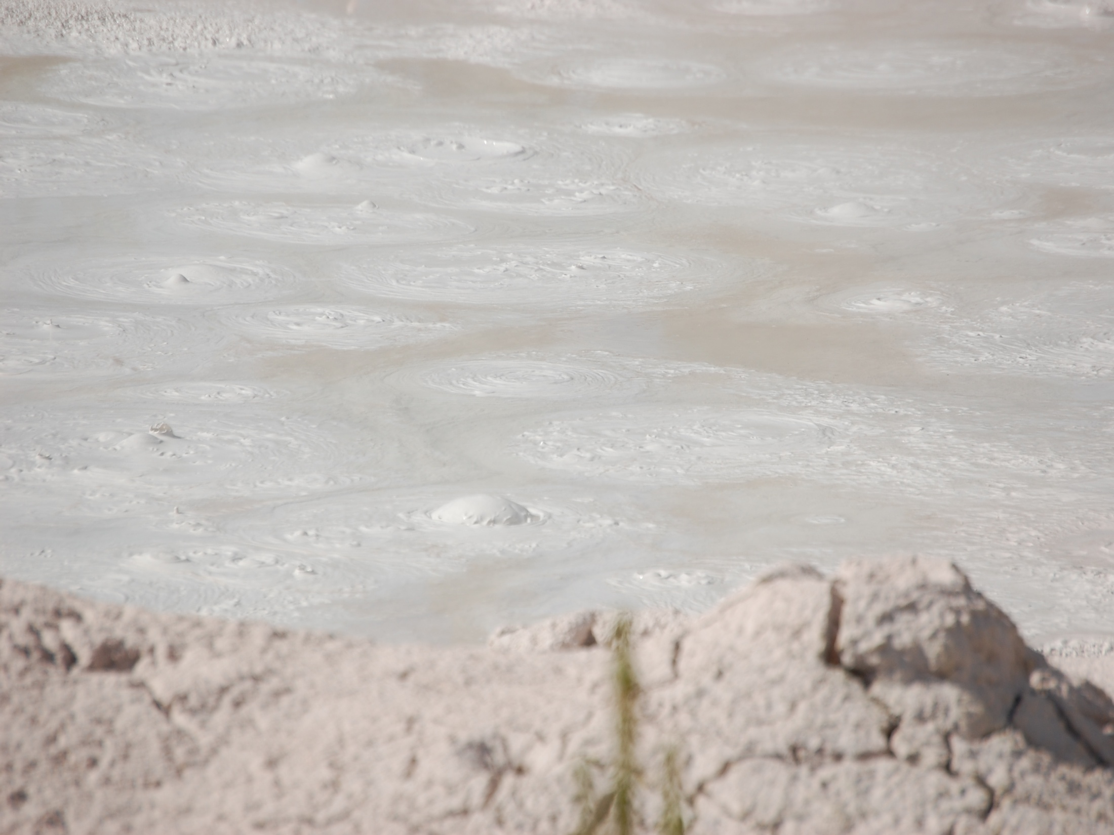
Mud Pot
hot spring with little water and a lot of altered rock (sediment clogged hot spring)

Slide 8
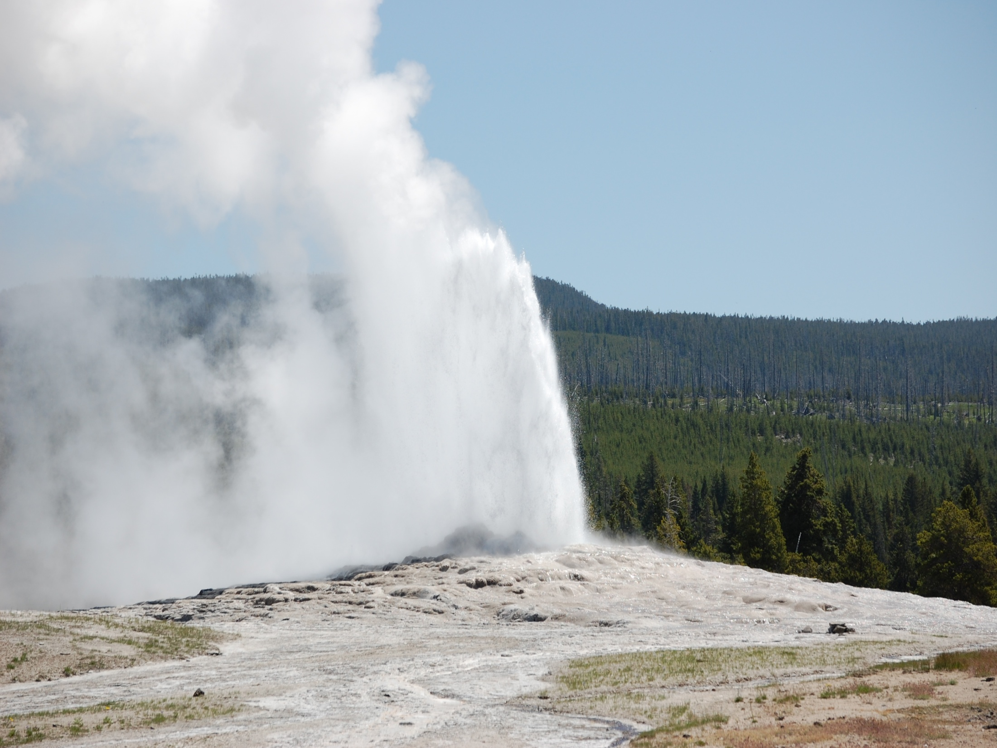
Geyser
intermittent hot spring that erupts jets of hot water and steam

Slide 9
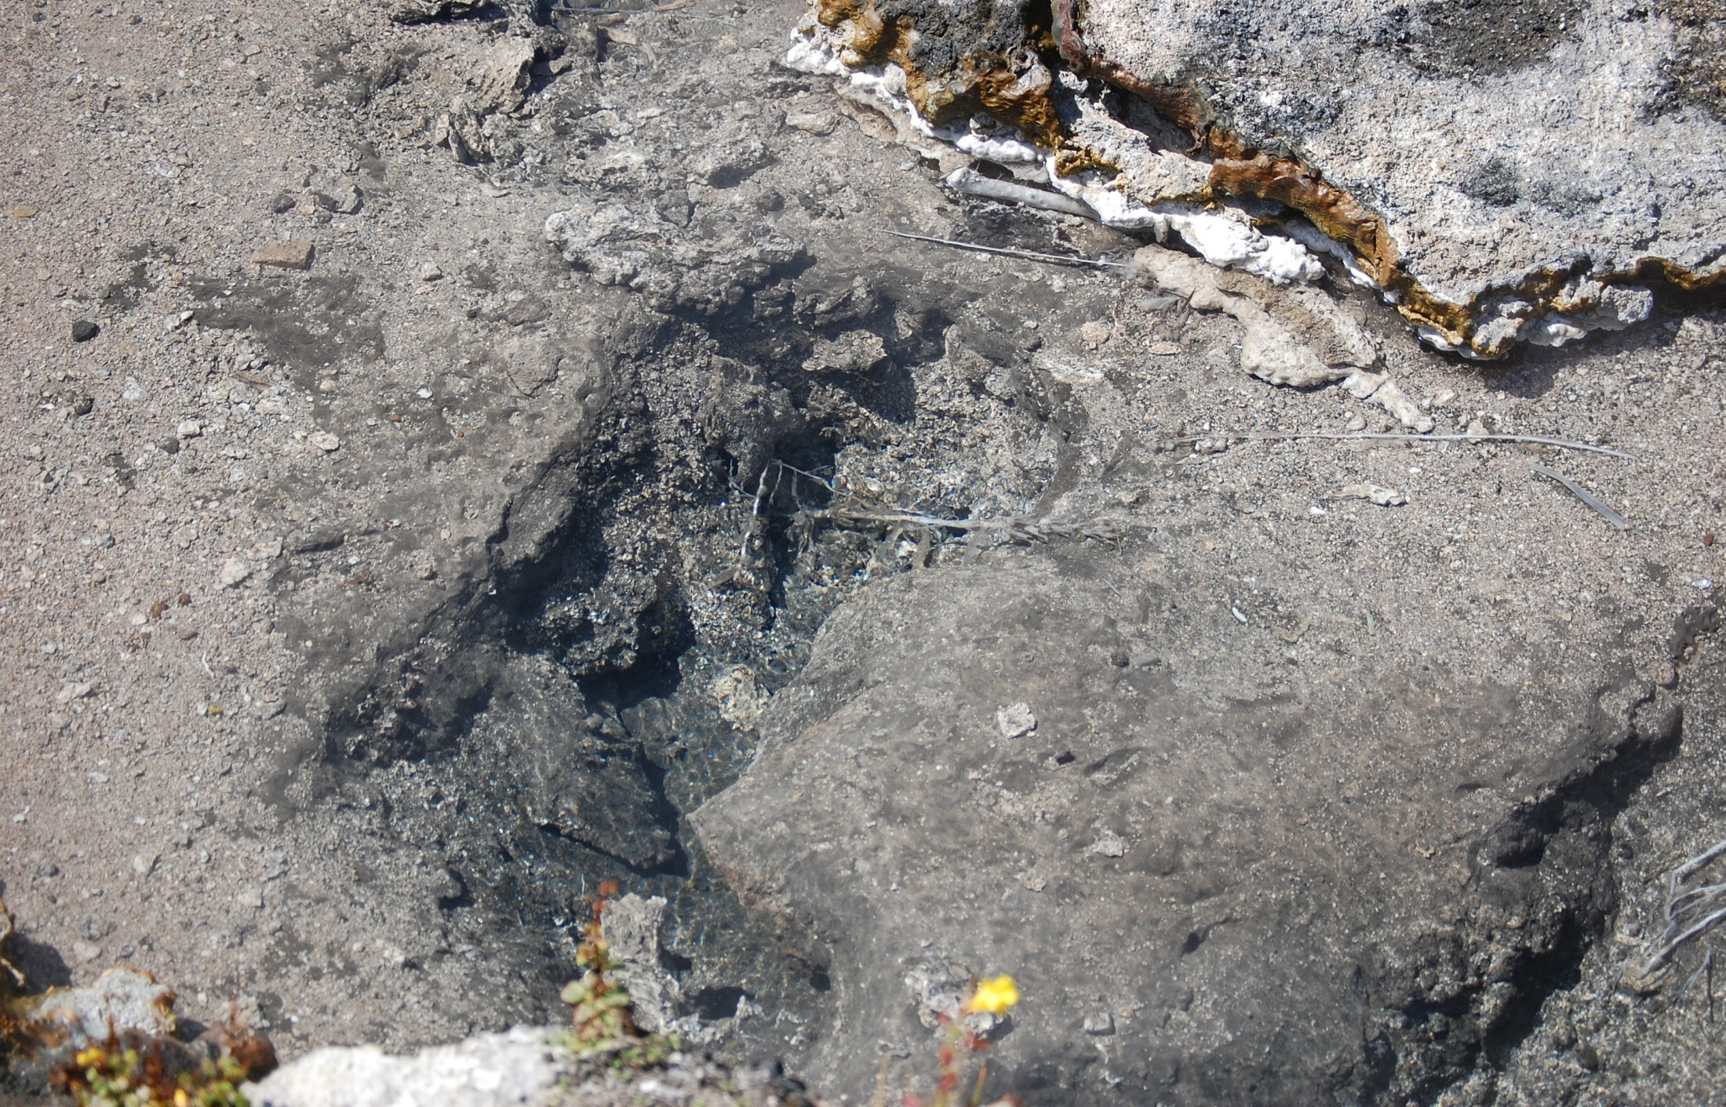
Fumaroles
vent emitting gas

Slide 10
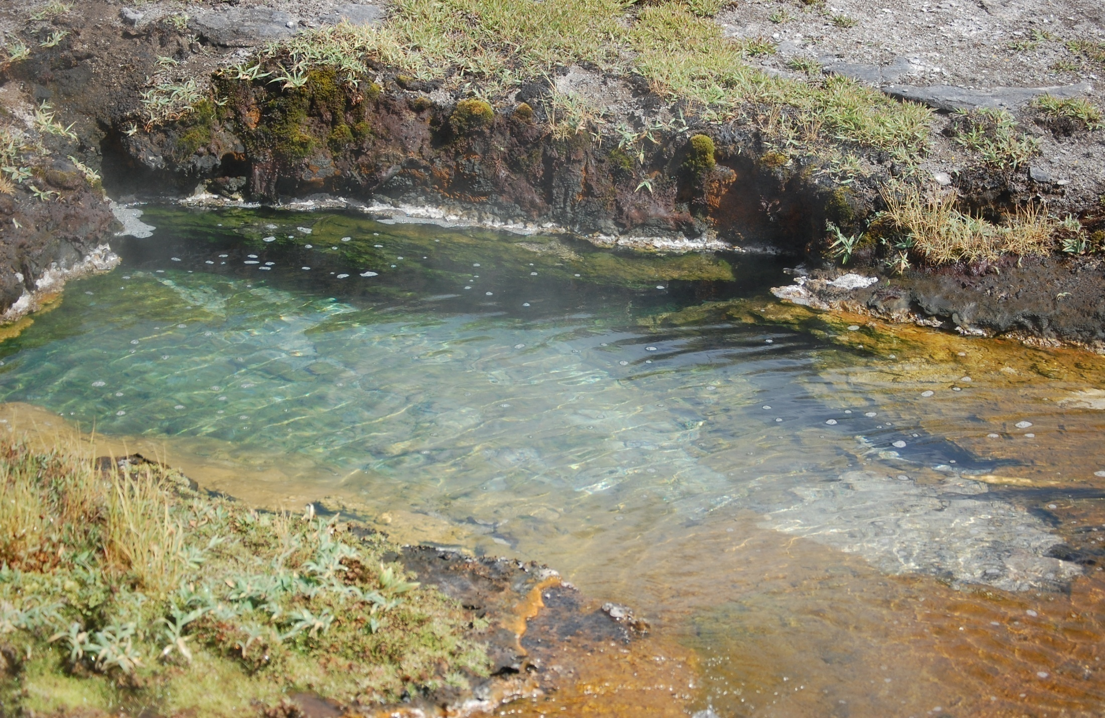
The organisms found here have redefined the basic ideas of what is necessary for life
How does this affect the views on how life began?
What are the limits of life?
What roles do microbes play in extreme environments?
Can they provide insights into the search for extraterrestrial life forms?

Slide 11
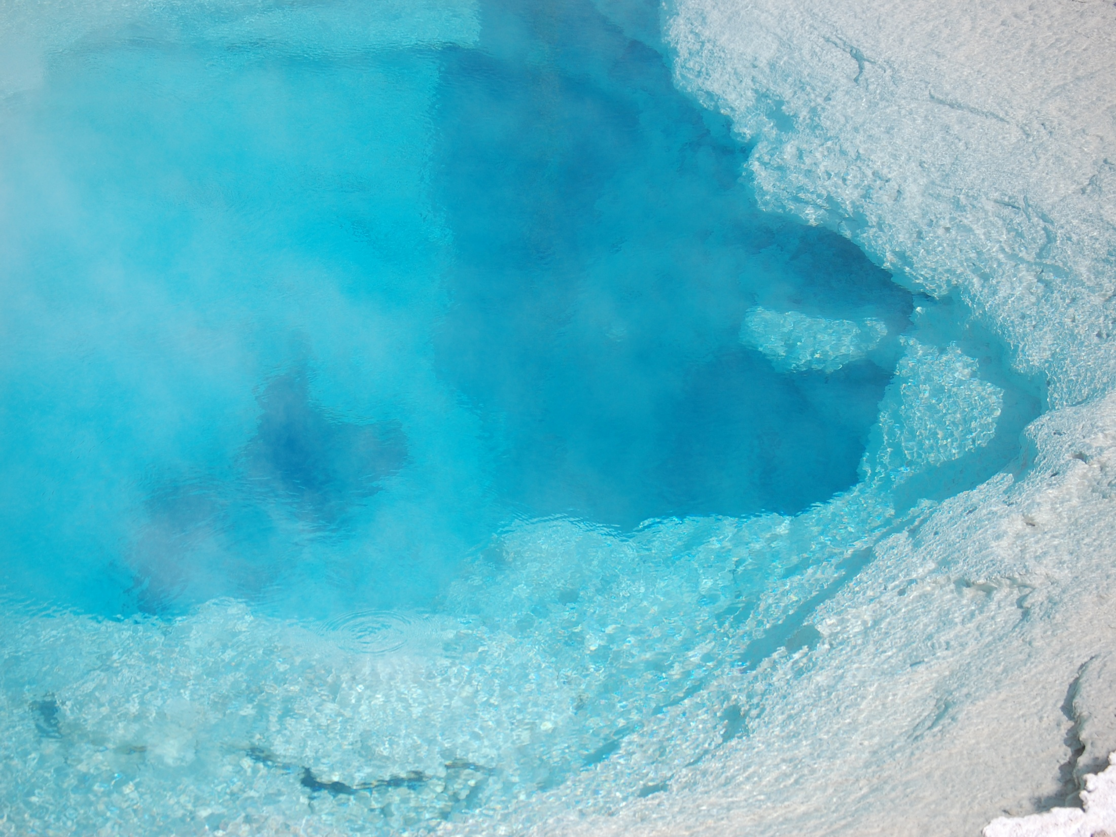
THERMOPHILES
• Organisms that thrive at extreme temperatures
• Bacteria: 113C
• Fungi: 55C
• Plants: 48C
•Extreme pH (pH 0)
•Toxic metal metabolism

Slide 12
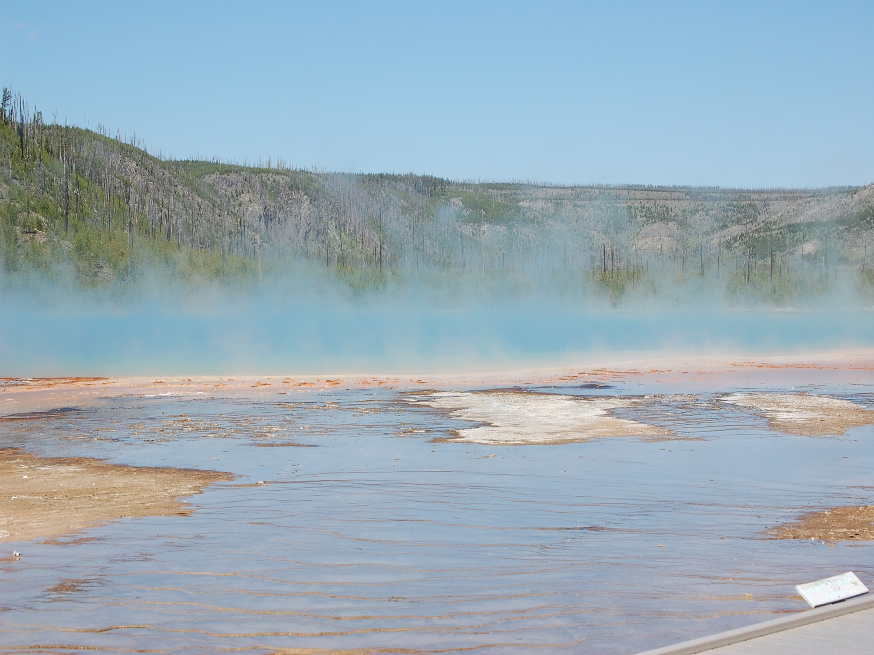
BASIC QUESTIONS…
• HOW DOES LIFE EXIST IN THESE EXTREME ENVIRONMENTS?
• WHAT ARE THE UNIQUE LIFE PROCESSES OCCURING?
• WHAT DOES IT TELL US ABOUT POSSIBLE LIFE YET TO BE DISCOVERED ON EARTH AND IN THE UNIVERSE?
• CAN WE APPLY KNOWLEDGE FOR PRACTICAL PURPOSES?

Slide 13
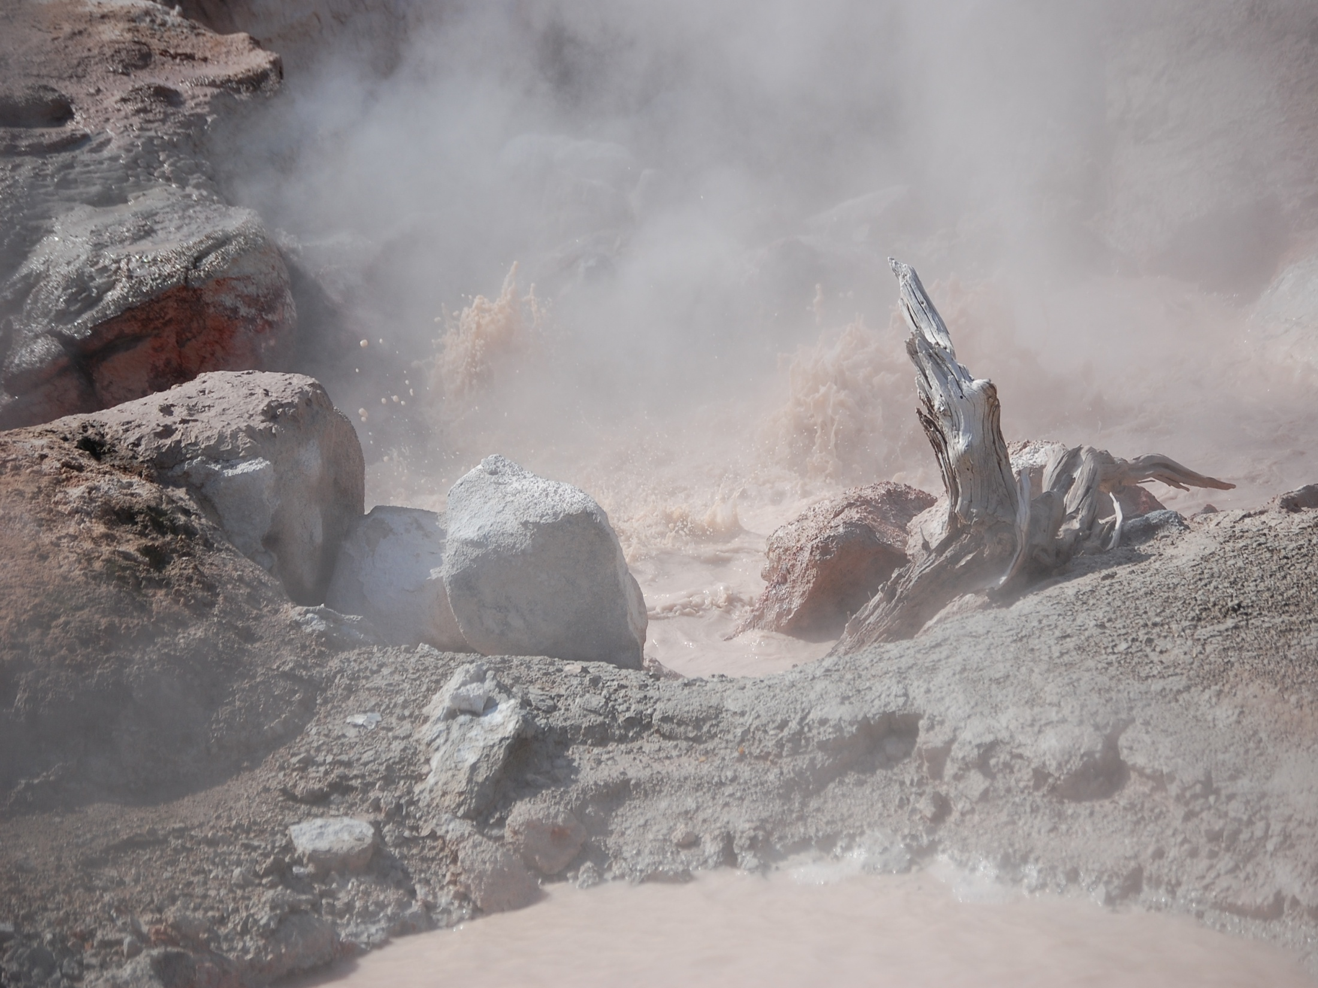
Scientific Highlights of Bioprospecting
Discovery of Arsenic Utilizing Thermophiles
Discovery of New Viruses in Boiling Acid
Temperature Tolerance Confirmed by Thermophilic Fungus

Slide 14
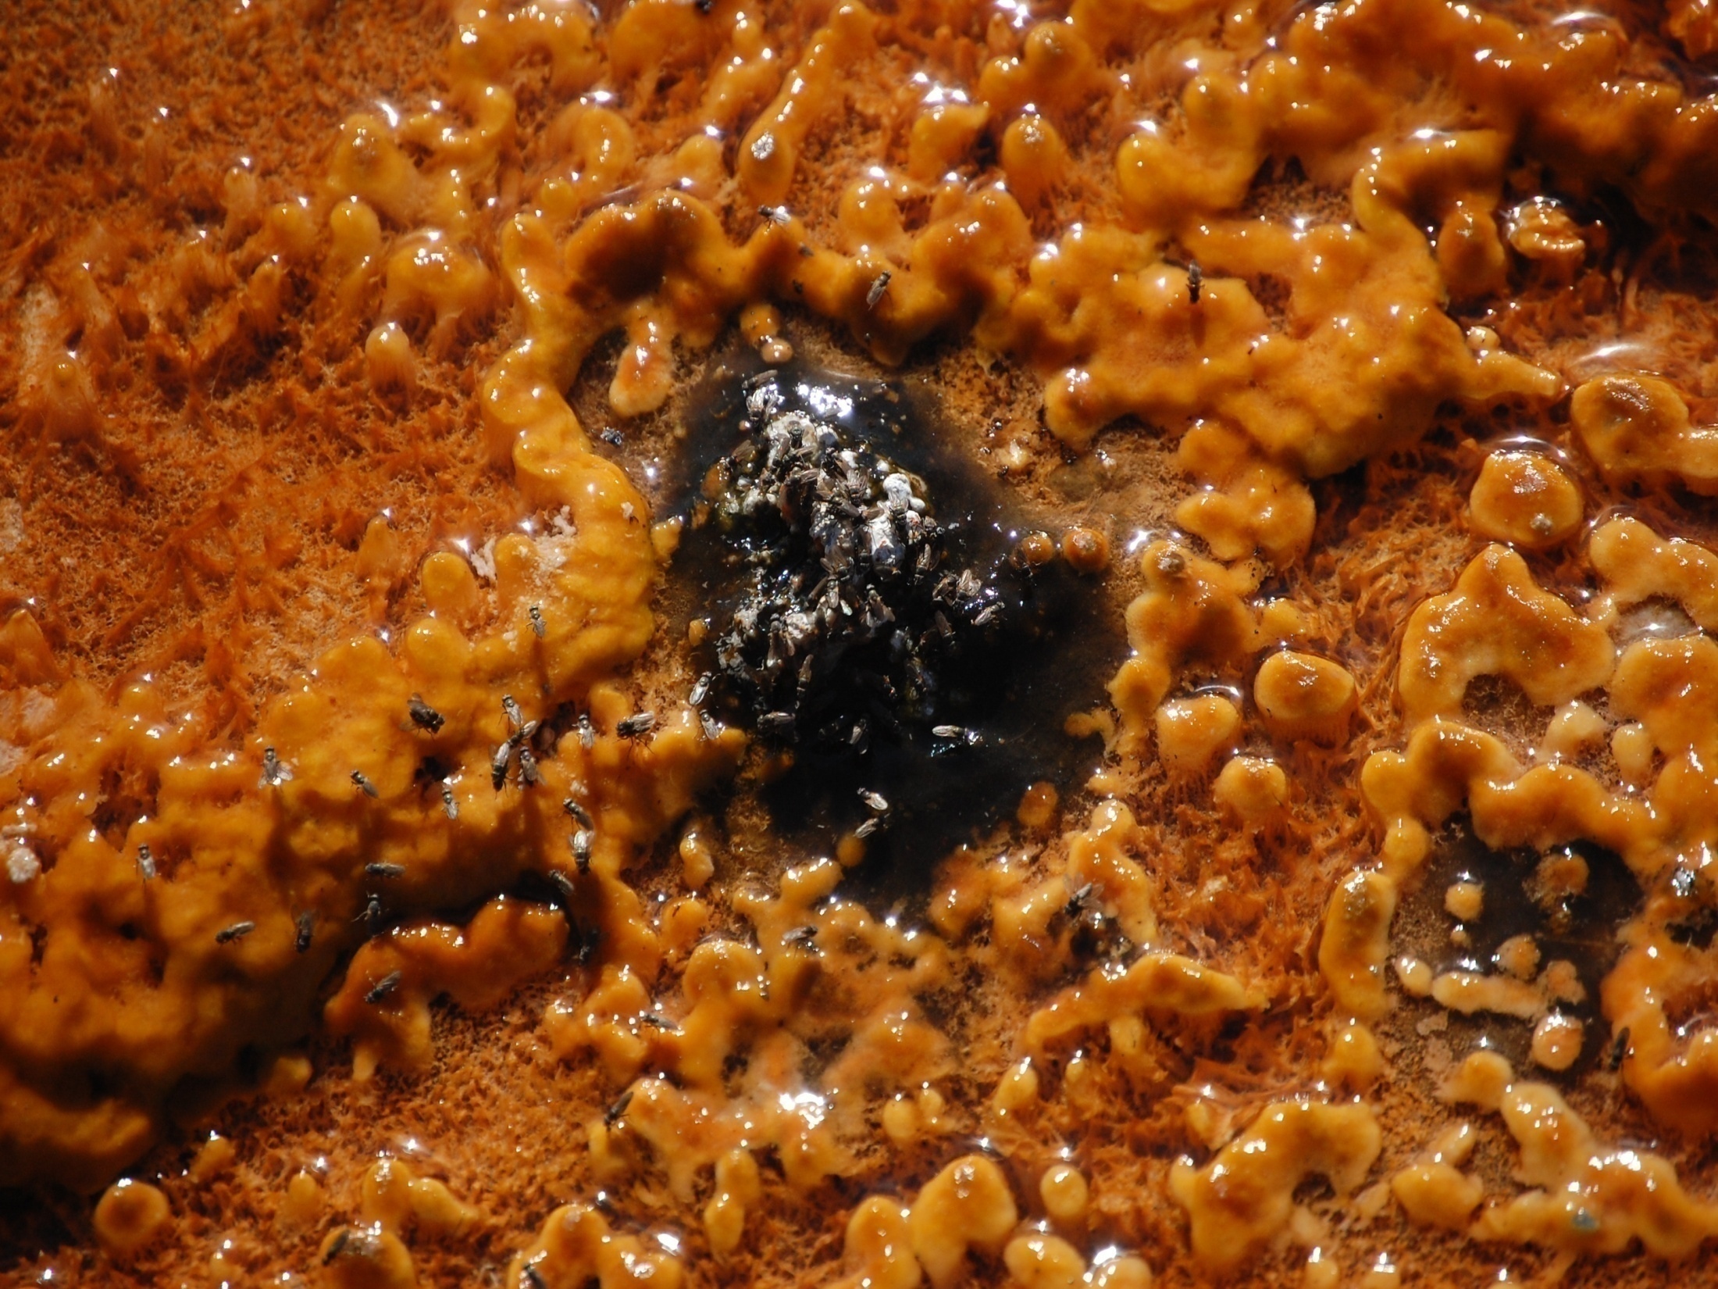
Discovery Impacts
Discovered by Dr. Thomas Brock, 1967 in Yellowstone.
First thermophile found was: Thermus aquaticus Yellowstone type-1 (Taq YT-1)
Thrive at temperatures above 45°C
1993 Nobel prize in chemistry awarded to Dr. Kary Mullis for inventing PCR.
In 1991 Cetus sold Hoffman-La Roche the PCR patent for $300 million.
Yearly income from this discovery is nearly $200 million
Hundreds of new proteins to target for commercial applications

Slide 15
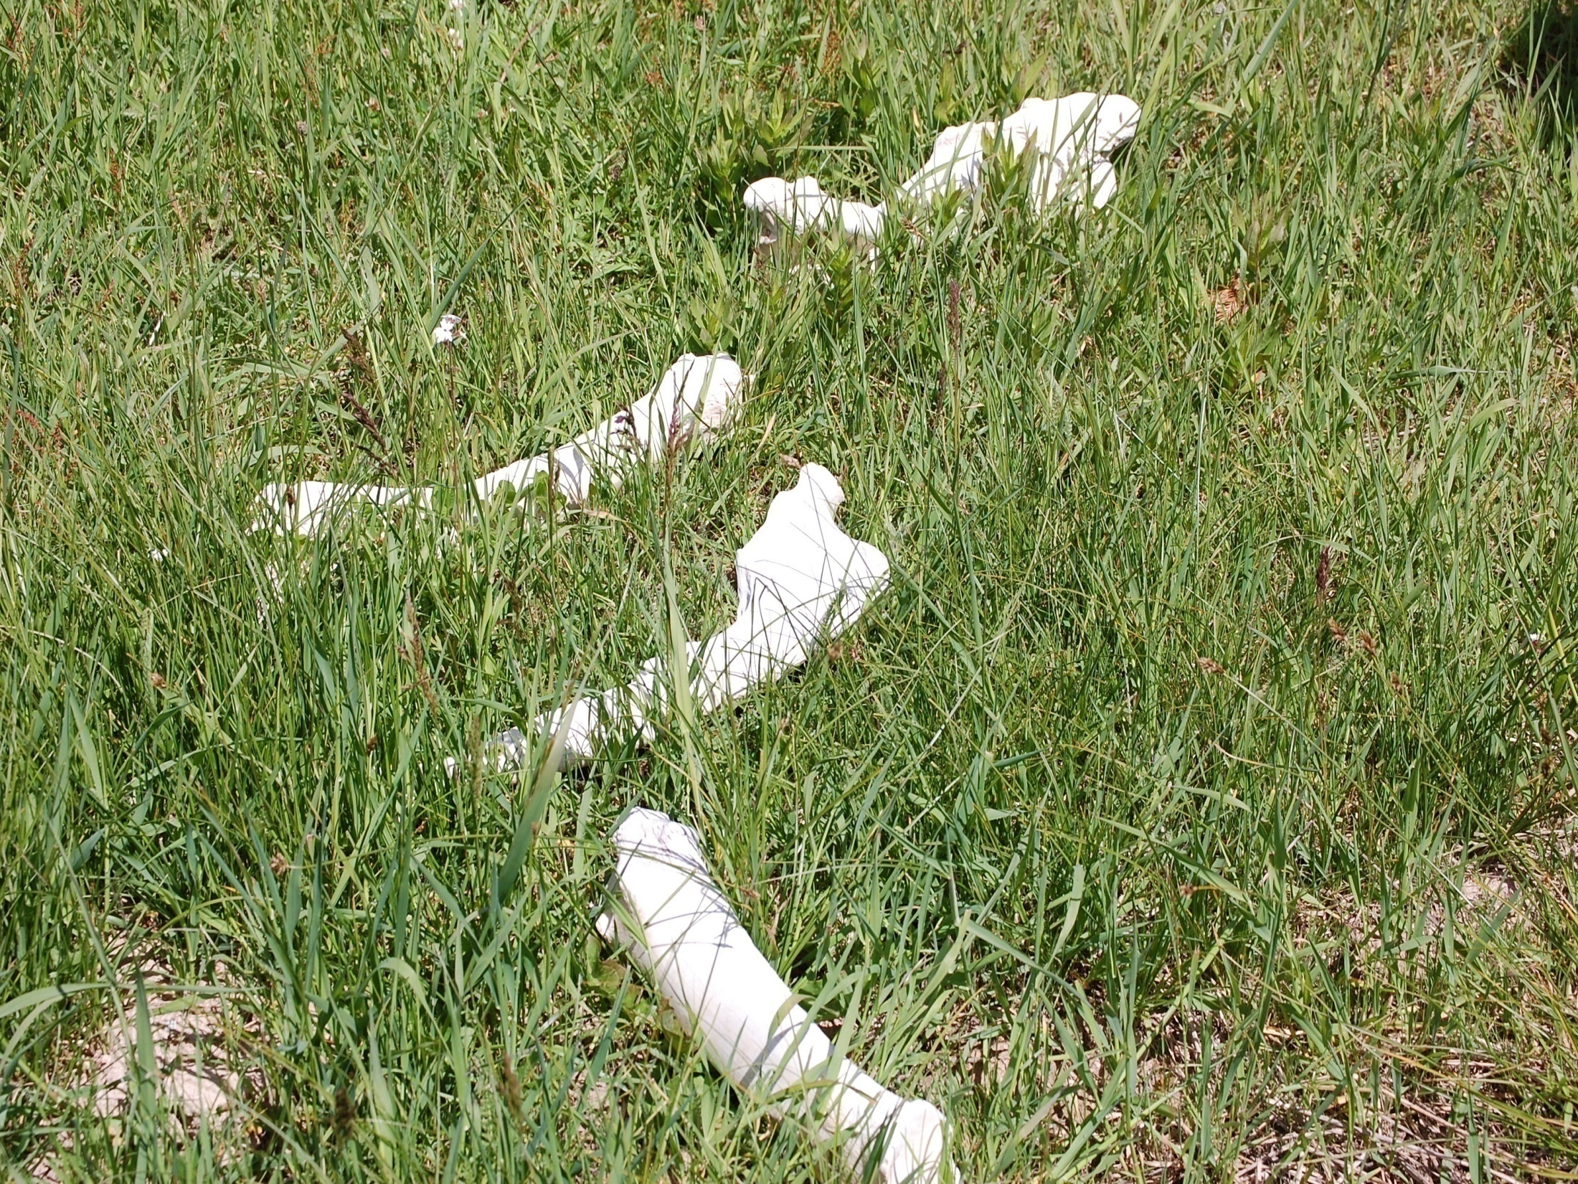
Tragedy of the Commons
•Garrett Hardin (1968)
•Common property resources (“the commons”)
•Highly susceptible to overexploitation

Slide 16
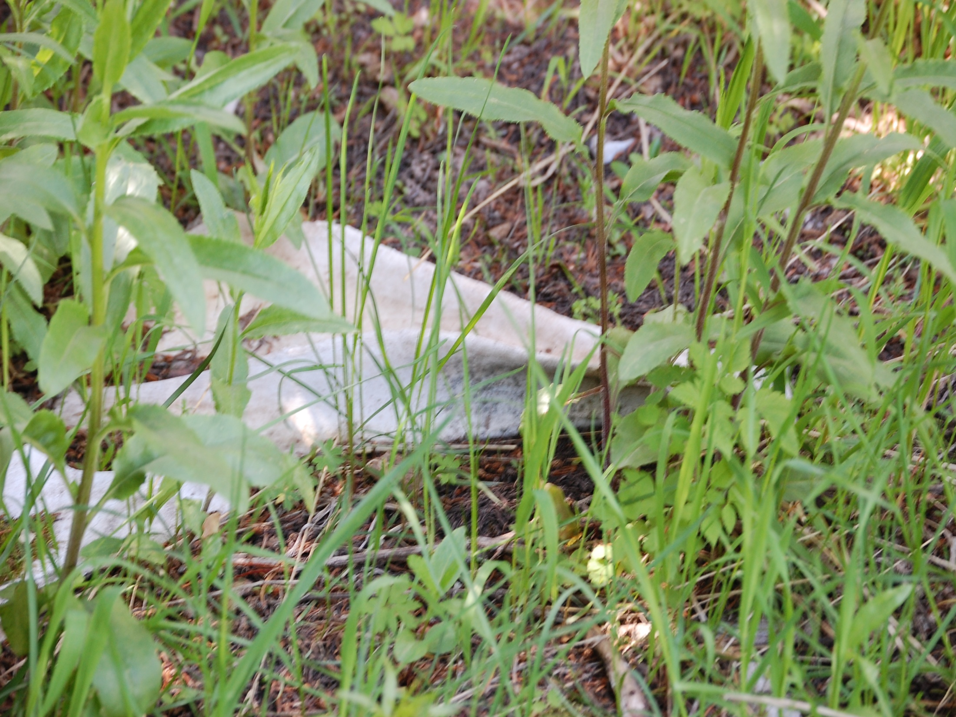
Tragedy of the Commons (continued)
•No technical solution
•Must be resolved through social action (“mutual coercion, mutually agreed upon”)
•Social norms
•The tragedy of the commons has become one of the most compelling and powerful ideas in environmental thought

Slide 17
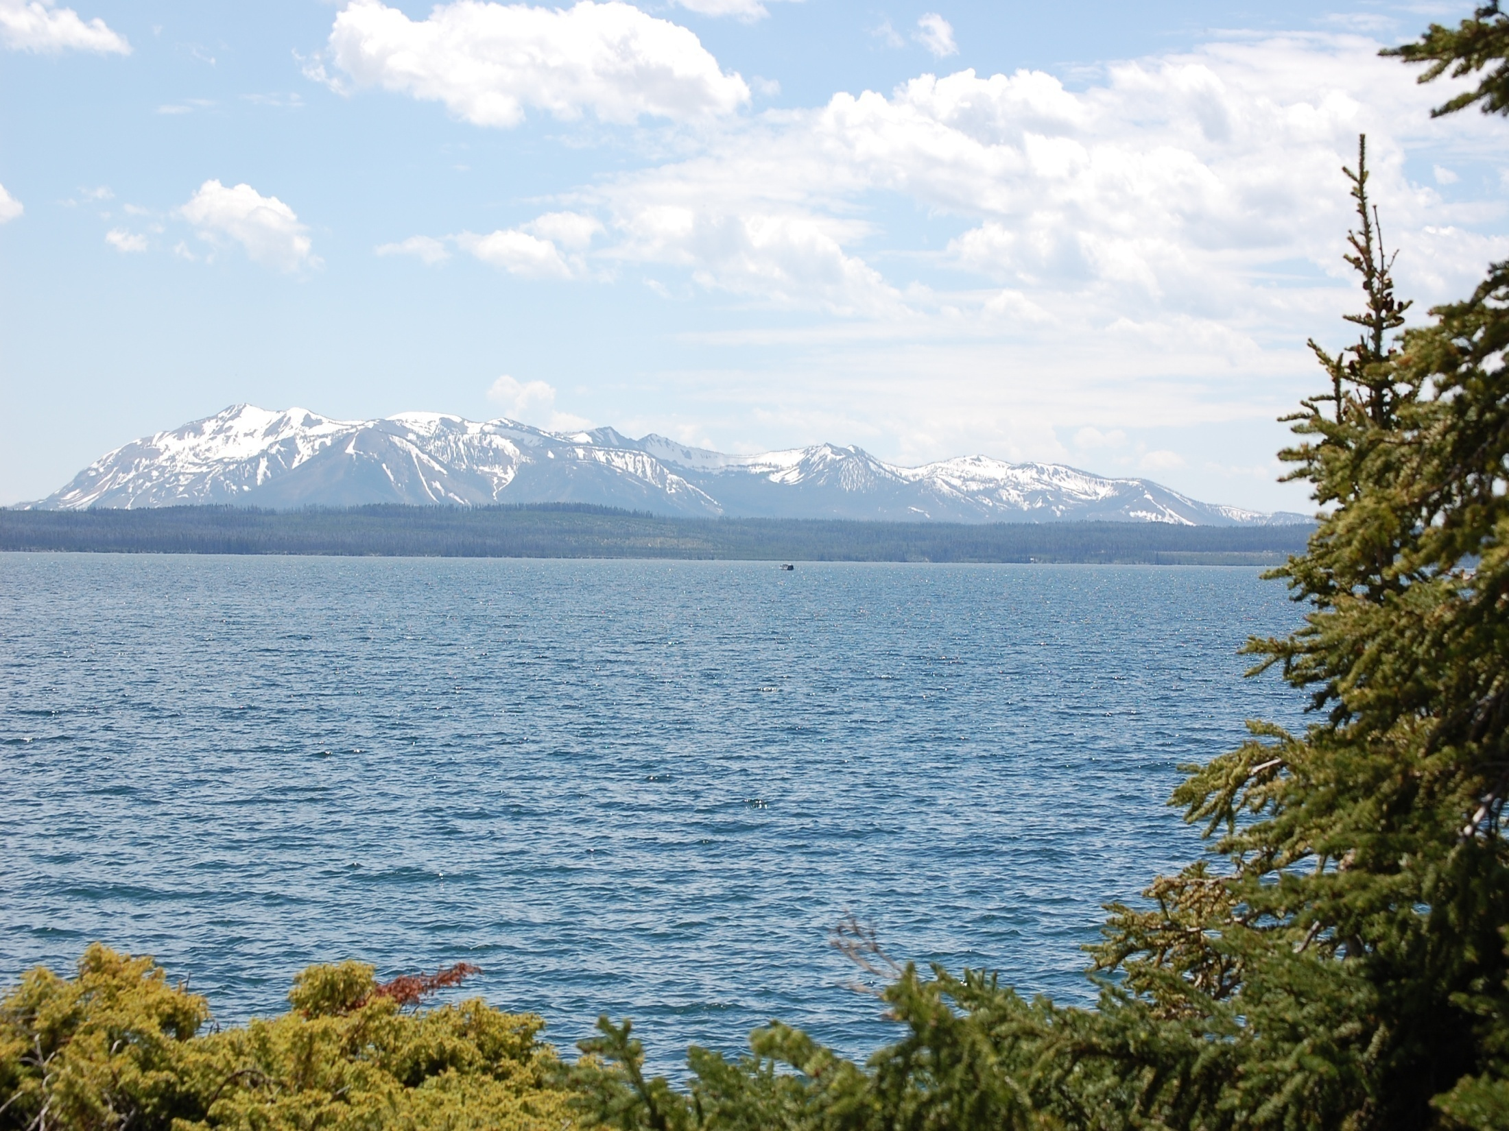
Examples of Commons
•A pasture
•Ocean fisheries
•The atmosphere (“reverse”commons)
•National parks
•Population

Slide 18
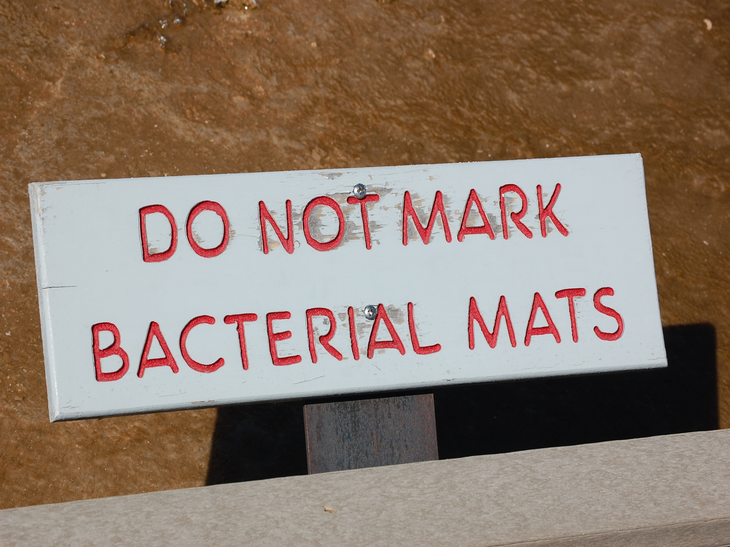
Role of National Parks
•Dual mission of parks
•Relationship between visitor use and impacts
•Management objectives/desired conditions
•Indicators and standards
•Carrying capacity: the point at which impacts of visitor use violate standards for relevant indicators.

Slide 19
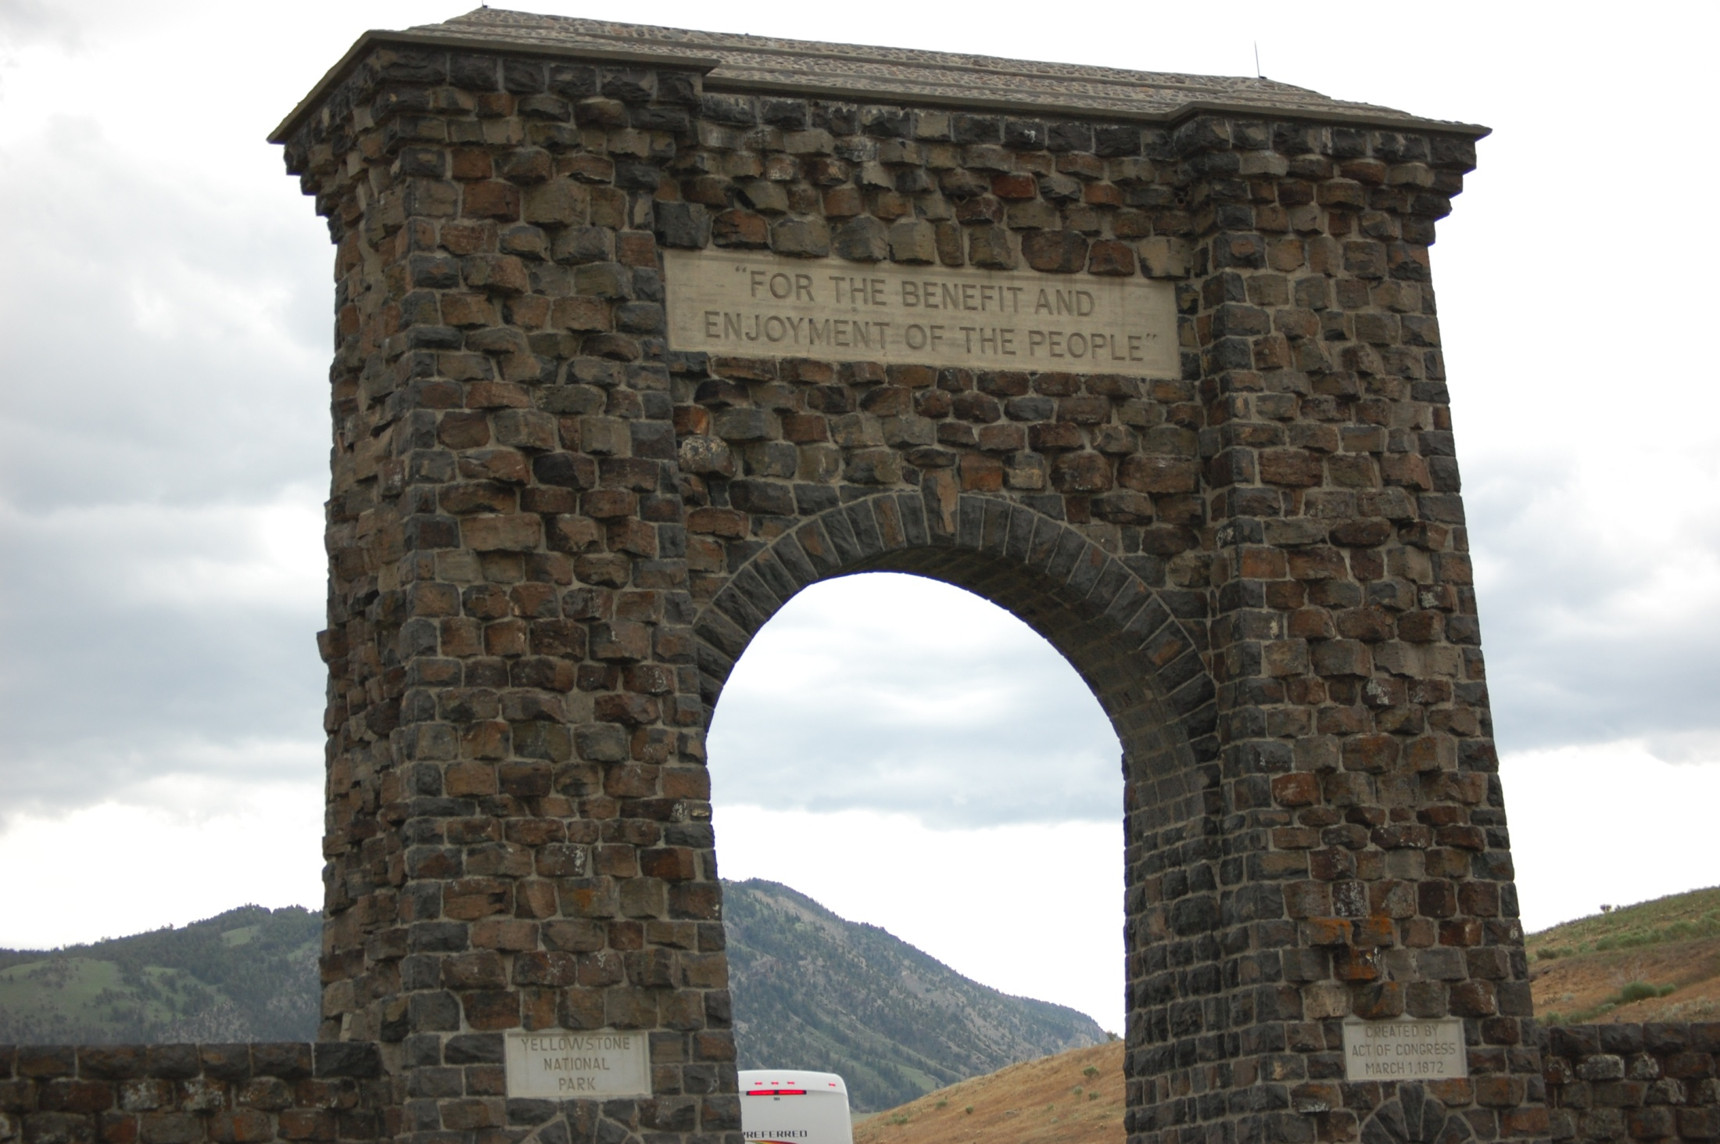
Why has it been so difficult to bring sound environmental management to public lands?
History – Interest groups vs. public apathy
Perceived as a local issue
Multiple Agencies Oversee Land Usage
Multiple Government Authorities
33% of BLM royalties go to state government
20% of USFS receipts go to county & local government
Multiple Use Conflicts

Slide 20
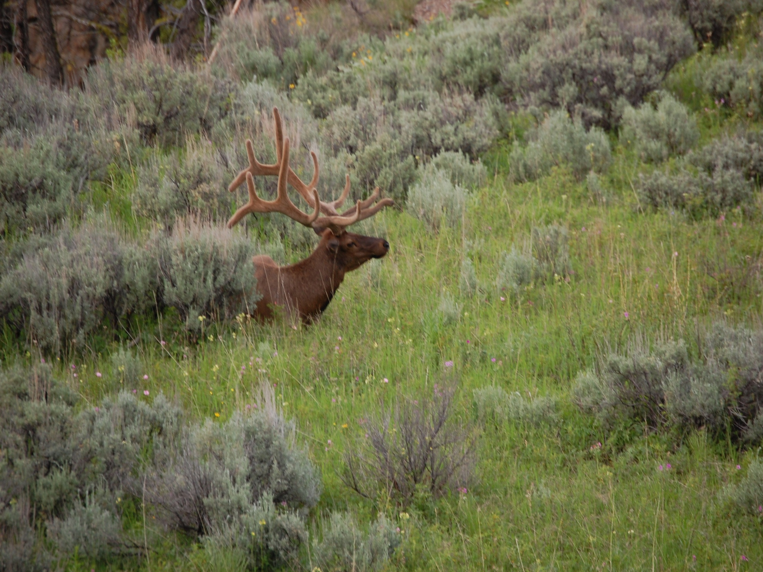
Focus Concepts
•Determine the amount of use the environment will sustain without spoiling it
•Develop ecosystem and individual organism management plans while taking the visitors experience into consideration
•Formulate management objectives/desired future conditions as well as develop indicators and standards
• Monitor indicator variables
• Apply management practices to ensure that standards are maintained

Slide 21
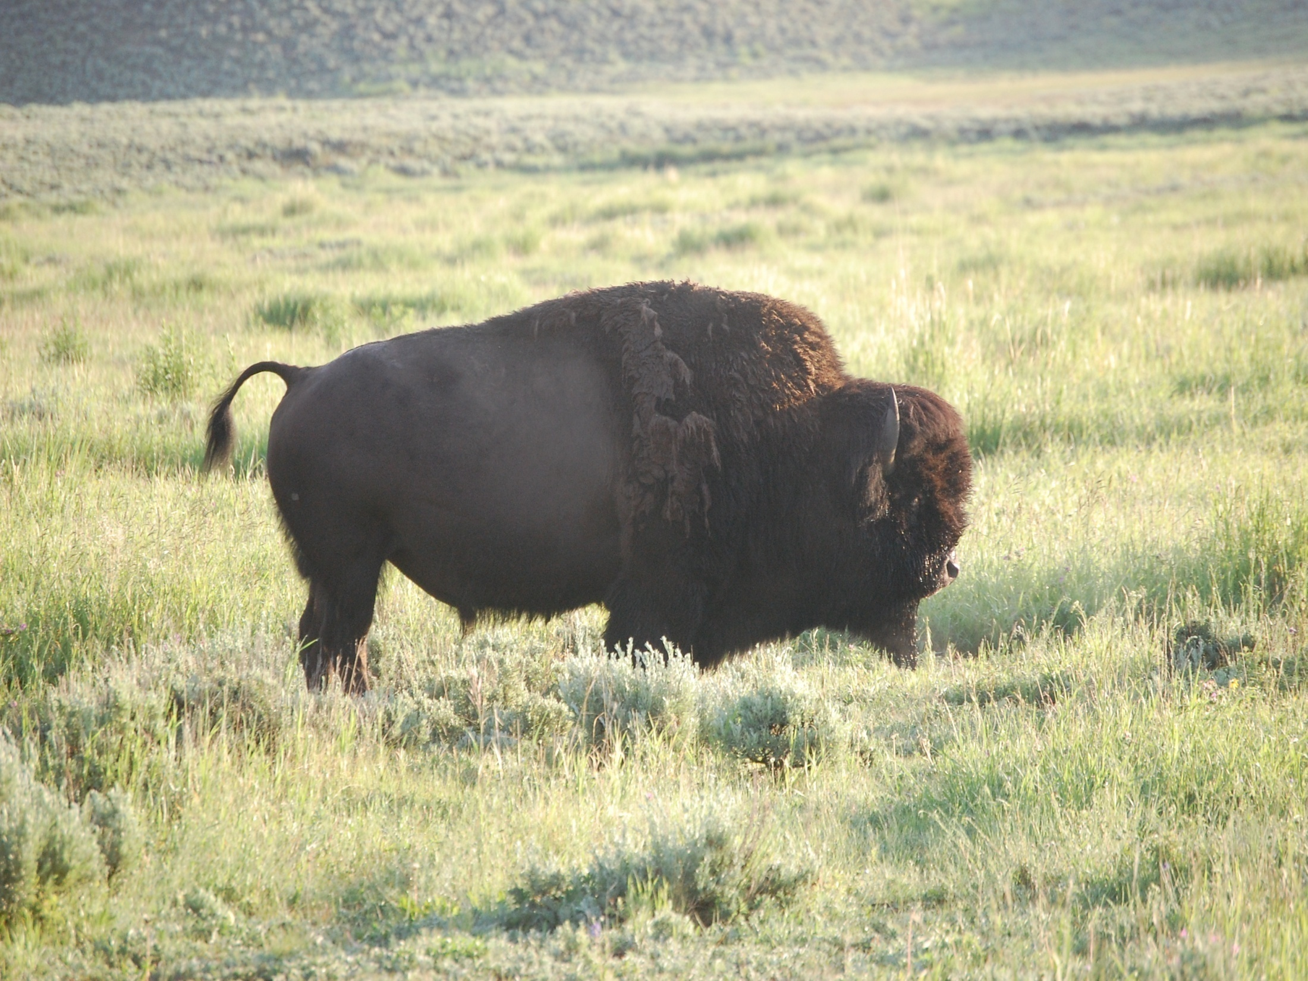
Focus Questions
In our democratic and market based society, how do the interests of all of these groups get addressed and resolved?
To what extent are science, politics and economics involved in the decision-making process?
What is the role of individual citizens in the formulation and execution of public policy?
How can individual citizens have a meaningful role in these debates?

Slide 22
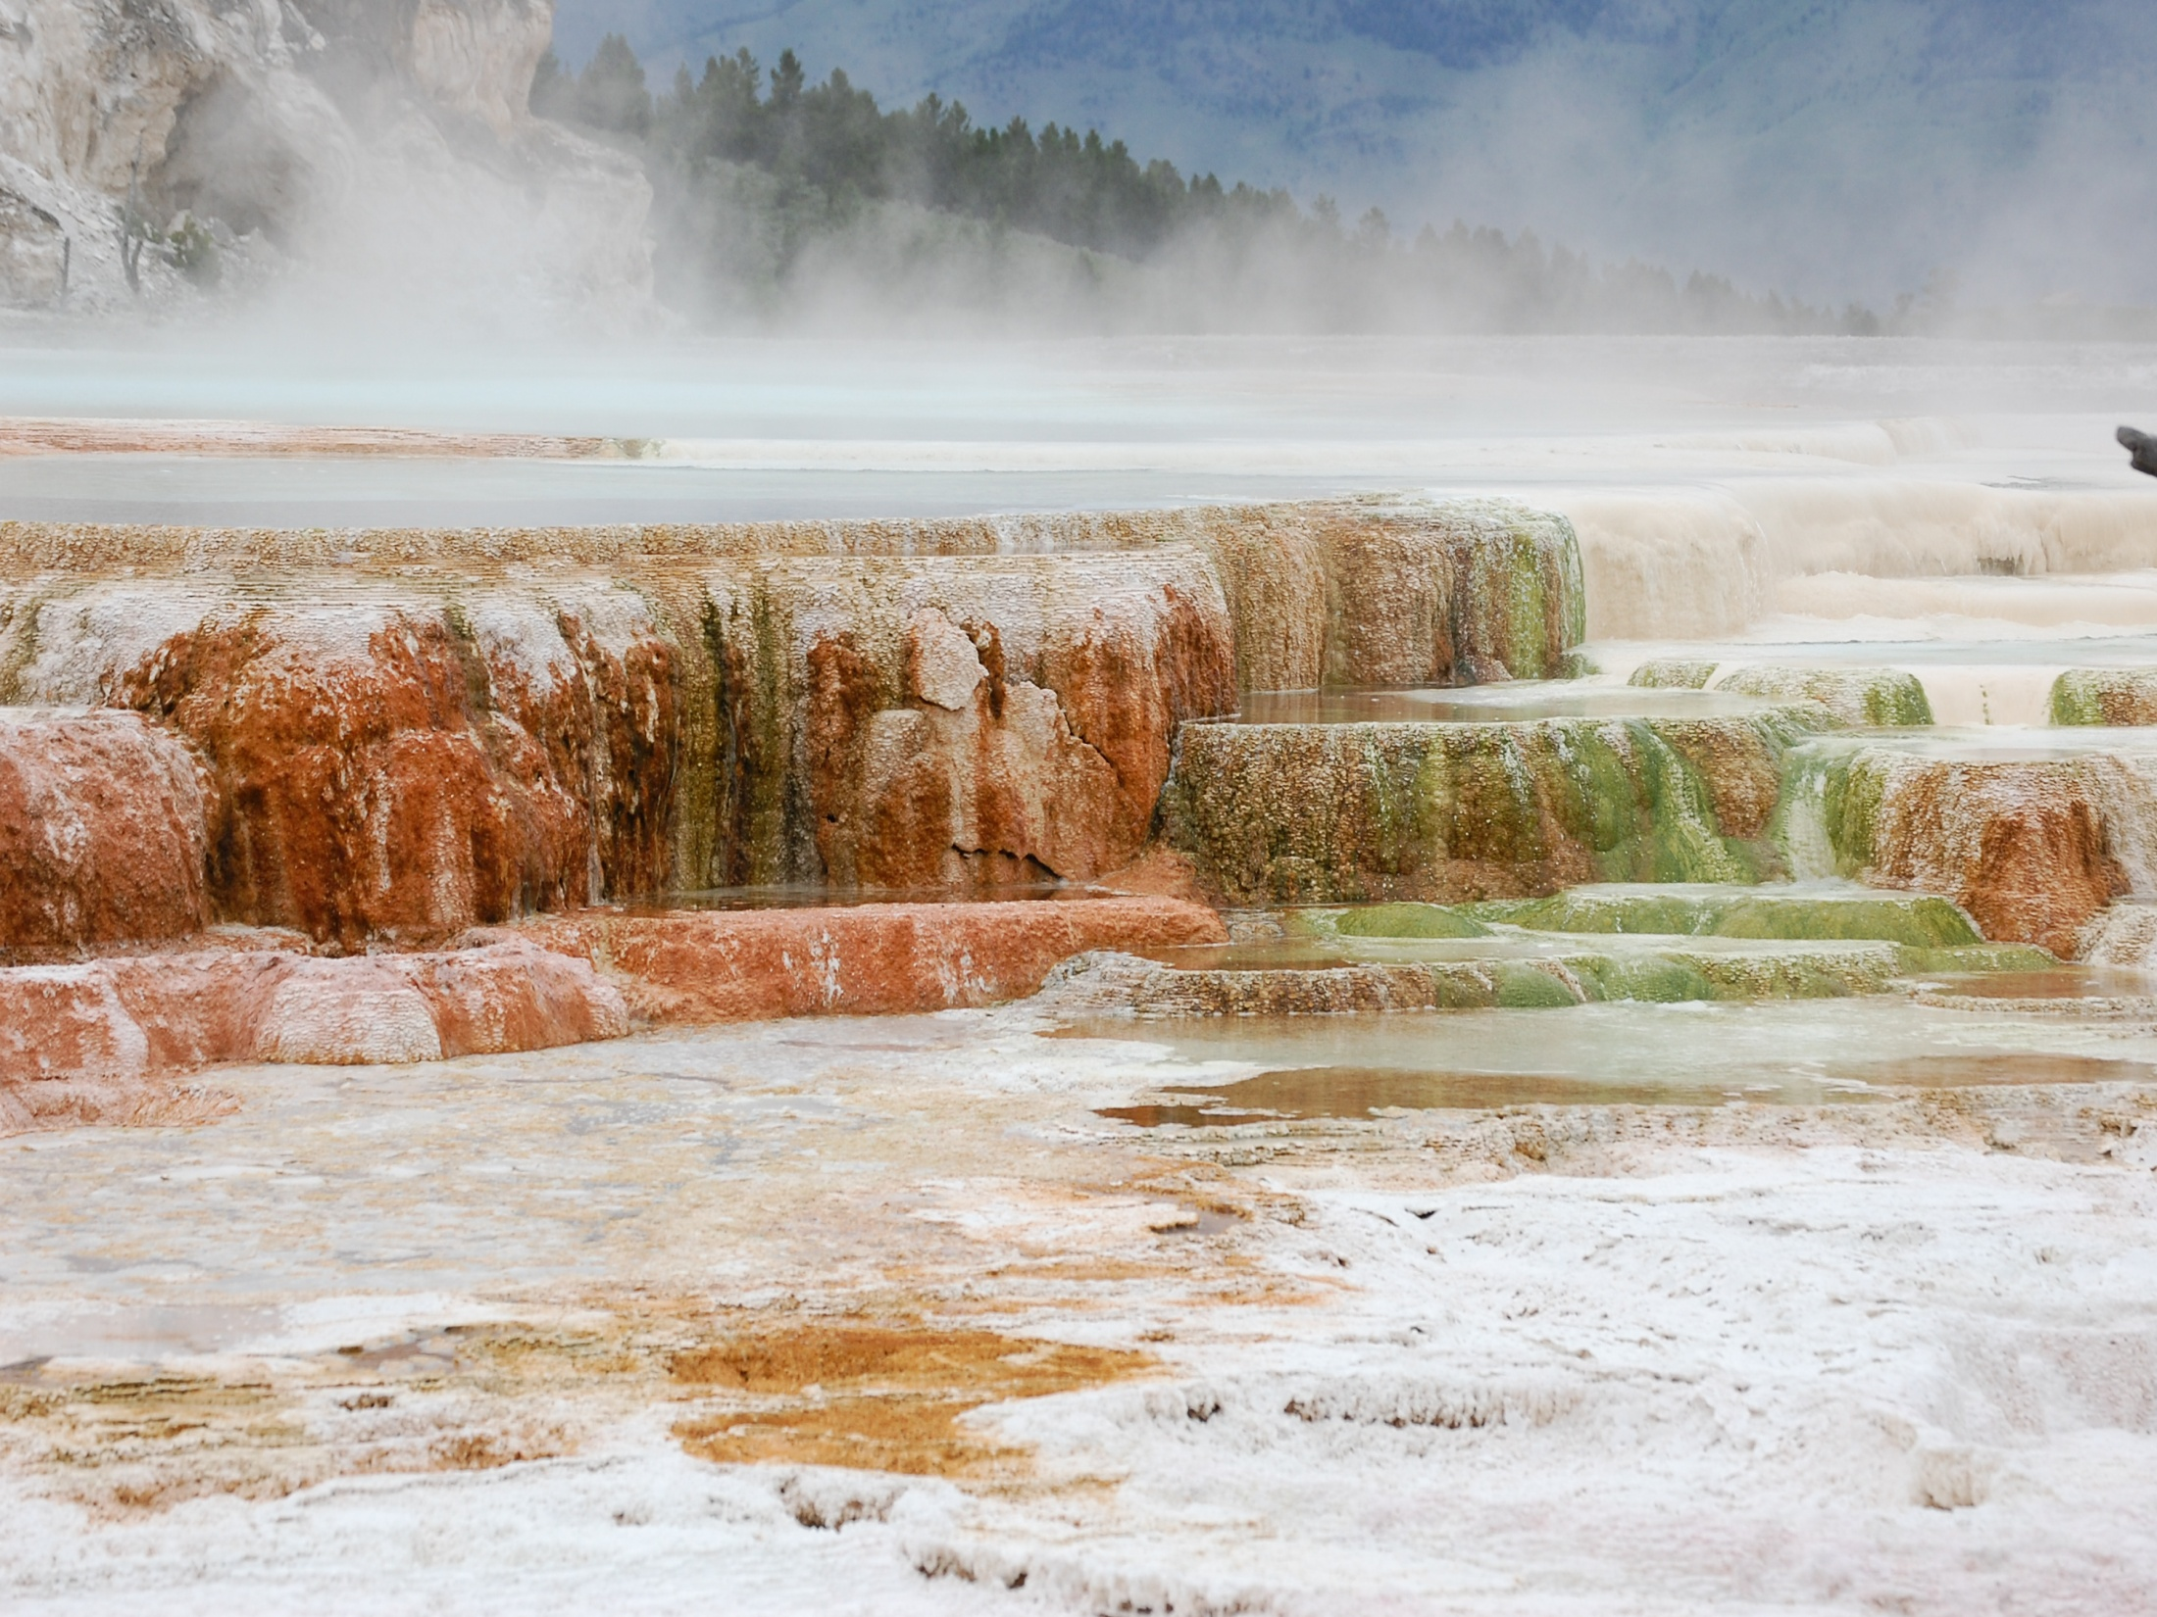
The End

Slide 23
Works Cited: http://internet.boticario.com.br/Internet/staticFiles/Fundacao/pdf/PALESTRAS_VCBUC/Robert%20Manning.pdf
http://ocw.mit.edu/NR/rdonlyres/Political-Science/17-32Environmental-Politics-and-PolicySpring2003/C33A2AEF-7378-43F2-89AE-6C58A02424E2/0/17_32_14publiclands.pdf
www.cook.rutgers.edu/~dbm/bioprospecting.pdf
tbi.montana.edu/facultystaff/young/Youngppt.pdf
ic.ucsc.edu/~syschwar/eart3/Lectures/Lecture13.1

