Slide 1
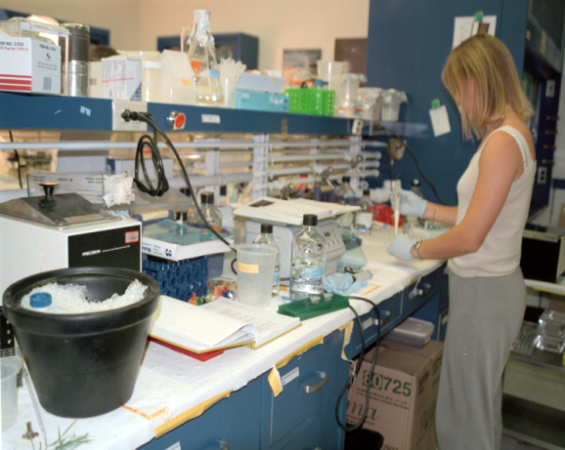
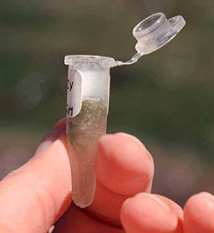
Benefits Sharing:
A New Tool for the National Parks
Notes:
The NPS, led by a Core team primarily working out of Yellowstone National Park (Bert Frost and I are Co-Chairs; Sue Mills, working in Yellowstone, is the Team Captain), has been developing servicewide procedures to guide how the Park Service would implement Benefits Sharings agreements.
What is “Benefits Sharing?” It is when a NPS unit gain benefits, monetary or otherwise, after a researcher makes a commercially-valuable discovery from studying specimens collected in a that unit.

Slide 2
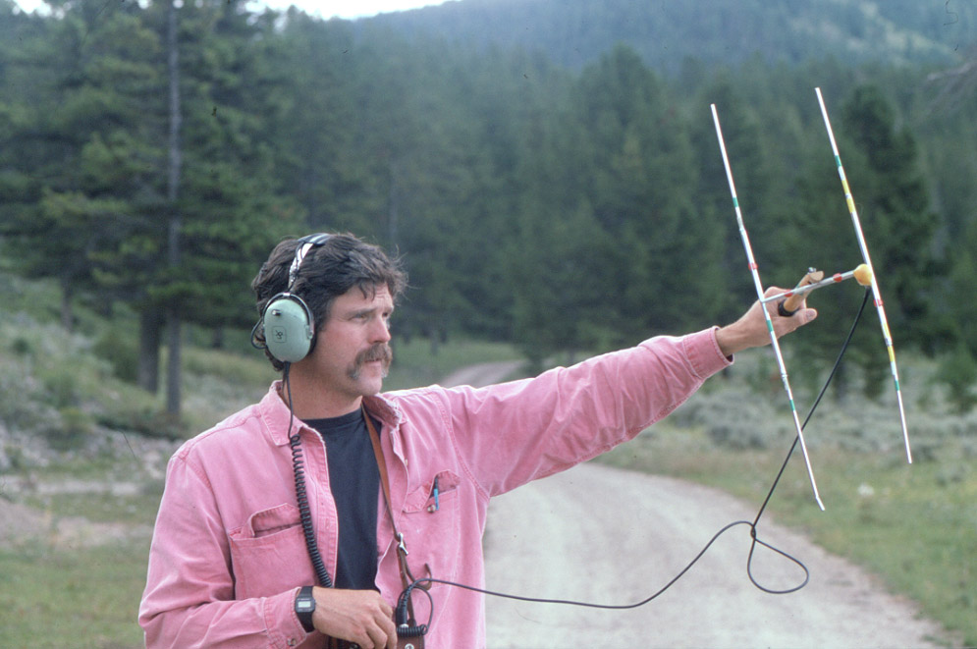
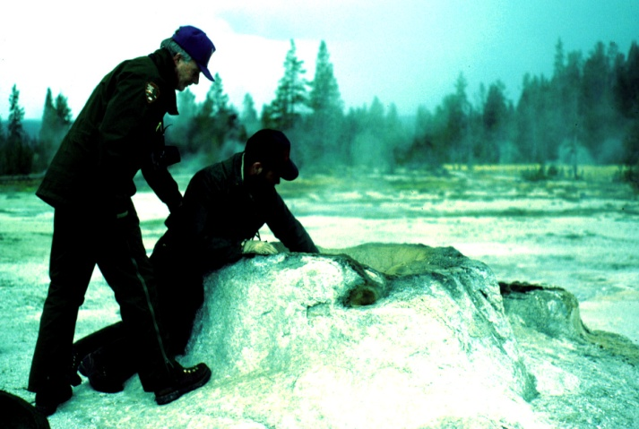
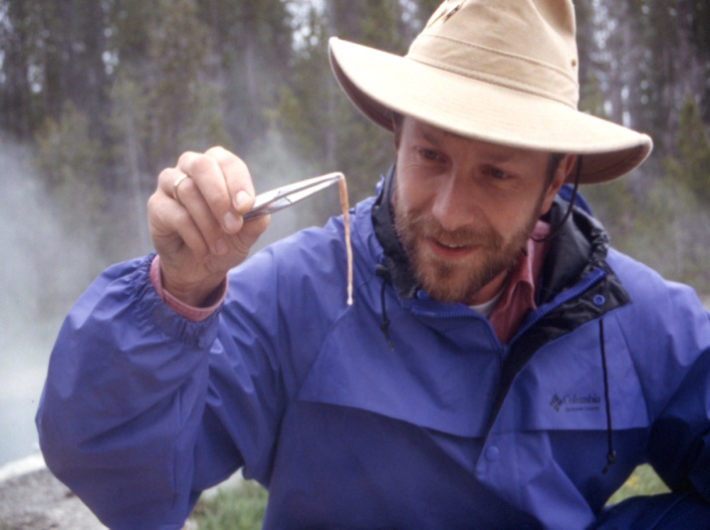
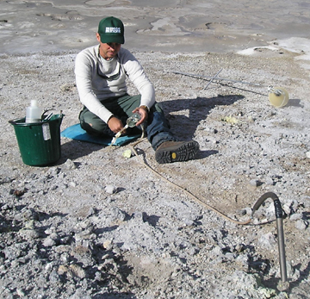
Parks for Science
Notes:
Benefits Sharing opportunities are the RESULT of a certain type of research that is currently legal and occuring in parks called bioprospecting. Bioprospecting is when a researcher searches to discover commercially valuable information from biological specimens collected.
Bioprospecting uses scientific information from park organisms, not the organisms themselves.
Using the organisms themselves would be BioHarvest, which is illegal in NPS Units and would not be permitted
I think the term “bioprospecting” is unfortunate—it conjurs up picks and shovels, collecting large amounts of material.
In practice, bioprospecting is about collecting small samples of water, algal mats, or soil that contain microbes—in general bioprospecting researchers have less impact than the average backpacker.
I want to emphasize that Bioprospecting is currently allowed under existing research permitting guidelines.
Yellowstone has 4 permits that are considered bioprospectors. Additional discoveries continue to be made from study of specimens collected years ago.
Servicewide, at least 55 U.S. patents have been granted for discoveries made from biological materials in U.S. parks (the majority have come from study of Yellowstone specimens).
Benefits Sharing is not currently allowed; it is on hold in the NPS, by order of a federal judge, pending analysis of potential impacts.

Slide 3
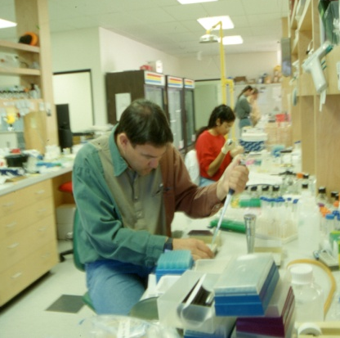
EIS Alternatives
Alternative B (Preferred Alternative)
Bioprospecting still allowed
Researchers must enter into Benefits Sharing Agreement with NPS before using research results for commercial purpose
Benefits Sharing Agreements would NOT authorize research—Research Permit a pre-requisite
Alternative C
Bioprospecting NOT allowed
Scientists whose products may have commercial applications would be denied research permits
Notes:
In the EIS, we analyze 3 different Benefits Sharing Alternatives :
Alternative A: No action
Bioprospecting would continue under approved research permits.
Benefits Sharing is not allowed.
Alternative B (The Preferred Alt.), Implement Benefits Sharing, which:
Allows bioprospecting to continue under approved research permits
Requires researchers to enter into a Benefits Sharing Agreement with the NPS before using their research results for any commercial purpose.
Would NOT authorize research – the research permit is a pre-requisite (research permitting is a separate process).
Alternative C
Prohibit scientific research in NPS that is associated with the development of commercial products (i.e., bioprospecting would not be allowed).
Researchers requesting Research Permits who acknowledged that their specimen collections could be used to develop commercial products or services would be denied permits.

Slide 4
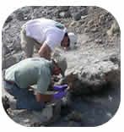
Bioprospecting and Benefits Sharing
Authorized by existing law and regulation
Enhances NPS mission of visitor use and resource protection
Compatible with NPS Management Policies
Notes:
Bioprospecting and Benefits Sharing are authorized by existing law and regulation
National Parks Omnibus Management Act of 1998.
Federal Technology Transfer Act of 1986.
U.S. intellectual property rights laws.
A Federal Judge has confirmed this authority. In fact, this is the first NEPA document that I have worked on where the substitive issues were ruled on prior to the analysis. The judge ruled that bioprospecting is (a) not a sale or commercial use of park resources (it is a commercial use of scientific discoveries made from park specimens); (b) not a consumptive use of park resources; (c) the research permit, not the benefits sharing agreement, provides the legal basis for biopropsecting.
Other federal agencies routinely engage in Benefits Sharing Agreements consistent with their missions and activities.
These activities enhance the NPS mission of visitor use and resource protection, by providing information, technical expertise, and (potentially) funding.
Bioprospecting and Benefits Sharing are compatible with NPS Management Polices.

Slide 5
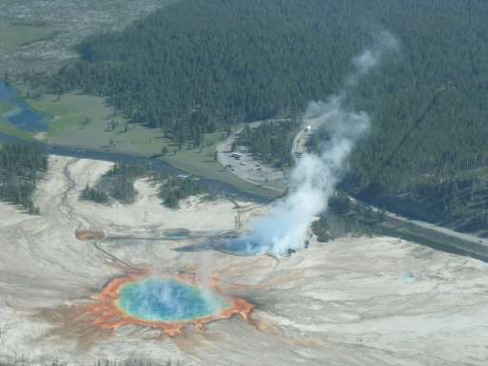
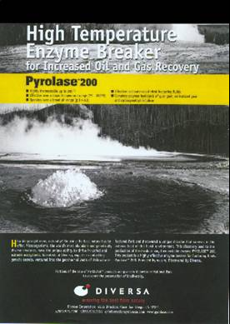
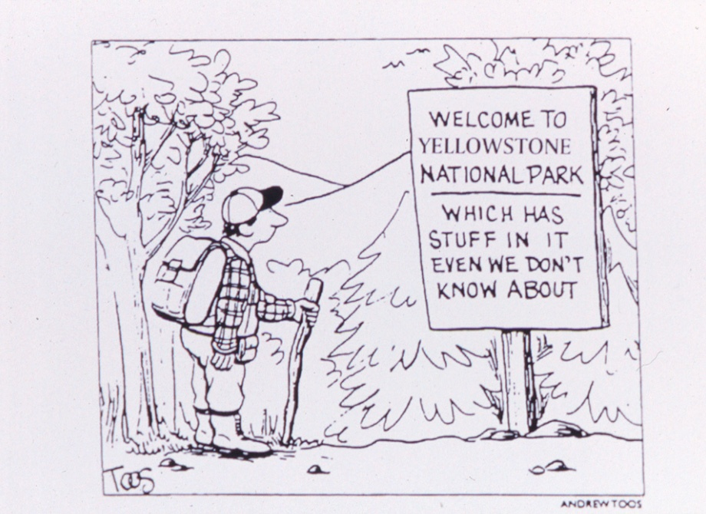
Benefits
New knowledge about park resources
Potential monetary benefits to improve resource conservation and protection
Benefits to Society
Notes:
Under Alternative B, Parks and Society would realize significant benefits, including:
Gain new information and knowledge about park resources that can be used in interpretation and visitor services.
Monetary benefits could include up-front funding or royalties from commercial products.
Funding could be used to support the park’s mission of resource conservation and protection.
The EIS analysis estimated potential monetary benefits ranging widely from $0 to more than $150,000 annually per agreement.
Benefits to people (Society), e.g.
DNA Fingerprinting
Biggest bioprospecting story in the world; has significantly improved our lives.
Technique (PCR replication) developed partly from research on Yellowstone organism (Thermus aquaticus).
Resulted in significant advances in every area of science including medicine, forensics, genetics, wildlife biology to name a few.
Pyrolase 200
resulted from Yellowstone thermophilic microbe research by Diversa Corporation under a research permit.
used in hydraulic fracturing operations during oil and gas recovery; reduces viscosity so the oil or gas can slip up to the wellhead easier, significantly increasing yield.

Slide 6
Views on Benefits Sharing
Supporters
12,000 DEIS notifications sent
9,600 commenters responded
75% respondents support the idea
Agencies/Groups that have expressed support:
Department of State
National Institutes of Health
White House Office of Science and Technology
National Parks and Conservation Association
Biotechnology Industry Association
Opponents
Small, but vocal and active group(s)
“ParksNotForSale.org”
Oppose:
“Commercialization” of parks
“Secret” deals
History of Litigation
EIS was ordered by federal judge
A FOIA request is now being fulfilled
Notes:
We sent out about 12,000 DEIS notifications. A clear majority of the 9,600 commenters on the DEIS supported bioprospecting and Benefits Sharing. Many agencies and NGOs have strongly supported this initiative, including NPCA.
For the EIS, in addition to press releases, we sent 10,000 personal notifications soliciting comments; there were more than 35 media articles.
There are 6 groups that have joined forces to oppose Bioprospecting and Benefits Sharing; they are led by one non-profit organization, the Edmonds Institute, but also now include PEER, Alliance for the Wild Rockies, and a couple of other groups. They have put up a web site and are quoted often in Benefits Sharing Articles. They oppose:
“Commercialization” of parks
“Secret” deals. This refers to the fact that, in our preferred alternative, as required by law and codified in a FOIA exemption, we do not plan to release protected financial information, including royalty rates, from Benefits Sharing Agreements. This is not unlike existing Concessions guidelines.
There is a history of litigation on this issue:
We are developing this EIS because the NPS was sued over a Benefits Sharing agreement that Yellowstone signed with Diversa Corp. The NPS won the lawsuit—the plaintiffs lost on all substantive issues (including a ruling that bioprospecting was NOT a commercial use of the park) and the judge dismissed the issues with prejudice—but he ordered the NPS to conduct an Environmental Analysis.
Edmonds, the same group that lost the original suit, has filed several broad, sweeping FOIA requests, the most recent asks for documents from December 2002 to November 2006. We are currently working on complying with that FOIA request in addition to completing the EIS.

Slide 7
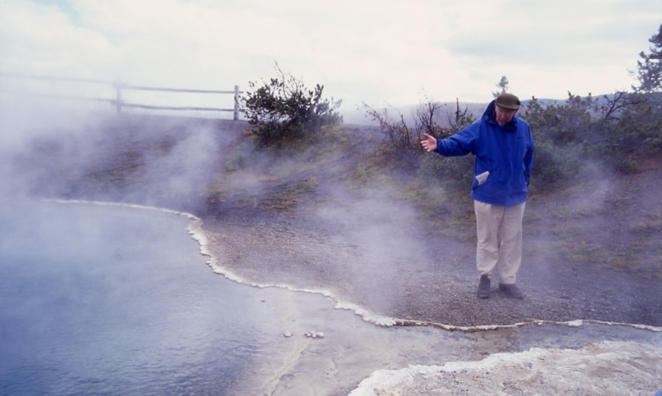
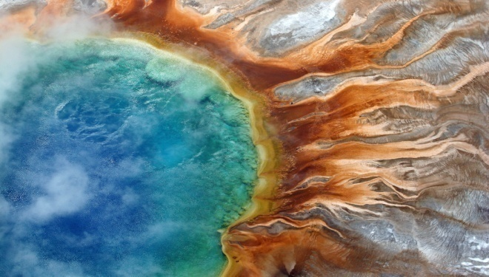
EIS Schedule
September 2006: DEIS 60-day Public Review
January 26, 2007: Public Comment Period Ended
November 2009: FEIS Posted on Federal Register
March 5, 2010: ROD signed
Notes:
DEIS comment breakdown
The majority of the 9,600 comments consisted of one of two form letters
7,222 NPCA form letter supporting benefits-sharing and Alt B1 (full disclosure of CRADA terms and conditions). During discussions with NPCA following the DEIS review, we were able to address some of their concerns and explain NPS’s need to comply with confidentiality laws which prevented full disclosure of all CRADA information.
2,150 ParksNotForSale.org form letter (no commercial bioprospecting, etc.)
190 "original/unique" comments
Few (less than a dozen total) comments recv'd from NPS and industry representatives
Comment content - the top 4
- Support B1, disclosure of CRADA terms and conditions (royalty rates)
- No commercialization of park resources
- Be sure park resources are protected
- Distrust of government and corporations (particularly if they're viewed as working together)
How we responded to comments
EIS Team coded comments (breaking comments down into statements of concern, determining issues comments speak to, etc.) in order to prep summary of comments including changes to DEIS (for prep of FEIS)
Key Washington office staff, YELL’s Deputy Superintendent and EIS Team members (including SOL Carla Mattix) reviewed the draft FEIS
If everything goes according to schedule, we will be ready with an ROD this winter.

