Slide 1
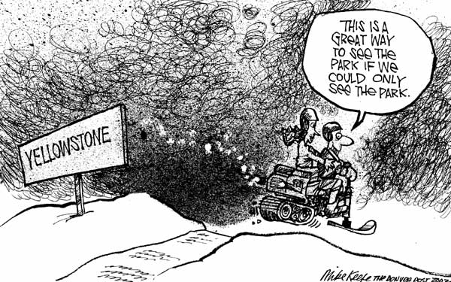
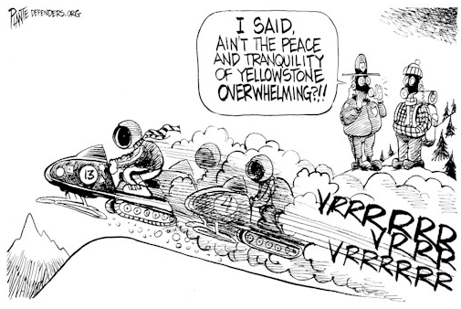
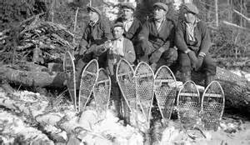
Winter Use Conflicts in YNP
What is a “natural”
landscape? What dimensions “count”?

Slide 2
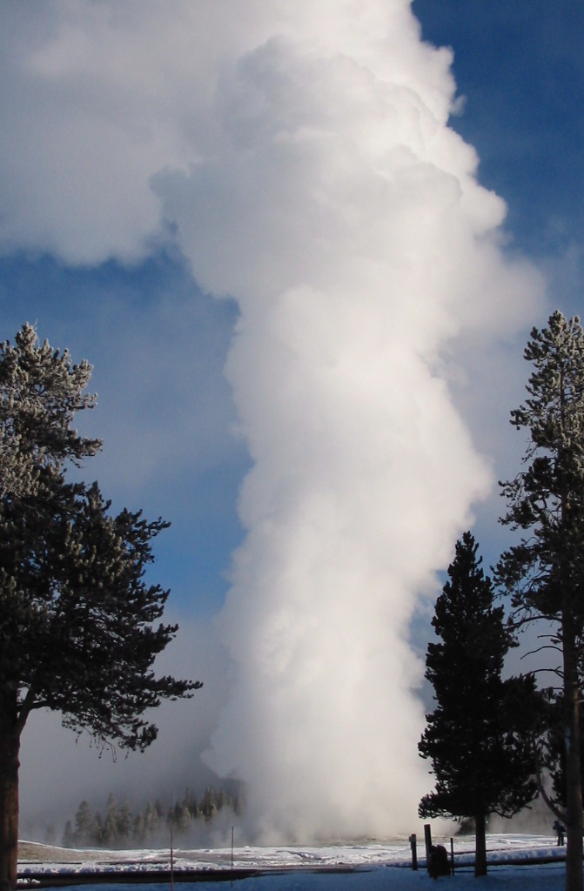
Case Study:
Winter Planning in
Yellowstone National Park
John Sacklin
Management Assistant
Indiana State University, June 2010

Slide 3
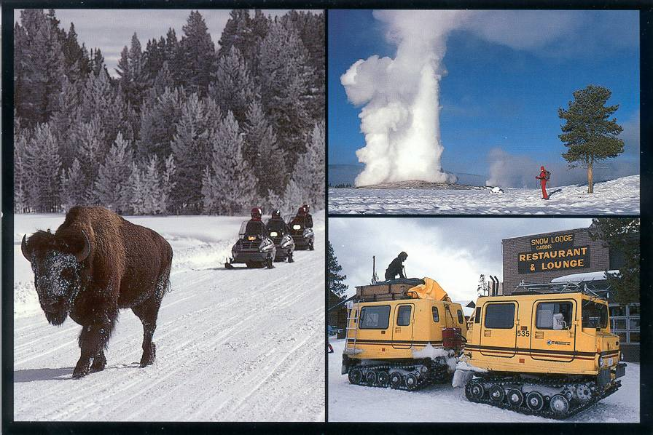
A Question of Values:
Winters in the Parks: What forms of use are appropriate?

Slide 4
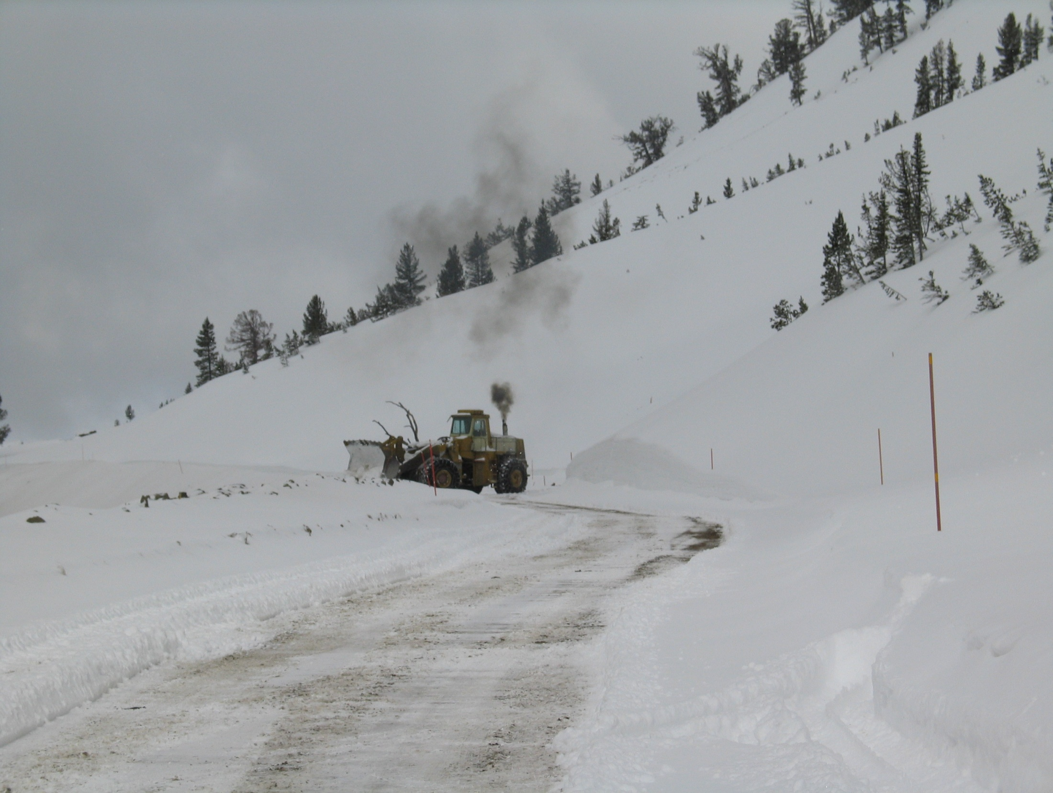
Historians will tell us that this is the twelfth time we have examined winter use in Yellowstone National Park since 1935

Slide 5
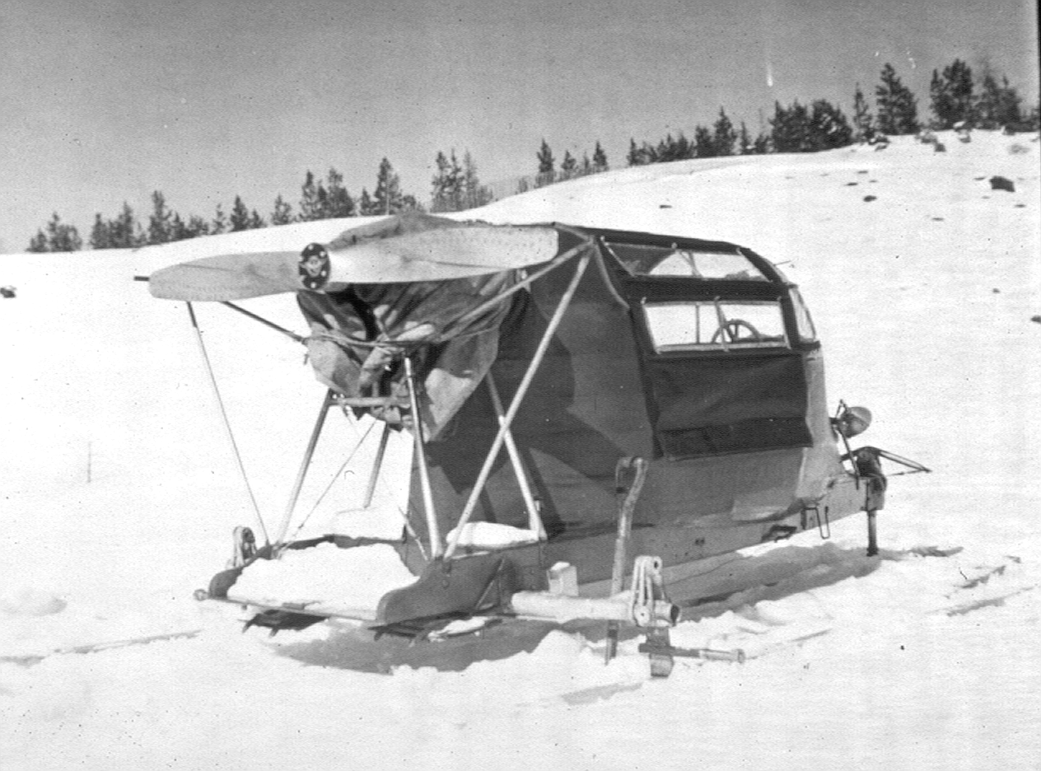
In the late 1940s: First snowplanes came into the parks

Slide 6
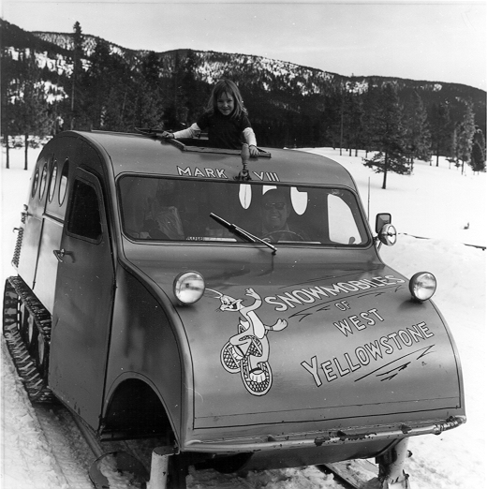
In the mid-1950s, the first snowcoaches entered Yellowstone

Slide 7
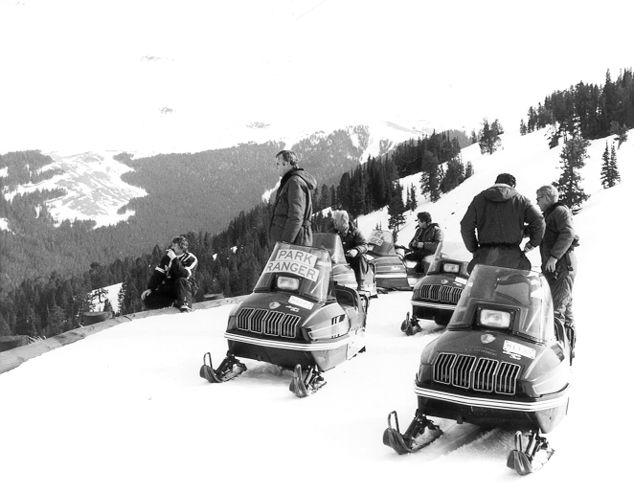
In 1963, Snowmobiles were first used in the parks

Slide 8
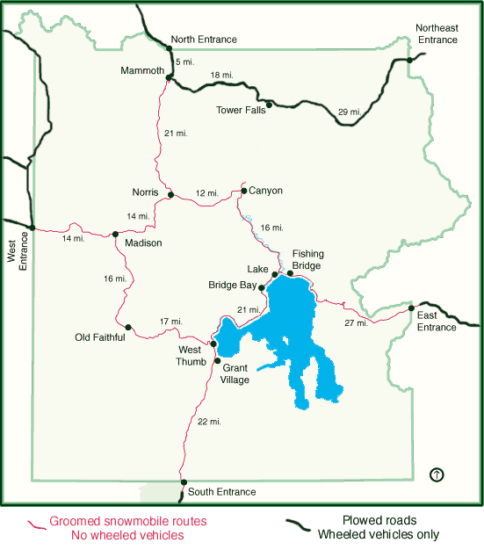
Yellowstone National Park

Slide 9
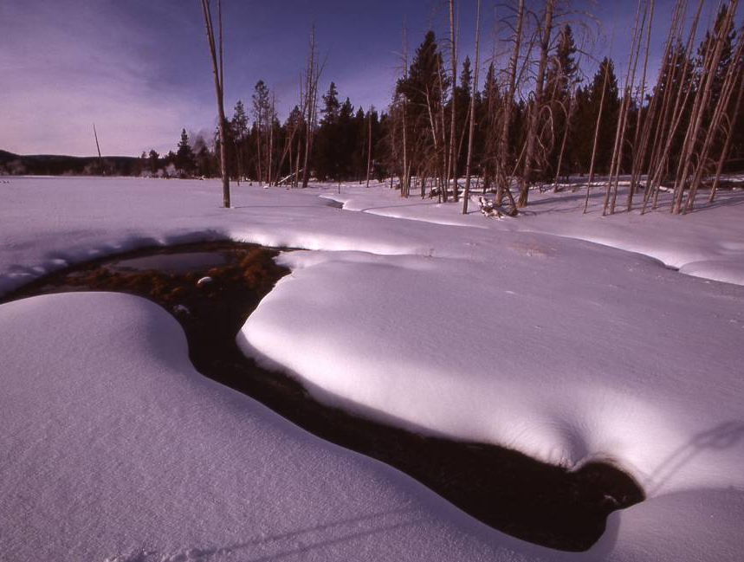
Increasing Recreation
Rapidly increasing winter use in the 1980s and 1990s brought complicated issues.

Slide 10
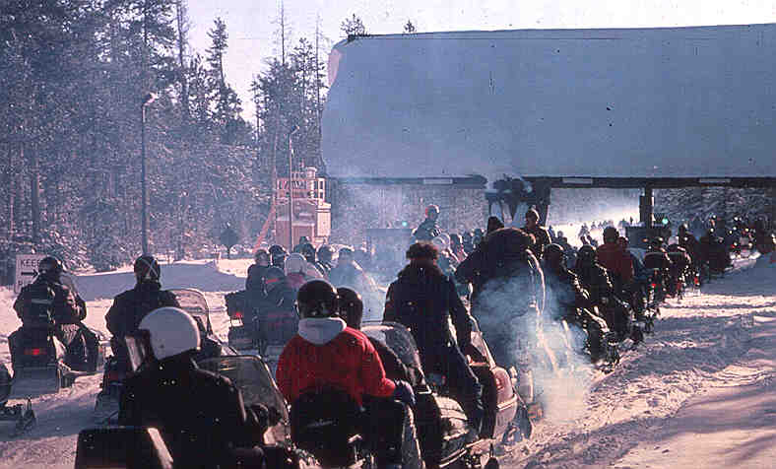
Issue: Air Pollution

Slide 11
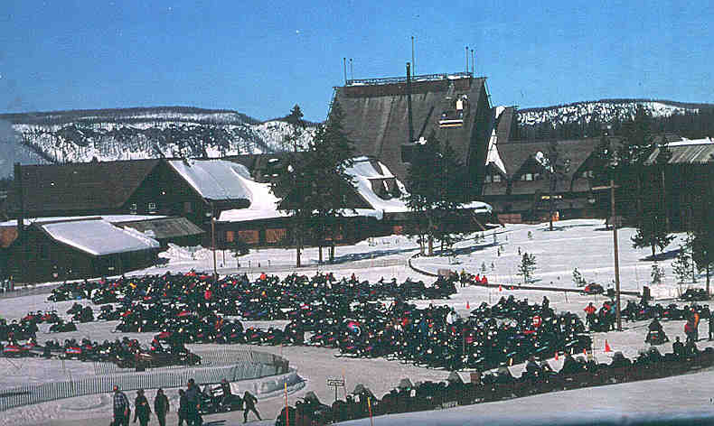
Issue: Natural Soundscapes

Slide 12
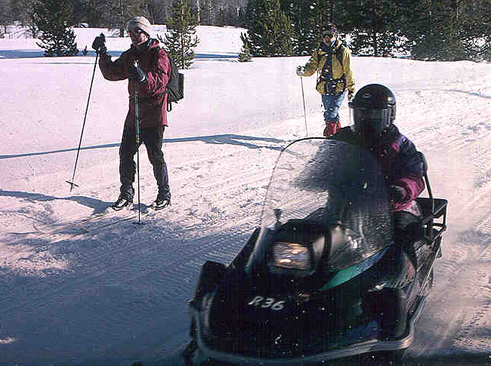
Issue: Different Expectations of Users

Slide 13
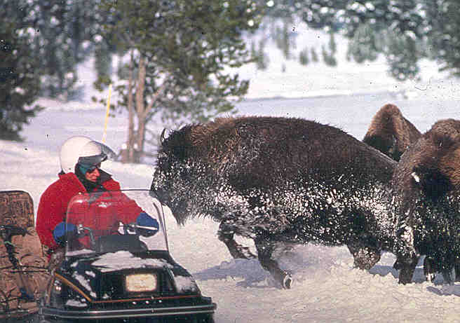
Issue: Safety

Slide 14
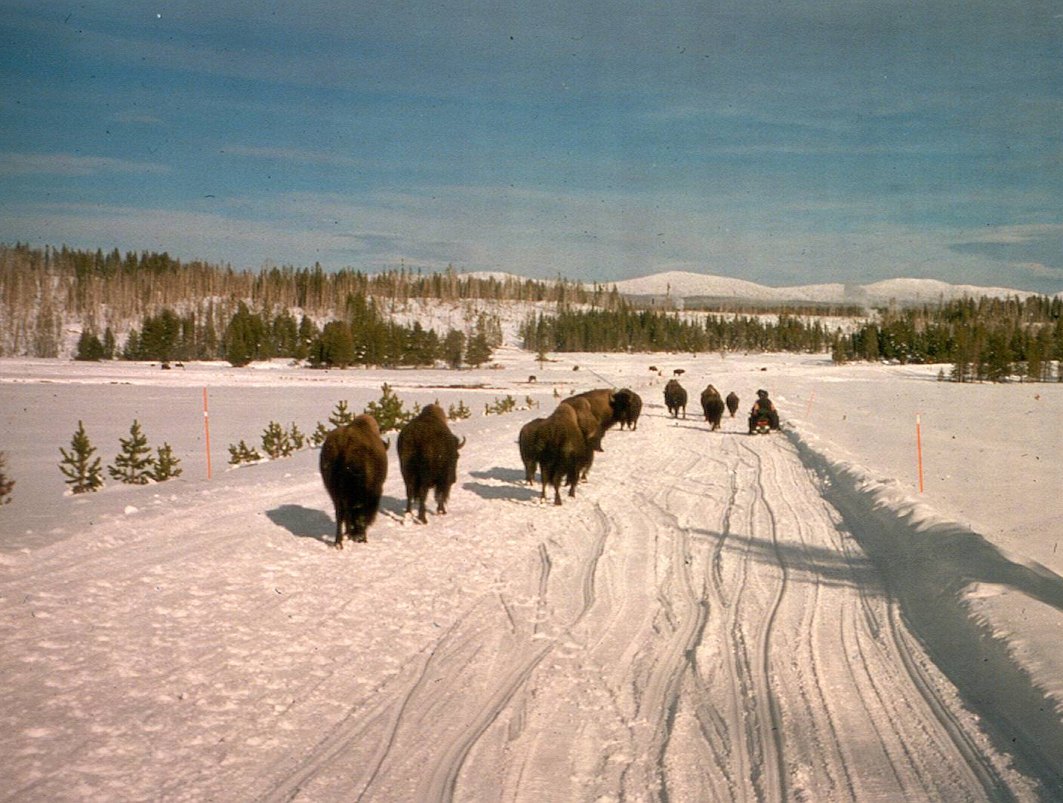
Issue: Bison and Roads

Slide 15
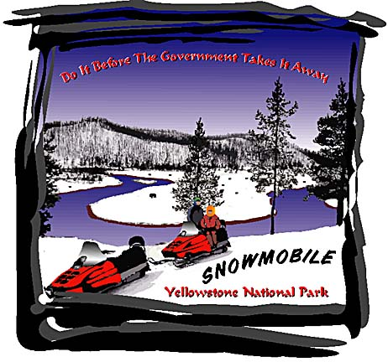

Slide 16
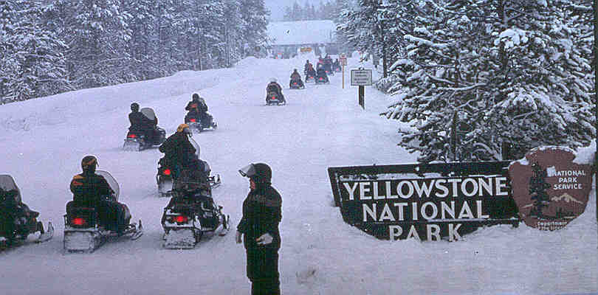
Initial Litigation and Petition
1997: The Fund for Animals files lawsuit over bison use of roads
1999: The Bluewater Network petitions the NPS to ban snowmobile use nationwide

Slide 17
A Decade of Winter Use Plans
Year | Decision | NEPA | Legal Outcome
2000 | Ban Snowmobiles in favor of Snowcoaches | EIS | Vacated by Wyoming Court
2003 | Allow 950 Snowmobiles (all BAT; all guided) | SEIS | Vacated by District of Columbia Court
2004 | Allow 720 Snowmobiles (all BAT; all commercially guided) (snowmobile/snowcoach use ends in 2006-2007) | EA | Upheld by Wyoming; Not ruled on in D.C.
2007 | Allow 540 Snowmobiles (all BAT; all commercially guided) | EIS | Vacated by D.C. Court. Upheld in Wyoming. Wyoming Court orders reinstatement of 2004 decision.
2009 | Allow 318 Snowmobiles (all BAT; all commercially guided) (temporary plan for two winters) | EA | Wyoming and Park County, Wyoming filed suit in Wyoming Court. NPCA intervened on NPS side. ISMA intervened on Wyoming side.

Slide 18
Last 5 Years of Winter Use Planning
July 2010 Release of draft alternatives
Nov 2011 NPS issues Final EIS includes 1 yr
rule for winter ‘11-’12
Feb 2012 NPS opens public comment on new
winter use alternatives – 70,000 comments
Feb 2013 NPS issues draft Final Plan outlining
Preferred Alternatives
Oct 2013 Final rule allowing OSV use published
in Federal Register

Slide 19
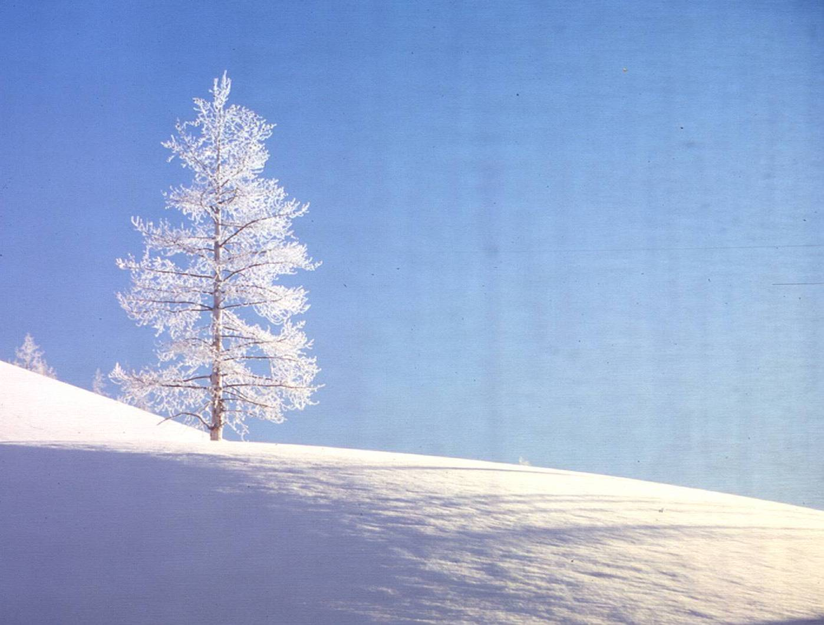
The Era of Managed Winter Use
Since 2004:
  Daily limit on snowmobile numbers
  All snowmobiles BAT – cleaner and quieter
  All snowmobiles commercially guided
  Night closure
  Speed limit reduced to 35 mph - West to Old Faithful
Results:
  Visitors satisfied (near 100% satisfaction)
  Clean air
  Much quieter
  Wildlife not harassed
  Law enforcement incidents dramatically reduced
“A Sea Change in Yellowstone in the Winter”

Slide 20
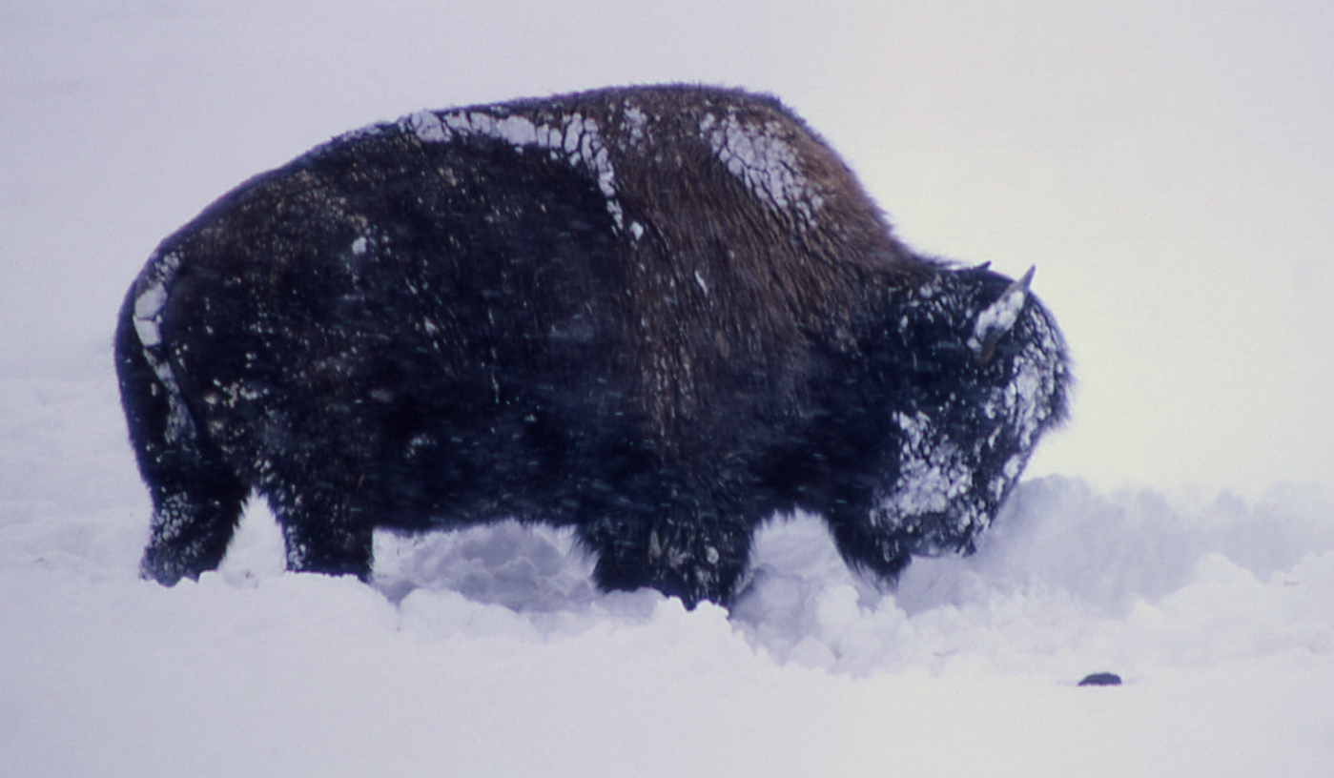
Current Status: Interim Plan
Interim plan completed in November 2009. In effect for two winters (through March 15, 2011).
During the next two winters, 318, all BAT, all commercially guided snowmobiles will be allowed along with 78 commercially guided snowcoaches.

Slide 21
Current Status: New EIS
Scoping January 29 - March 30 on new long-term winter plan and Environmental Impact Statement.
Draft EIS and Proposed Rule on public review March - April 2011.
Final plan and rule completed by November 2011.

Slide 22
Current Litigation
?
?
Wyoming and Park County, Wyoming filed suit in Wyoming Court (Judge Alan Johnson).
  NPCA intervened on Government side.
  ISMA intervened on Wyoming side.
Oral arguments scheduled for July 9.
No active litigation in Washington, D.C. court.

Slide 23
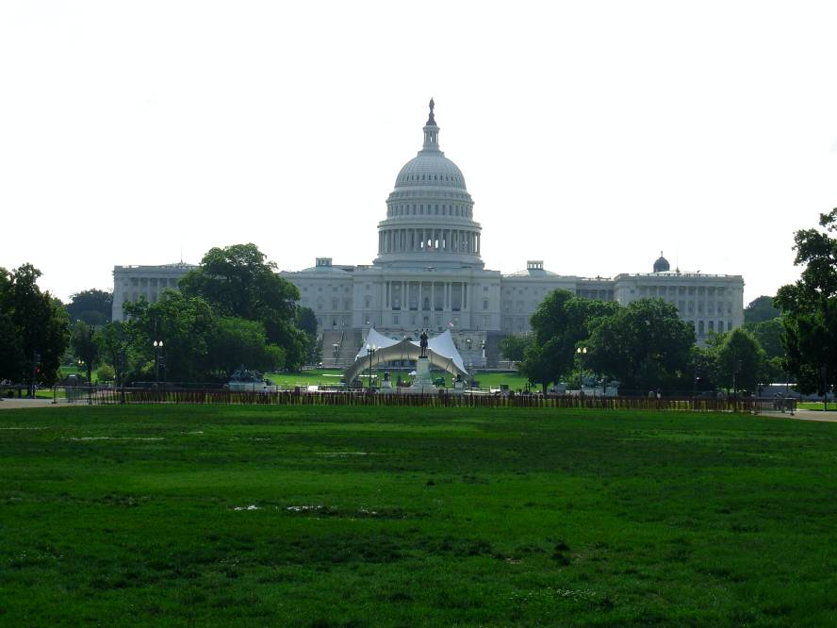
Congressional
Action
Congress directed the National Park Service to implement the 2004 decision for the winters of 2004-2005, 2005-2006 and 2006-2007.
Similar language was not included in Appropriations Acts for Fiscal Years 2008, 2009, or 2010.

Slide 24
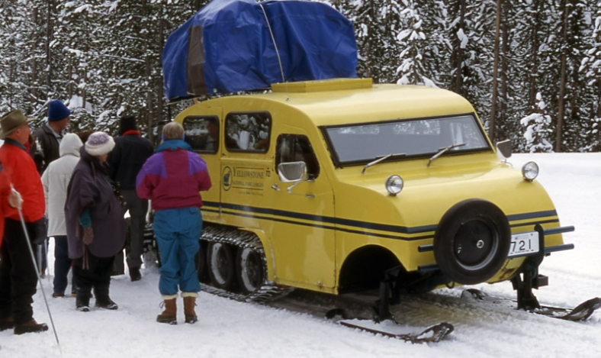
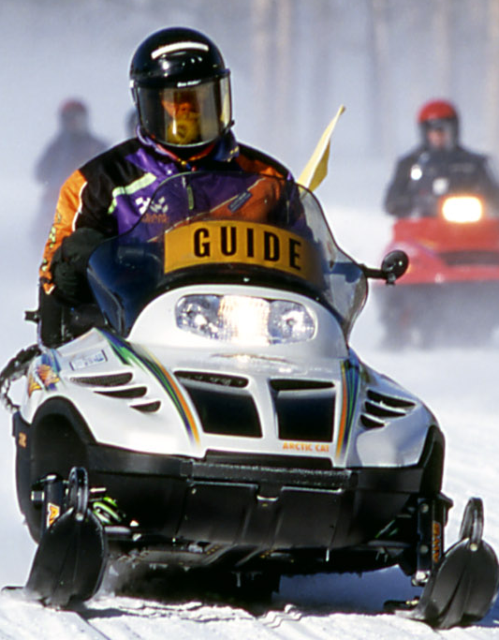
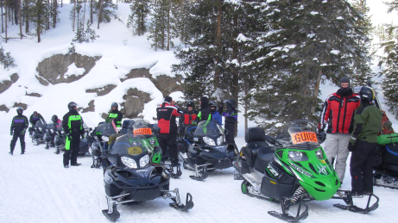
Commercial Guiding
Guide companies are under contract to NPS.
Guides are employees or sub-contractors.
Guide companies train their guides (NPS assists).
NPS monitors and enforces regulations.
“Symbiotic Relationship”

Slide 25
The Current (2013) Plan Objectives
Visitor Use, Experience and Accessibility
Provide the opportunity for visitors to experience and be inspired by Yellowstone's unique winter resources and values while ensuring resource protection.
Increase visitor understanding and appreciation of the park's winter resources.
Provide access for winter opportunities in the park that are appropriate and universally accessible.

Slide 26
The Current (2013) Plan Resources
Wildlife: Manage use to not disrupt winter ecology.
Sound: Manage use to protect naturally occurring sounds, and to minimize noise.
Air Quality: Manage use to minimize impacts of air pollution including visibility and aquatic systems.
Wilderness: Manage use to protect wilderness character and values. Develop and implement an adaptive management program that includes monitoring the condition of resources.

Slide 27
Health & Safety
Manage access in the winter for the safety of all visitors and employees, including limiting impacts from emissions, noise, and known hazards.
Coordination & Cooperation
Improve coordination and communication regarding winter use management with park partners, gateway communities and other stakeholders.
Park Operations & Management
Promote advances of OSV technology that will reduce impacts and facilitate continuous improvement of technology over time. Provide for winter use that is consistent with the park priority to provide critical visitor services at core locations.

Slide 28
What is BAT?
Snowmobiles would be required to meet a 67 dBA noise emission standard at typical cruising speed of 35 mph (SAE J1161) and emit no more than 90 g/kwh of carbon monoxide and 15 g/kwh of hydrocarbons using standard testing procedures.
Snowcoaches would be required to have engine and emission controls that meet EPA Tier 2 standards.

Slide 29
Flow diagram of Damages

Slide 30
Alternatives in Final Plan (SEIS)
Alternative 1: No public OSV use because the interim rules in effect from 2009 to 2013 would expire and therefore the general rule prohibiting OSV use would take effect. Approved non-motorized use would continue.

Slide 31
Alternatives in Final Plan (SEIS)
Alternative 2: Management of OSVs would allow for snowmobile and snowcoach use levels of up to 318 snowmobiles and 78 snowcoaches per day. All OSV requirements under the 2009 to 2013 interim rules would continue, including all OSV guide requirements, hours of operation restrictions, and Best Available Technology (BAT) requirements for snowmobiles. BAT requirements would be developed and implemented for snowcoaches.

Slide 32
Alternatives in Final Plan (SEIS)
Alternative 3: OSV access to the park would transition to BAT snowcoaches only. Initially provide for both snowmobile and snowcoach access under interim rule levels (318 snowmobiles and 78 snowcoaches) until the 2017-2018 winter season when all snowcoaches would need to meet BAT requirements. Beginning in 2017-2018, operators would have three years – until the 2020/2021 winter season – to phase out snowmobiles. Once the 3-year phase-out is complete, up to 120 snowcoaches would be allowed in the park per day and the East Entrance Road (Sylvan Pass) would be closed to use during the winter season.

Slide 33
NPS Preferred Alternative
Alternative 4: manage OSV use by setting a maximum number of daily transportation events. A transportation event is defined as one snowcoach or a group of up to 10 snowmobiles, averaging 7 snowmobiles per group per season, traveling together within the park. Permit up to 110 transportation events daily, of which up to 50 may be groups of snowmobiles (the remaining 60 would be allocated to snowcoaches).

Slide 34
This approach facilitates greater operator flexibility, rewards future OSV technological innovations, and reduces OSV-caused environmental impacts.
If OSVs meet enhanced environmental performance standards (described as “E-BAT” in the plan/SEIS), commercial tour operators would be permitted to increase their average transportation event size from one to two snowcoaches and from an average of up to seven to an average of up to eight snowmobiles per transportation event (while keeping snowmobile transportation events at a maximum of 10 snowmobiles per event).

Slide 35

Consumer and Producer Surplus
Khan Academy lesson
Consumer surplus is the difference between the total amount that consumers are willing and able to pay for a good or service) and the total amount that they actually pay.
Producer surplus is the amount that producers benefit by selling at a market price that is higher than the least that they would be willing to sell for. This is roughly equal to profit contribution.
These are both measures of the value created by an activity.

Slide 36
PS falls over time in Alt 3 as snowmobiles are phased out and replaced with snowcoaches.

Slide 38
Surplus forAlternatives.
Changes in CS over time
Changes in PS over time
Alt 1 – No OSV
Alt 2 – Up to 318 & 78
Alt 3 – phase out snowmobiles after ‘17-’18, then 120 coaches only
Alt 4 – Max 110 transport “events”

Slide 39
Final Report for Final Rulemaking
Economic Analysis of Winter Use Regulations in YNP
Prepared for
National Park Service
Environmental Quality Division
Prepared by
RTI International
3040 Cornwallis Road
Research Triangle Park, NC 27709
RTI Project Number 0212533

Slide 40
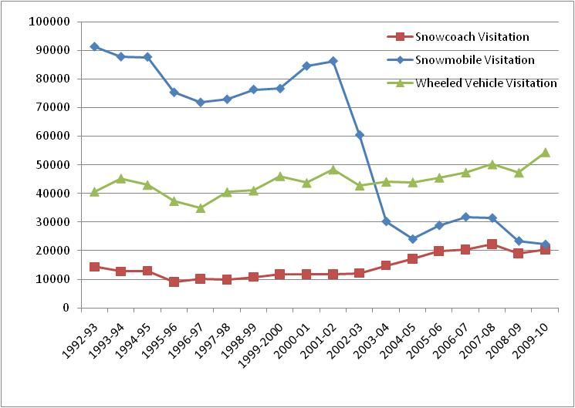
Winter Visitors

Slide 41
Recent Use Levels
Winter | Vehicle and Daily Limits | Average | Peak | Groups | Vehicles / Group | People / Coach or Group
2009-2010 | Snowmobiles (318) | 187 | 293
 | Snowcoaches (78) | 32 | 59
2008-2009 | Snowmobiles (720) | 205 | 426 | 31 | 6.6 | 8.9
 | Snowcoaches(78) | 29 | 54 | 29 | 1 | 8.5
2007-2008 | Snowmobiles (720) | 294 | 557 | 36 | 6.9 | 9.3
 | Snowcoaches (78) | 35 | 60 | 35 | 1 | 8.8

Slide 42
Daily Snowmobile Use Pattern

Slide 43
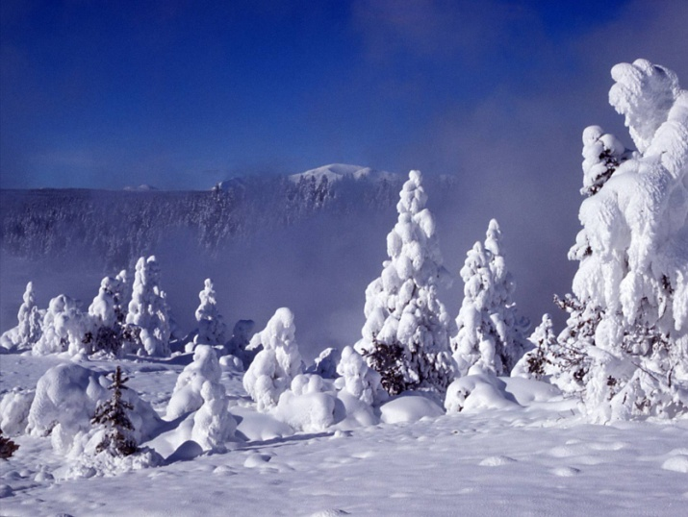
Administrative Travel
Snowmobiles:
  1/3 of snowmobile groups on road corridors
  2/3 of snowmobile groups in developed areas
Snowcoaches:
  7% on road corridors
  18% in developed areas
Snowmobile BAT:
  Estimated 70% are BAT
  BAT to be required 2011-2012
Snowcoach BAT
  To be determined

Slide 44
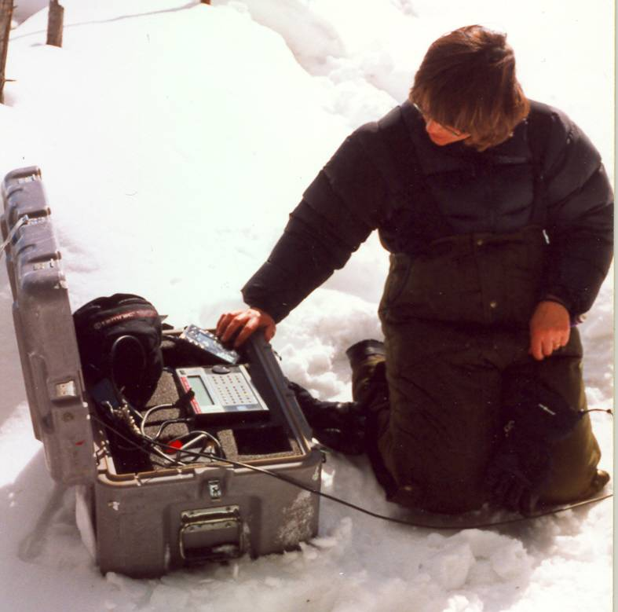
Monitoring, Modeling and Studies
Winter monitoring reports and modeling analysis:
Air quality
Soundscapes
Wildlife
Health & Safety
Pollution Deposition
Bison and Roads
Economics
Snowcoach Emissions
Avalanche Safety
Snowpack Analysis

Slide 45
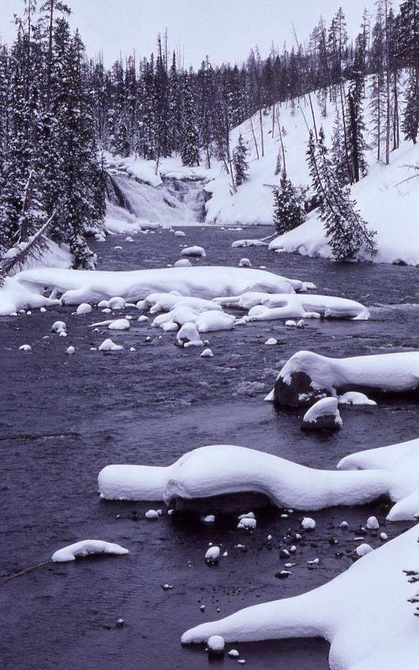
Soundscape Monitoring
All oversnow vehicles are heard 47% of time from 8 am to 4 pm at Madison Junction site (goal is not to exceed 50%)
All oversnow vehicles are heard 55% of time at Old Faithful site (goal is not to exceed 75%)
Loud oversnow vehicles heard 177 times at Madison Junction site (“loud” is vehicle noise exceeding 70 dBA for one second or 60 dBA for 10 seconds).
94% of loud events are snowcoaches

Slide 46
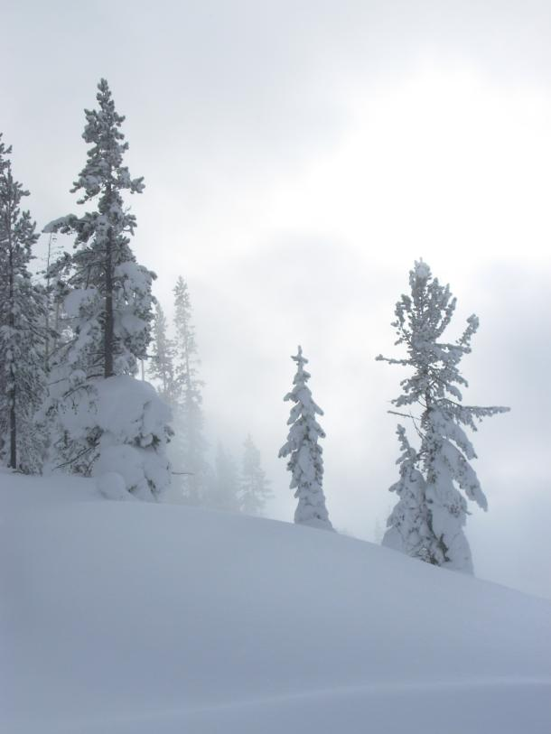
Audibility of Snowmobiles and Snowcoaches
Currently, guided (BAT) snowmobile groups are heard for the same amount of time as a guided snowcoach.
Some new snowcoaches, as well as older models, are too loud.
Snowcoach BAT has not been required.

Slide 47
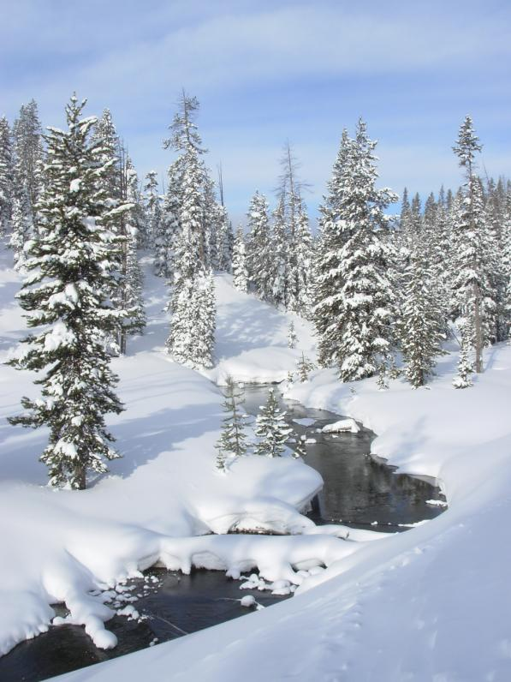
Air Quality
Best Available Technology snowmobiles and newer snowcoaches are similar in their per passenger emissions.
Cleanest coaches better than BAT snowmobiles; some new coaches far dirtier.
Snowmobiles lack catalytic converters.
Modern “conversion” snowcoaches challenged by low power to high weight ratio.
BAT has not been required for coaches.
Inversions common in winter and are significant contributor to higher levels of pollution in winter than summer.

Slide 48
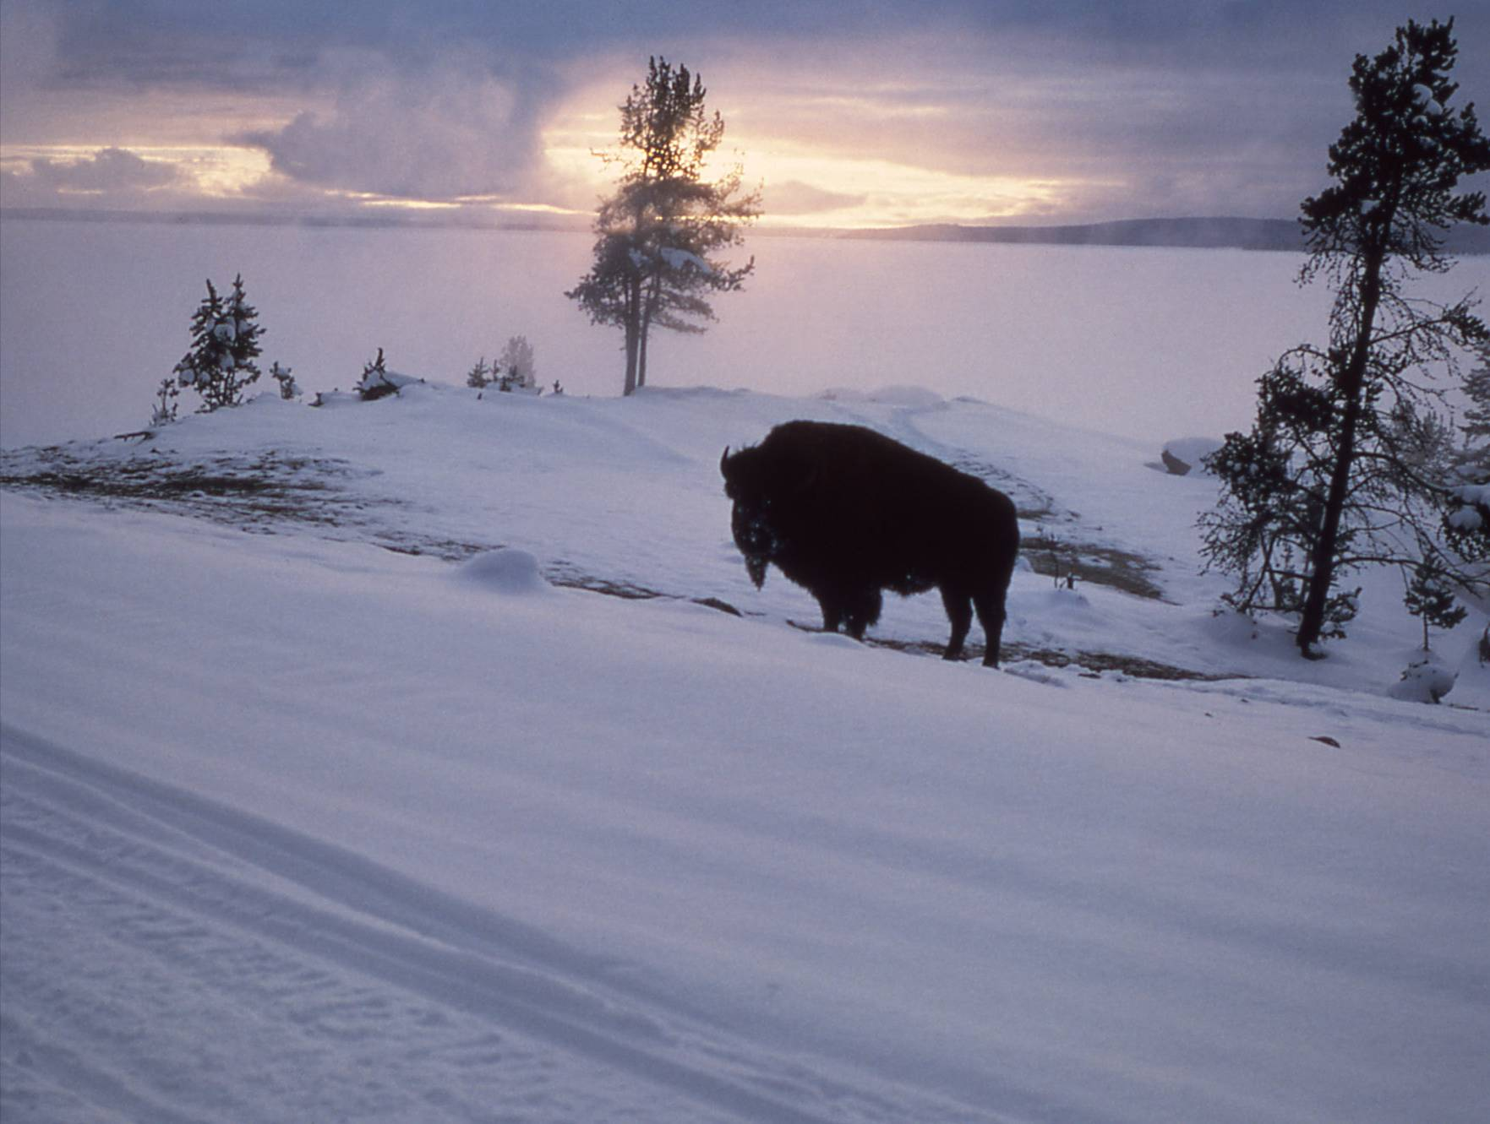
Wildlife Monitoring
Bison and elk populations and movement patterns have not been affected by oversnow vehicle use.
For individual animals, 8 to 10 percent of elk and bison show a movement response to snowmobiles and snowcoaches. Approximately 90 percent of elk or bison either show no apparent response or a "look and resume" response.
Level of reaction was consistent for a wide range of daily average oversnow vehicle use (ranging from 156 to 593 vehicles per day, with a peak day of 1,168 vehicles (1999 through 2004)).
Commercial guiding is important in minimizing harassment to wildlife.

Slide 49
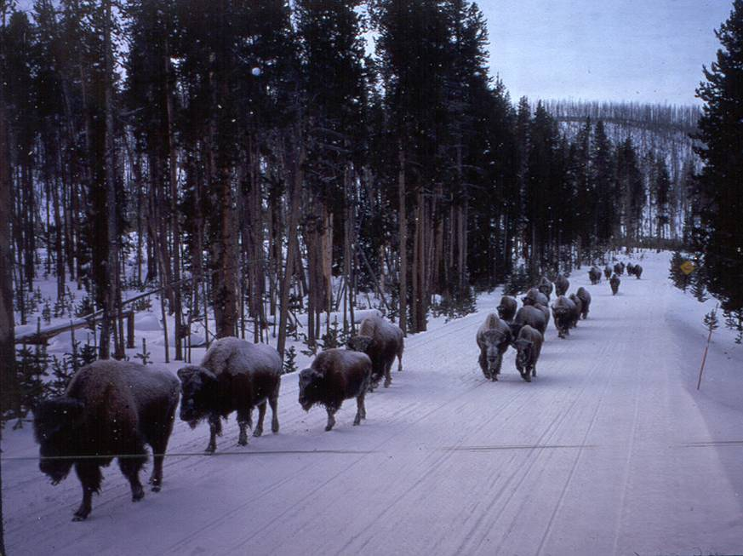
Bison and Roads
Long-term concern that bison use of groomed roadways (“energy-efficient pathways”) has led to altered distribution.
Growing scientific consensus that groomed roads have merely expedited a population expansion that would have occurred in the absence of groomed roads anyway.
A possible exception is Gibbon Canyon.
Initial study of bison use of Madison to Norris Road may result in road closure.

Slide 50
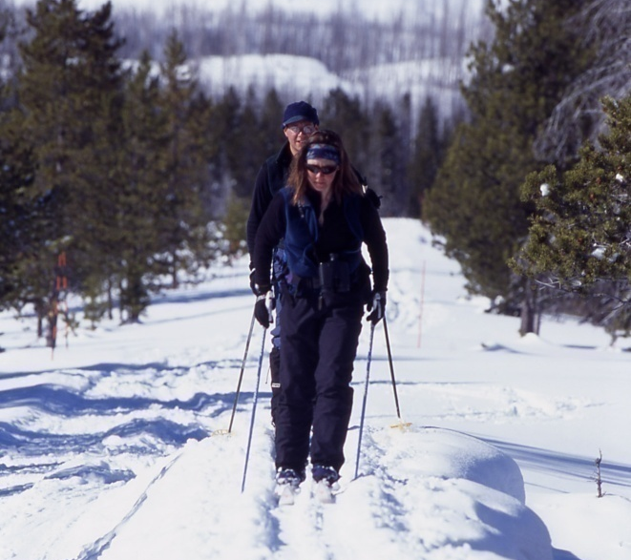
Visitor Survey Results
(2008)
(57% of visitors snowcoached, 41% snowmobiled,
26% cross-country skied, and 25% snowshoed)
Soundscapes:
  87% were ‘very satisfied’ with their overall soundscape experience and the remaining 13% were ‘satisfied.’
Wildlife:
  Visitors overwhelmingly (87%) find wildlife aspect of their Yellowstone winter experience very satisfying.
Classifying Visitors (earlier surveys):
  Activity groups (snowmobile versus snowcoach) were not found to be useful for predicting either visitor behavior or visitor attitudes.
  Visitors within the activity sought a variety of experiences.
  The different activity groups had more in common than opposition.

Slide 51
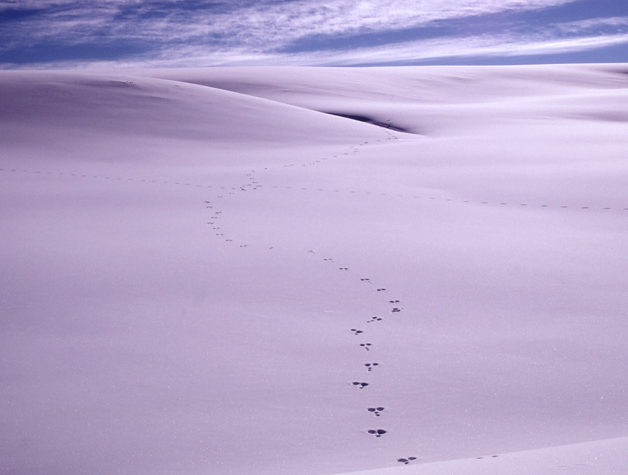
Inputs to Planning and Decision Making
Laws
Regulations
Policies
Goals
Department of the Interior
NPS – Region / Washington
Science
Congress
Other Agencies
Courts
Press
Interest Groups

Slide 52

Reflections & Lessons Learned

Slide 53
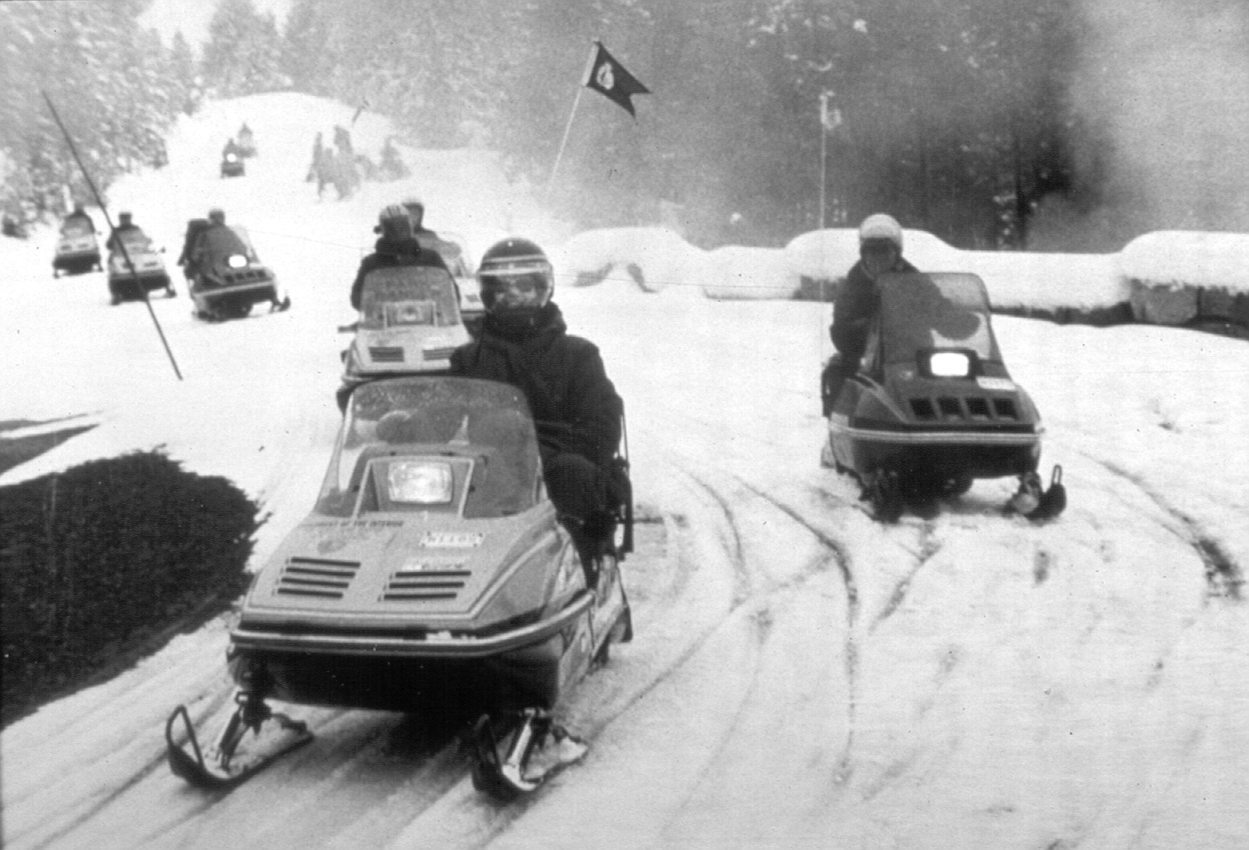
Invest Some Time in Understanding the History of the Issue

Slide 54
Get Good Data
(Science can inform, but it cannot decide)

Slide 55
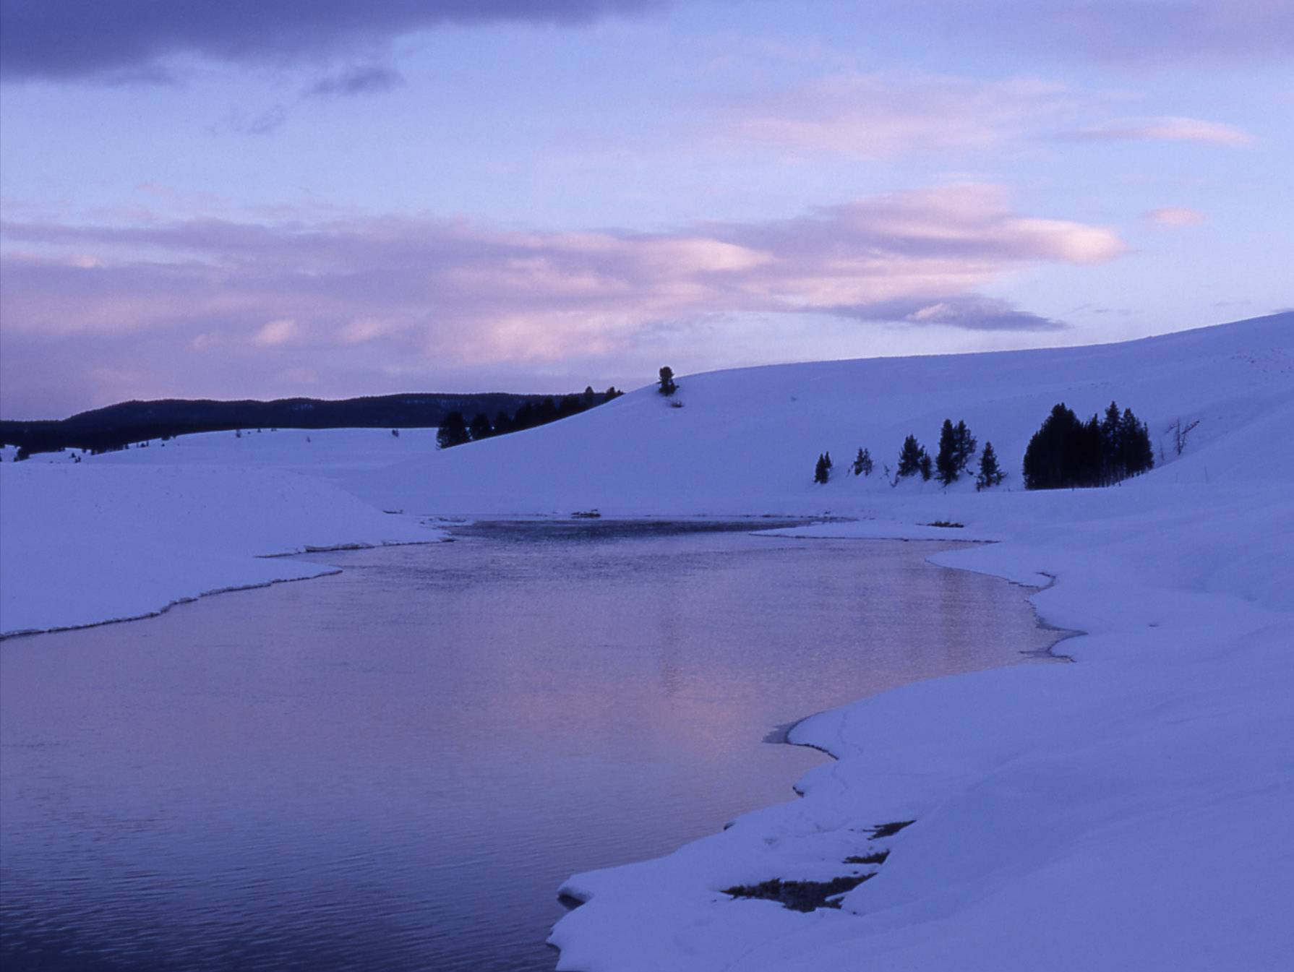
Get to Know the People Involved
Interest groups
Politicians
Key players
Involve them as much as possible

Slide 56
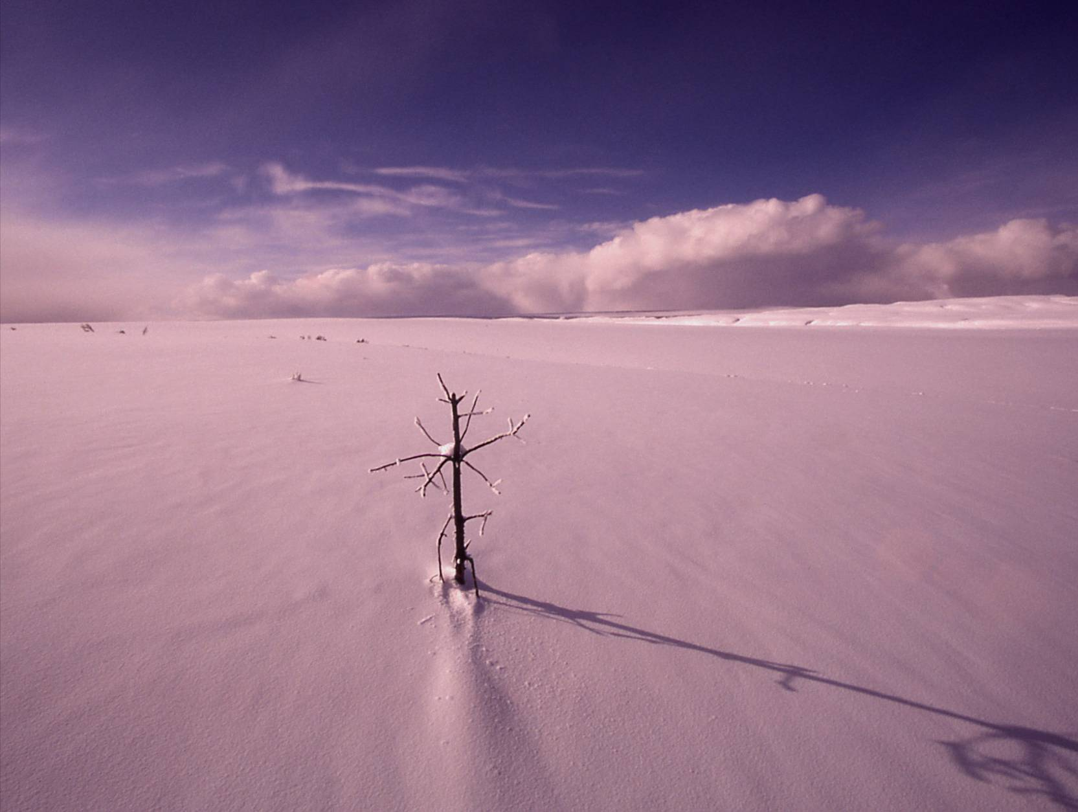
Know When to Take a Stand

Slide 57
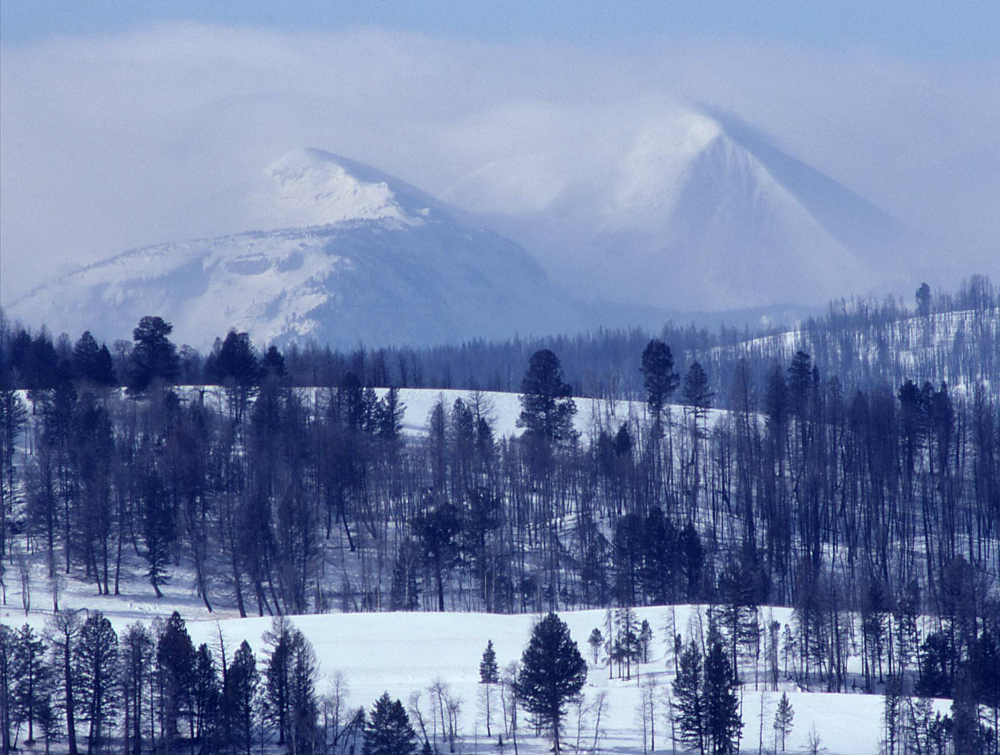
Be in it for the Long Haul:
Keep Your Eye on the Prize
(Politics Change)

Slide 58
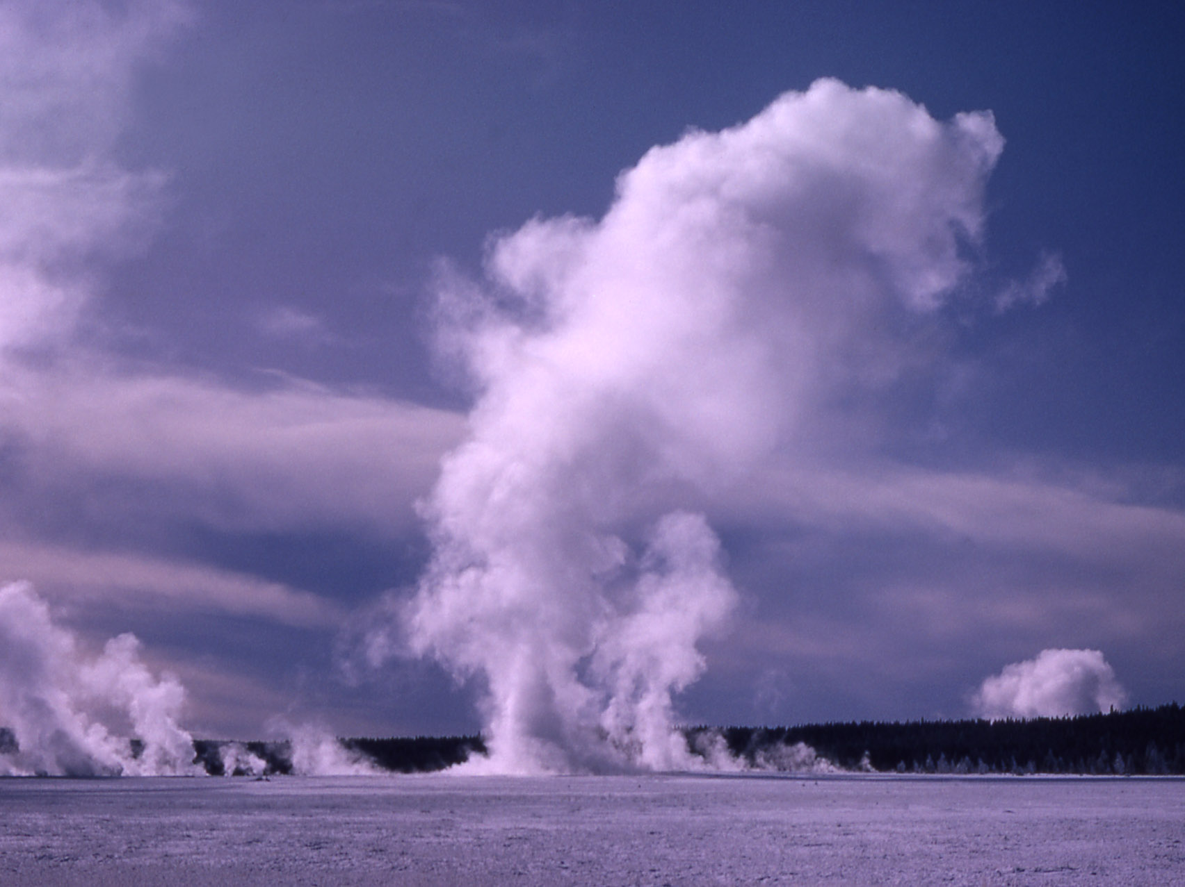
Recognize When You Have an Issue of Values

Slide 59
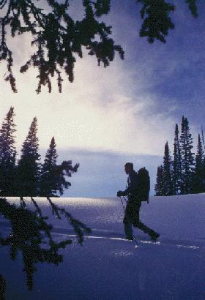
Core Conflict of Values: Environmentalists See Parks as Sacred Temples of Nature

Slide 60
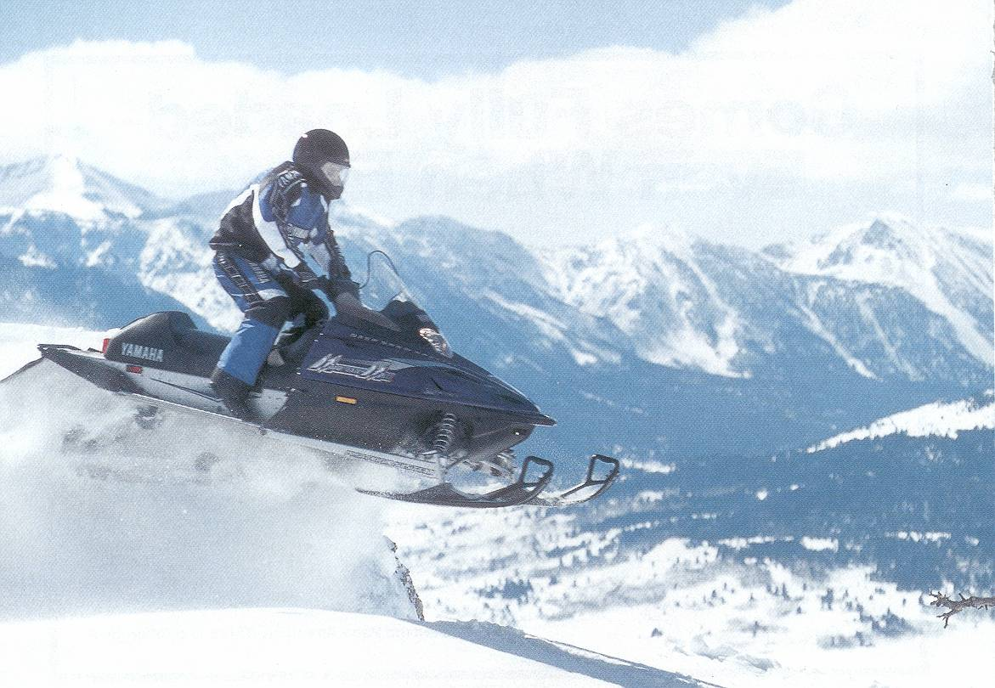
Symbolism to Snowmobilers: Freedom and Independence

Slide 61
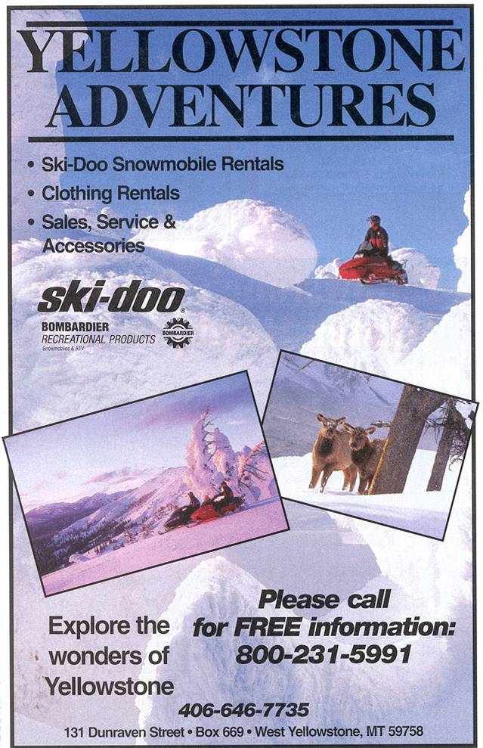
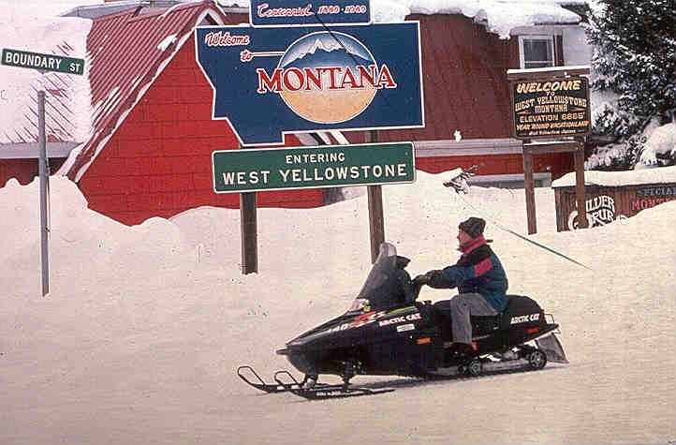
West Yellowstone:
Town Identity &
Family Values
Notes:
West Yellowstone, Montana, at the park’s western entrance, has made itself a winter economy based largely upon the snowmobile. It bragged at one time that it was the “Snowmobile Capital of the World.” Snowmobiling has transformed the town from a sleepy hibernacula to a buzzing, busy town; some merchants earned more in Feb. than any other month.
Banning snowmobiles threatens the town’s identity; its cultural geography.

Slide 62
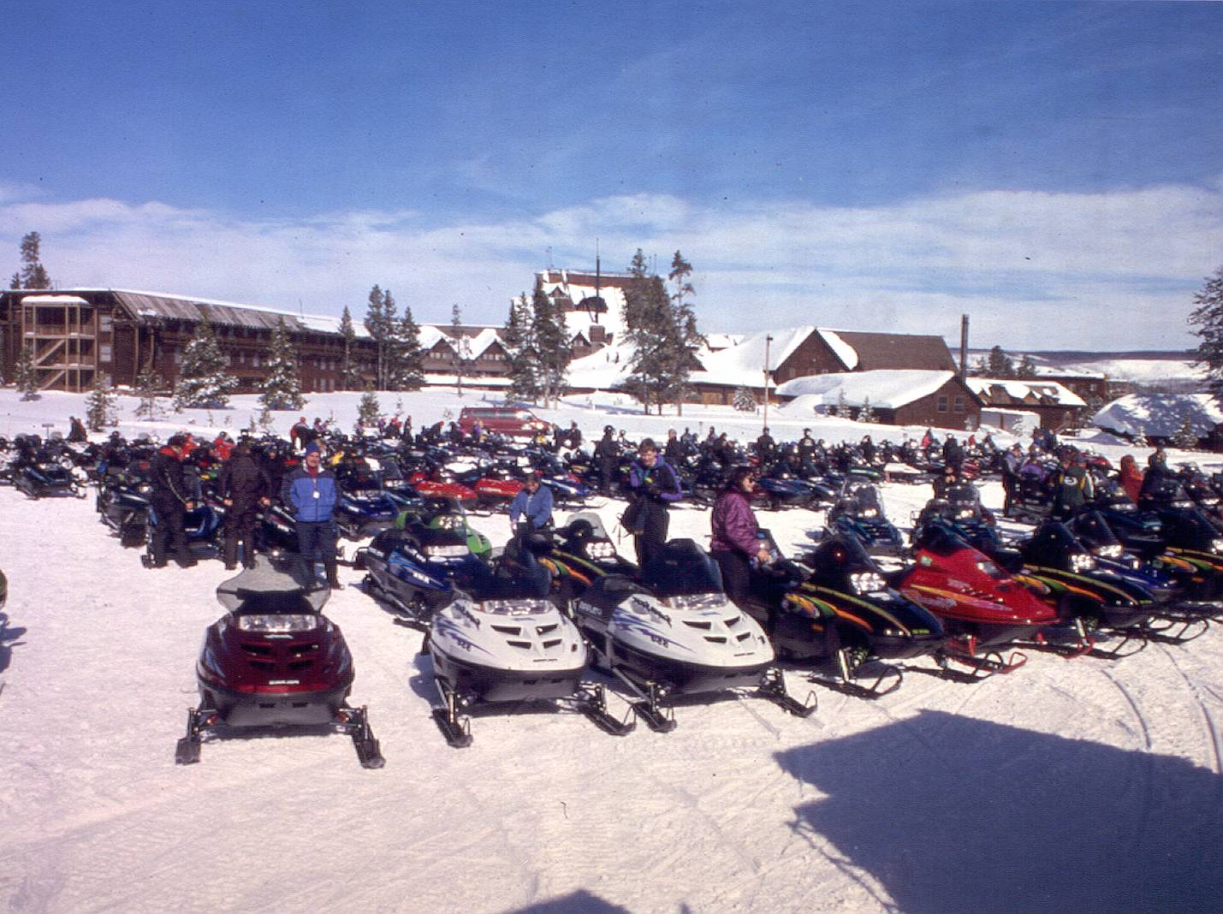
Industry: Snowmobile Training Ground
Notes:
However, in the last decade or so several out-of-state corporations have built hotels in West Yellowstone, changing the character of the town away from the family/small town atmosphere and more toward a corporate feeling.
Additionally, the snowmobile industry sees Yellowstone as a “training ground,” a place to introduce people to snowmobiling. The park is flat & beautiful—an easy place to learn to snowmobile.
Consequently, industry increasingly plays a role in the debate, drawing upon the strength of the capitalist system in American economy.
Some would say, too, that it manipulates the town of West Yellowstone to its own ends; the industry, for example, was not significantly hurt in the recent downturn, while many in West were.

Slide 63
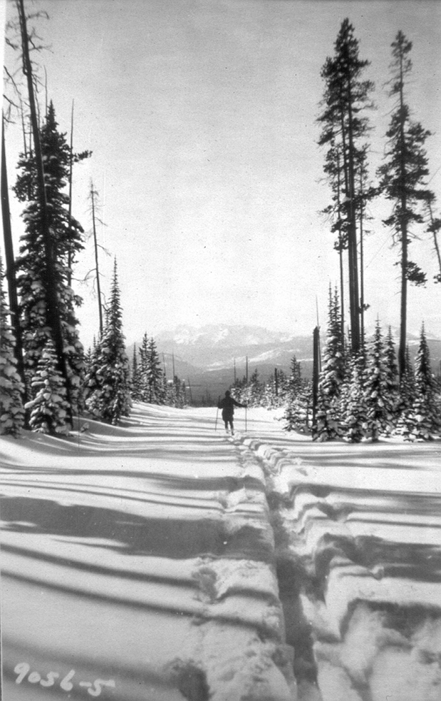
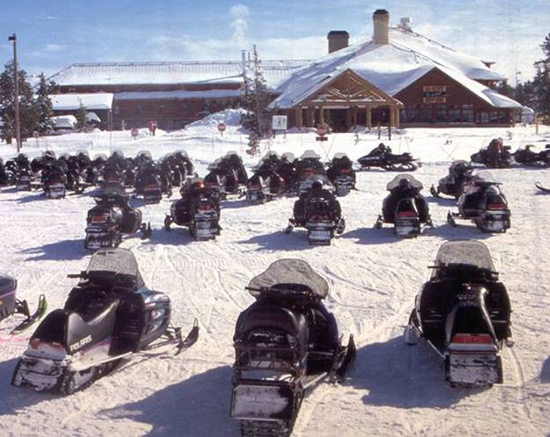

Twelve times we have debated this issue, over almost 75 years.
What forms of use are appropriate in Yellowstone in winter?
What should Yellowstone look like in winter?
We may always debate how Yellowstone should look in winter; it embodies our differing concepts of what a park should be and how we should manage nature.

Slide 64
Public Engagement
Stakeholders?
  Examples:
  Conservation Interests
  Access Advocates
Strategies?
  For instance:
  Open information sharing.
  Actively listen to and acknowledge concerns.
  Explaining where agency and public input was incorporated, and how it did/did not influence NPS decisions.
Techniques?
  One idea:
  Small group meetings with stakeholders.
From: Public & Agency Information/Participation Plan
Yellowstone/Grand Teton Winter Use Planning
As of October 2005

Slide 65
The Courts
?
?
Litigation has occurred at every step of the process.
Plaintiffs file suit in Federal Court they believe best represents their interests:
  Conservation Groups: Washington, D.C.
  Access Interests: Wyoming

Slide 66
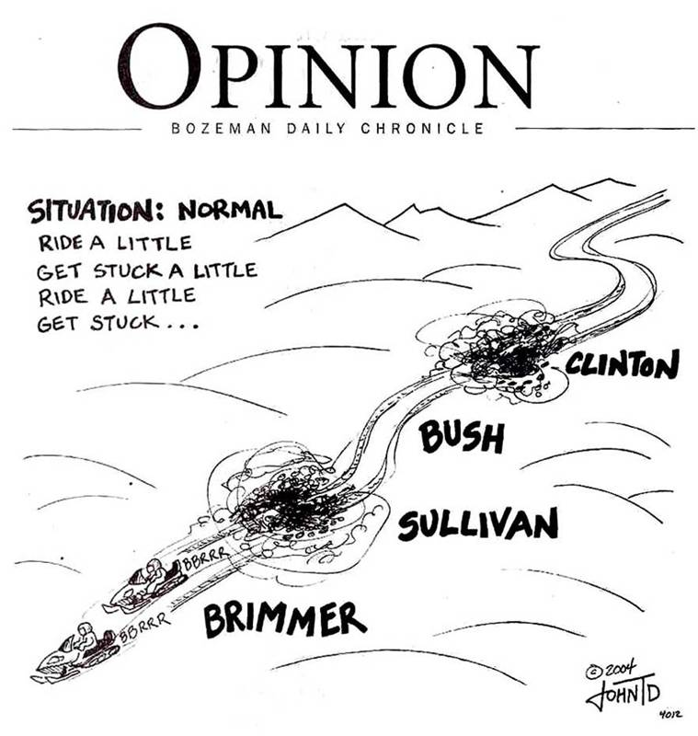
The Press
(circa 2004)

