Slide 1
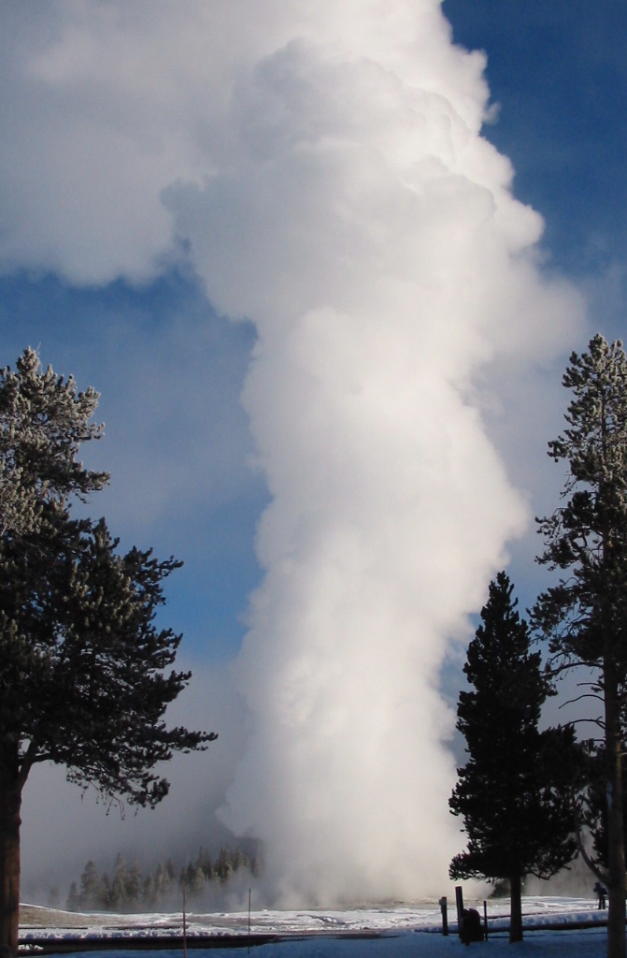
Case Study:
Winter Planning in
Yellowstone National Park
John Sacklin
Management Assistant
Indiana State University, June 2010

Slide 2
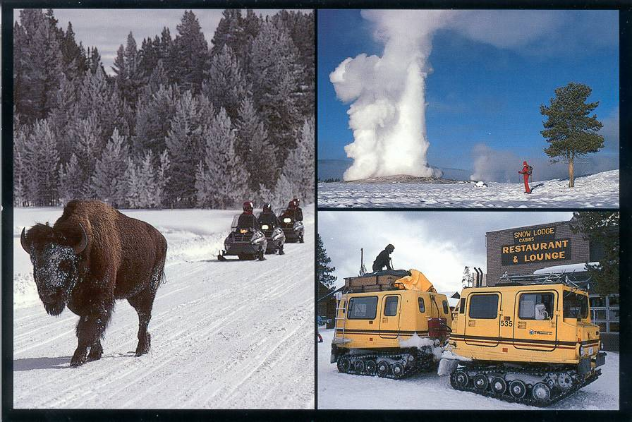
A Question of Values:
Winters in the Parks: What forms of use are appropriate?

Slide 3
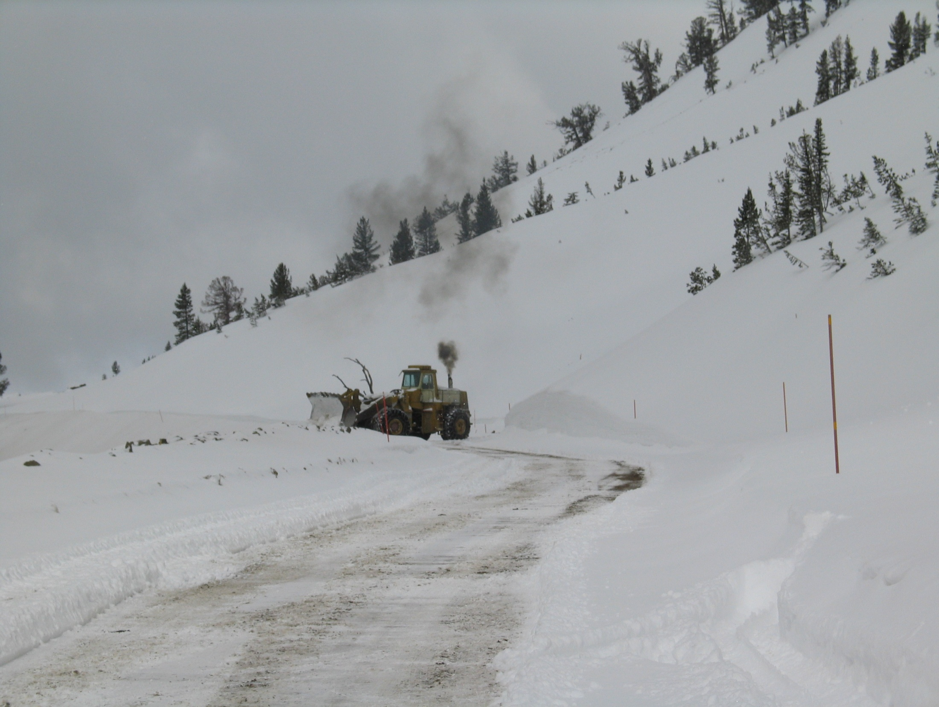
Historians will tell us that this is the twelfth time we have examined winter use in Yellowstone National Park since 1935

Slide 4
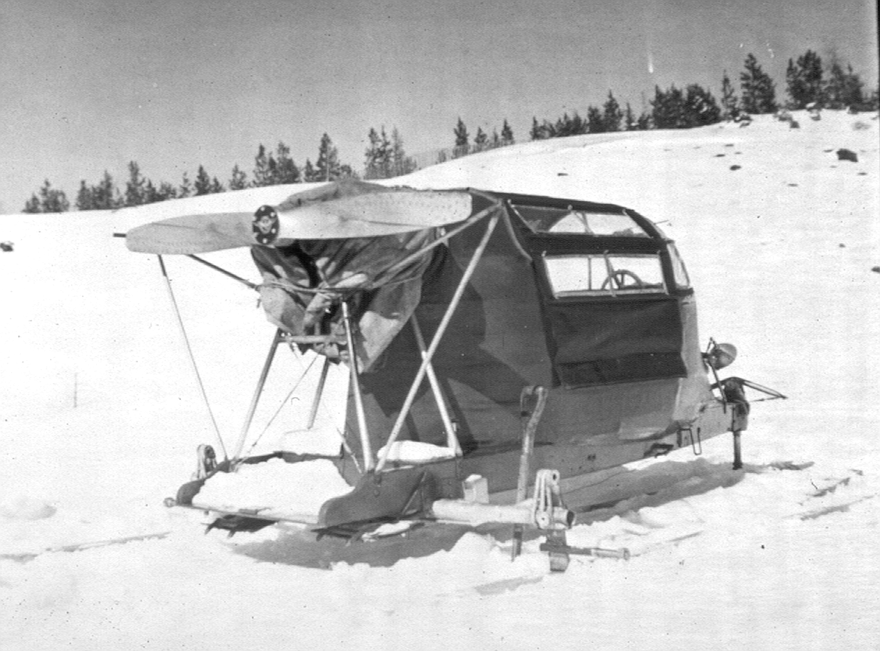
In the late 1940s: First snowplanes came into the parks

Slide 5
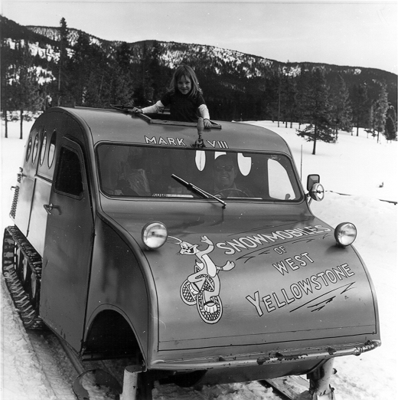
In the mid-1950s, the first snowcoaches entered Yellowstone

Slide 6
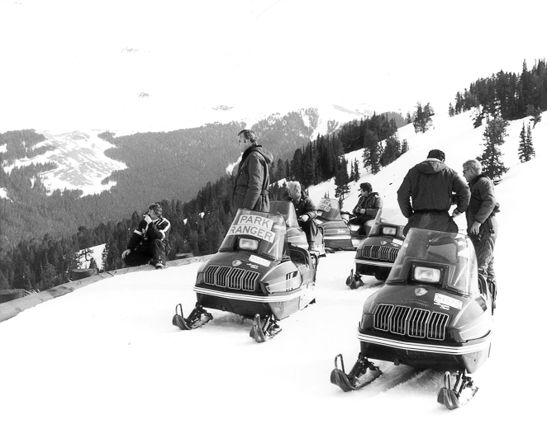
In 1963, Snowmobiles were first used in the parks

Slide 7
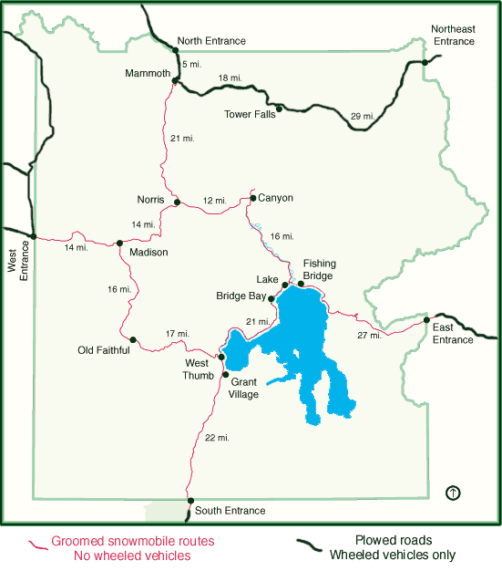
Yellowstone National Park

Slide 8
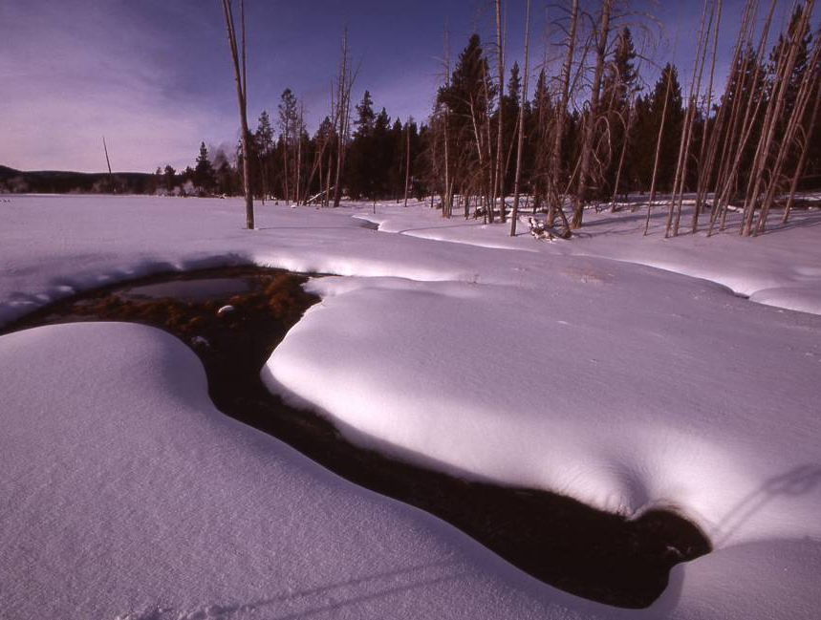
Increasing Recreation
Rapidly increasing winter use in the 1980s and 1990s brought complicated issues.

Slide 9
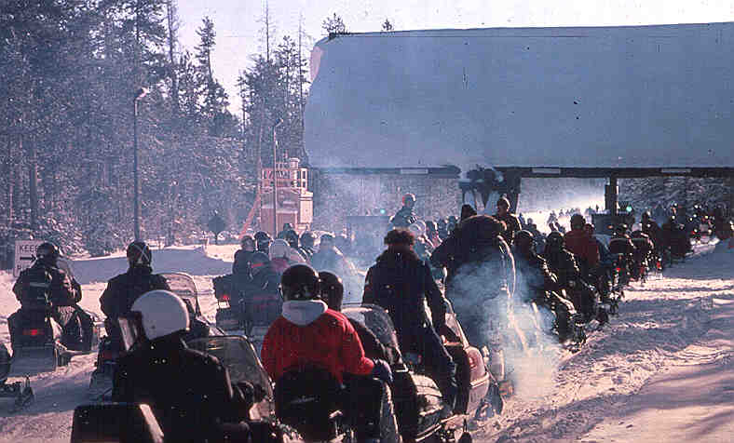
Issue: Air Pollution

Slide 10
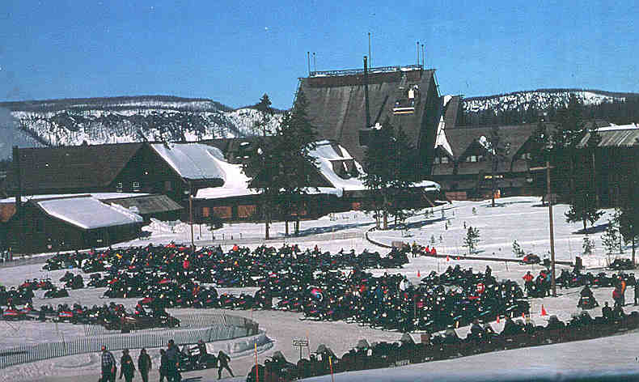
Issue: Natural Soundscapes

Slide 11
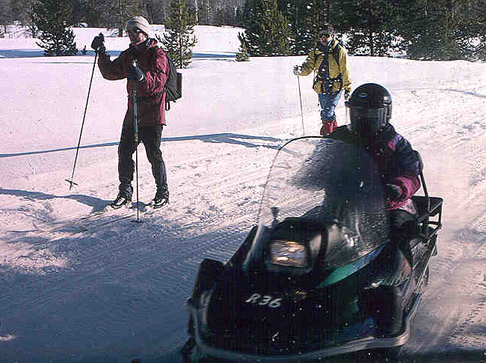
Issue: Different Expectations of Users

Slide 12
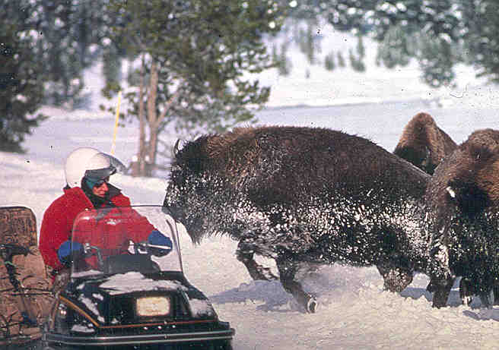
Issue: Safety

Slide 13
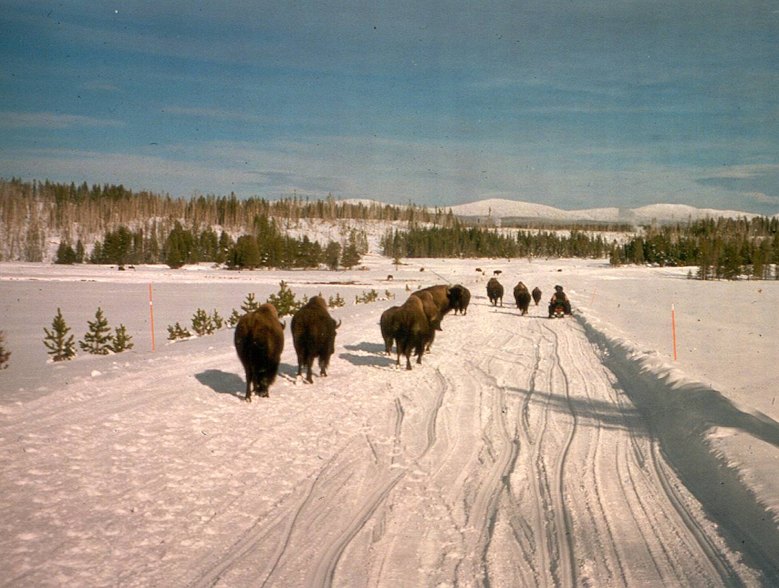
Issue: Bison and Roads

Slide 14
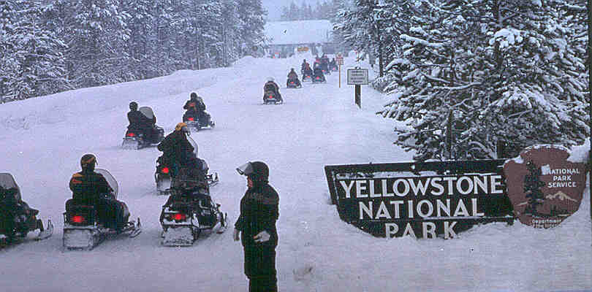
Initial Litigation and Petition
1997: The Fund for Animals files lawsuit over bison use of roads
1999: The Bluewater Network petitions the NPS to ban snowmobile use nationwide

Slide 15
A Decade of Winter Use Plans
Year | Decision | NEPA | Legal Outcome
2000 | Ban Snowmobiles in favor of Snowcoaches | EIS | Vacated by Wyoming Court
2003 | Allow 950 Snowmobiles (all BAT; all guided) | SEIS | Vacated by District of Columbia Court
2004 | Allow 720 Snowmobiles (all BAT; all commercially guided) (snowmobile/snowcoach use ends in 2006-2007) | EA | Upheld by Wyoming; Not ruled on in D.C.
2007 | Allow 540 Snowmobiles (all BAT; all commercially guided) | EIS | Vacated by D.C. Court. Upheld in Wyoming. Wyoming Court orders reinstatement of 2004 decision.
2009 | Allow 318 Snowmobiles (all BAT; all commercially guided) (temporary plan for two winters) | EA | Wyoming and Park County, Wyoming filed suit in Wyoming Court. NPCA intervened on NPS side. ISMA intervened on Wyoming side.

Slide 16
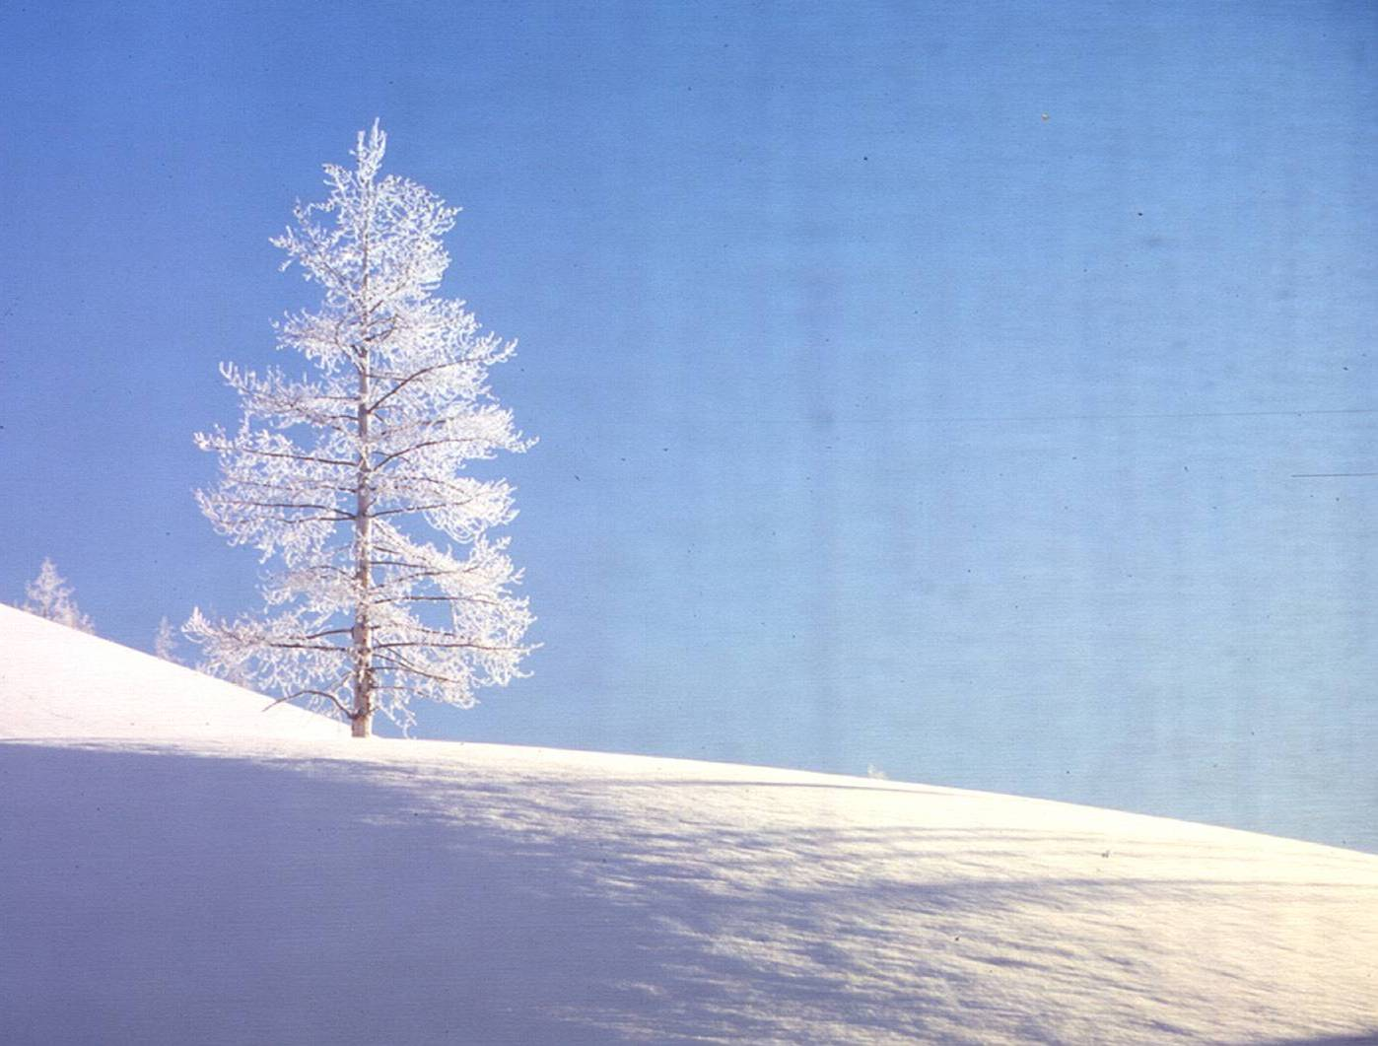
The Era of Managed Winter Use
Since 2004:
  Daily limit on snowmobile numbers
  All snowmobiles BAT – cleaner and quieter
  All snowmobiles commercially guided
  Night closure
  Speed limit reduced to 35 mph - West to Old Faithful
Results:
  Visitors satisfied (near 100% satisfaction)
  Clean air
  Much quieter
  Wildlife not harassed
  Law enforcement incidents dramatically reduced
“A Sea Change in Yellowstone in the Winter”

Slide 17
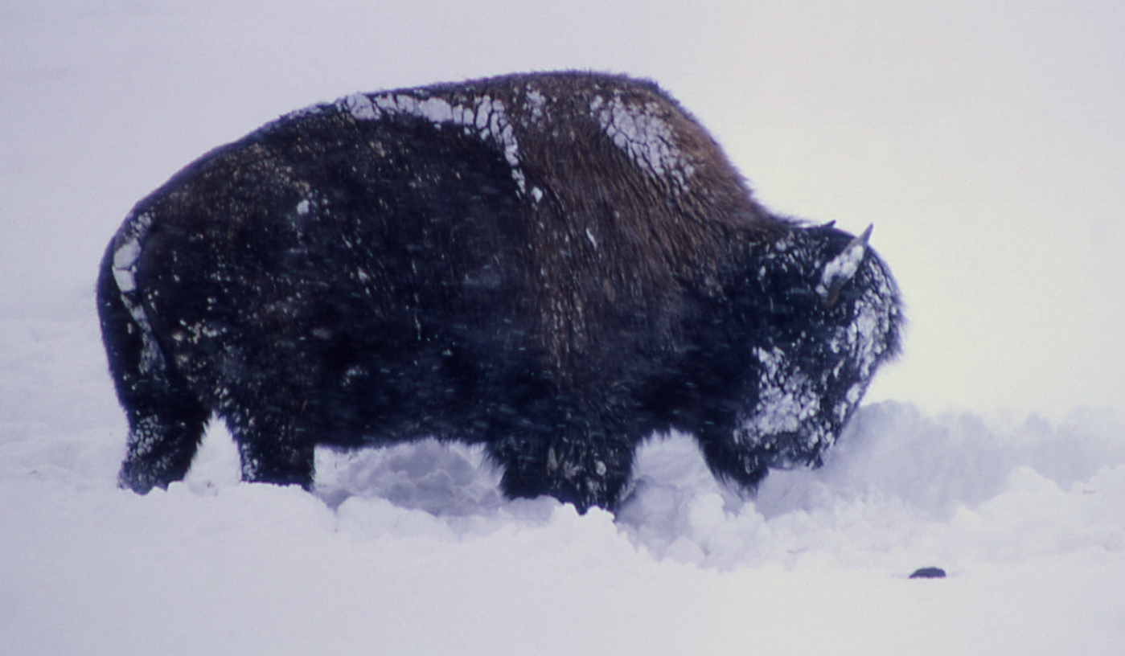
Current Status: Interim Plan
Interim plan completed in November 2009. In effect for two winters (through March 15, 2011).
During the next two winters, 318, all BAT, all commercially guided snowmobiles will be allowed along with 78 commercially guided snowcoaches.

Slide 18
Current Status: New EIS
Scoping January 29 - March 30 on new long-term winter plan and Environmental Impact Statement.
Draft EIS and Proposed Rule on public review March - April 2011.
Final plan and rule completed by November 2011.

Slide 19
Current Litigation
?
?
Wyoming and Park County, Wyoming filed suit in Wyoming Court (Judge Alan Johnson).
  NPCA intervened on Government side.
  ISMA intervened on Wyoming side.
Oral arguments scheduled for July 9.
No active litigation in Washington, D.C. court.

Slide 20
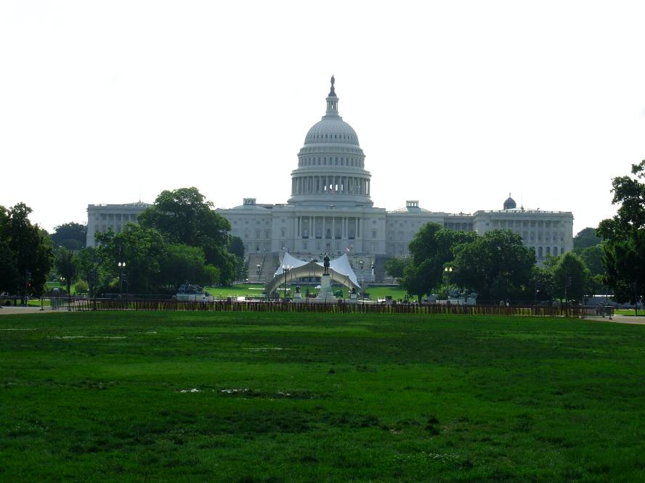
Congressional
Action
Congress directed the National Park Service to implement the 2004 decision for the winters of 2004-2005, 2005-2006 and 2006-2007.
Similar language was not included in Appropriations Acts for Fiscal Years 2008, 2009, or 2010.

Slide 21
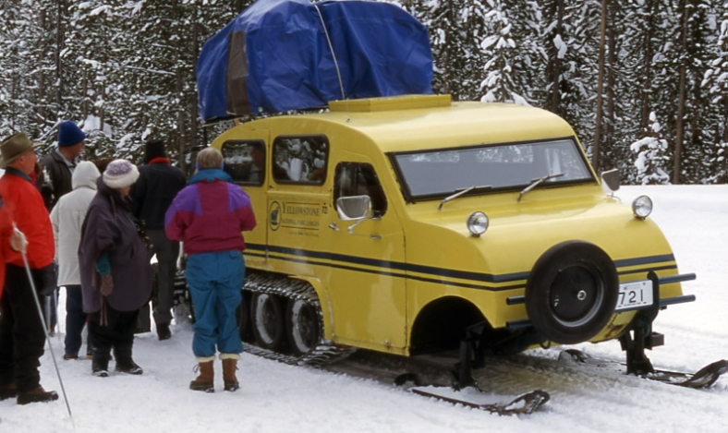
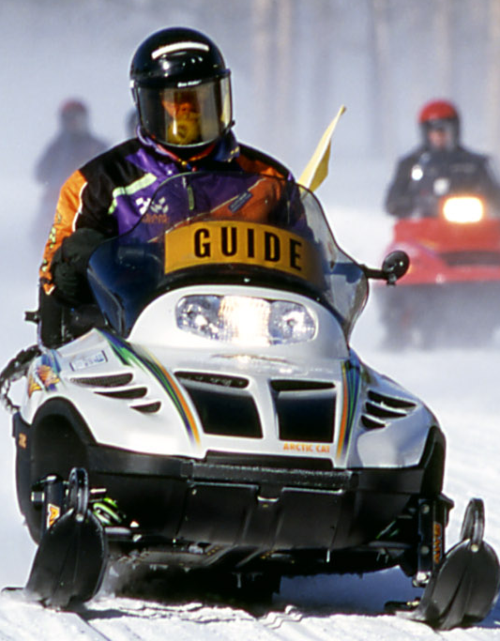
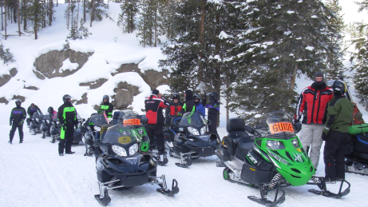
Commercial Guiding
Guide companies are under contract to NPS.
Guides are employees or sub-contractors.
Guide companies train their guides (NPS assists).
NPS monitors and enforces regulations.
“Symbiotic Relationship”

Slide 22
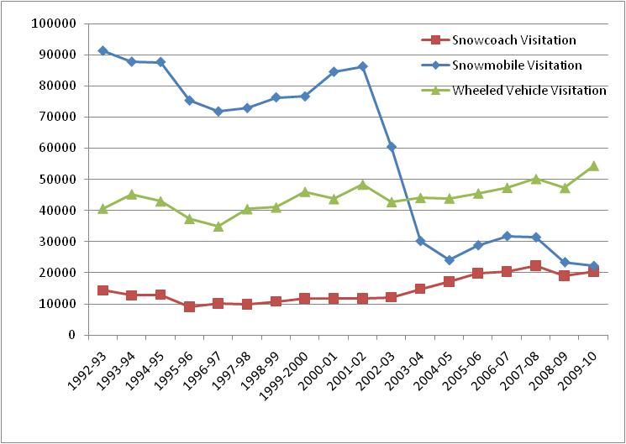
Winter Visitors

Slide 23
Recent Use Levels
Winter | Vehicle and Daily Limits | Average | Peak | Groups | Vehicles / Group | People / Coach or Group
2009-2010 | Snowmobiles (318) | 187 | 293
 | Snowcoaches (78) | 32 | 59
2008-2009 | Snowmobiles (720) | 205 | 426 | 31 | 6.6 | 8.9
 | Snowcoaches(78) | 29 | 54 | 29 | 1 | 8.5
2007-2008 | Snowmobiles (720) | 294 | 557 | 36 | 6.9 | 9.3
 | Snowcoaches (78) | 35 | 60 | 35 | 1 | 8.8

Slide 24
Daily Snowmobile Use Pattern

Slide 25
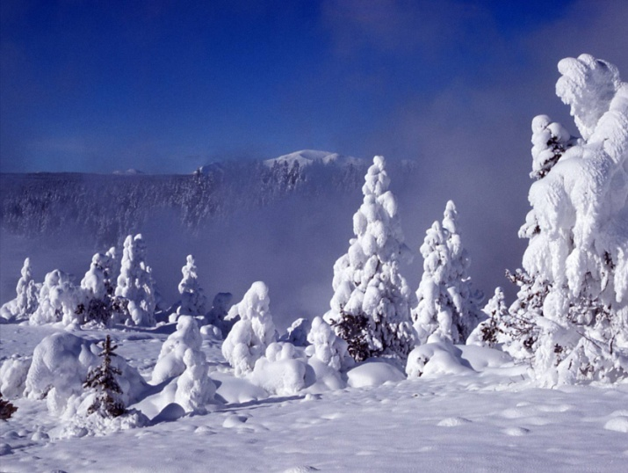
Administrative Travel
Snowmobiles:
  1/3 of snowmobile groups on road corridors
  2/3 of snowmobile groups in developed areas
Snowcoaches:
  7% on road corridors
  18% in developed areas
Snowmobile BAT:
  Estimated 70% are BAT
  BAT to be required 2011-2012
Snowcoach BAT
  To be determined

Slide 26
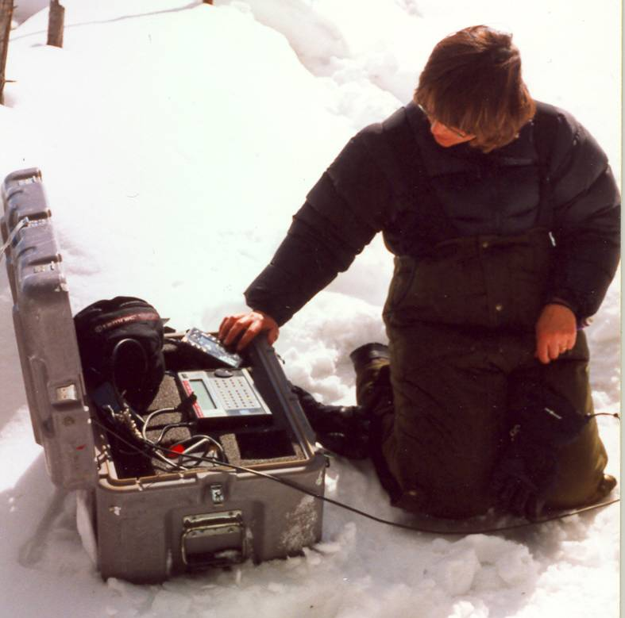
Monitoring, Modeling and Studies
Winter monitoring reports and modeling analysis:
Air quality
Soundscapes
Wildlife
Health & Safety
Pollution Deposition
Bison and Roads
Economics
Snowcoach Emissions
Avalanche Safety
Snowpack Analysis

Slide 27
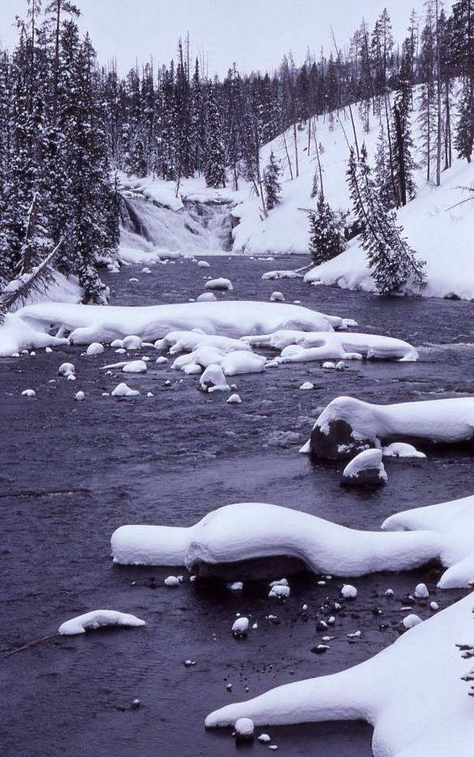
Soundscape Monitoring
All oversnow vehicles are heard 47% of time from 8 am to 4 pm at Madison Junction site (goal is not to exceed 50%)
All oversnow vehicles are heard 55% of time at Old Faithful site (goal is not to exceed 75%)
Loud oversnow vehicles heard 177 times at Madison Junction site (“loud” is vehicle noise exceeding 70 dBA for one second or 60 dBA for 10 seconds).
94% of loud events are snowcoaches

Slide 28
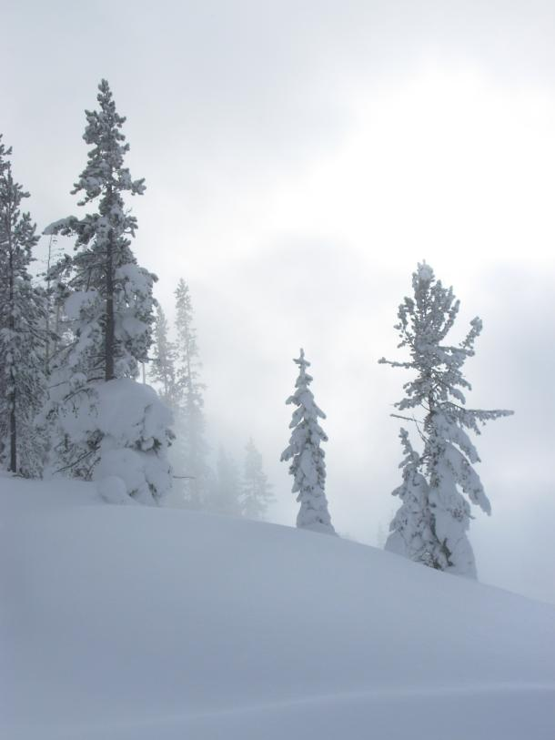
Audibility of Snowmobiles and Snowcoaches
Currently, guided (BAT) snowmobile groups are heard for the same amount of time as a guided snowcoach.
Some new snowcoaches, as well as older models, are too loud.
Snowcoach BAT has not been required.

Slide 29
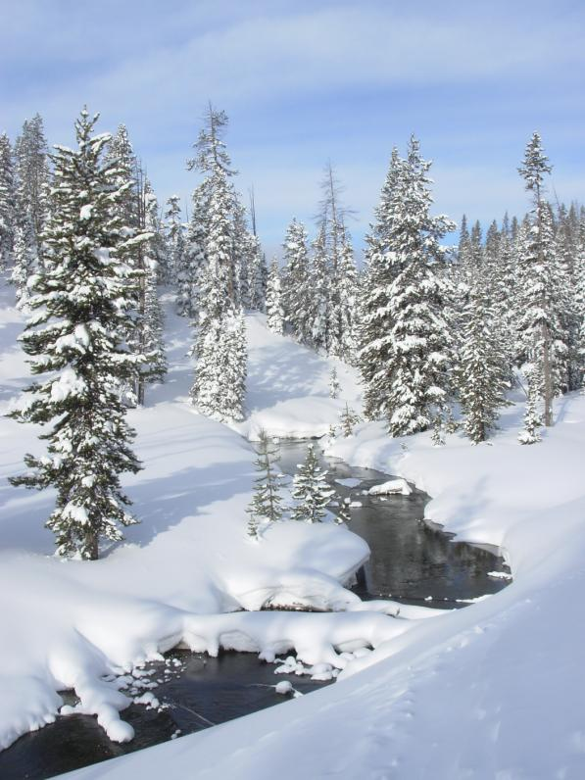
Air Quality
Best Available Technology snowmobiles and newer snowcoaches are similar in their per passenger emissions.
Cleanest coaches better than BAT snowmobiles; some new coaches far dirtier.
Snowmobiles lack catalytic converters.
Modern “conversion” snowcoaches challenged by low power to high weight ratio.
BAT has not been required for coaches.
Inversions common in winter and are significant contributor to higher levels of pollution in winter than summer.

Slide 30
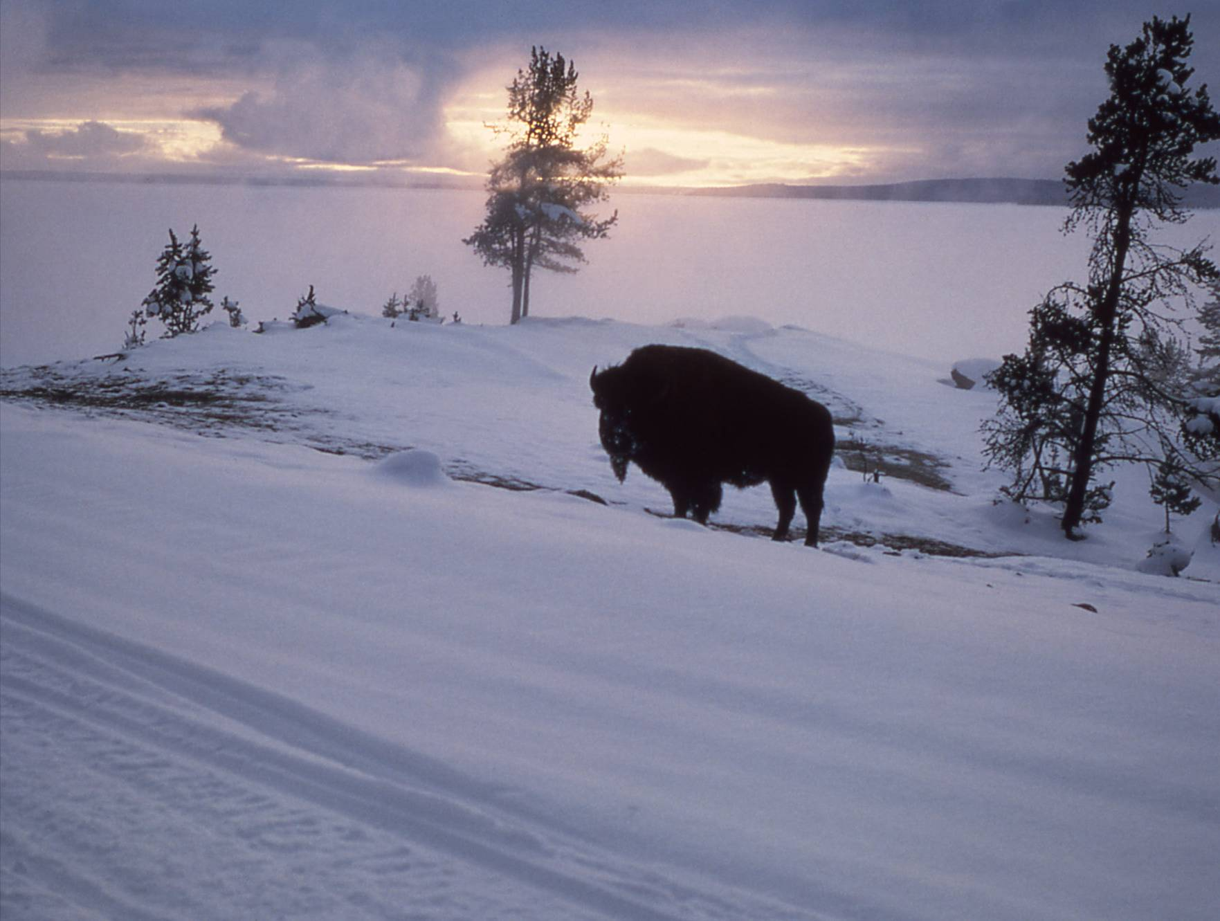
Wildlife Monitoring
Bison and elk populations and movement patterns have not been affected by oversnow vehicle use.
For individual animals, 8 to 10 percent of elk and bison show a movement response to snowmobiles and snowcoaches. Approximately 90 percent of elk or bison either show no apparent response or a "look and resume" response.
Level of reaction was consistent for a wide range of daily average oversnow vehicle use (ranging from 156 to 593 vehicles per day, with a peak day of 1,168 vehicles (1999 through 2004)).
Commercial guiding is important in minimizing harassment to wildlife.

Slide 31
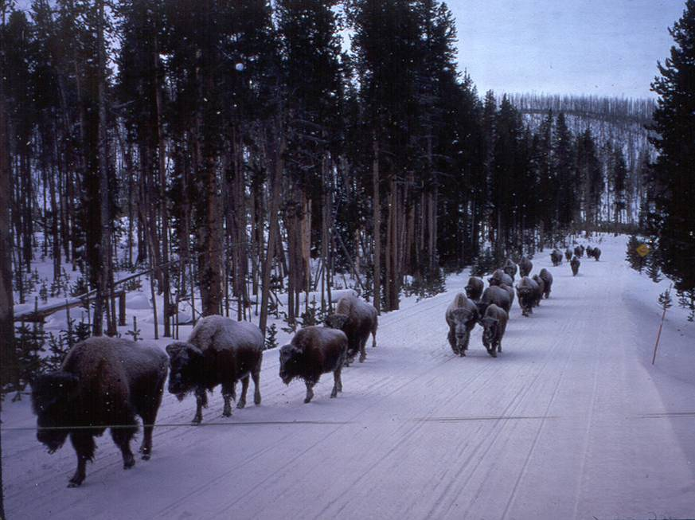
Bison and Roads
Long-term concern that bison use of groomed roadways (“energy-efficient pathways”) has led to altered distribution.
Growing scientific consensus that groomed roads have merely expedited a population expansion that would have occurred in the absence of groomed roads anyway.
A possible exception is Gibbon Canyon.
Initial study of bison use of Madison to Norris Road may result in road closure.

Slide 32
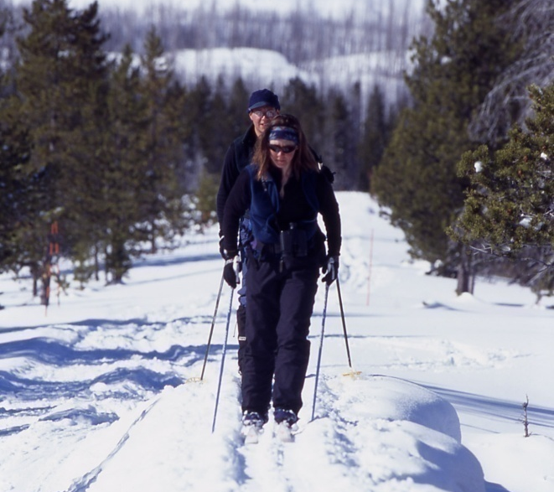
Visitor Survey Results
(2008)
(57% of visitors snowcoached, 41% snowmobiled,
26% cross-country skied, and 25% snowshoed)
Soundscapes:
  87% were ‘very satisfied’ with their overall soundscape experience and the remaining 13% were ‘satisfied.’
Wildlife:
  Visitors overwhelmingly (87%) find wildlife aspect of their Yellowstone winter experience very satisfying.
Classifying Visitors (earlier surveys):
  Activity groups (snowmobile versus snowcoach) were not found to be useful for predicting either visitor behavior or visitor attitudes.
  Visitors within the activity sought a variety of experiences.
  The different activity groups had more in common than opposition.

Slide 33
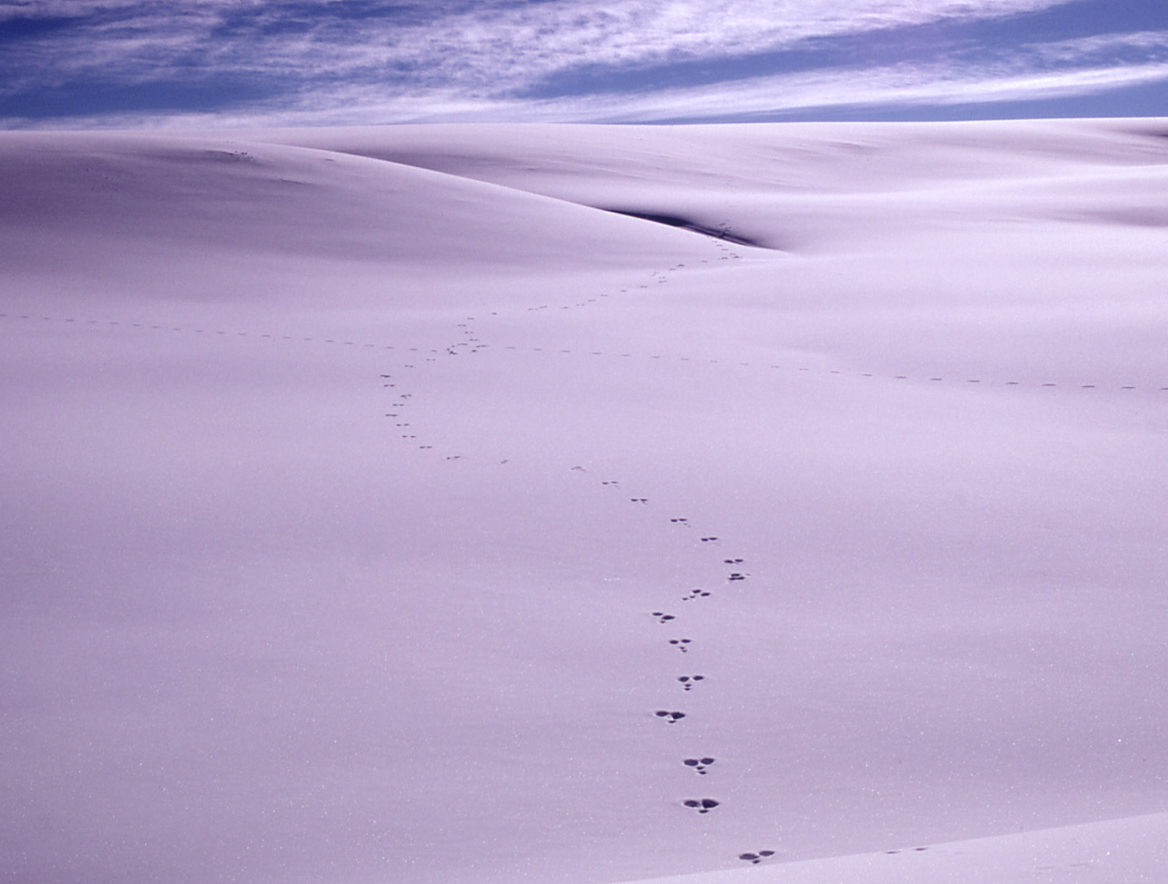
Inputs to Planning and Decision Making
Laws
Regulations
Policies
Goals
Department of the Interior
NPS – Region / Washington
Science
Congress
Other Agencies
Courts
Press
Interest Groups

Slide 34

Reflections & Lessons Learned

Slide 35
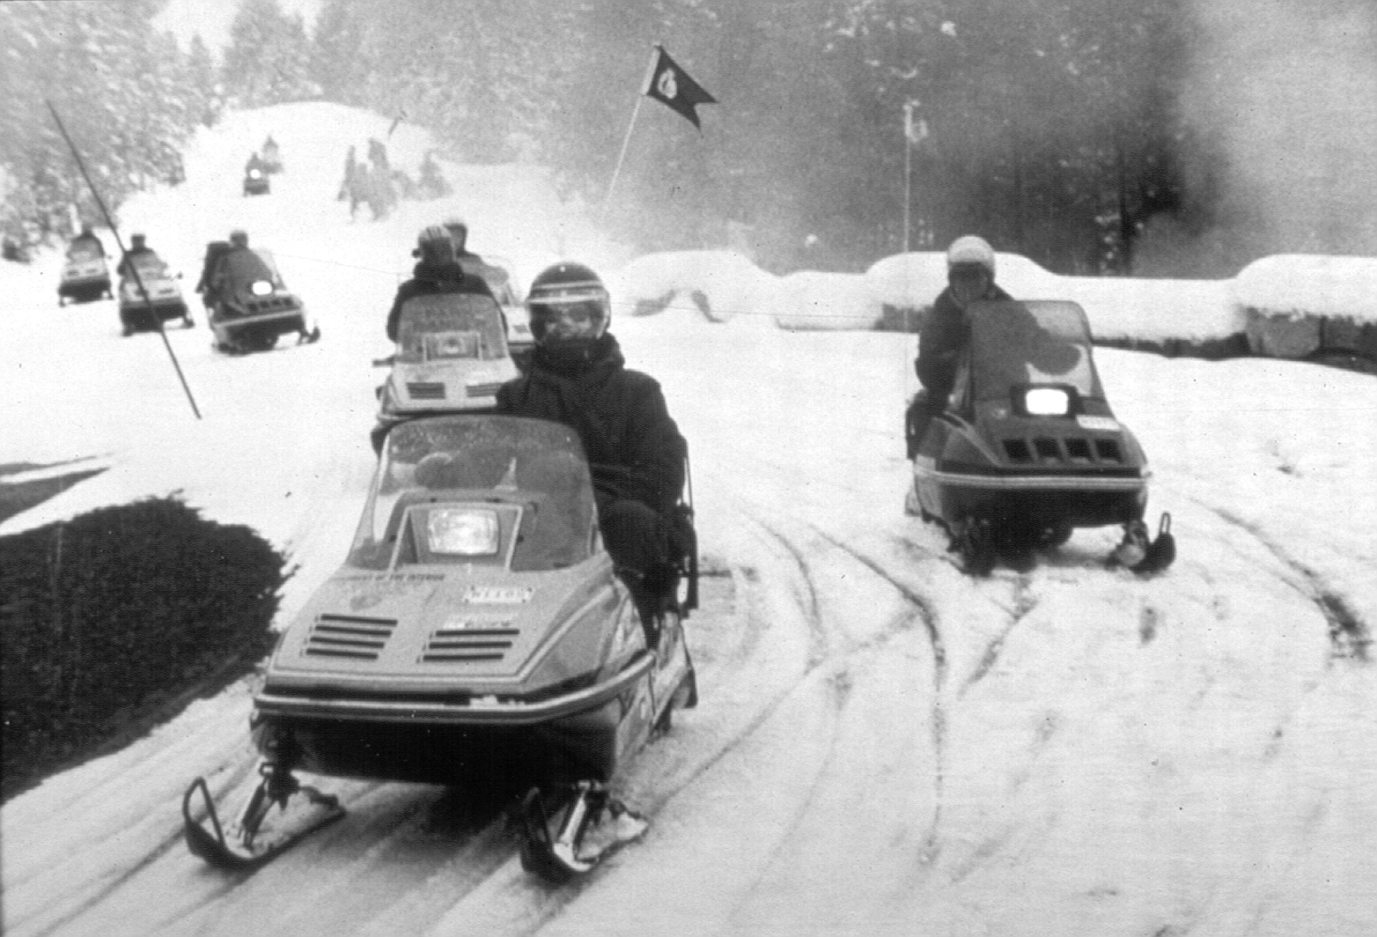
Invest Some Time in Understanding the History of the Issue

Slide 36
Get Good Data
(Science can inform, but it cannot decide)

Slide 37
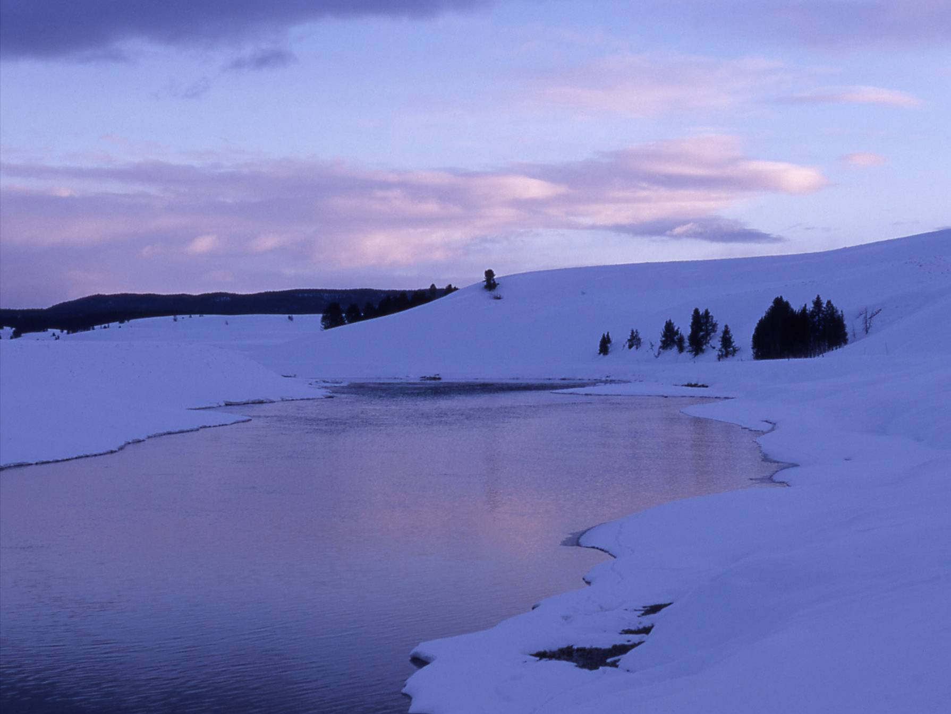
Get to Know the People Involved
Interest groups
Politicians
Key players
Involve them as much as possible

Slide 38
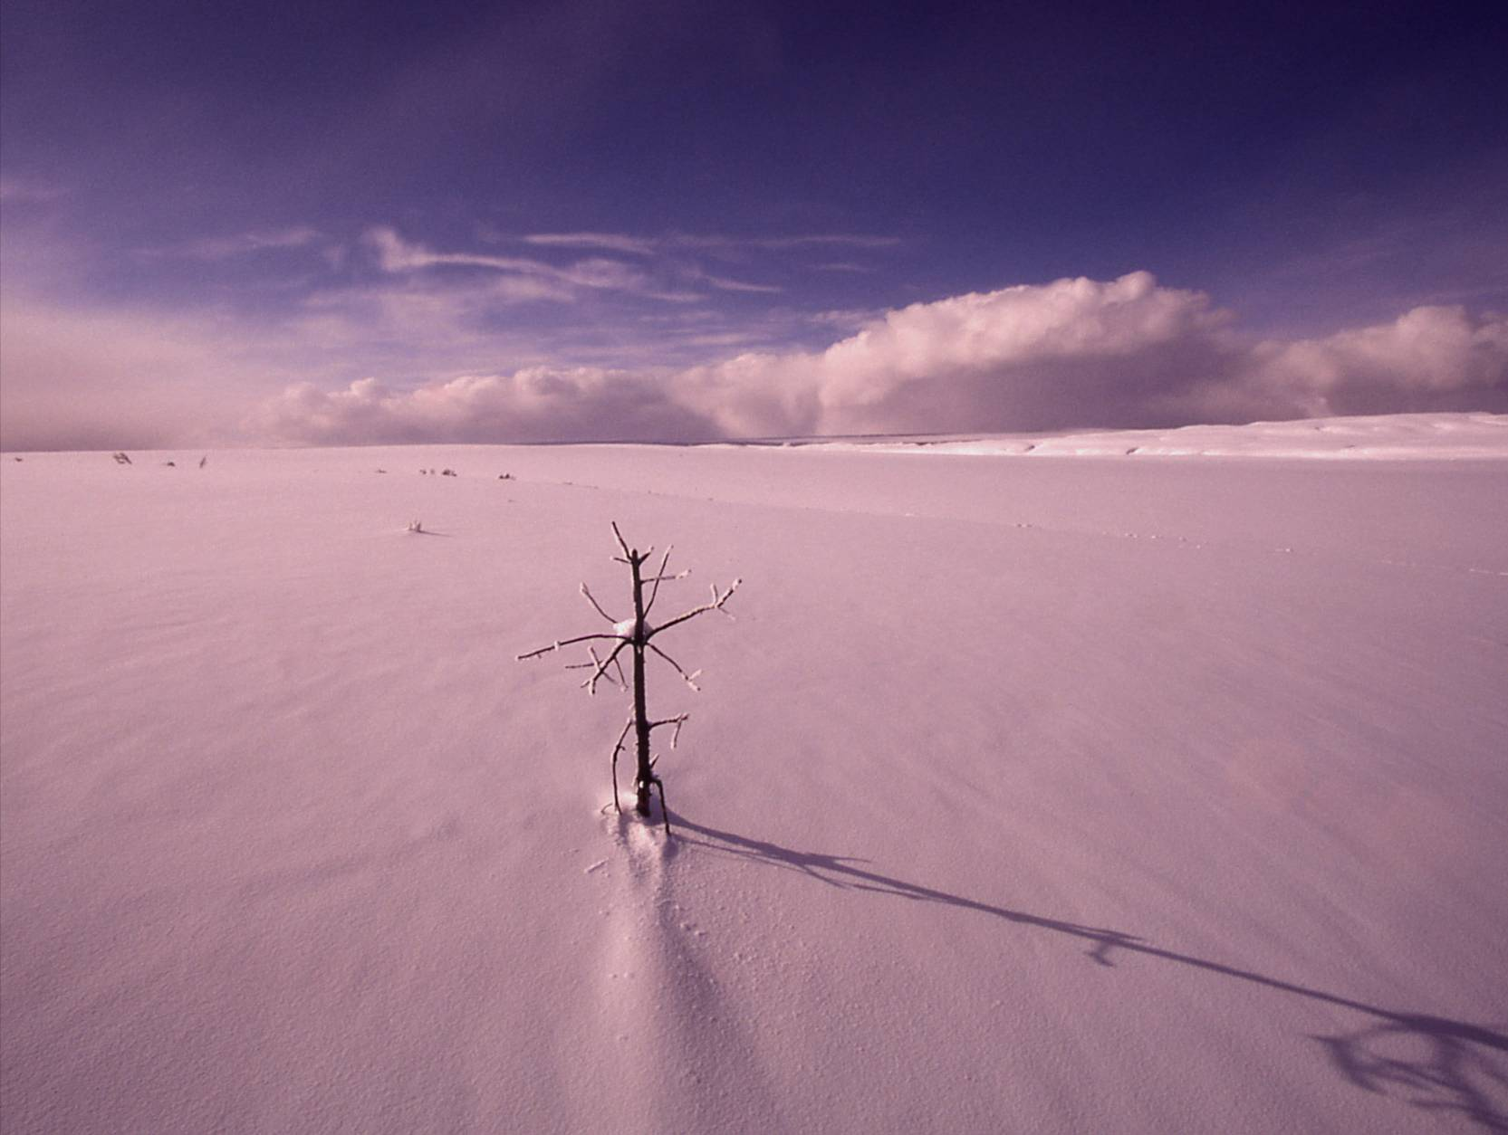
Know When to Take a Stand

Slide 39
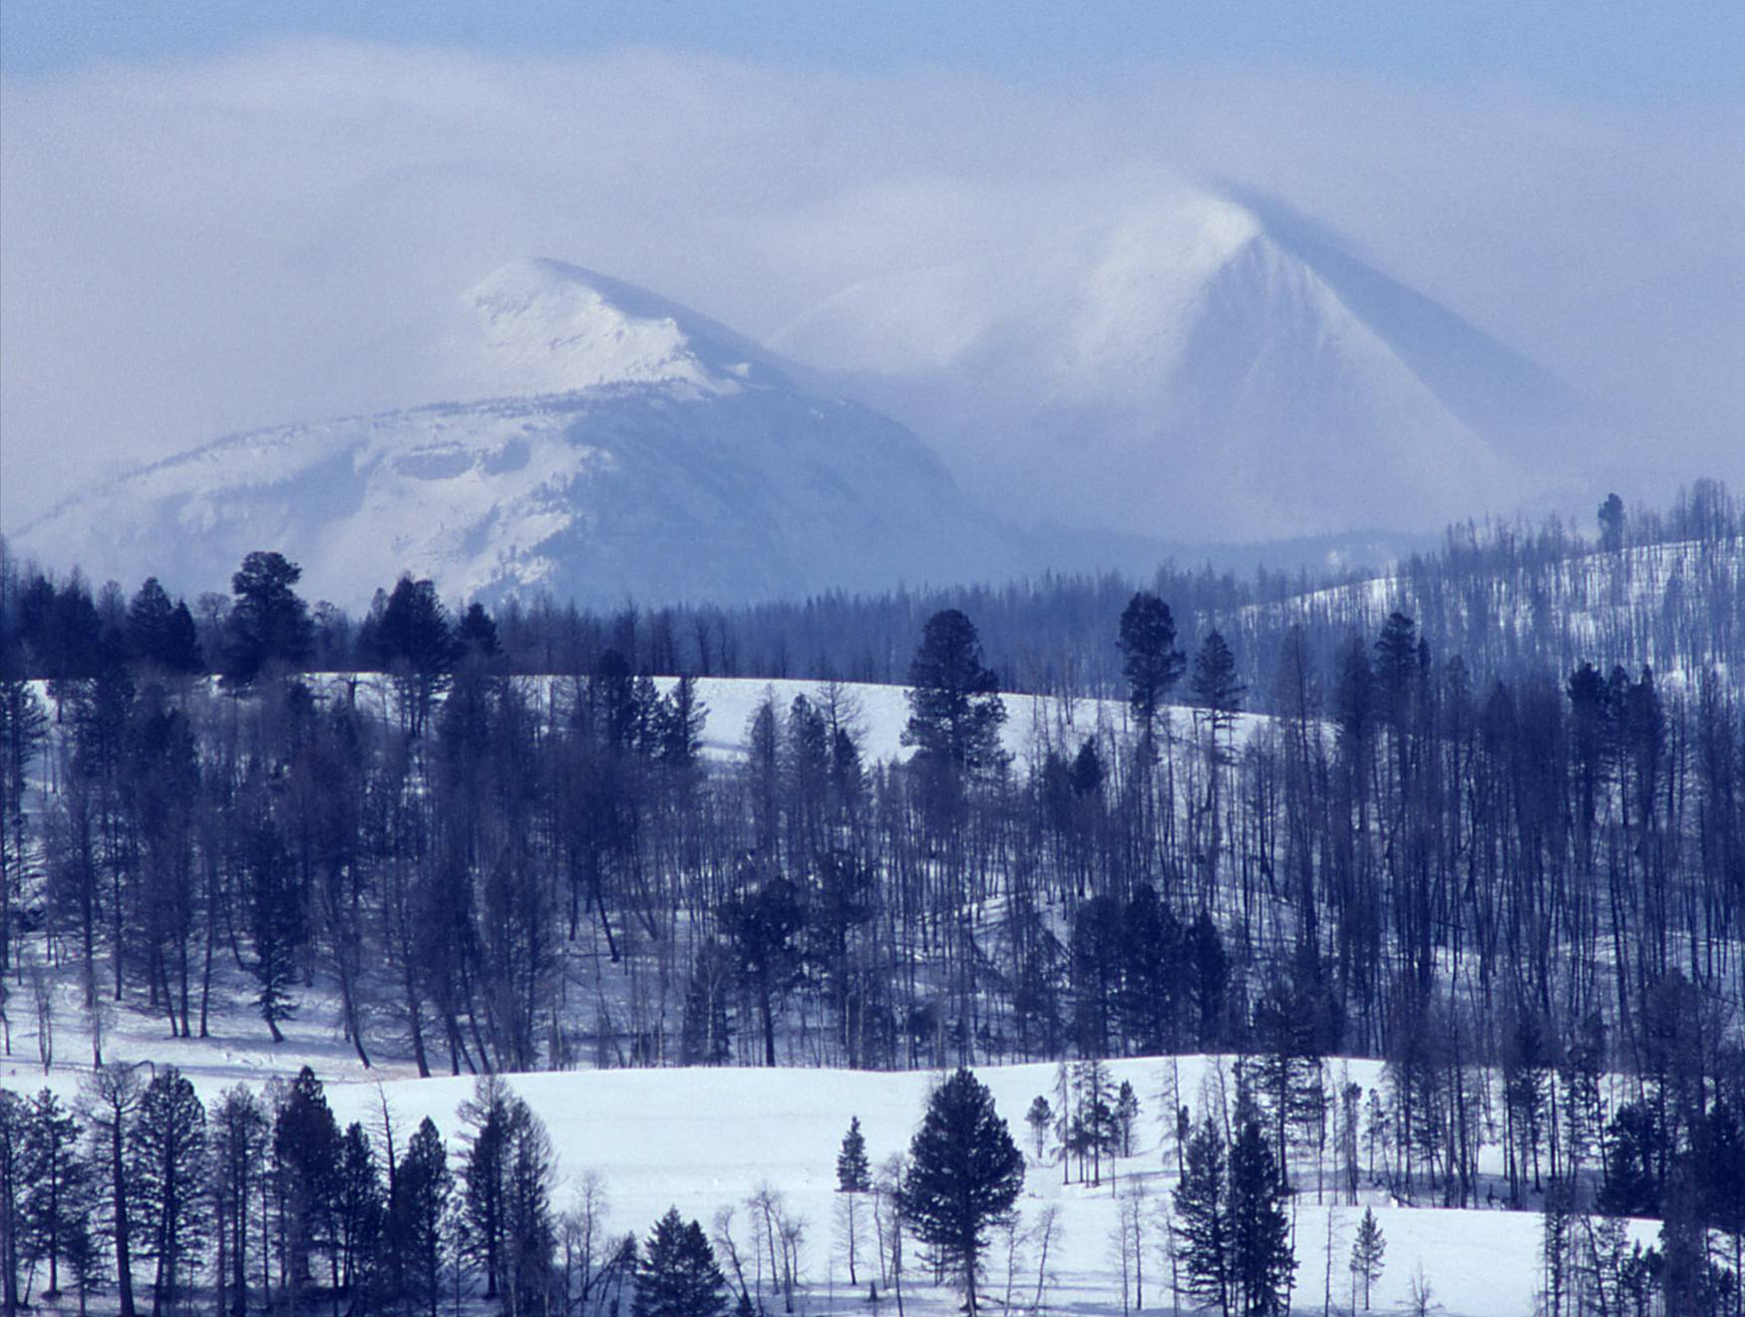
Be in it for the Long Haul:
Keep Your Eye on the Prize
(Politics Change)

Slide 40
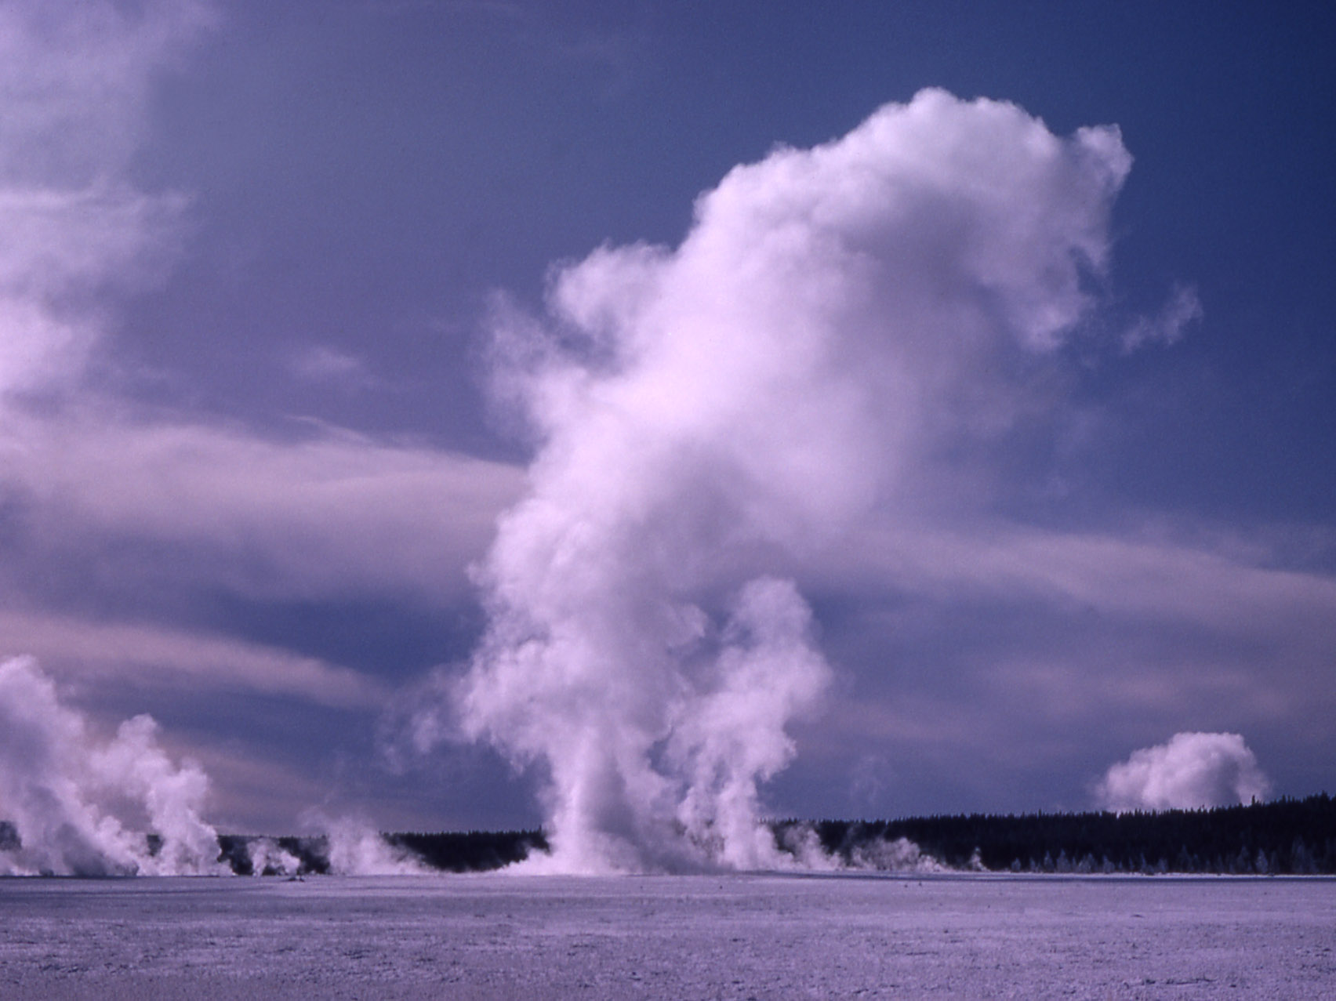
Recognize When You Have an Issue of Values

Slide 41
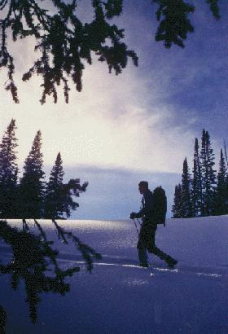
Core Conflict of Values: Environmentalists See Parks as Sacred Temples of Nature

Slide 42
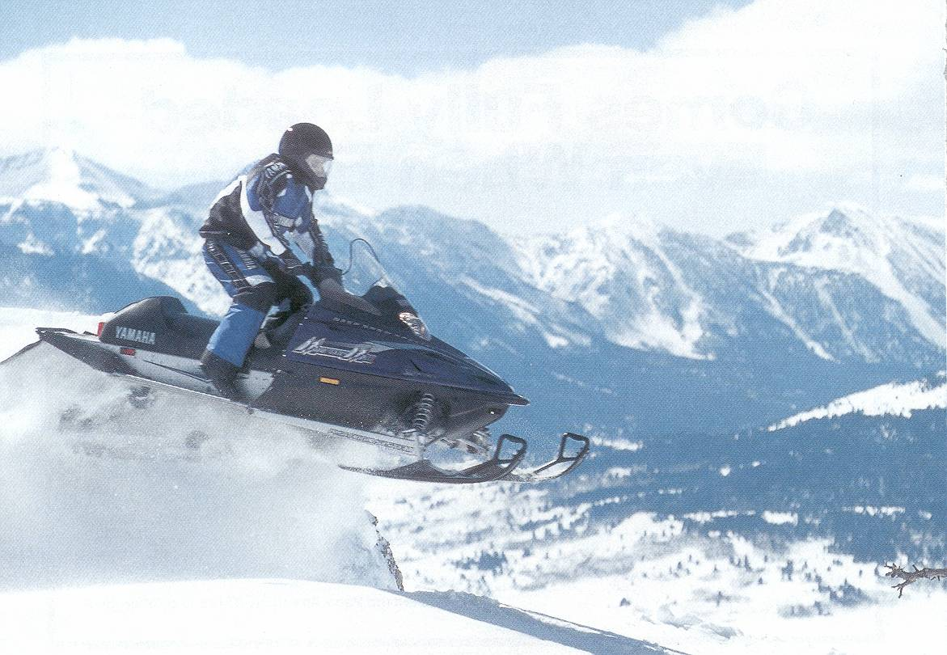
Symbolism to Snowmobilers: Freedom and Independence

Slide 43
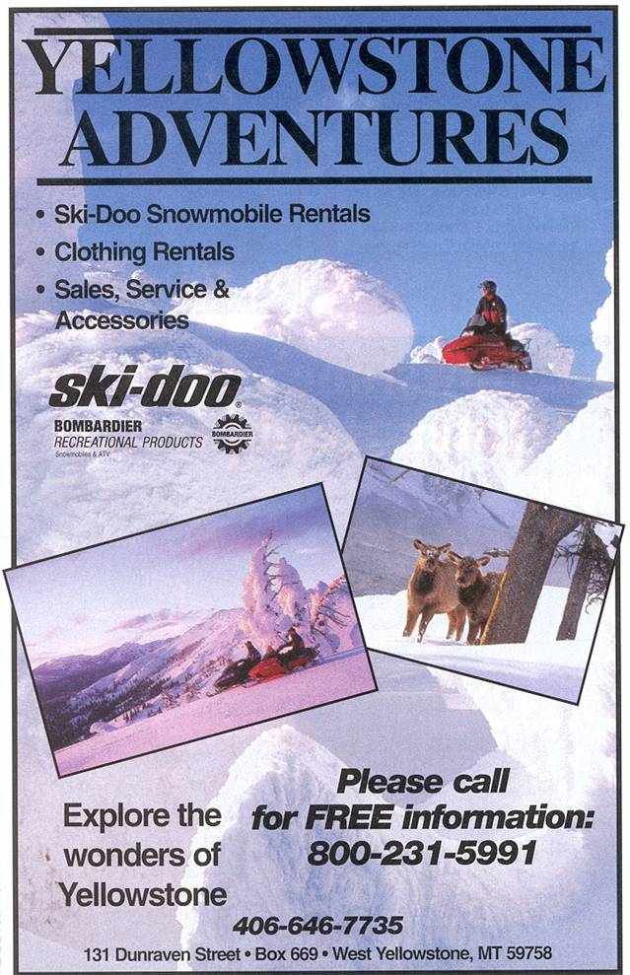
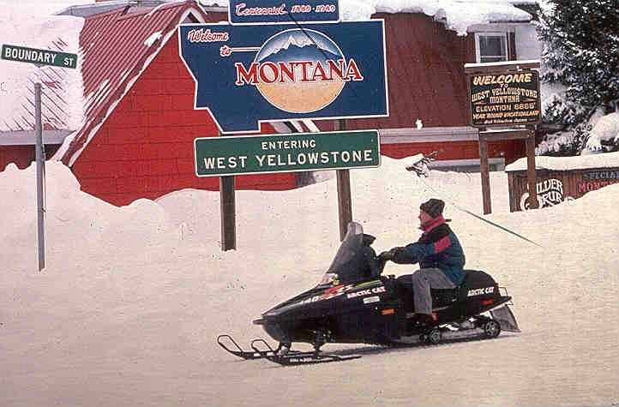
West Yellowstone:
Town Identity &
Family Values
Notes:
West Yellowstone, Montana, at the park’s western entrance, has made itself a winter economy based largely upon the snowmobile. It bragged at one time that it was the “Snowmobile Capital of the World.” Snowmobiling has transformed the town from a sleepy hibernacula to a buzzing, busy town; some merchants earned more in Feb. than any other month.
Banning snowmobiles threatens the town’s identity; its cultural geography.

Slide 44
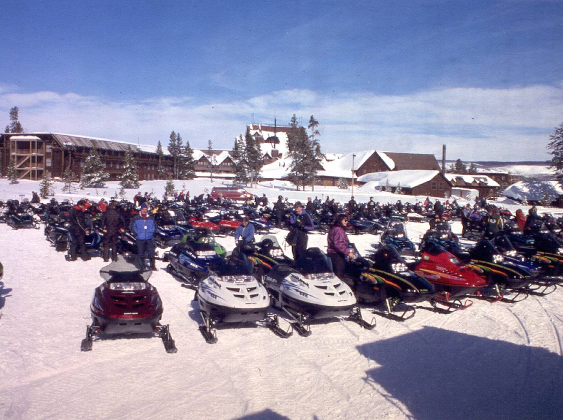
Industry: Snowmobile Training Ground
Notes:
However, in the last decade or so several out-of-state corporations have built hotels in West Yellowstone, changing the character of the town away from the family/small town atmosphere and more toward a corporate feeling.
Additionally, the snowmobile industry sees Yellowstone as a “training ground,” a place to introduce people to snowmobiling. The park is flat & beautiful—an easy place to learn to snowmobile.
Consequently, industry increasingly plays a role in the debate, drawing upon the strength of the capitalist system in American economy.
Some would say, too, that it manipulates the town of West Yellowstone to its own ends; the industry, for example, was not significantly hurt in the recent downturn, while many in West were.

Slide 45
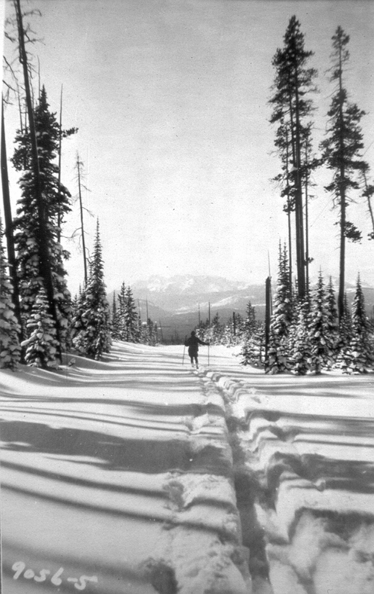
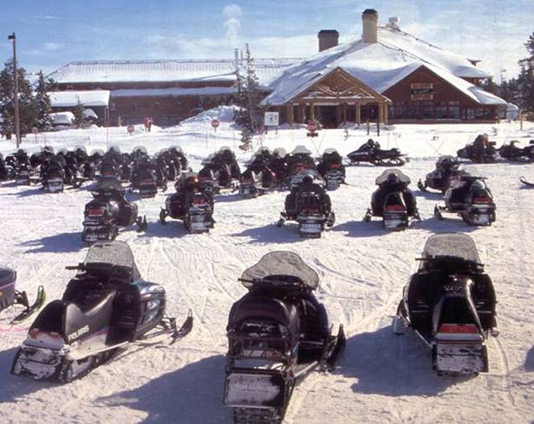

Twelve times we have debated this issue, over almost 75 years.
What forms of use are appropriate in Yellowstone in winter?
What should Yellowstone look like in winter?
We may always debate how Yellowstone should look in winter; it embodies our differing concepts of what a park should be and how we should manage nature.

Slide 46
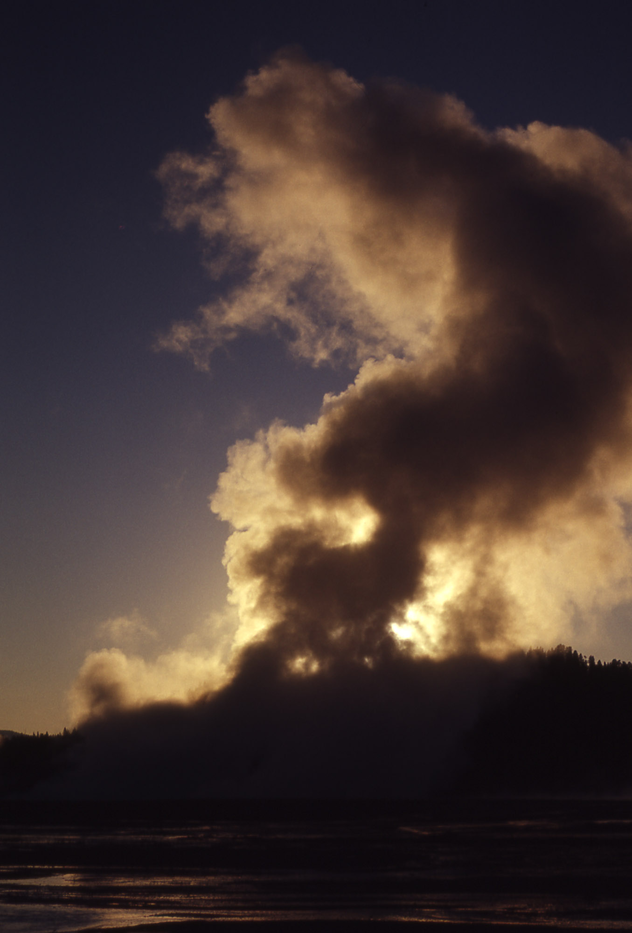

Slide 47
Public Engagement
Stakeholders?
  Examples:
  Conservation Interests
  Access Advocates
Strategies?
  For instance:
  Open information sharing.
  Actively listen to and acknowledge concerns.
  Explaining where agency and public input was incorporated, and how it did/did not influence NPS decisions.
Techniques?
  One idea:
  Small group meetings with stakeholders.
From: Public & Agency Information/Participation Plan
Yellowstone/Grand Teton Winter Use Planning
As of October 2005

Slide 48
The Courts
?
?
Litigation has occurred at every step of the process.
Plaintiffs file suit in Federal Court they believe best represents their interests:
  Conservation Groups: Washington, D.C.
  Access Interests: Wyoming

Slide 49
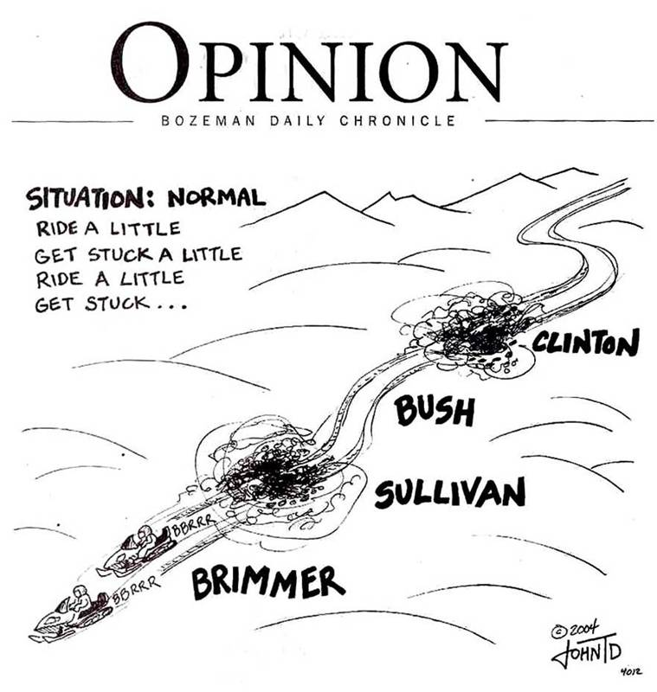
The Press
(circa 2004)

