Slide 1
What Economics Is About: Understanding the Basics of Our Economic System
Economics for Public Land Use conflicts in the Greater Yellowstone Ecosystem
Spring 2015

Slide 2
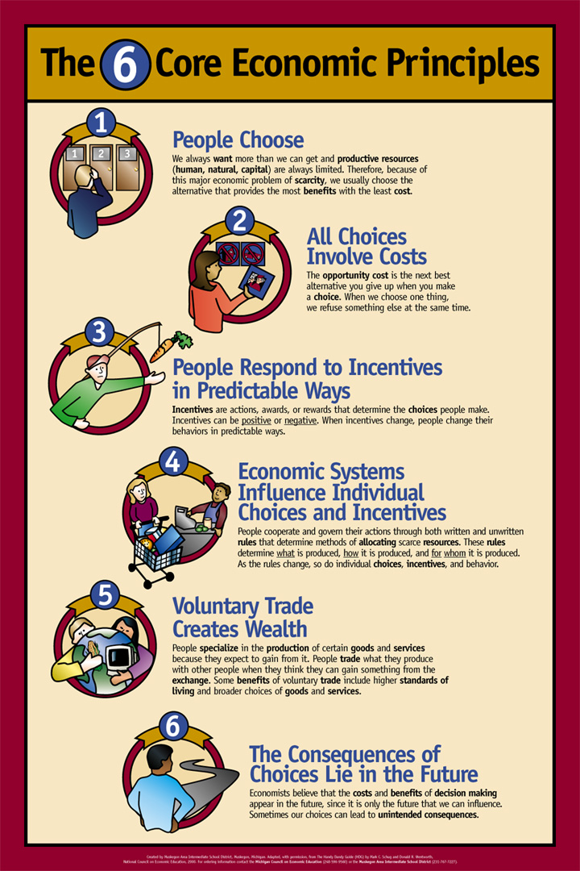
Indiana Council for Economic Education
And the
ISU Center for Economic Education
Called the “Handy Dandy Guide”

Slide 3
Five Propositions for Economic Reasoning
(Walton & Rockoff)
People choose, and individual choices are the source of social outcomes.
Choices impose costs.
Incentive matter.
Institutions matter, and the “rules of the game” influence choices.
Understanding based on knowledge and evidence imparts value to opinions.

Slide 4
Conant’s Proposition for Economic Reasoning
Economies are systems. An intervention in one market will have secondary, most often counter and unintended, consequences in many other markets as the primary (intended) effect works its way through the economic system.
Human societies create social institutions.
Institutions determine incentives.
Incentives determine economic behavior.
Economic behavior works through the institutions that make up the economic system to generate economic outcomes.
Societies then use their social decision making process to evaluate the economic outcomes and determine what changes to make in their institutions.

Slide 5
Scarcity - The Economic Problem Faced by all Societies
Every society is endowed with scarce resources with which to produce the goods & services that provide its citizens with their standard of living.
4 Basic Resources: Natural, Human, Capital, and Entrepreneurial
Economics is the study of how societies use their scarce resources to meet their citizens’ wants.

Slide 6
What is scarce in the GYE?
Grass – Bison
Bullets (Security) – Wolves
that one is for you, Lennon!
Peace & Quiet – Winter Use
Thermophyle Sites = Geothermals & Gainsharing

Slide 7
All Economic Resources are Scarce
Not enough of the resource to freely satisfy all wants.
Scarcity requires choice.
Scarcity creates competition.
Scarcity means all resource uses have a cost.
Economists call this cost opportunity cost.
Opportunity cost is the central concept of economics.

Slide 8
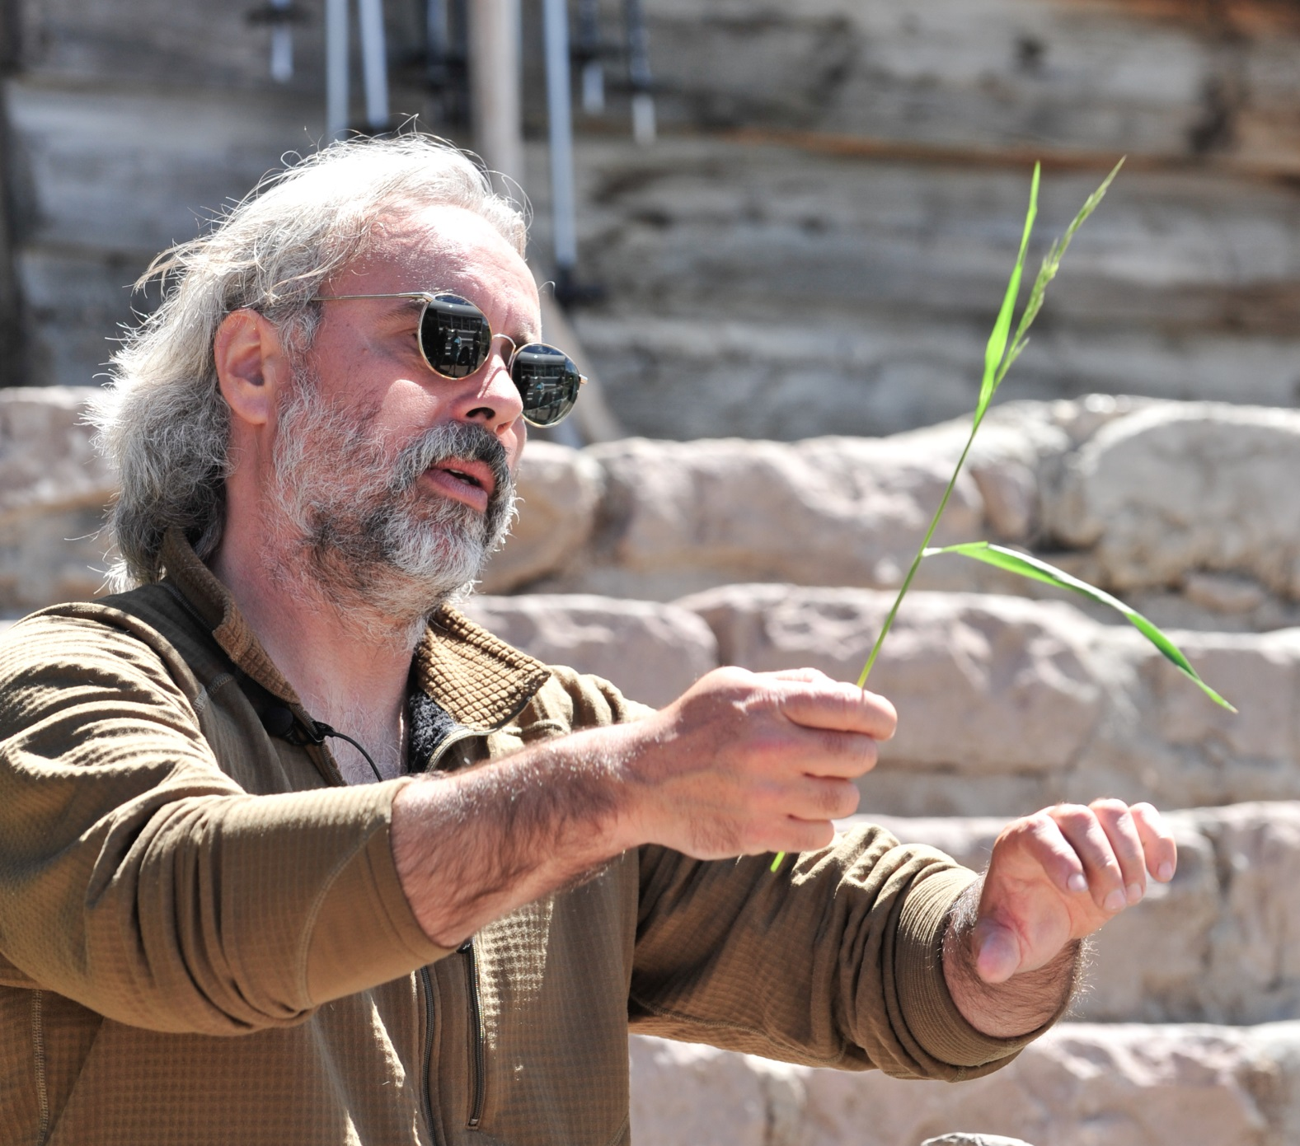
Scarcity and Opportunity Cost

Slide 9
Economic Systems
Societies Create Economic Systems to Deal with Scarcity of Productive Resources.
Economic Systems are made up of Economic Institutions (ie, NPS, BLM, APHIS, BFC, MDOL).
Economic Institutions are created in order to answer the 3 basic questions of economics, What, How, For Whom in the way the best satisfies the society’s Goals and Values.

Slide 10
Fundamental “Types” of Economic Systems
Traditional Economic Institutions – traditions
Command Institutions – Centralized decisions
Market Institutions – Decentralized decisions
Mixed Economies – Some institutions of each type
Scarcity creates competition, NOT the form of the economic institutions
Institutions define the “form” of competition
ration by price, time, political power….

Slide 12
American Democracy
Or:
Natural Resource Policy
Wildlife Mgt Policy
Land Use Mgt Policy
Ecological Policy
etc, etc, etc….

Slide 13
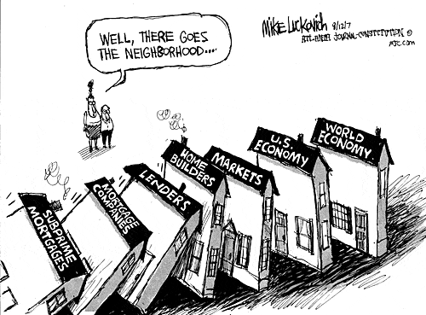
Illustrating the Economy as a System

Slide 14
Make Up Your Own
Grazing Rights on Public or Private Lands…
Ranching as an economic activity…
Open spaces in area valleys…
Elk (etc) habitat…
Wolves…
Rivers and streams…
Loss of increasingly scarce landscape

Slide 15
What’s wrong with this sign?
What is the opportunity cost of electric hand dryers?

Slide 16
The Role of Government in a Market Economy
Provides the legal framework
(property rights, etc.)
Protects competition and regulates where competition is not economically feasible.
Endangered Species Act
(wolves)
Bison and Gainsharing Policies
Park Concessions

Slide 17
Role of Government in a Market Economy
Provides for Public Goods (non-rival & non-exclusive)
Intercedes in markets with significant externalities
(both economies and diseconomies)
Is Yellowstone National Park a Public Good? Are the geothermals or their thermopyles?
Snowmobiles and winter use rivalry and restrictions?

Slide 18
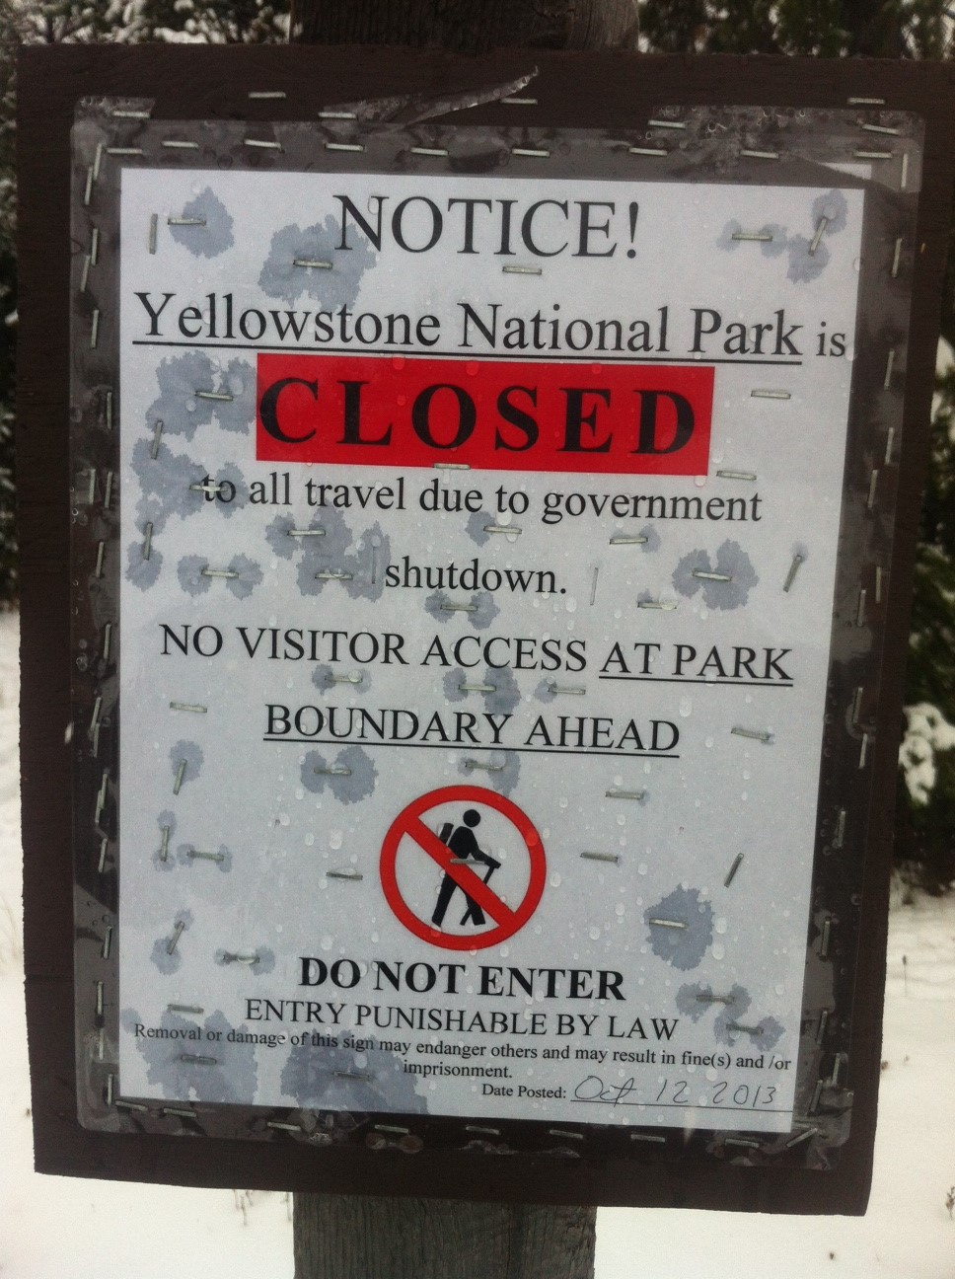
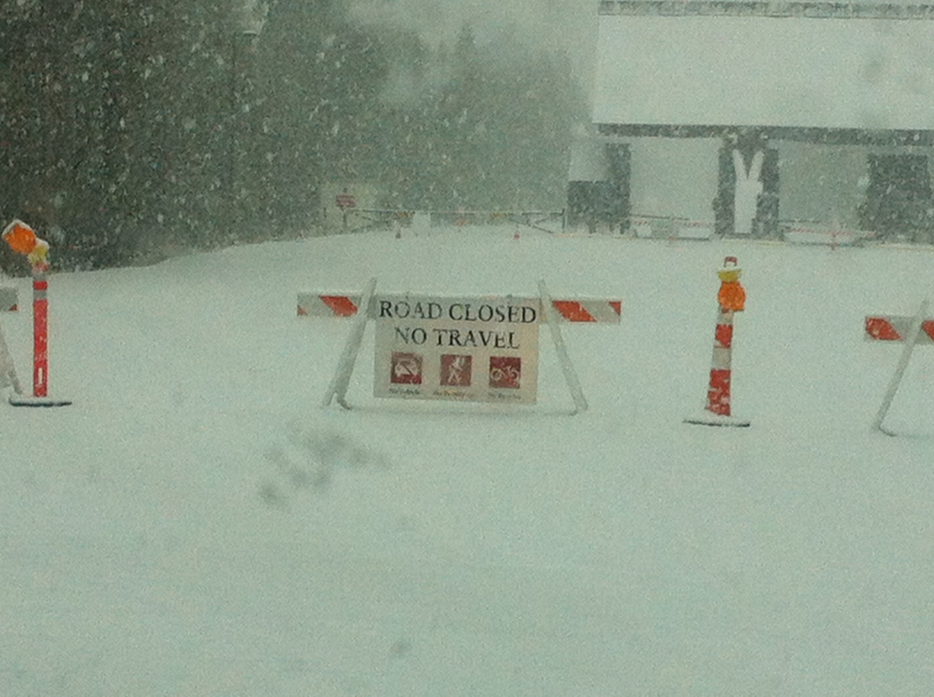
Public Good or Gov’t Provision?
Exclusive? You bet!

Slide 19
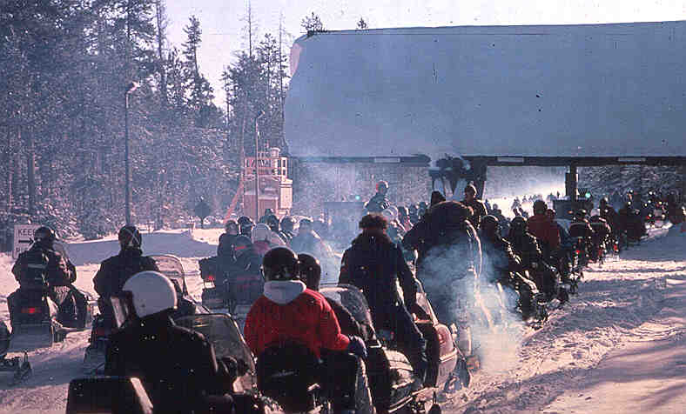
Rival – yep!

Slide 20
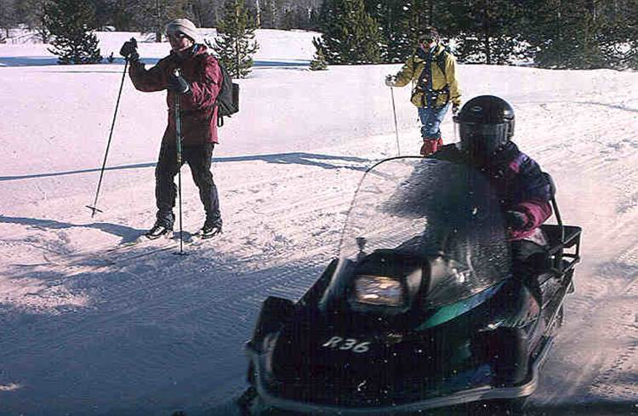
Rivalry and Exclusivity Can Change Over Time

Slide 21
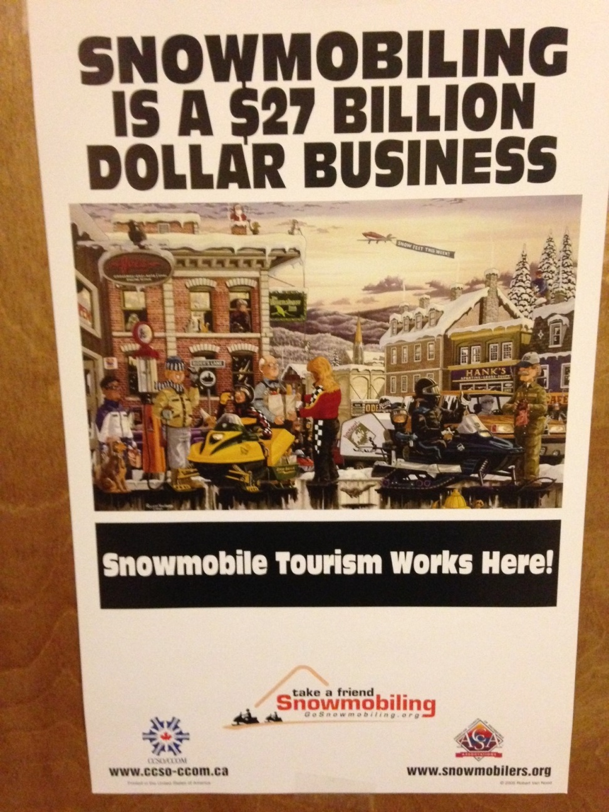
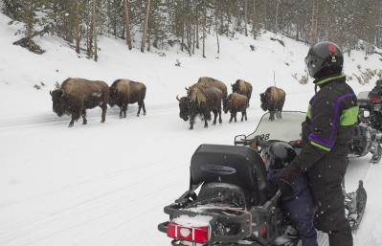
So Why a Government Function?
Tragedy of the Commons?
Externalities?

Slide 22
The Role of Government in a Market Economy
Redistributes Income – social safety net
(bison policies, winter use plan, gainsharing policies & wolf protection
all redistribute income)
Stabilization – counter-cyclical policies
Stabilization Tools:
* Fiscal Policy * Monetary Policy
Stabilization Measures:
* Economic Growth (GDP)
* Employment Growth
* Price Level

Slide 23
Other Basic Economic Concepts Important to understanding these issues
Productivity: The Key to Minimizing the Effects of Scarcity
Economic activity is directed toward a distinct goal: allocating resources to maximize value.
Role of NPS – mostly just how the scarce assets are regulated

Slide 24
Other Basic Economic Concepts Important to understanding these issues
Entreprenuership: The least understood critical economic resource
Entrepreneurial activity is a drive for innovation and improvement that creates something “new” or a new way of producing value.
Role of NPS – all of the policies we are looking at have entrepreneurial aspects.

Slide 25
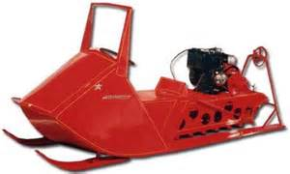
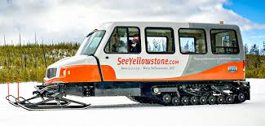
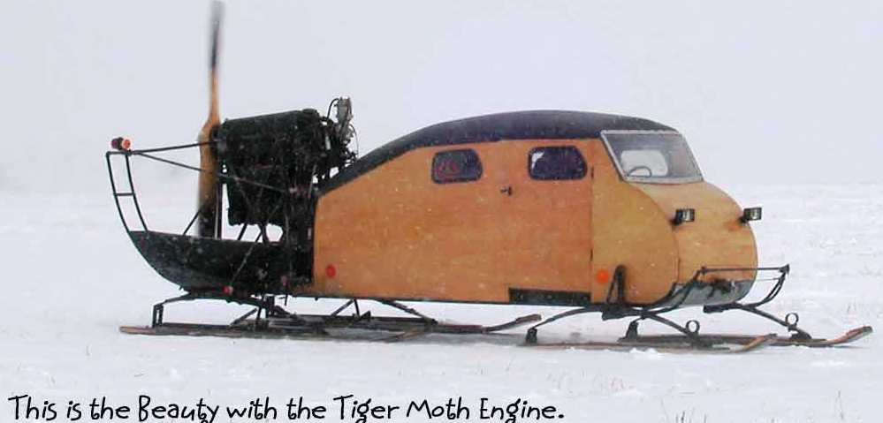
Productivity
Did winter use restrictions play a role in the development of more efficient snowmobiles?

Slide 26
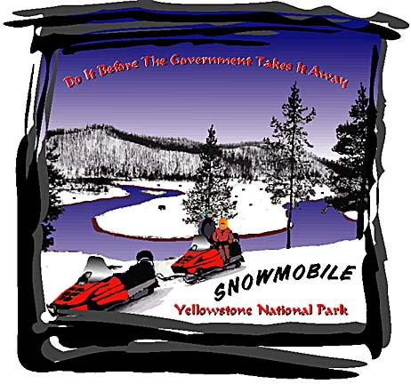
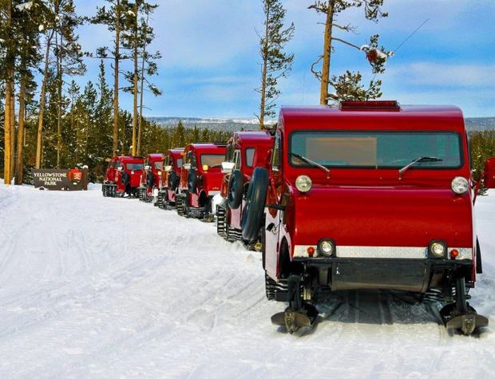
Entrepreneurship
Entrepreneurship – filling previously unfilled markets

Slide 27
Next Week
Public Economics
First short paper due – debate on purposes of National Parks, ie recreation, conservation, preservation.
Then returning to the Bison Issue

