Slide 1
Natural Resources and Public Choice
Indiana State University
and
The American Democracy Project
Yellowstone National Park Field Experience
Clare McKinney Lutgen

Slide 2
Changing The Way We Teach
"The question is not, Is it possible to educate all children well? but rather, Do we want to do it badly enough?"
- Deborah Meier

Slide 3
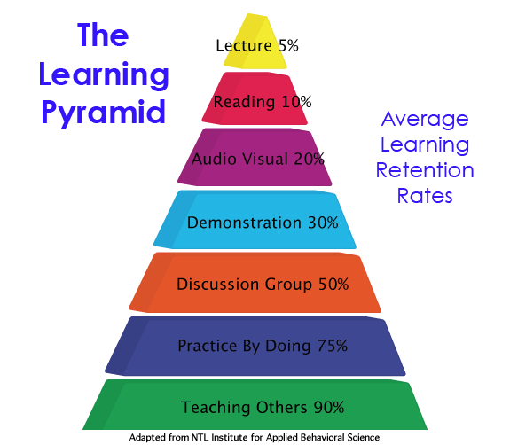
Outside the Walls – Bringing the World to the Classroom
The most effective instructional practices provide direct, purposeful learning experiences, such as hands-on or field experiences.

Slide 4
Bringing the Field Experience to the Classroom
Intentionally
making it REAL.
making it RELEVANT.
Making it SIGNIFICANT.

Slide 5
Yellowstone National Park A Field Experience
Using
Natural Resources
and
Public Choice
to
Change How
we
Teach

Slide 6
The National Park Service
The National Park Service preserves unimpaired the natural and cultural resources and values of the national park system for the enjoyment, education, and inspiration of this and future generations.

Slide 7
Maintaining the Balance
Preserve and
Protect
vs.
“For the People”
“All the People”

Slide 8
To Preserve Unimpaired
The
Natural
Resources

Slide 9
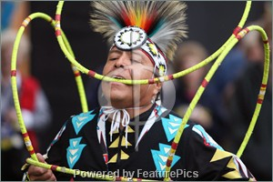
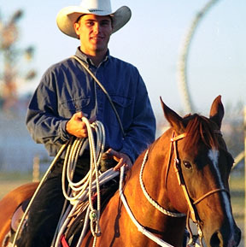
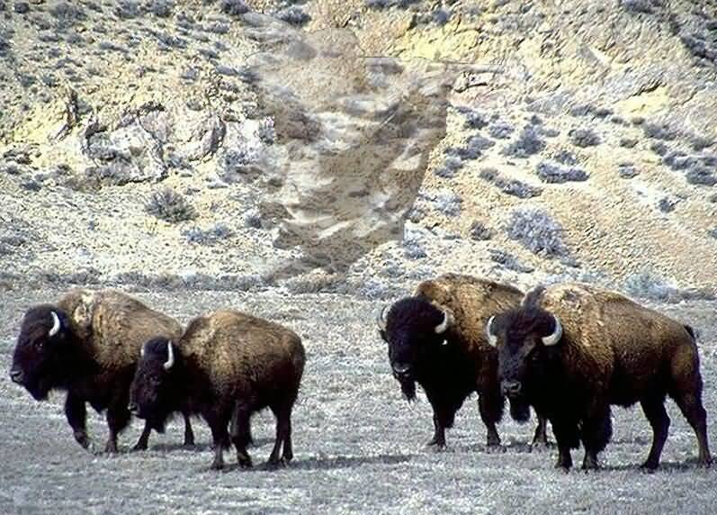
To Preserve Unimpaired
The
Cultural
Resources

Slide 10
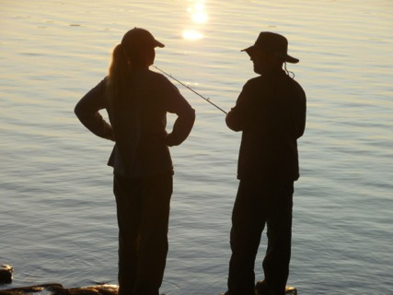
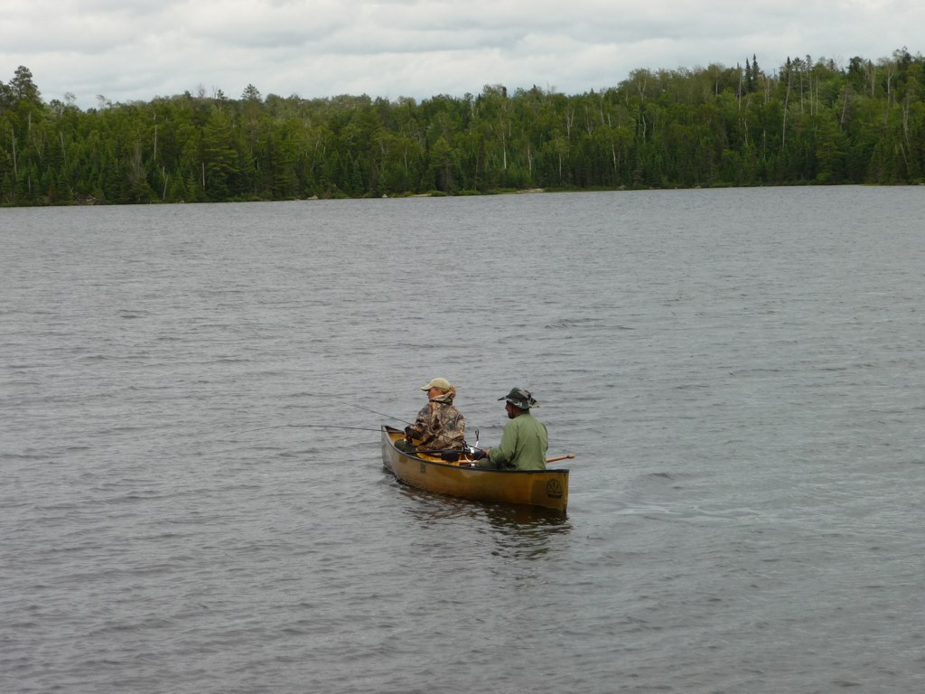
For the People
Enjoyment

Slide 11
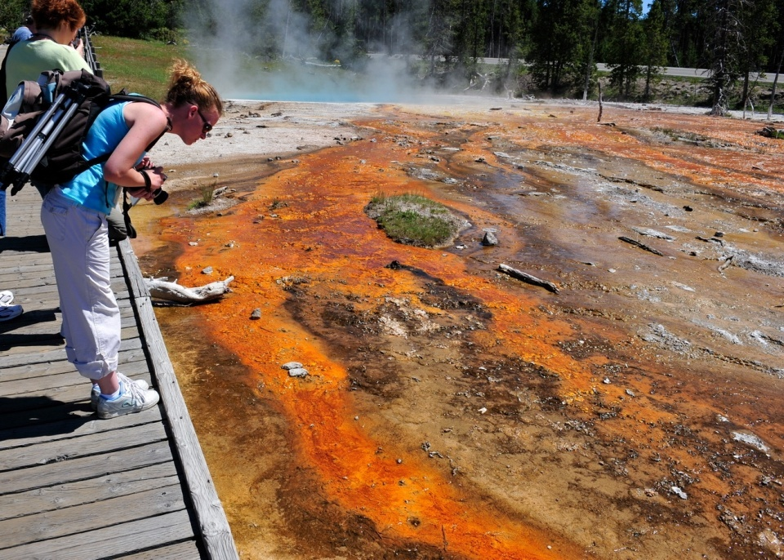
For the People
Education

Slide 12
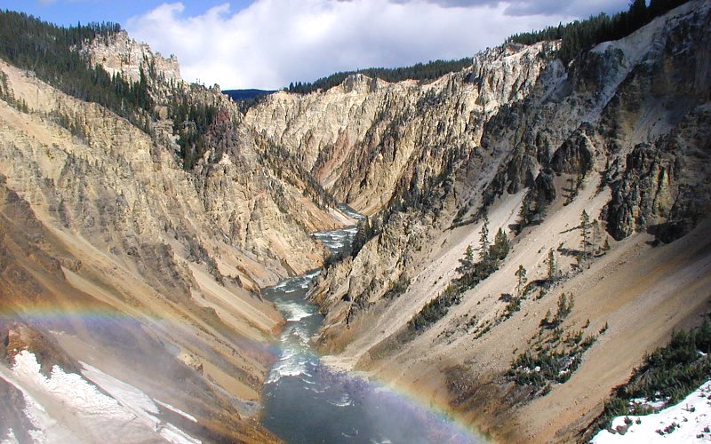
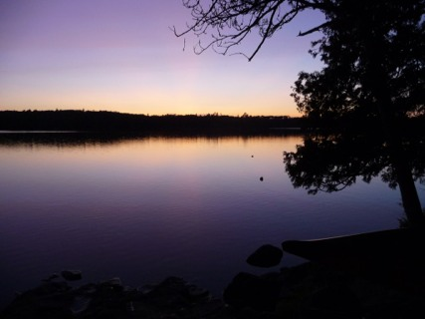
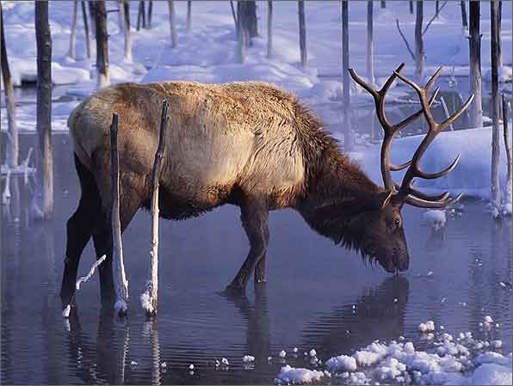
For the People
Inspiration

Slide 13
THE ISSUES
How do your students tip the scale?

Slide 14
WILDLIFE MANAGEMENT

Slide 15
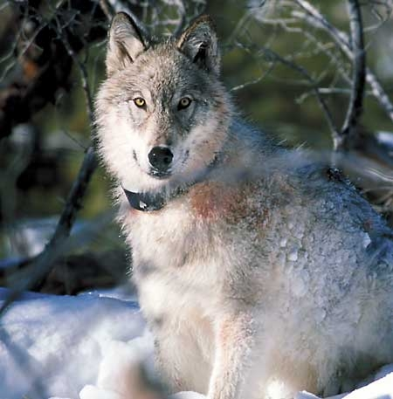
Asking the Right Questions
Wildlife Management
Once we “manage” wildlife, can it still be considered wild?

Slide 16
Wildlife Management Bison in Yellowstone
The Yellowstone Bison herds, which once numbered in the millions, are now the only remaining genetically pure bison herds reduced to 2,500 to 3,000 animals.

Slide 17
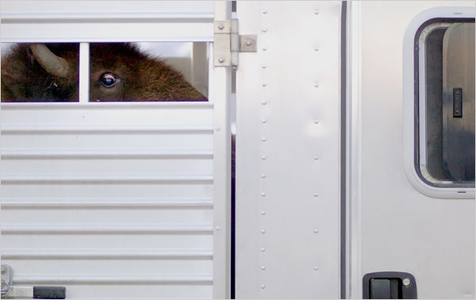
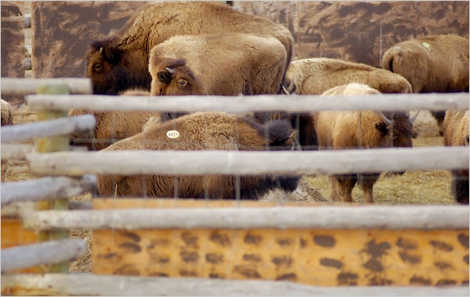
Bison Management
Hunting Capture for Slaughter

Slide 18
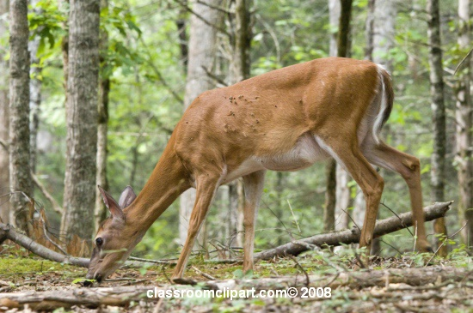
Wildlife Management Whitetail Deer in Indiana
Changes to the landscape and to interactions among wildlife species brought about by humans are responsible for the current high densities of whitetail deer and their pervasive effects on the ecosystem.
(Lathum, 2005)

Slide 19
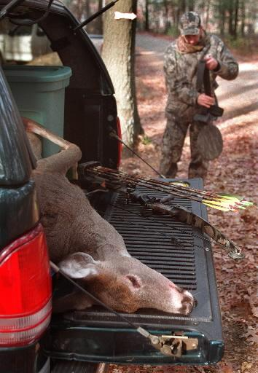
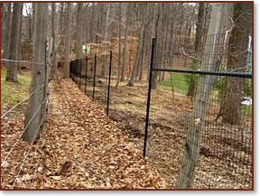
Whitetail Deer Management
Deer exclosures Hunting

Slide 20
Wolves in Yellowstone
“Wolves are here so we need to manage them. They are part of this landscape and limits should be imposed only when there is too much stress on the land.”
~ Bruce Malcolm
Montana rancher

Slide 21
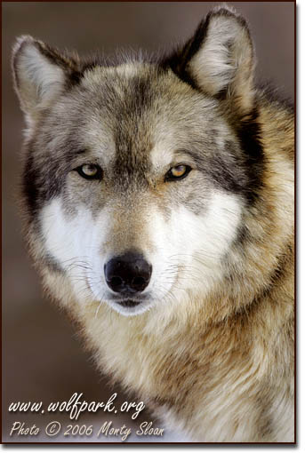
Wolves in Indiana
Along with research and seminars on wolf behavior, particularly reproductive and inter-pack social behavior, Wolf Park provides interpretive programs to school groups throughout the year.

Slide 22
OUR CULTURAL HERITAGE

Slide 23
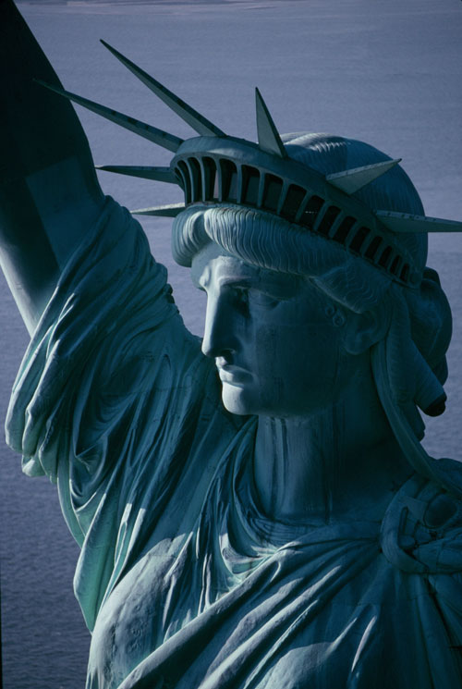
Asking the Right Questions
What makes us American?
Can Native American culture be preserved?
What does culture mean to you?

Slide 24
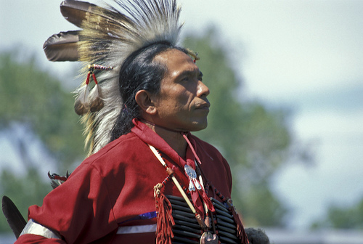
Native Americans Our Cultural Heritage
“As westward expansion continued, we repeatedly heard the references to the wilderness. It wasn’t the wilderness to us. It was home.”
~ Patrick Hill
Crow tribal leader

Slide 25
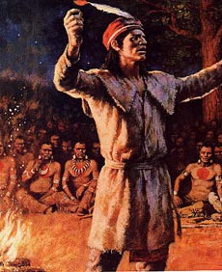
Indiana Native Americans
The pride and honor of Tecumseh and the Prophet are evident in local lore and within our state park system. Who we are as Hoosiers has evolved from those early days of expansion and it took place in our own backyards.

Slide 26
LAND USE AND DEVELOPMENT

Slide 27
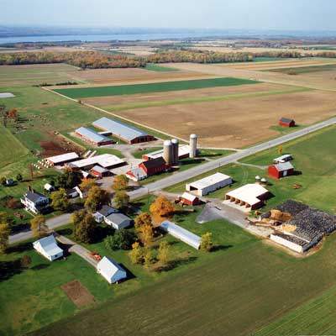
Asking the Right Questions
Should small farms or ranches be saved?
What are the effects of urban sprawl?
Should farmers and ranchers be subsidized?

Slide 28
Land Use in the Greater Yellowstone Area
"As the population expands out into a lot of the areas that have been traditional habitat for deer, elk, lions, bears--everything--the animals aren't leaving,“
~ Rich Clough, Missoula administrator for Fish, Wildlife and Parks.
As generational ranches fail to be productive or to be passed on to the next generation, development occurs.

Slide 29
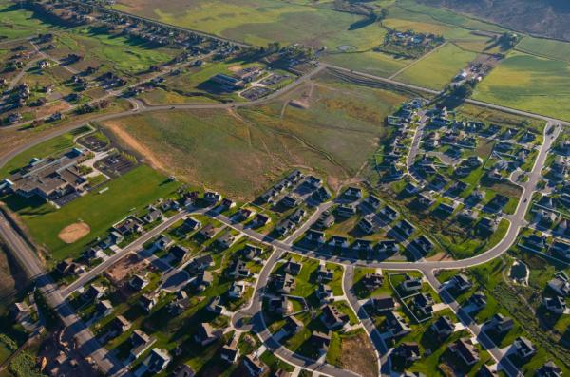
Land Use in Tippecanoe County
As of 2009, Tippecanoe county's population is 164,237 people. Since 2000, it has had a population growth of 111.99 percent. What was once farmland has become subdivisions.

Slide 30
RESTRICTED PUBLIC USE

Slide 31
Asking the Right Questions
Who makes up the “public”?
Does equal always mean fair?
How should the public be represented?

Slide 32
Winter Land Use in YNP
Restricted winter use within Yellowstone National Park has been long debated and the ecological concerns continue to conflict with the notion of a “public” park system.

Slide 33
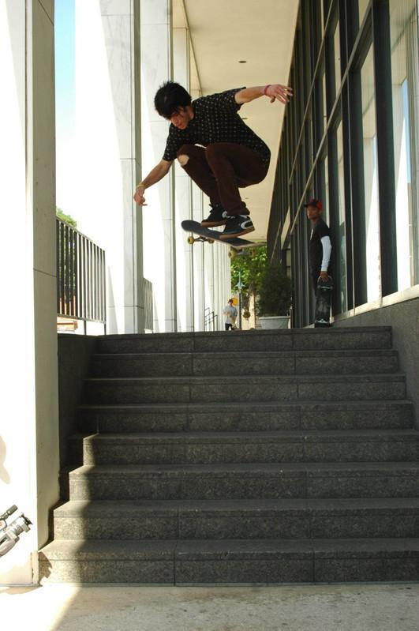
Public Land Use in Lafayette
Use of public areas such as parks, libraries and school properties often restrict public use.

Slide 34
SPECIAL INTEREST GROUPS

Slide 35
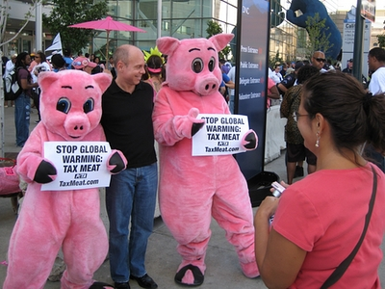
Asking the Right Questions
What defines a special interest group?
Would you risk your personal safety for a cause?
What makes a group “radical”?

Slide 36
Special Interest Groups
The Buffalo Field Campaign:
“Working in the field every day to stop the slaughter of Yellowstone's wild free roaming buffalo.”

Slide 37
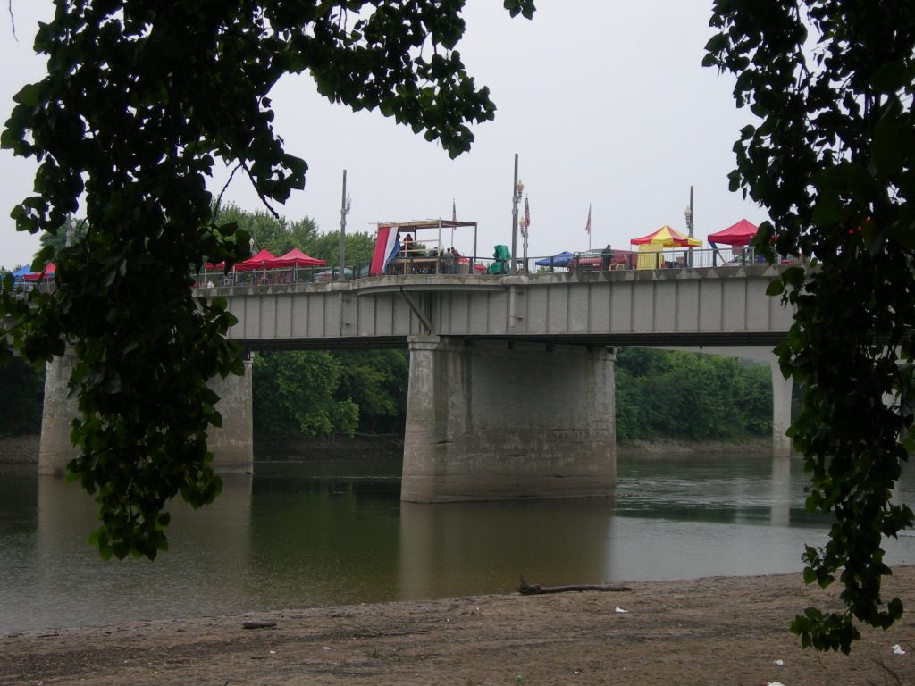
Citizens in Action of Lafayette
The Lafayette based Citizens in Action group, as part of a national movement, organized a tax protest in April and dumped tea into the Wabash River.

Slide 38
WHAT IS THEIR BEST IDEA?
Ask your students to
state their ideas.
explain their ideas.
defend their ideas.

Slide 39
ASK YOUR STUDENTS
In their language arts classes…
In their science classes…
In their social studies classes…
In their mathematics classes…
In their elective classes…
“What is your best idea?”.
Life is not
divided up by content areas.

Slide 40
Our Best Idea by Ken Burns
“ I prefer to think of Yellowstone, and by extension all national parks, a bit differently-not as something we have preserved, but also something we’ve accomplished: one of America’s best ideas.”

Slide 41
Our Best Idea
“So no, I’m not done with our national parks. Far from it. In these troubled times it’s nice to know they’re out there. By the people. For the people. And for all time.”
~ Ken Burns, National Geographic Adventure, June/July 2009

Slide 42
Asking the Right Questions
How can you make it relevant for your students?
How can you bring the world to your classroom?
How can you profoundly effect and engage your students?
Do you want to educate all children well?

Slide 43
I would like to thank and recognize the following individuals:
John Conant for making this experience possible.
Charlie Amlaner for his insights and his wonderful photographic images that far surpassed my own, so I used his.
Randy Brist for the photographs of my husband Greg and I in The Boundary Waters Wilderness Area.
The members of the Oakland High School team for taking the time away from home to “get out there” in an effort to serve our children well.

