Slide 1
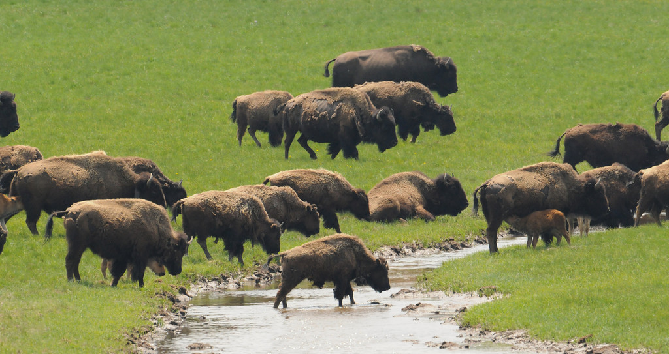
Yellowstone Bison Genetically Pure Population

Slide 2
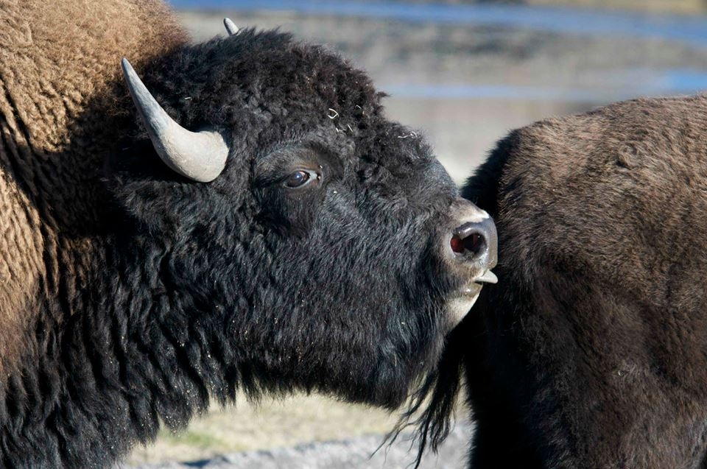
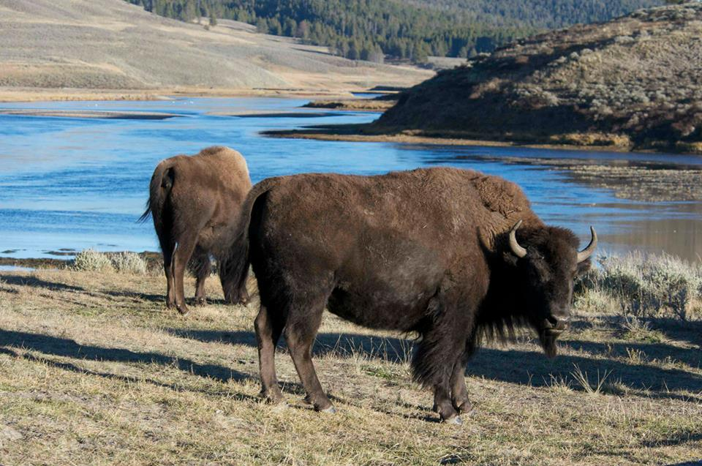
YNP Bison
* About 50% test + for exposure to brucellosis.
* Can cause bison & cattle to abort their first calf.
* Because YNP Bison migrate onto lands used by ranchers to graze cattle, MT has, at times, lost its Brucellosis free status, a real concern.

Slide 3
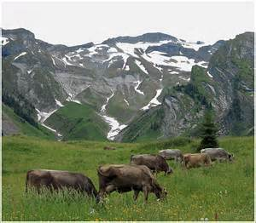
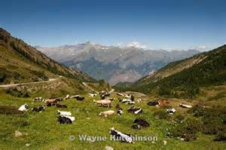
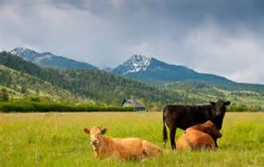
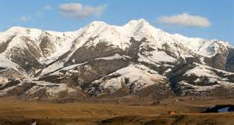
Cattle Ranching: A Way of Life in Paradise Valley
Summer Range Only
Breeding Stock

Slide 4
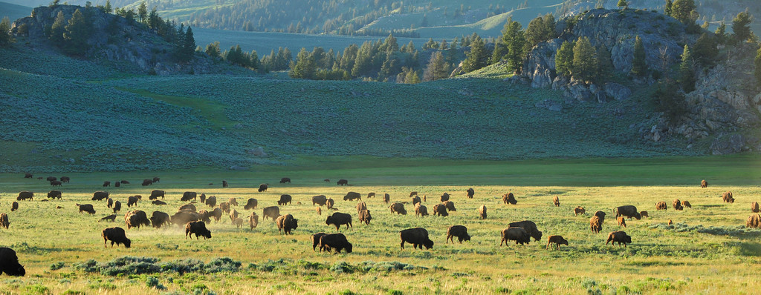
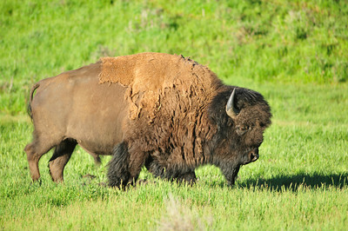
Brucellosis in YNP
* Bison probably contracted from cattle raised in park for visitors/employees in early 1900s.
* Spread by contact with infected tissues & birth fluids shed in spring.
* Human form (undulant fever) can be nasty.

Slide 5
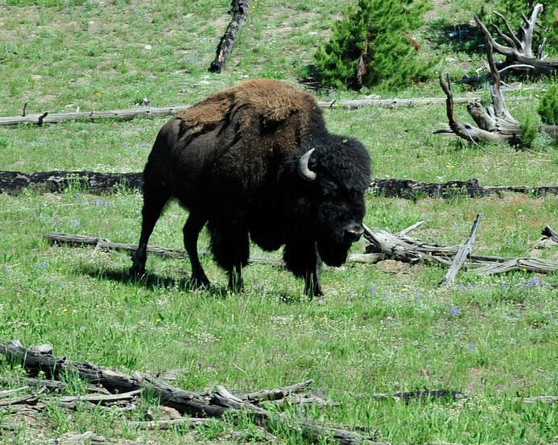
Brucellosis in YNP
* Vaccine for cattle, RB51 is not very effective.
* Transmission mechanism is debated.
Elk and other undulants in YNP carry
brucellosis.

Slide 6
Brucellosis History in YNP
* “Some” bison are now tolerated outside park until May 15.
* Cattle have been removed from N boundary.
* Brucellosis free status in MT 1985 & public “hunts” kill 600 bison in 1989. Hunts end 1990.
* 1995 MT files lawsuit against NPS, mgt plan begins 1996.
* 1997 unusually sever winter - >1000 YNP bison killed.
* 1998 only 94 killed, Draft EIS released, 67,000 comments.
* 2000 Fed Judge orders mediation. Final EIS
* 2005 FWP & APHIS open quarantine facility. Bison vaccinations.

Slide 7
Brucellosis History in YNP
* 2006 1000 removed from YNP thru mgt action, quarantine, or hunting (Native Am only).
* 2008 Another sever winter, 2000 bison removed plus large “winter kill”. Revision of Mgt Plan. Some bison tolerated outside park until May 15
* Church of Universal Triumphant – Up to 100 “sero-negative” outside N boundary plus up to 100 outside W. + Up to 100 “untested”.

Slide 8
Debated Issues
Abundance – how many are enough? How many can YNP “carry”?
Distribution – where tolerated outside park?
Brucellosis – what can be done to suppress and reduce transmission?
Genetics – preservation of genetic diversity and population substructure?
Habitat – human intervention?
Wildness – appropriate mgt practices: “preserve native species and ecological processes that sustain them”?

Slide 9
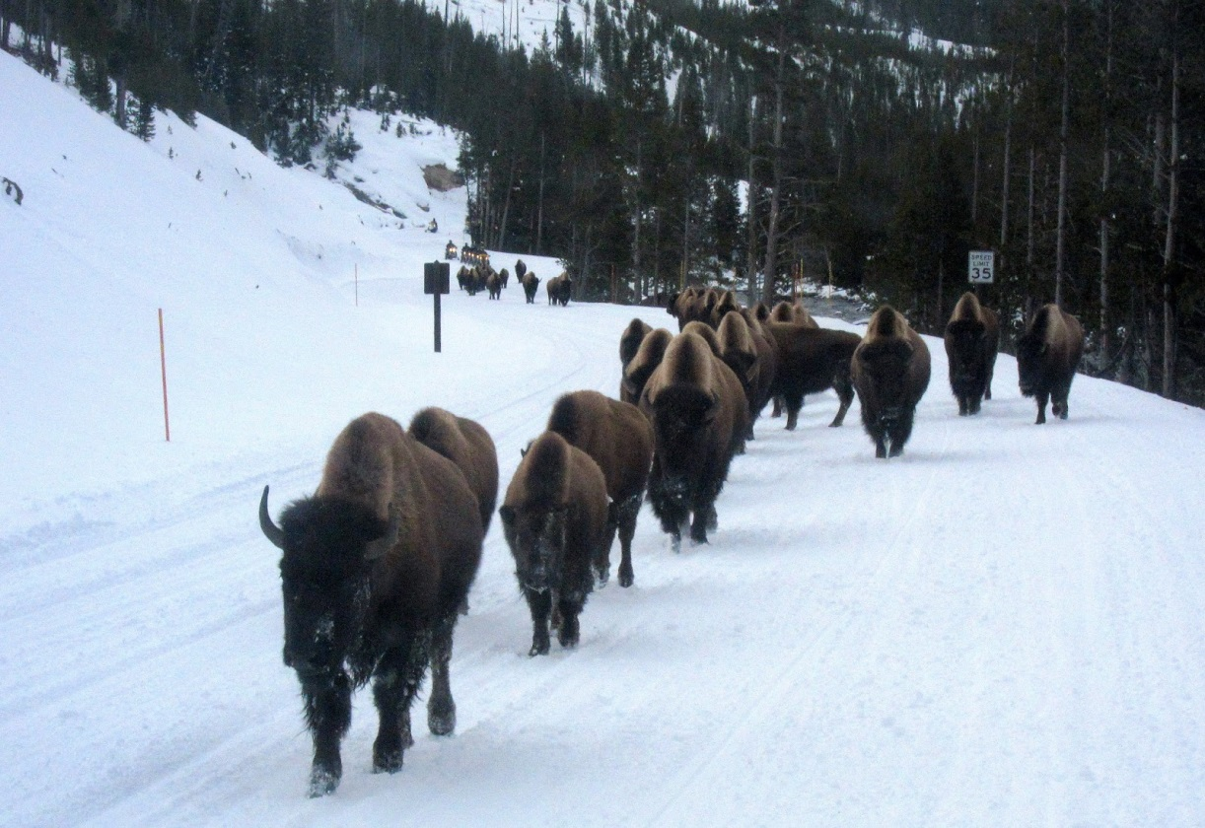
Jurisdictions & Interests
Bison move between YNP (NPS) & MT (State & NFS).
Are Bison wildlife (Elk) or domestic (cattle)?
Court mediated agreements, not “science” or “Best Practice”.

Slide 10
IBMP
Final EIS for IBMP for MT & YNP adopted 2000.
Adaptive management plan for implementation 2008.
www.ibmp.info provides documents for the public.
Partners: NPS, APHIS, USFS, MT DOL, MT FWP, Inter-Tribal Buffalo Council (ITBC), Nez Perce and Flathead Nations.

Slide 11
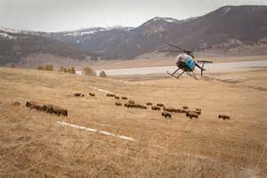
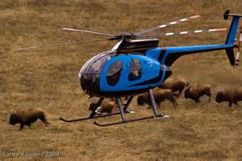
IBMP Objectives
Maintain wild, free-ranging bison population.
Reduce risk of brucellosis transmission to cattle.
Maintain role of bison in YNP ecosystem (grazers and food for carnivores, etc).

Slide 12
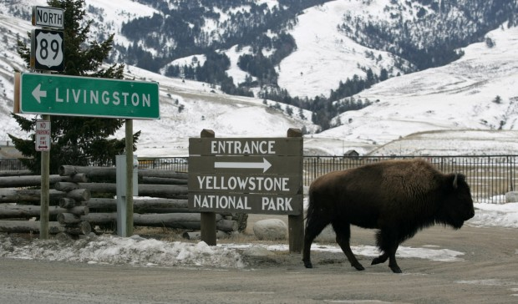
IBMP Objectives
Maintain genetic integrity of population.
Prevent dispersal beyond conservation area.
Lower brucellosis prevalence (not native)

Slide 13
IBMP
IBMP meets several times per year in public venues to review, evaluate, and modify operating procedures for accomplishment of plan objectives.
“Treaty harvests” provide meat to Native Tribes for consumption and restoration of bison to tribal lands to improve cultural, economic, and social well-being of Native Tribes.

Slide 14
Bison FAQs
Summer 2014 about 4.900 Bison in YNP.
2000 Mediated settlement between US Ag and Interior and MT sets Bison limits near 3,000.
No natural predators.
NPS Biologists proposed removing 900 Bison near N boundary (Gardiner) this winter (‘14-’15) to reduce 2015 pop growth and reduce potential for “mass migration” into MT.

Slide 15
Bison FAQs
If bison pop. were allowed to increase & disperse naturally into cattle occupied MT, it is likely they would be “removed” by the state.
MT has superseding management authority outside the park.
Management practices by MT include, hunting, hazing, & capture to limit distribution of bison.

Slide 16
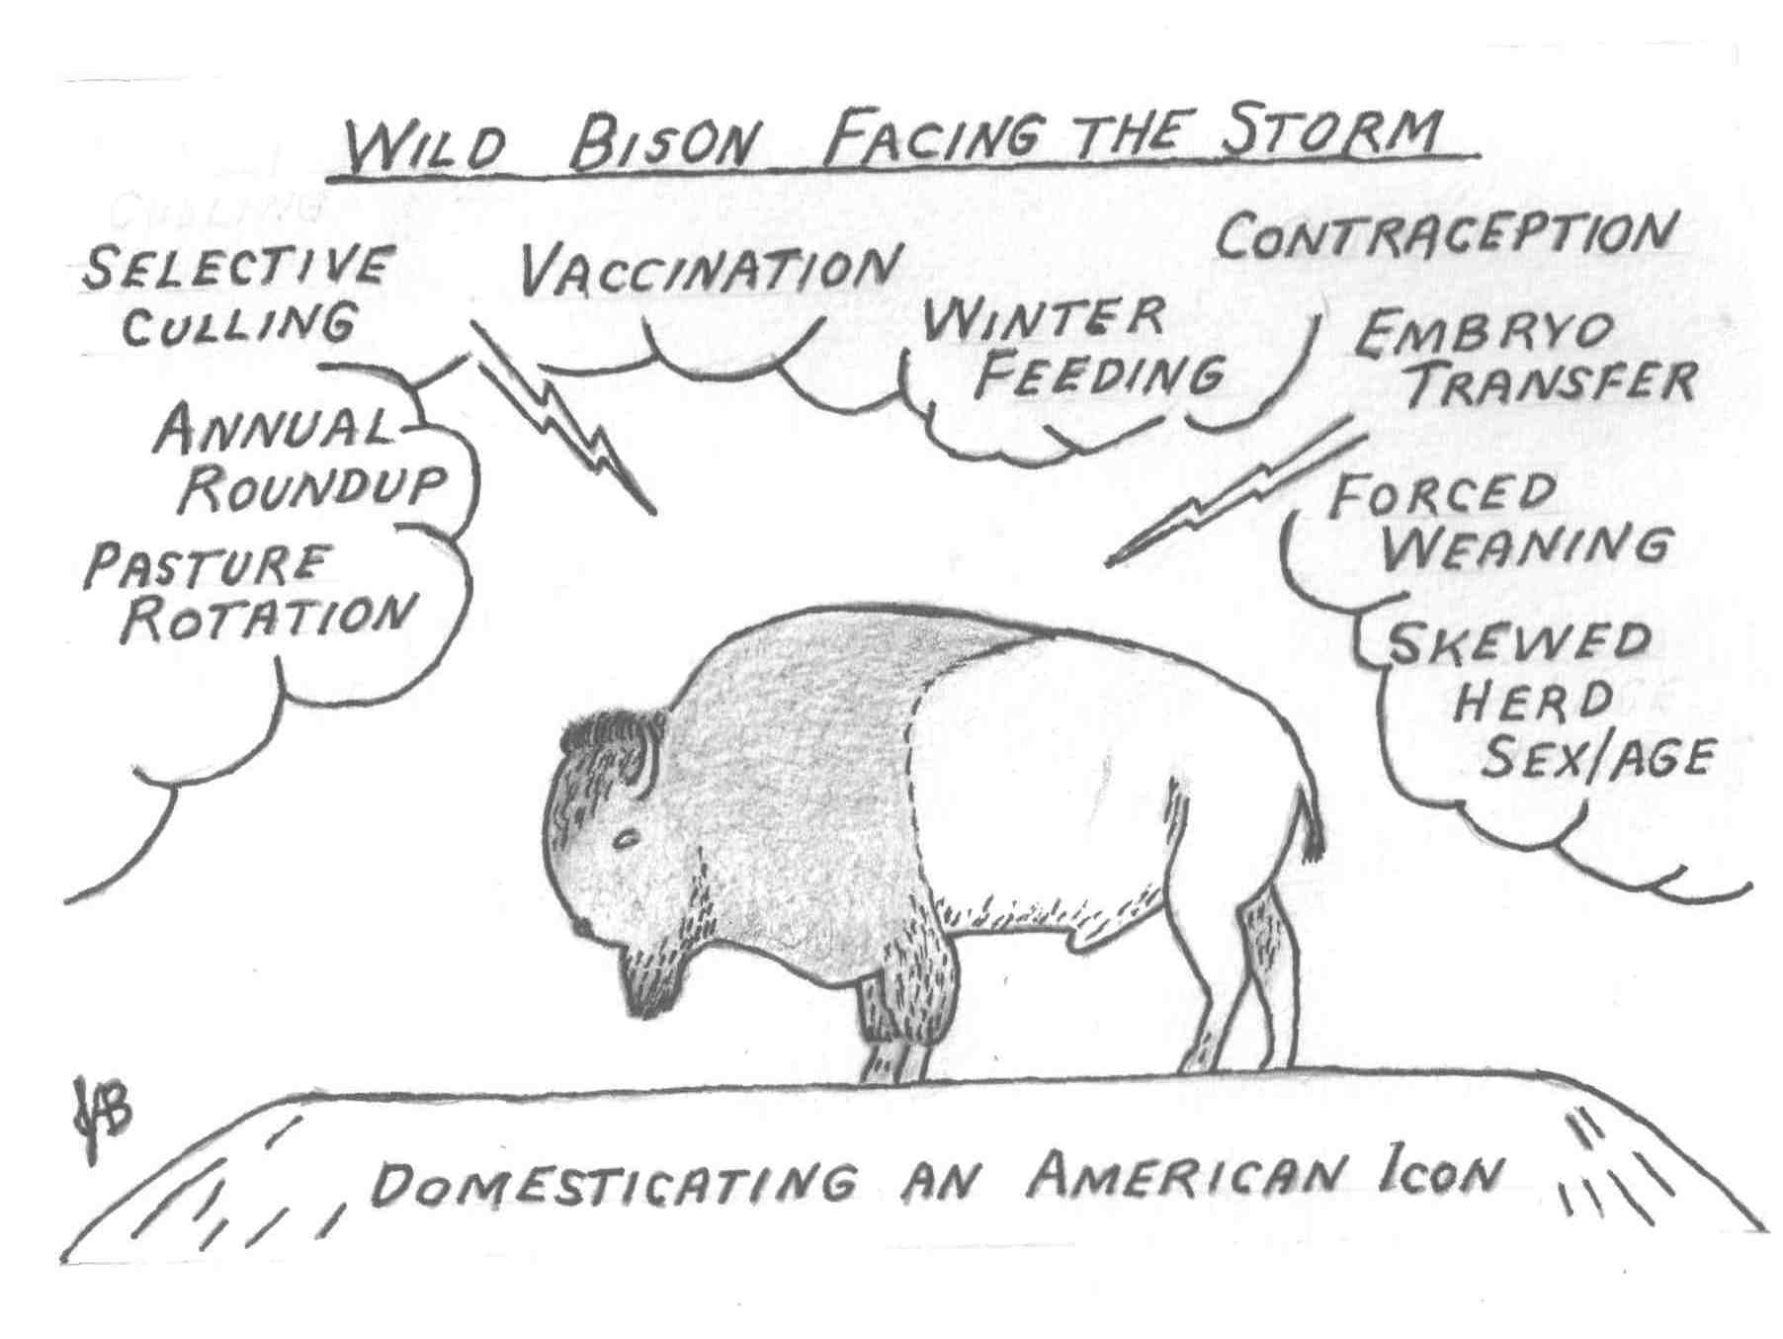

Slide 17
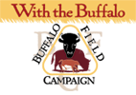
BFC Vision, Mission, Values
Vision- We envision a life for buffalo in which they thrive within the state of inherent wildness as expressed in the Buffalo Bill of Rights. We also envision a world in which buffalo and all other native wildlife are given precedence on public land, and that buffalo herds will remain as a self-regulating sustainable population, and a viable genetic source for the future evolution potential of the species. Mission- To stop the slaughter of Yellowstone’s wild buffalo herd, protect the natural habitat of wild free-roaming buffalo and native wildlife, and to work with people of all Nations to honor the sacredness of the wild buffalo.
Core Values- Sustainability, Community, Education, Wildlife, Co-existence, Ecology/Phenology, Environmental Activism, Preservation, Sound Science, Respect, Integrity, Honor, Spirituality, Creativity, Fun, Not bound by convention, Non-violence, Open Communications, and Honor all cultures and celebrate diversity

Slide 18
The last wild, migratory buffalo populations are currently estimated at fewer than 4,500 individual animals, living in and around Yellowstone National Park. Wild, migratory bison are ecologically extinct throughout their native range in North America.
2014-2015 Total Buffalo Killed: 522 (+/-) Government Capture: 500 (+/-) Buffalo Released from Capture: 0 Government Slaughter: Tribal - ITBC & CSKT Slaughter: 338 (+/-) Died in Government Trap: 3 Died in Government Research Facility**: Miscarriage in Government Trap: State Hunt: 26 Treaty Hunts: 148

Slide 19
Where do Buffalo Really Roam?
Nature Conservancy – 2008 a small herd is reintroduced at Broken Kettle Grasslands in Iowa.
Other large free-ranging, publicly controlled herds exist in:
Wind Cave NP (SD 200-400) Antelope Island SP (Utah 600-700) Custer SP (SD 1300) Henry Mtn herd (Utah 300-500)
National Bison Range (MT 400)
YNP is working to move YNP bison to other federally owned lands and have done so a couple of times already.

Slide 20
American Prairie Reserve
2005 first bison introduced (16).
Since then bison have been brought in from Elk Island NP in Canada (from MT in early 1900’s – 238 total in 3 groups 2010, 2012, 2014).
This prairie has been expanded to 31,000 acres by 2013.
APR has donated bison to 2 National Wildlife Refuges and the Fort Peck Indian Reservation.
APR Bison Report

Slide 21
Feasibility of quarantine procedures for YNP bison calves for conservation of brucellosis free bison\ J of Am Vet Medical Assoc
Objective
—To determine the feasibility of qualifying individuals or groups of Yellowstone National Park bison as free from brucellosis.
Design
—Cohort study.
Sample
—Serum, blood, and various samples from live bison and tissues taken at necropsy from 214 bison over 7 years

Slide 22
Feasibility of quarantine procedures for YNP bison calves for conservation of brucellosis free bison
Procedures
—Blood was collected from bison every 30 to 45 days for serologic tests and microbiological culture of blood for
Brucella abortus
-- Seropositive bison were euthanized until all remaining bison had 2 consecutive negative test results. Half the seronegative bison were randomly euthanized, and tissues were collected for bacteriologic culture. The remaining seronegative bison were bred, and blood was tested at least twice per year. Cow-calf pairs were sampled after calving and 6 months later for B abortus.

Slide 23
Feasibility of quarantine procedures for YNP bison calves for conservation of brucellosis free bison
Results
—Post-enrollment serial testing for B abortus antibodies revealed no bison that seroconverted after 205 days (first cohort) and 180 days (second cohort).
-- During initial serial testing, 85% of bison seroconverted within 120 days after removal from the infected population.
-- Brucella abortus was not cultured from any euthanized seronegative bison (0/88).
-- After parturition, no cows or calves had a positive test result for B abortus antibodies, nor was B abortus cultured from any samples.

Slide 24
Feasibility of quarantine procedures for YNP bison calves for conservation of brucellosis free bison
Conclusions and Clinical Relevance
—Results suggested it is feasible to qualify brucellosis-free bison from an infected herd following quarantine procedures as published in the USDA APHIS brucellosis eradication uniform methods and rules.
-- Latent infection was not detected in this sample of bison when applying the USDA APHIS quarantine protocol.
-- J Am Vet Med Assoc 2014; 244:588-591)

Slide 25
Bottom Line of the Study
The ability to obtain brucellosis-free bison from exposed populations now gives herd managers, whose previous population control options were primarily limited to slaughter, an outlet to remove live bison from their herds.
In the future, any entity, whether private, tribal, academic, or governmental with the intention of operating a facility to obtain brucellosis-free bison can use the methodology used in this study as a foundation to create a testing regimen applicable to their source population.

Slide 26
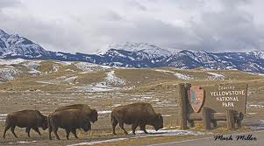
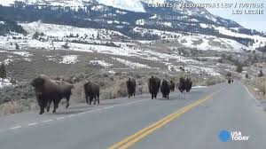
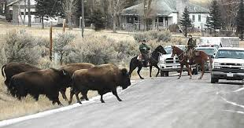
Why do Bison leave YNP? Why is that a problem?
Rick Wallen - NPS

Slide 27
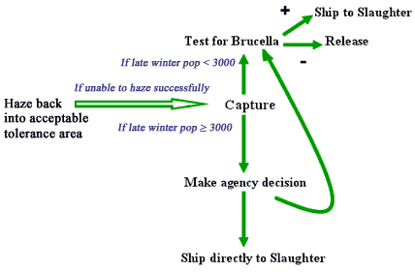
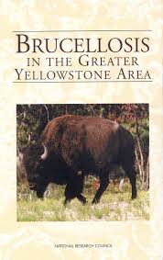
What is brucellosis?
Brucellosis and Bison

Slide 28
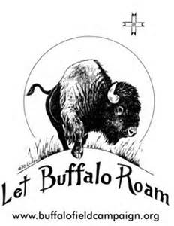
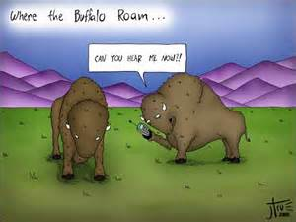
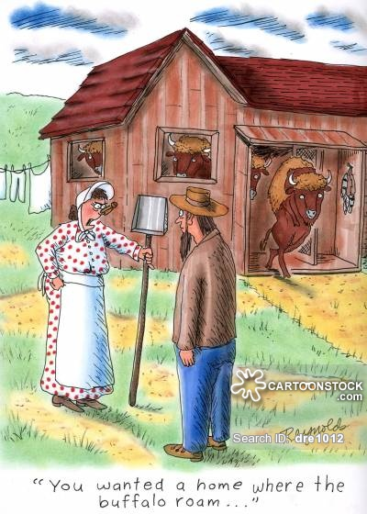
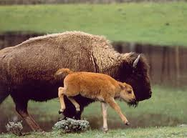
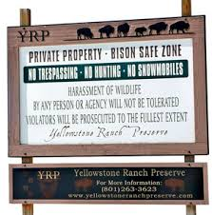
Land is Scarce
Finding Space for an American Icon

Slide 29
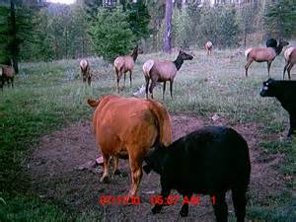
Why are Elk Managed Differently?
Management of Elk
Population

Slide 30
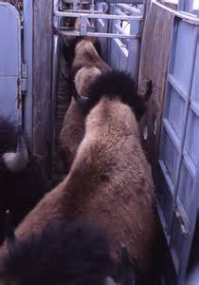
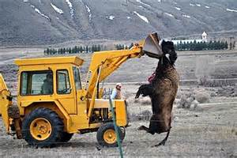
Alternatives to slaughter?
Rick Wallen - NPS

Slide 31
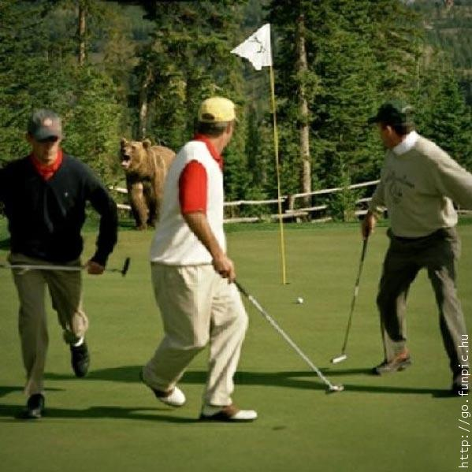
Recreation in GYE: Or why no golf courses!
Mind if I play
through, fella’s?

Slide 32
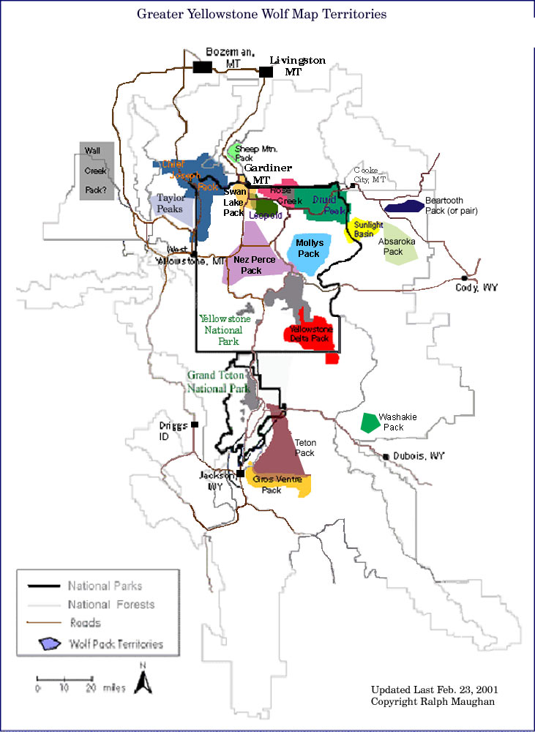
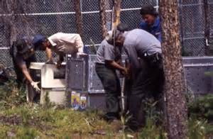
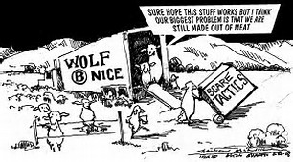
Environment for Wolves: Natural & Political

Slide 33
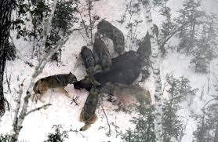
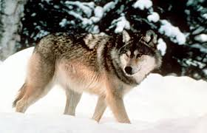
Wolves – Balancing Yellowstone, but what about the rest of the GYE?
1920’s – extermination of Yellowstone’s gray wolf, the “apex” predator, triggers an ecosystem collapse known as a “trophic cascade”.
1995 – thru use of ESA the gray wolf is reintroduced to the ecosystem.

Slide 34
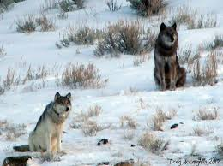
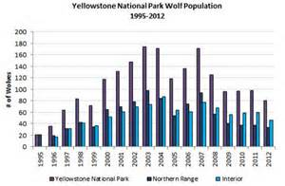
Wolves in YNP 2013 wolf report
Winter ’13-‘14 400-450 in GYE, 95 counted in 10 packs YNP (20% collared).
Typical park home range 200-300 sq miles.
Typical life-span 3-4 years in wild, but can live 10 or more.

Slide 35
Current Wolf Management
As a recovered population, wolves are now managed by
the appropriate state, tribal, or federal agencies.
Within Yellowstone National Park, no hunting of wolves
is allowed. Outside the park, regulated hunting is allowed
and managed by the respective states where wolves occur.
Because wolves do not recognize political boundaries, and
often move between different jurisdictions, the harvest of
some wolves that live within the park for most of the year,
but at times move outside the park, occurs

Slide 36
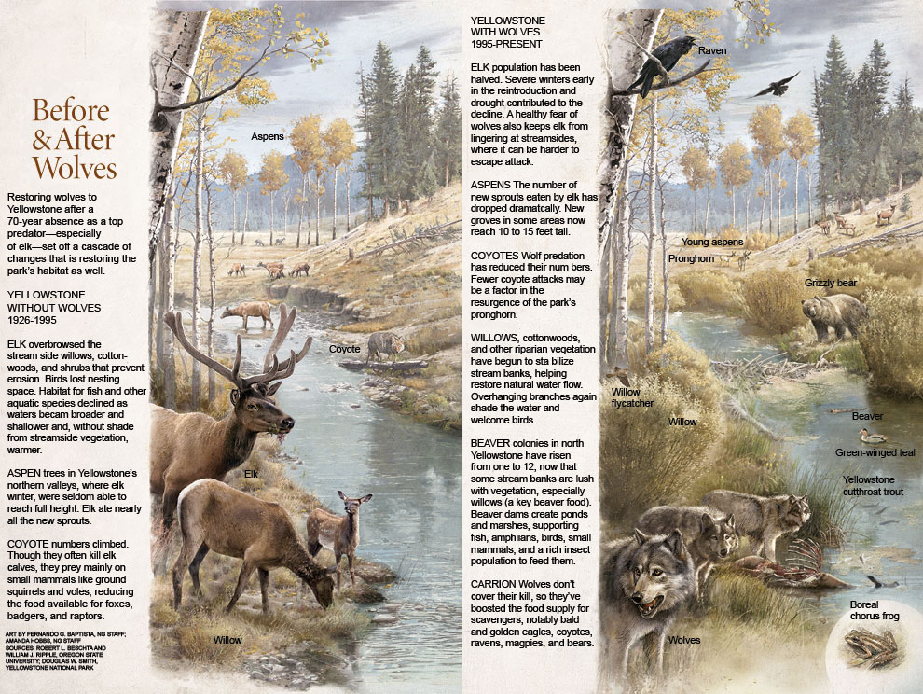

Slide 37
Yellowstone Before Reintroduction After 70 Year Absence (1926-1995)
Elk over browse creeksides (willows, cottonwoods) which prevent erosion.
Birds lose nesting space.
Fish habitat suffers (streams become wider, shallower, and warmer (no shade)).
Aspen in N valleys suffer as Elk eat all new sprouts.
Coyote numbers rise and hence small mammal populations are reduced.
Foxes, Badgers, and Raptor populations decline.

Slide 38
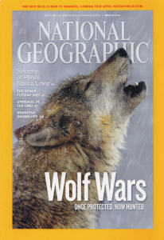
National Geographic, March 2010
Wolf Wars
Packs are making a comeback. That’s a thrill for wildlife lovers. But wolves are still wolves, killing cattle and elk. Many Westerners are angry. And so, the age-old fight over land and food has begun anew.

Slide 39
YNP With Wolves (since 1995)
Elk population cut in half.
Fear of wolves keep elk from lingering creekside where it is harder to escape.
New Aspen groves have now reached 10’-15’.
Coyote population down thru wolf predation.
Stream banks are stabilizing restoring natural water flow. Shade from overhanging returns.
Beaver colonies are back which create ponds & marshes which supports insect populations and the small animals that eat them.
Wolf kills provide food for scavengers (birds, coyotes, even bears).

Slide 40
Wolf Program
FWP obtained full authority to manage wolves in Montana upon the federal delisting of the Rocky Mountain gray wolf in May 2011.
FWP is committed to responsibly manage Montana’s wolf population while addressing conflicts with livestock and other wildlife populations.
FWP is further committed to allowing hunters, to become even more involved in Montana’s approach to wolf management.

Slide 41
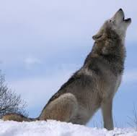
MT Fish, Wildlife & Parks
Focus is ensuring that Montana’s conservation and management program keeps the wolf off the federal endangered species list while pursuing a wolf population low enough to manage impacts on game populations and livestock.

Slide 42
DRAFT MONTANA PROTOCOL TO ADDRESS WOLF-LIVESTOCK CONFLICTS
1. Maintain a viable and connected wolf population in Montana.
2. Maintain authority for State of Montana to manage wolves.
3. Maintain positive and effective working relationships with livestock producers, hunters, and other stakeholders.
4a. Reduce wolf impacts on livestock.
4b. Reduce wolf impacts on big game populations.
4c. Maintain sustainable hunter opportunity for wolves.
4d. Maintain sustainable hunter opportunity for ungulates.
5. Increase broad public acceptance of sustainable harvest and hunter opportunity as part of wolf conservation.
6. Enhance open and effective communication to better inform decisions
7. Learn and improve as we go.
This protocol will be assessed in not more than one year to determine its effect on overall effectiveness relative to livestock losses, agency response times and related costs, and the wolf population itself.

Slide 43
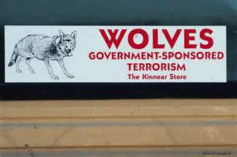
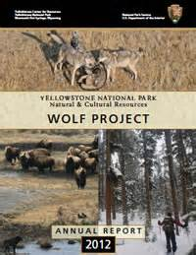
YNP Wolf Project
Why Reintroduce Wolves to YNP and GYE?

Slide 44
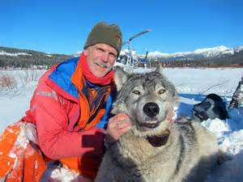
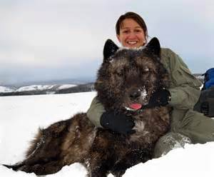
Wolves in YNP
How do wolves benefit the GYE?

Slide 45
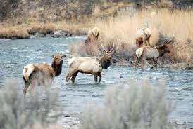
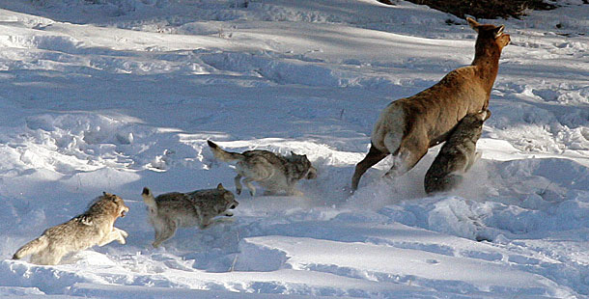
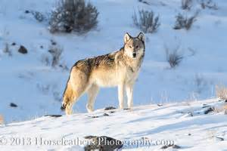
Wolves & Elk Population
Wolves Affect Elk Population

Slide 46
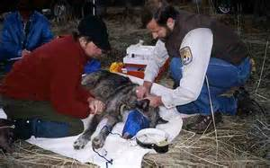
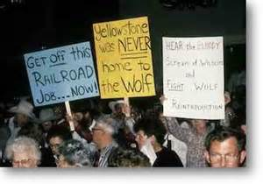
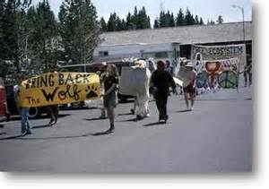
Wolf Mgt Challenges
Predators Crossing Park
Boundaries

Slide 47
US Fish & Wildlife Service Gray Wolves in the Northern Rocky Mtns

Slide 49
MT reports decrease in wolves, attacks on livestock
The Spokesman-Review, April 9, 2015
# 1 Most Commented Article of the Week w/ 50 comments posted.

Slide 50
MT Fish, Wildlife & Parks Weekly Wolf Report
Report lists “wolf-livestock conflicts” and “wolf capture, collaring, & removal activities”.
PROGRAM UPDATES: Weekly reports for 2015 will be shown in an additive, running tally fashion.
Montana Annual Wolf Report can be found on the FWP website
http://fwp.mt.gov/fishAndWildlife/management/wolf/

Slide 51
Wolf Videos from MT FWP http://fwp.mt.gov/education/videoLibrary/videoSearch.html#
Wolf Monitors
The Real Wolf Man (Ed Bangs)
Day to Day Wolf Work
Wolf Hunting Season

