Slide 1
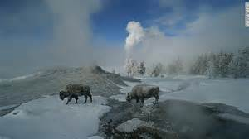
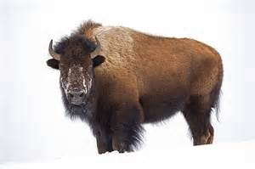
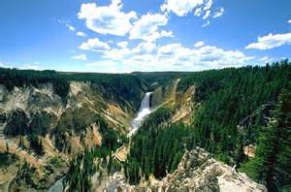
Public Choice Mechanisms: Conflicts in Yellowstone

Slide 2
Public Choice: A Public Decision Making Process
The trade-off between tourism and environmental protection that shaped the historic landscape remains important for the politics of the Yellowstone region.
The debate over snowmobiles, bison, wolves, fire management or bio-prospecting in Yellowstone are just examples of these trade-offs.
For example, snowmobiles and snowcoaches are popular among winter visitors. They are important for the economy of West Yellowstone, Montana. They are also noisy, affecting other visitors and some species of wildlife.

Slide 3
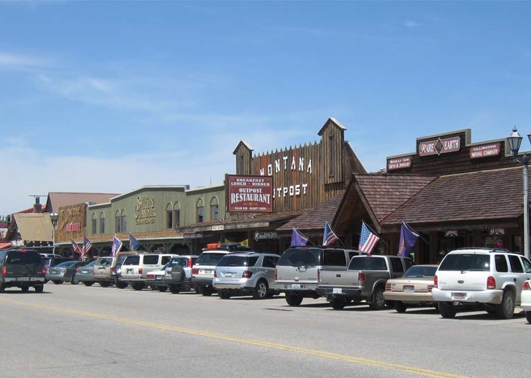
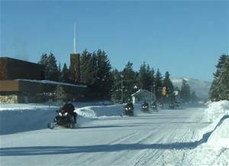
Public Choice: A Public Decision Making Process
The political debates here involve differences in values as well as the economic interests of communities that depend on the park.
What we need to consider is: How does the American Society make these decisions. What is the parallel to Profit or Utility Maximization?

Slide 4
Public Choice Theory
Public Choice Theory applies the methods and theories of economics to the analysis of political behavior.
Modeling of the behavior of individuals in the public sector is assumed to be driven by the same goal of utility maximization as individuals in the private sector or as consumers.

Slide 5
Collective Choice Processes
The individual becomes the fundamental unit of analysis. Public choice rejects the construction of organic decision-making units, such as “the people,” “the community,” or “society.” Groups do not make choices; only individuals do.

Slide 6
Collective Choice Processes
Public and private choice processes differ, not because the motivations of actors are different, but because of stark differences in the incentives and constraints that channel the pursuit of self-interest in the two settings.

Slide 7
Key Conclusion of Public Choice Economics
One key conclusion of public choice is that changing the identities of the people who hold public office will not produce major changes in policy outcomes.
Institutional problems require institutional solutions.

Slide 8
Government Failure
Government failure is the public sector analogy to market failure and occurs when a government intervention causes a more inefficient allocation of goods and resources than would occur without that intervention.
Likewise, the government's failure to intervene in a market failure that would result in a socially preferable mix of output is referred to as passive Government failure

Slide 9
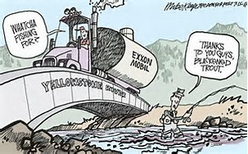
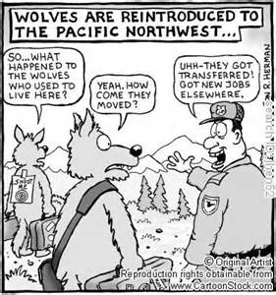
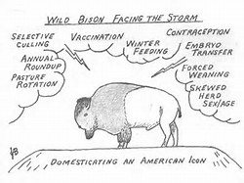
Fail: Market or Gov’t

Slide 10
Government Failure
However, while market failure has been widely studied, government failure has only recently come into common usage as the lenses of public choice theory and the new institutional economics have begun to explore the problems.
Just as a market failure is a problem which prevents the market from operating efficiently, a government failure is a systemic problem which prevents an efficient government solution to a problem.

Slide 11
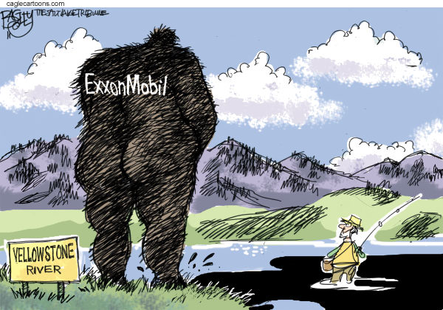
Types of Market Failure
Public Goods
Externalities
Market Power High Transaction Costs
Agency Problems
High Transaction
Costs
Information Asymmetry

Slide 12
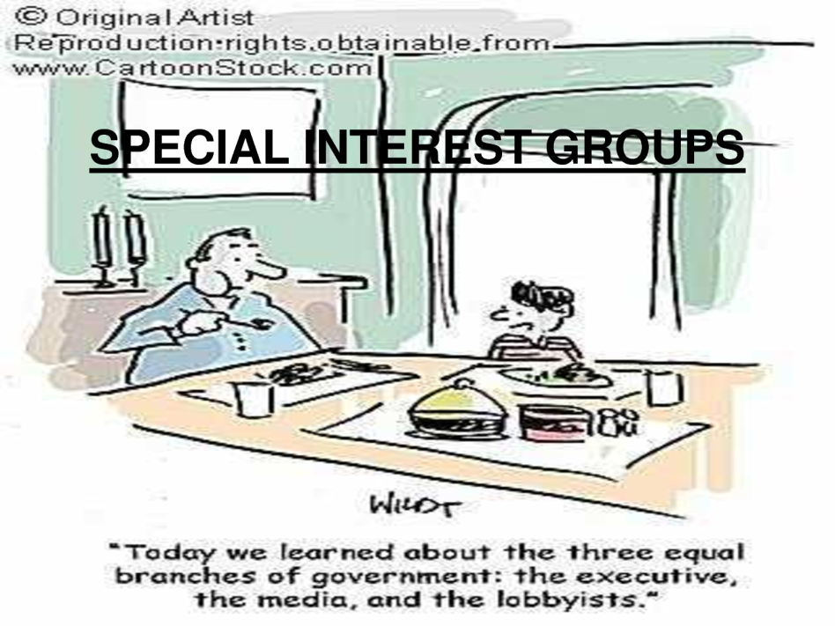
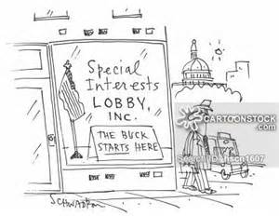
Types of Government Failure
Log Rolling
Pork Barrel Spending
Special Interest Bias
Political Bias
Crowding Out
Regulatory Capture
Subsidies & Taxes
Rent Seeking
Secondary Effects

Slide 13
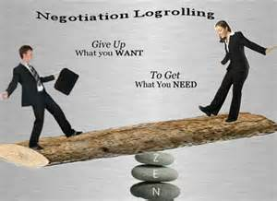
Logrolling
Is the process by which legislators “trade” votes on bills that are most important to them and how expenditures that most people oppose get through the legislative process.
“You vote for my project, and I’ll vote for yours.”

Slide 14
Pork Barrel Spending
The tendency by legislators to encourage government spending in their own constituencies, whether or not it is efficient or even useful. Senior legislators, with greater status and ability to "bring home the bacon", may be reelected for this reason, even if their policy views are at odds with their constituency.

Slide 15
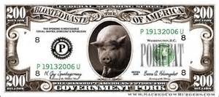
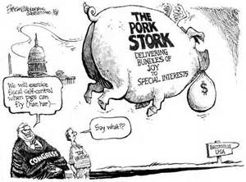
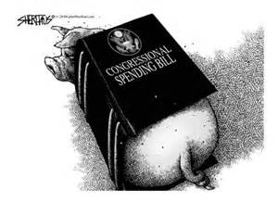
Pork Barrel Politics

Slide 16
Special Interest Bias
Consumer voting is product independent, political voting is not. Political choice is effectively limited to “democrat” or “republican”. This provides a powerful incentive for a politician running for election to “purchase” as many special interest issues as needed to “win” election.

Slide 17
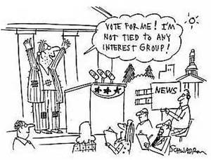
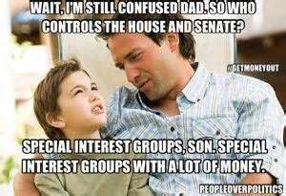
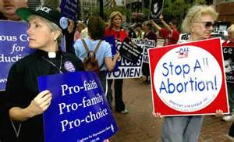
Special Interest Group

Slide 18
Political Bias
The complexity of economic issues and the difficulty to tracking cause and effect over time leads to a political bias in favor of policies with short-term benefits, regardless of their costs, and against policies with short-term costs, regardless of their benefits.

Slide 19
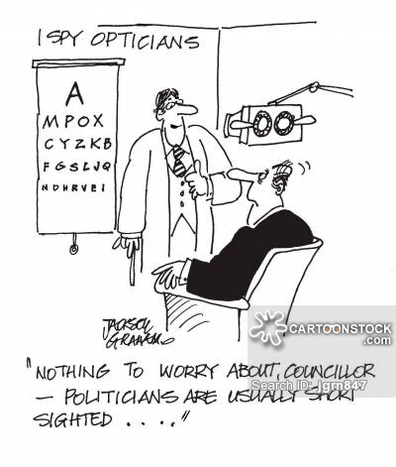
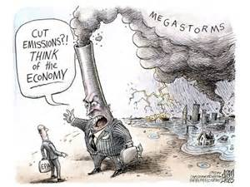
Separate cause & effect

Slide 20
Political Bias II

Slide 21
Crowding out
Crowding out occurs when the government expands its borrowing to finance increased expenditure or tax cuts, crowding out private sector investment by way of higher interest rates. Increased D for loanable funds increases interest rates, which reduces the quantity of private borrowing. In the same way, G spending crowds out private spending.

Slide 22
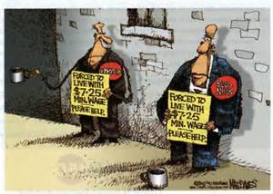
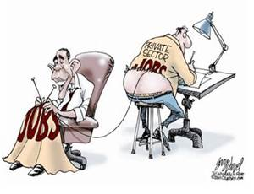
Most resources are in fact, exclusive and rival…

Slide 23
Regulatory Capture
The co-opting of regulatory agencies by members of or the regulated industry. Rent seeking behavior is one of the mechanisms which allow this to happen, poor institutional structures are another. Regulatory Agency administrators are often recruited from the knowledgable administrators working in the industry.

Slide 24
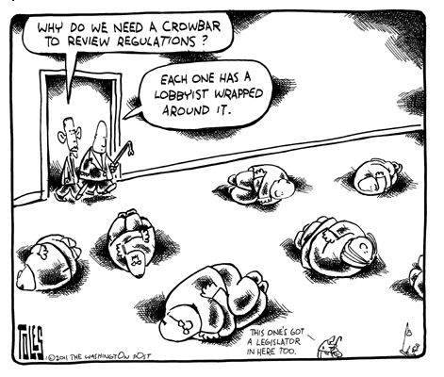
Who Regulates the Regulators?

Slide 25
Taxes and Subsidies
Taxes and government subsidies provided to particular businesses or industries distort relative prices and hence change resource allocation in inefficient ways, reducing overall economic welfare.

Slide 26
Rent Seeking (vs Profit Seeking) Behavior
The tendency by interest groups to lobby for laws and regulations that provide them a guaranteed benefit (rent). Legislators often try to change laws to ensure their continued incumbency, such as gerrymandering. Bureaucrats may seek to advance their power and budget authority at the expense of efficiency. Regulated entities may seek to obtain special provisions that reduce competition, increase subsidization, or both.

Slide 27
Special Interest, Rent Seeking, Short-Term Bias

Slide 28
Economic Actions Always Have Secondary Effects
The economy is a system and as a system all of its markets are interconnected. A policy in one market will have significant implications for other markets. Unfortunately, the unintended secondary effects most often run counter to the intended effects, making policy less beneficial than expected.

Slide 29
Secondary Effects

Slide 30
All of the Above…

