Slide 1
Tips on Interviewing.!
Teachable
Moment

Slide 2
Being prepared for an interview shows that you "want" the job.
Make a Good First Impression.!
Dress Appropriately.!
Be Prepared to Ask & Be Asked Questions.!

Slide 3
Make An Impression!
Be On Time.!
Use Eye Contact
Offer Firm Handshake
Smile & Show Interest
Have A Positive Attitude.!

Slide 4
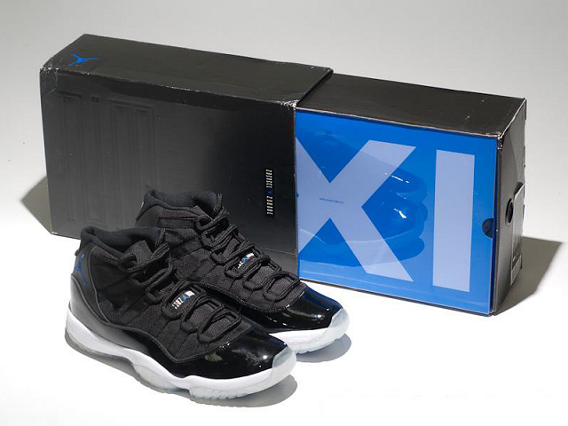
Tips For Dressing Appropriately
DO’s
Dress Shirt &/or Tie
Slacks
Neat & Pressed
Light Perfume & Cologne
Dark Colors
Showered & Neatly Trimmed Hair
DON’Ts
Sneakers
Shorts
Sandals
T-Shirt
Tight Shirts
Bright Colors
Sagging Jeans

Slide 5
Frequently Asked Questions.!
Questions asked by employer
Questions asked by employee
Tell me about yourself.
What are your strengths?
What are your weaknesses?
Why do you want to work here?
What is your greatest accomplishment?
Why should I hire you?
Talk about your skills and achievements.
What are the responsibilities of this job?
What qualifications do you hope the successful candidate will have?
What is the most important contribution that you hope the successful candidate will make in this position?
How will I be trained to do this job?
Who do I report to?
Describe the work environment.
Why is this position open?
Describe a typical day.

Slide 6
How the Career Center can Help
The Career Center provide students help with frequently asked questions (FAQs) such as
What is a resume?
Why do I need resume/portfolio?
How do I make resume/portfolio ?
What information needs to be on portfolio?
How do I build my resume up?
Hyperlinks
www.indstate.edu/carcen/
http://www.indstate.edu/carcen/cof/default.aspx
https://indiana-state-csm.symplicity.com/students/

Slide 7
Resume/Portfolios must be unique!
Potential employers interview many candidates for the same position.
It is essential to have a unique resume or portfolio because it sets you apart from competition.
Resume and Portfolios should be easy to read and formatted correctly.

Slide 8
Resume/Portfolios
It is a great idea to keep you credentials protected.
It is also a good idea to put certificates in a three ring binder in plastic sheet covers.
Most of our certificates and achievements that we acquire over time is often irreplaceable, so it is in your best interest to protect them.

Slide 9
Resume/Portfolio and Interview gone wrong
http://www.youtube.com/watch?v=UT-j_LSWM_A
http://www.youtube.com/watch?v=IAdewi3kpY8
My Plan is an aptitude test.
http://www.youtube.com/watch?v=ogSJV2IOZ6o

Slide 10
NETWORKING
Although networking has been hailed as the number one way to find a job, about 70% of the employers prefer to hire their interns.
Join and attend Professional Organizations in your field.
Join and use Linked-in (it has lots of jobs and people from various companies to get to know to give you references)
Tell everyone you meet (your family, your friends, Your friends families, people you meet while traveling etc that you are job hunting and have short resumes on a business card to give them.)
Talk to the professors in your department
Get to know someone in the organization in which you want to be hired and have them give you a recommendation
Make connections with ISU alumni

