Slide 1
CARDHOLDER QUICK REFERENCE GUIDE
FOR SDG2

Slide 2
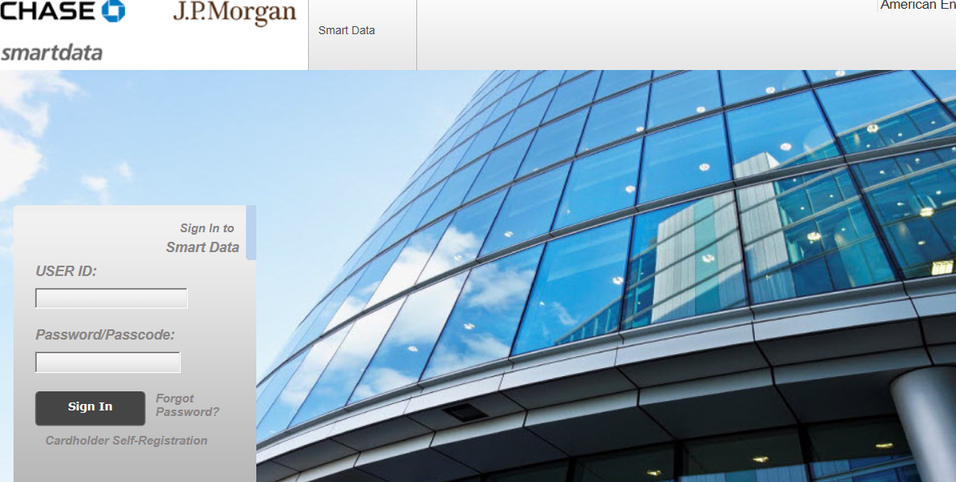
CARDHOLDER QUICK REFERENCE GUIDE FOR SDG2
* If you are logging on for the first time the instructions are as follows:
· Click "Cardholder Self‐Registration"
· Enter your 16 digit account number
· Enter the Company Code: 042814
2

Slide 3
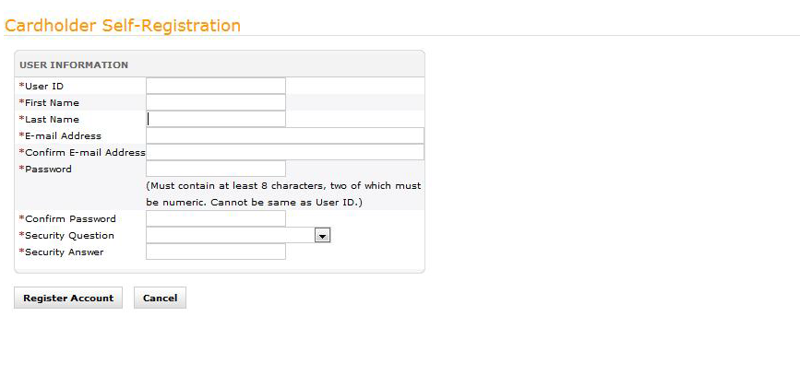
CARDHOLDER QUICK REFERENCE GUIDE FOR SDG2
“Cardholder Registration”
User ID Requirements
· Your user ID must be at least six characters in length with no spaces or special
characters.
· Your user ID is case sensitive.
· Create an ID that will be easy for you to remember, but difficult for others to guess.
3
Once you have entered and confirmed all of your information, click "Register Account". There will be a message indicating that your user ID has been created. Click to Return to Login page and re‐enter your user ID and password you created . This will take you to the Home Page, which gives you a great deal of information regarding your account. If you click on the Account User’s Guide link in the bottom right of the Home Page screen, and then go to page 9 in the guide, you will see a detailed explanation of the Home Page screen. (On most monitors, you have to roll up the page and click on “view more” to get to the link.)
Important Note
Your ID must be unique in the whole MasterCard database. If you try an ID that is already being used you will get the following message –
The user ID you specified already exists in the application. Please try again.
· Enter your email address and confirm.
· In the “Password” area, enter your new password. NOTE –Password is case
sensitive.
· Passwords must contain a combination of letters and numbers at least eight
characters in length. At least two of the characters must be numbers.
· From the drop down window, select a security question.
· In the next box enter your answer to the security question you selected.
NOTE ~ your security answer must be at least 4 characters long and cannot
Contain spaces.

Slide 4
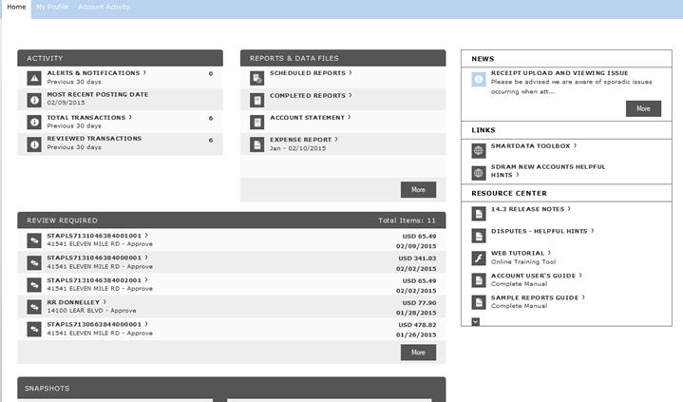
CARDHOLDER QUICK REFERENCE GUIDE FOR SDG2
              A
SDG2 HOME PAGE
A. Menus: provides access to all screens and operations
B. Account Activity Summary: Contains important transactional information.
C. News and Links: Displays messages and resources posted by application administrators.
D. Reports & Data Files: Provides access to reports.
E. Resource Center: Provides application user guides, interactive tutorials, online help, etc.
F. Review required: Latest transactions that have posted to your account.
G. Snapshots: Graph of spend by category and total spend
H: Expense Report: Link to your current Expense Report for printing.
4
Print the expense report and attach all receipts to the report.
Sign & date the report and submit it to your supervisor for approval signature.
Hand deliver the report to the drop box in the Office of the Controller in Parsons Hall.
The system deletes completed reports after 30 days.
A
B
D
C
H
E
F
G

Slide 5
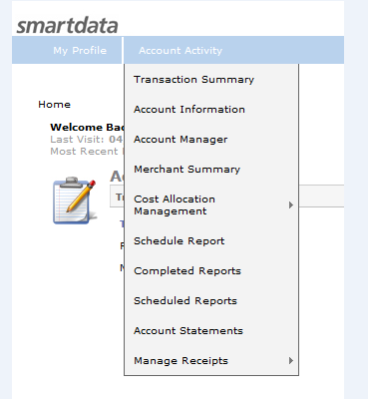
CARDHOLDER QUICK REFERENCE GUIDE FOR SDG2
ALLOCATING TRANSACTION DATA
The SDG2 system refers to entering account number information as “Cost Allocation” or
“Allocating Transaction Data”.
· Place you cursor on ACCOUNT ACTIVITY.
· Click “Transaction Summary”
5

Slide 6
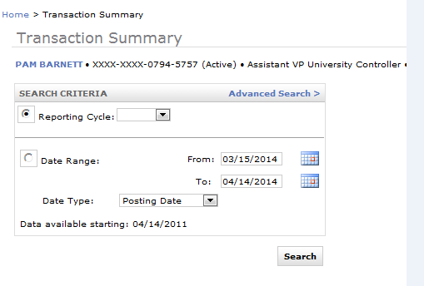
ALLOCATING TRANSACTION DATA (cont’d.)
Search Criteria
· Selecting Reporting Cycle will provide a listing of all the billing cycles available.
· Selecting Date Range allows you to specify a specific date range of transactions to review.
· Date Type: Posting Date is when the transaction was applied to your account.
Transaction Date is the date the charge was authorized. Use Posting Date if matching to your statement. This selection is grayed out when you select
Reporting Cycle because it is set up to default to Posting Date.
*NOTE: We will use Reporting Cycle for processing transactions. You may use the specific date range when you want to search for information.
6
A note about navigation within the SDg2 system: Do not use the back button on your web browser. Click on the form names in blue under the blue heading bar to navigate to a different form. Or, use the menu items from the blue heading bar.

Slide 7
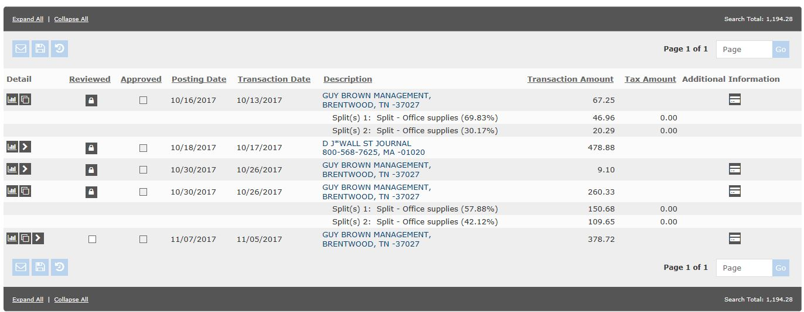
CARDHOLDER QUICK REFERENCE GUIDE FOR SDG2
“Allocating Transaction Data (Cont’d)”
7
The 3 icons or buttons at the left of each transaction are, from right to left: Transaction, Split Transaction, and Accounting Detail.
The “Transaction” button will give you all the information that is available for that transaction. It is for information purposes.
The “Split Transaction” button is to be used when you have to allocate an expense to more than one index and/or account.
The “Accounting Detail” button will bring you to the ‘Accounting Codes Information’ box that contains the fields that need to be filled in for the transaction for data entry.
The “Line Item” button gives you a list of items purchased for the specific expense. This information is carried over from level three merchants only.
All transactions meeting your date/status criteria will be listed on the screen.
When you click on the “Expand All” link located to the left near the SEARCH RESULTS bar; you will see which transactions need to have your account numbers added.

Slide 8
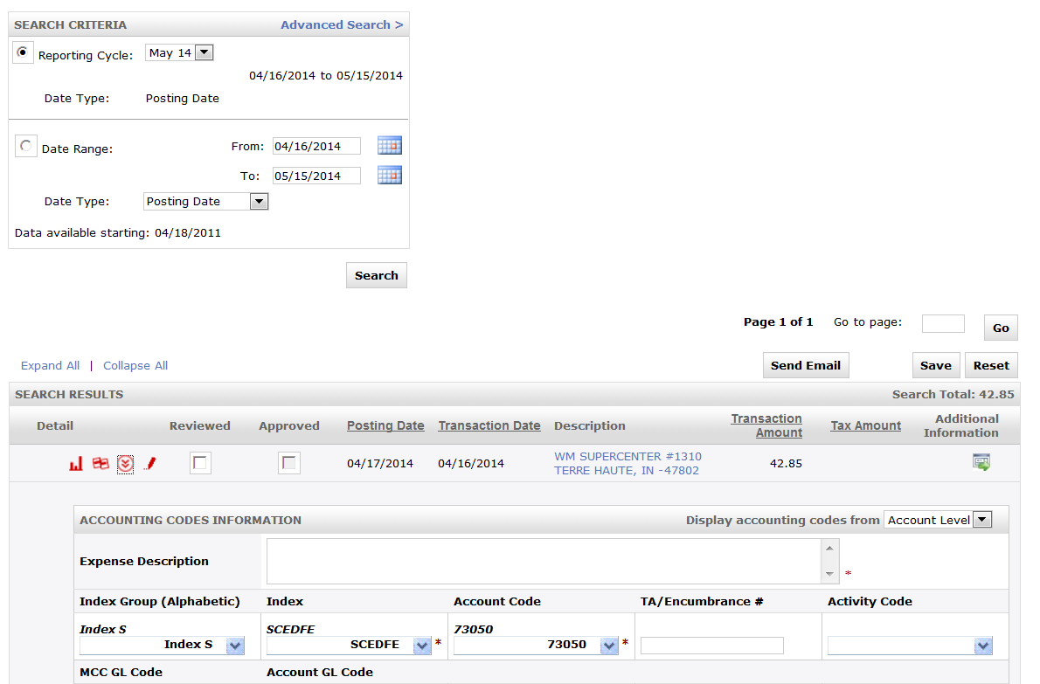
CARDHOLDER QUICK REFERENCE GUIDE FOR SDG2
“Allocating Transaction Data (cont’d)”
A. The ‘Expense Description’ box is where you will need to enter a business purpose/event.
B. The ‘index group’ is where you select from the group of indexes according to the beginning letter of the index.
  Change the index from within the index box
  Change the account code from within the account code box
C. Click on the ‘reviewed’ checkbox for each transaction to lock your transactions.
D. Click on the ‘save’ button at the top or bottom right of the screen.
E. The ‘review’ check box will disappear and a padlock will appear n its place.
8
Note: If the index does not appear in the drop‐down list, contact Barbara Tschida, barbara.tschida@indstate.edu, ext 3521 or
Donna Scarbrough, donna.scarbrough@indstate.edu, ext 3519 for assistance.
D
C
A
B

Slide 9
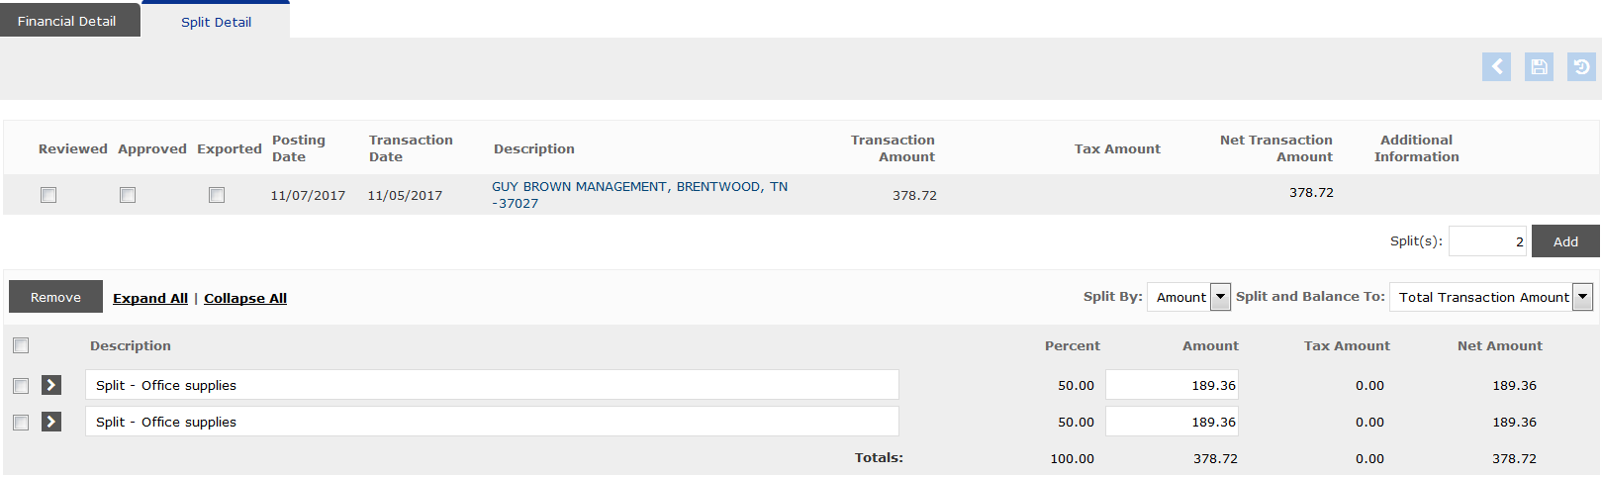
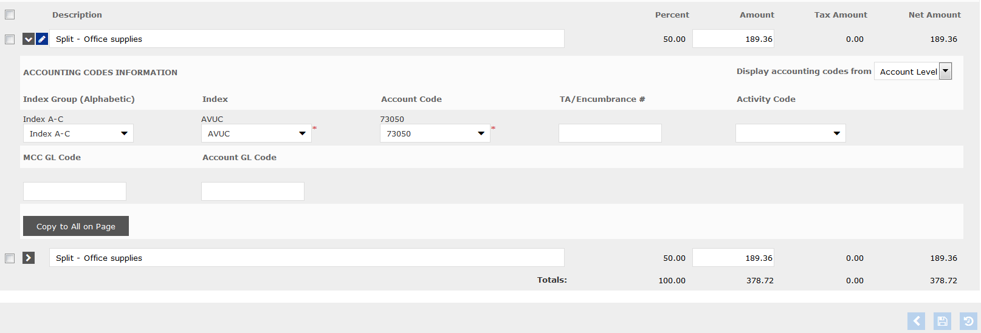
CARDHOLDER QUCIK REFERNCE GUIDE FOR SDG2
“Allocating Transaction Data (cont’d)”
Splitting a Transaction (2 screen shots)
Click the Split Transaction icon for the transaction from the transaction summary page (the split transaction screen appears, see below).
Split By field, indicate whether you want to split by currency (amount) or (percent).
Description, enter the business purpose for each split
Click Save. Once the new splits have been saved, you can click on the Accounting Detail icon (>) to access the accounting codes.
Click on the (>) icon to open the split transactions in order to change the accounting fields
Change your accounting fields as explained on page 8
Click SAVE
9
3
1
4
2
Appearance of Page (below) after you click the (>) accounting detail icon.
455
6

Slide 10
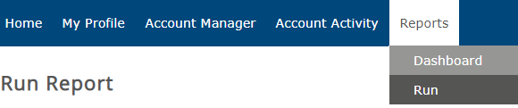
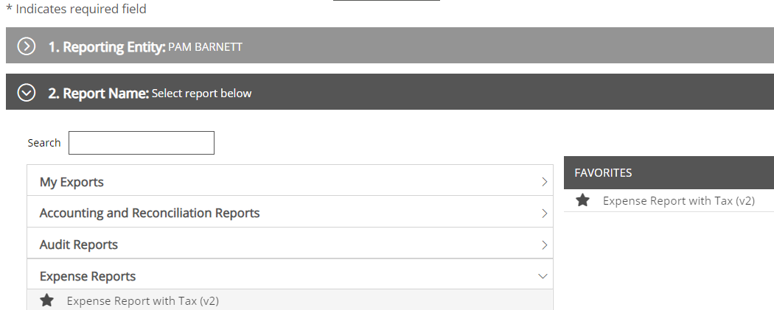
CARDHOLDER QUICK REFERENCE GUIDE FOR SDG2
“Scheduling Expense Report with tax (v2)”
- Click on “Report Tab” at the top of the screen
- Click on “Run”
-Select “Expense Reports” from the Report Selection.
-Click on “Expense Report with tax (v2)”:
Clicking on the “star” in front of expense report w/tax (2) sves the report to your favorites (on the right)

Slide 11
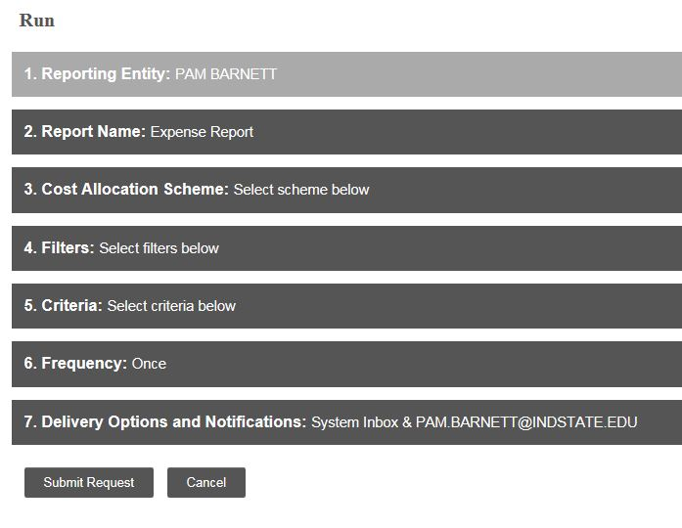
CARDHOLDER QUICK REFERENCE GUIDE FOR SDG2
“Scheduling Expense Reports (cont’d)”
After you have clicked on Expense Report you will see the following screen. You will not make any changes to options 3, 4, or 7.
From here you will click on option 5-Criteria
(see next slide)
11
DO NOT MAKE ANY CHANGES TO THESE TWO (2) SCREENS

Slide 12
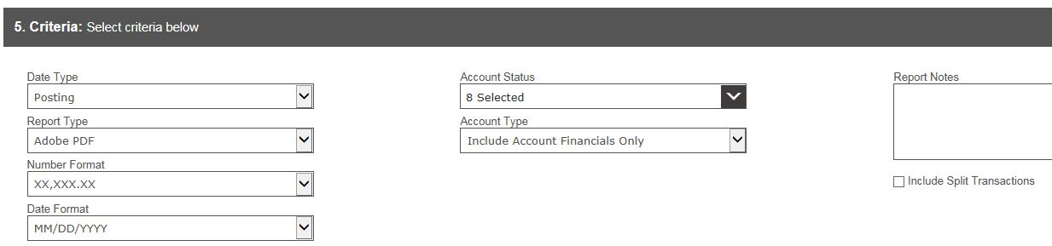
CARDHOLDER QUICK REFERENCE GUIDE FOR SDG2
“Scheduling Expense Reports (cont’d)”
12
Option 5 (Criteria)
  ALWAYS click on the box in front of “include split transactions”
  Report Notes: This is where you would enter a name of your choice for the report. (could be billing cycle month or cardholder name)

Slide 13
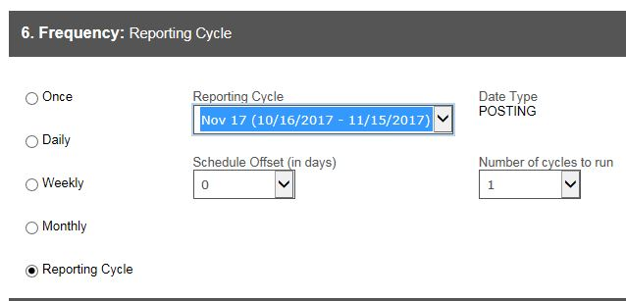
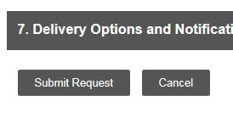
CARDHOLDER QUICK REFERENCE GUIDE FOR SDG2
“Scheduling Expense Reports (cont’d)”
Option 6 (Frequency: Reporting Cycle)
Click on the radial button next to “Reporting Cycle”.
Select the Reporting Cycle for the appropriate reporting period (such as “Nov 17 (10/16/2017 – 11/15/2017).
Option 7 (Delivery Options and Notification)
Click “Submit Request” to process your report
13
Hint: Use “Reporting Cycle” for completed cycles.
Use “run Once” only when running a report in the middle of the cycle.

Slide 14
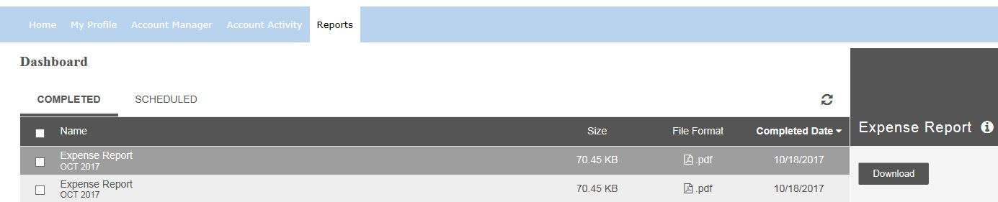
CARDHOLDER QUICK REFERENCE GUIDE FOR SDG2
“Scheduling Expense Reports (cont’d)”
Printing your Expense Report
After submitting your report, you will come to the “Dashboard” page. (located under the reports tab)
Completed tab: select the report you want to print and click on the “download button” on the right side of the screen
(the report can also be located on the home page as in the past)
Scheduled tab: You can see the status of scheduled reports here.
14

Slide 15
CARDHOLDER QUICK REFERENCE GUIDE FOR SDG2
“Supervisor Information”
15
SMART DATA GENERATION 2 SUPERVISOR
Group Managers are system users that need access to code accounting detail for transactions on cards for which they are not the cardholder. They may also be cardholders with multiple cards due to split jobs or other reasons. Examples of Group Managers are department Administrative Assistants or Executive Assistants who expedite the collection of receipts and coding of transaction for cardholders in their area.
Group Managers are set up using the first initial of first name, complete last name and followed by _s.
See example as follows:
User name=Jane Jones
User ID=jjones_s
Password=042814
As soon as you sign in, you will be prompted to change your password and provide
answers to some security questions. See the password set up on page 3 of this manual.
If you are a group manager, your initial sign-on screen will look a little different because
you will have 4 tabs in the blue bar (Financial, Reports, Account, User) instead of the 3
tabs (My Profile, Reports, Account Activity) listed for regular cardholders.

Slide 16
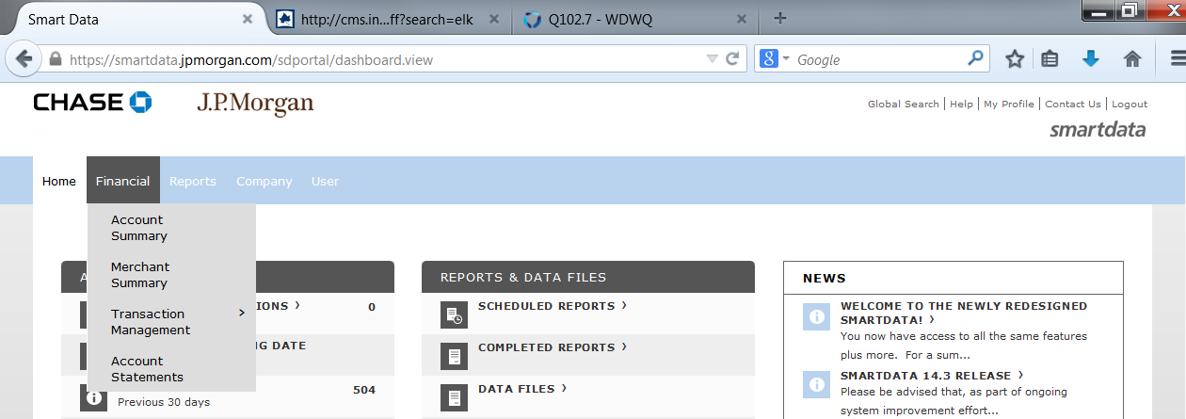
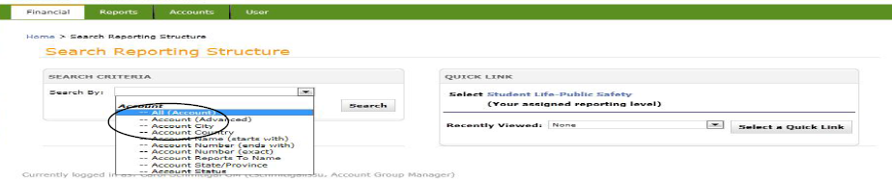
CARDHOLDER QUICK REFERENCE GUIDE FOR SDG2
“Supervisor Information”
16
In order to access cardholders and their transactions, place your cursor on the FINANCIAL tab, click on ACCOUNT SUMMARY.
A search screen will appear. Select –ALL ACCOUNTS from the search drop‐down and
click on the search button. A list of the cardholders in your group will appear (see next page).

Slide 17
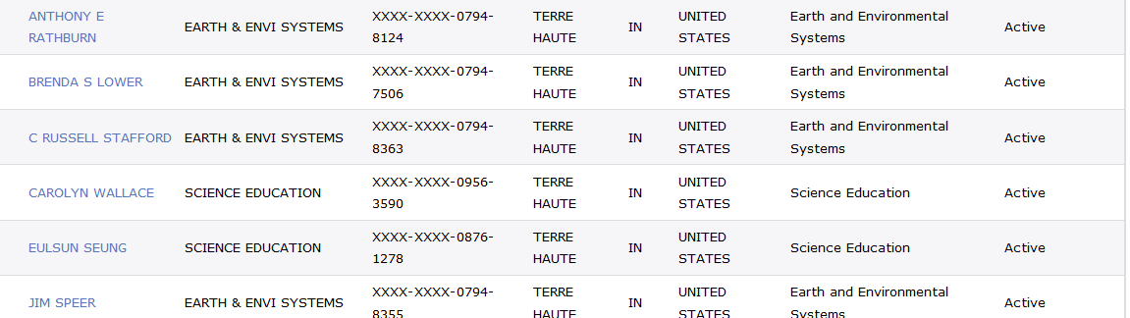
CARDHOLDER QUICK REFERENCE GUIDE FOR SDG2
“Supervisor Information (cont’d)”
17
Click on the CARDHOLDER NAME to select a cardholder account to code and/or review. At this point the process for the allocation of transaction data is the same as it is for the cardholder. Turn back to page 6 in this manual to follow the directions for allocating data.
The other thing that is a little different is that group managers access the report capability from the tab REPORTS on the green bar instead of as a menu option under ACCOUNT ACTIVITY.

Slide 18
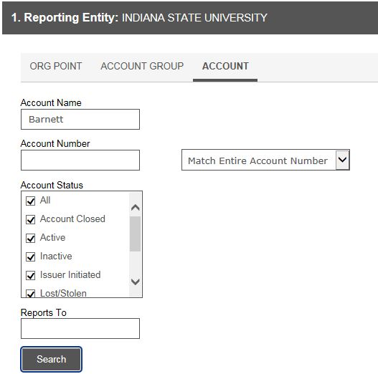
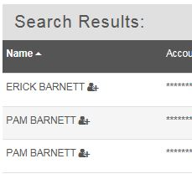
CARDHOLDER QUICK REFERENCE GUIDE FOR SDG2
“Supervisor Information (cont’d)”
Scheduling expense report for each cardholder
  Put your mouse over the “Reports tab” and click on “Run”
Click on 1 Reporting Entity:
  Click on Account
  Type last name of cardholder in Account Name Field
  Click the “search” button
  Scroll down and click on the cardholder name
Follow instructions from bottom of slide 11 through slides 15 to schedule report.
18

Slide 19
CARDHOLDER QUICK REFERENCE GUIDE FOR SDG2
19
To allocate transactions
To generate a report
1. From the Account Activity menu, select
Transaction Summary.
2. Select Reporting Cycle or a specific date range.
3. All transactions meeting your date/status
criteria will be listed.
4. Click the arrow icon or Expand All. You will
see which transactions need your account
numbers listed.
5. Complete Accounting Codes information for
each transaction.
6. Click Save.
7. Splitting a transaction (optional):
  Click on the split Transaction Icon (middle icon)
  Enter the number of splits and click add.
  Enter the dollar value for each split and an expense description, and click Save.
  Click on the accounting detail icon or the arrow icon in front of each description field.
  Select your account number data for each portion of the split
  Click Save
1. Select Reports > Run
2. Select Travel Reports > Expense Report
3. Select Criteria > check box for include split
transactions and report notes (optional)
4. Select Frequency > select reporting cycle
5. Click on submit request button
6. System will email when the report is complete.
Or you can monitor the “dashboard” or
completed reports section of the reports inbox.
7. Print a copy of the report and attach all receipt
to the report.
8. Get the appropriate signatures and date the
report .
9. The report is available for 30 days.

