Slide 1
Indiana State University (ISU) online reservation tool EHI Direct

Slide 2
Enterprise Holdings Story

Slide 3
THE POWER OF THE BRANDS
More than 2
Million
World Wide
10,000 World Wide Locations
$25.9 Billion
VEHICLES
LOCATIONS
REVENUE
1,200,000
U.S. Fleet
6,400 U.S.
506,2000*
365,000**
Enterprise Holdings
Hertz Dollar/Thrifty
Avis Budget
Source: Auto Rental News – Fact Book 2019
*ARN estimate

Slide 4
The STRENGTH BEHIND our Brands
100,000
RANKED #13
BOND CREDIT RATING
EMPLOYEES
BBB+, Baa1
America’s Largest Private Companies –
Only U.S. investment-grade car
rental
company –

Slide 5
Preferred Car Rental Brand
Best Car Rental Company in the World
No.1 Car Rental Agency

Slide 6
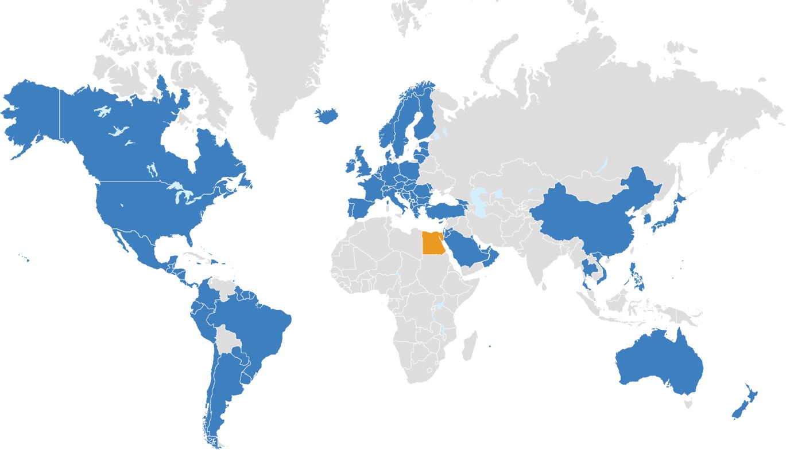
CURRENT WORLDWIDE FOOTPRINT
Operational: Canada, US, Albania, Argentina, Armenia, Aruba, Australia, Austria, Barbados, Belgium, Belize, Bonaire, Bosnia & Herzegovina, Brazil, Bulgaria, Cayman Islands, Chile, China, Colombia, Corsica, Costa Rica, Croatia, Curacao, Cyprus, Czech Republic, Denmark, Dominican Republic, Ecuador, El Salvador, Estonia, Finland, France, Georgia, Germany, Greece, Grenada, Guadeloupe, Guam, Guatemala, Guyana, Honduras, Hungary, Iceland, Ireland, Israel, Italy, Jamaica, Japan, Jordan, Kosovo, Kuwait, Latvia, Lithuania, Luxembourg, Macedonia, Martinique, Mexico, Moldova, Montenegro, Netherlands, New Zealand, Nicaragua, Norway, Oman, Palau, Panama, Paraguay, Peru, Philippines, Poland, Portugal, Puerto Rico, Qatar, Reunion Island, Romania, St. Barth, St. Maarten, Saipan, Saudi Arabia, Serbia, Singapore, Slovakia, Slovenia, South Korea, Spain, Suriname, Sweden, Switzerland, Thailand, Tortola, Trinidad & Tobago, Turkey, Turks & Caicos, United Arab Emirates, UK, Uruguay, Vietnam
Opening Soon: Egypt, St. Lucia, St. Thomas
TBD
MORE DETAILS

Slide 7
GLOBAL PHILANTHROPIC INITIATIVES
50 Million Tree Pledge
$1 million annually to plant 1 million trees
Red Cross Disaster Relief
$3 million to disaster relief
Fisher House
$6 million, six-year commitment
Fill Your Tank
$10 million annually over six years

Slide 8
EHIDirect – Reservation Process
What is it?
How to use it?
Benefits Related
Invite to be sent to you

Slide 9
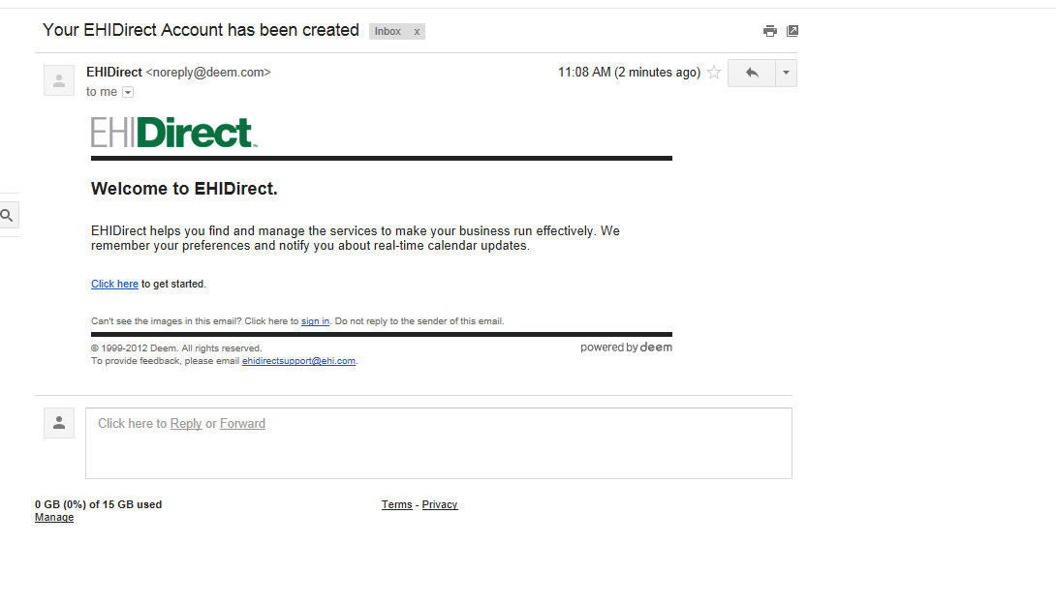
This is what invite looks like. Comes from EHIDirect. You may need to check your spam or junk folder.

Slide 10
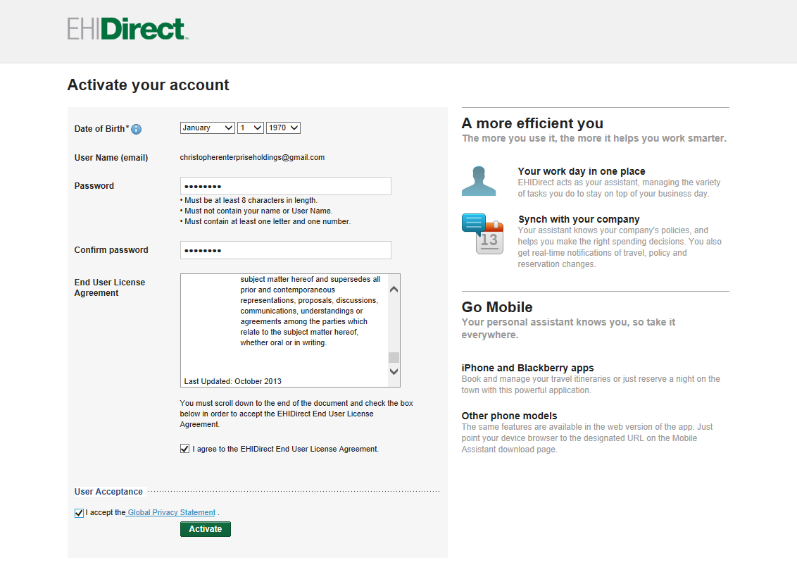
Create your password – for your access.

Slide 11
Ready to reserve. Only use this tool for Car Rental. Not to be used for Air or Hotel.
Please do not use ‘delivery’ or ‘collection’ buttons

Slide 12
Select Location – then Vehicle Type. Then notice NAME of “Contract” – ISU Business Use.

Slide 13
Review your Trip. Checking date/time/location and vehicle class – then Continue

Slide 14
Click “Change Traveler” to update name and phone # and email to the person you are reserving for. And insert your TA#

Slide 15
At bottom of page – you can confirm – billing# - should preload for your department.

