Slide 1

Fall 2019 Department Chair Training
Presented by: Office of Registration and Records

Slide 2
1. Introductions
2. Compliance Functions
3. Curriculum Functions
4. Reporting Functions
5. Student Functions
6. Project List

Slide 3
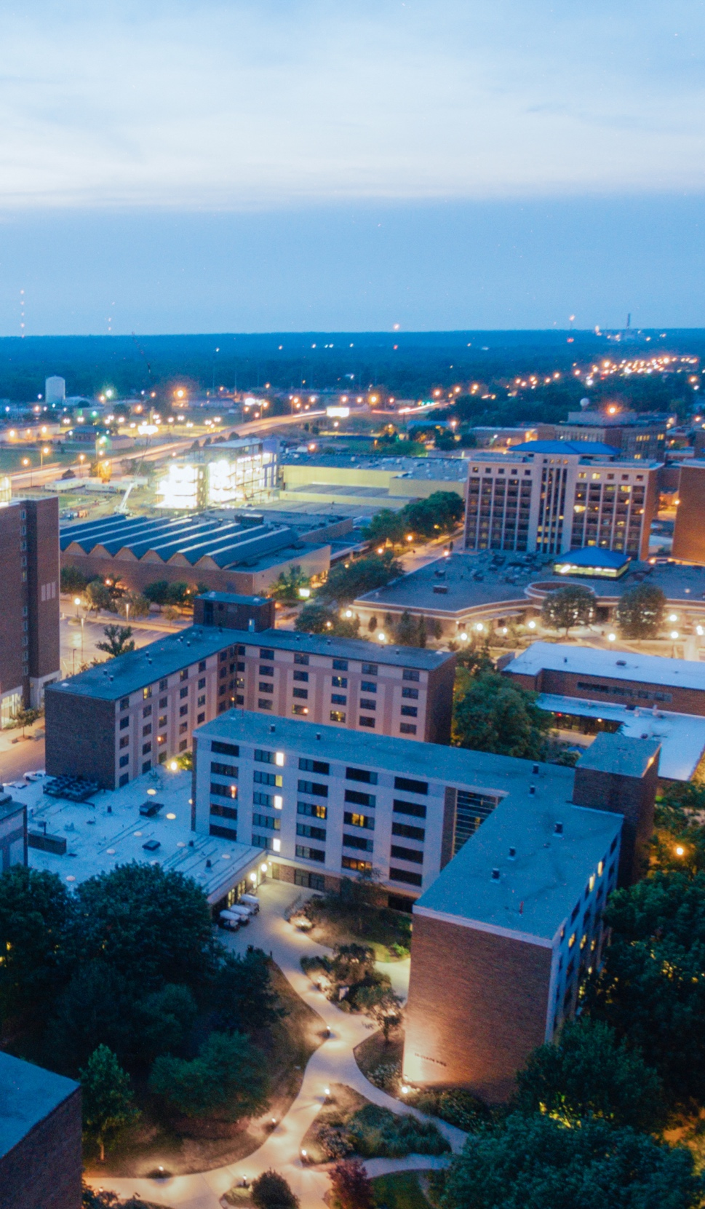
Compliance
Degree & Enrollment Reporting
FERPA
Immunizations
Residency Appeals
Subpoenas
Veteran Affair’s Education Benefits
Military Tuition Assistance Reporting

Slide 4
Compliance - Of Note
FERPA
  Report any violations to the Registrar
  Online training available; one on one training-contact ORR
  Data Incident Prevention
    Non-enterprise-wide software
    Encrypt all non-directory information
Immunizations
  ORR is responsible for the immunization compliance of the university
  We collect, record, and report to the State of Indiana
Residency Appeals
  Residency is determined at time of admission
  Any appeals are submitted to ORR

Slide 5
Compliance References
Online FERPA Training (skillport):
http://www2.indstate.edu/humres/docs/SycamoreELearningFAQ's.pdf
Course Name: FERPA for Higher Education, ID: lchr_01_a85_lc_enus
ISU FERPA Directory Information:
https://www.indstate.edu/registrar/student-resources/your-rights-student-under-family-educational-rights-and-privacy-act
Office email (CRM)— ISU-ORR@mail.indstate.edu
Immunization information: https://www.indstate.edu/registrar/state-immunization-requirements
Residency Appeals: https://www.indstate.edu/sites/default/files/media/Documents/PDF/ResidenceClassificationInstructions.pdf
Veterans Services
https://www.indstate.edu/registrar/veteran-military-family-resources
https://www.indstate.edu/services/veterans/benefits

Slide 6

Curriculum
Course, Fee & Program Proposals
Academic Catalogs
Degree Audits
Schedule of Classes
Change of Program
Transfer Articulations and Evaluations

Slide 7
Curriculum – Of Note
Course and Program changes approved through Curriculog
Undergraduate and Graduate Catalogs – shows active programs/courses.
Schedule of Classes Responsibilities
  Required Training (December/January)
  Updating Rooms if instructor decides to move classrooms
  Not allowing non-registered students to sit in a class
  Astra Scheduler to view room schedules
  Webforms to make class changes
  SOC departmental report in Argos
Academic BLUEprint replaced Schedule of Classes Bulletin (pdf)
Change of Program Workflow – available to undergraduates in MyISU Portal, can initiate a change in catalog year, degree, major, minor, concentration

Slide 8
Curriculum References
Curriculog—On-line Program and Course Proposal Software: https://indstate.curriculog.com/
Curriculog Training Guide – accessible through Faculty badge in portal
Catalog - https://catalog.indstate.edu/
MySAM (degree audit and suite of tools) direct link: https://dw-app-002.indstate.edu/ ( also accessible through Faculty badge in portal)
Transfer Equivalencies:
Transfer Course Search Tool (current student tool): https://www.indstate.edu/registrar/student-resources/transfer-equivalencies
Transfer Planning Tool (produces unofficial degree audit for prospective students): https://www.indstate.edu/transfer/transfer-planning-tool
Academic BLUEprint (same software as our academic catalogs) : https://catalog.indstate.edu/

Slide 9
Curriculum References
Ad Astra—Room scheduling calendar
https://www.aaiscloud.com/INStateU/Default.aspx
SOC Webforms- to change/add sections
https://www2.indstate.edu/resources/registrar/schedule/
SOC Documentation:
https://www.indstate.edu/sites/default/files/media/documents/pdf/soc-documentation.pdf
Departmental Transfer Guidelines:
https://www.indstate.edu/registrar/faculty-staff-resources/scheduling/departmental-tranfer-guidelines

Slide 10

Reporting
3-week Attendance
Grading
- Interim
- 1st 8 weeks
- Final
Priority Registration
Argos Reports
- Departmental Tools
- Ad Hoc reports

Slide 11
Reporting - Of Note
Importance of 3-week attendance
  Students reported as not attending all classes are administratively withdrawn
  Impacts Student Financial Aid
  Argos reporting tool:
  https://argos.indstate.edu/argos/ or badge on portal
  Help desk ticket - TDX:
  https://indstate.teamdynamix.com/TDClient/Home/Default.aspx?ToUrl=
  Important Term Dates:
  https://www.indstate.edu/registrar

Slide 12
Reporting References
ORR SharePoint site –all new chairs should have access to ORR Reports:
https://team.indstate.edu/academic_affairs/ORR/Shared%20Documents/Forms/AllItems.aspx
ORR University Shared Documents: https://team.indstate.edu/academic_affairs/ORR/University%20Shared%20Documents/Forms/AllItems.aspx
Sign up for available trainings: http://challenger.indstate.edu/workshop/registrar/
  MySAM Curriculog
  Schedule of Classes Final/Interim Grading
Faculty/Staff Instructions
  https://www.indstate.edu/registrar/faculty-staff-resources

Slide 13


Student
Graduation and Commencement
Registration Activities
Change of Grade
Transcript/Diploma Services
Tuition & Fee Assessment

Slide 14
Student – Of Note
Graduation/Degree Awarding Timelines – quick turn-around; auto awarding of MySAM 100%; Communications sent out to students and colleges
8-week part of terms: different add/drop/withdrawal deadlines and online capabilities
Importance of having grades turned in on time
  Impacts: Graduation, dean’s list, academic standing, registrations for next term
Just a reminder both graduate and undergraduate students apply for graduation online through the MyISU Portal.
Change of Grade process is entirely electronic. Process begins with instructor; change is then routed to Department Chair and then Dean representative (Associate Dean).

Slide 15
Student References
Registration: What to do when they seek you out this first week wanting into a class; paper registration forms should only be used when the online system is no longer available:
  Banner over-ride capability (SFASRPO), online training available: https://statevids.indstate.edu/Play/13685
    Class Capacity Class Restriction
    Co-requisite Major Restriction
    Pre-requisite Student Attribute
    Time Conflict Duplicate Course
    College Restriction Department Restriction
Departmental Transfers and impact on timing: https://www.indstate.edu/sites/default/files/media/Documents/PDF/faculty-resources-Departmental-Transfer-Guidelines.pdf
Proxy Access (What non-directory information can be shared with others): http://www.indstate.edu/proxyaccess/
Transcript Ordering: https://www.indstate.edu/registrar/transcript-request

Slide 16
Projects
Accelerated Graduate Programs
Banner Pre-Hold Identifier
Banner Self-Service Upgrades
  Overall change to look & feel
  Enhanced functionality
DegreeWorks Upgrades
  Overall change to look & feel
  Enhanced functionality
SEM Process Review
Degree Audits for Graduate Students

Slide 17

What do you need from us?
Questions?​

