Slide 1
UKG Dimensions for Managers Go Live – October 29, 2022
This training is to establish a foundation for properly managing time kept in UKG Dimensions timekeeping system.
Upon completion, Managers should be comfortable reviewing, editing and approving their employee’s timecards in UKG Dimensions and providing guidance to staff.

Slide 2
Departmental and Supervisor Responsibilities
Department Head to authorize Dimensions access for supervisors and timekeepers.
Supervisors provide detailed time tracking instructions to employees.
Supervisors will make corrections and document reason for edit with a comment on the time card.
Supervisors or Timekeepers will review time cards throughout each pay period and apply approval and sign off within proper timeframe.
Supervisors or Timekeepers will report discrepancies to Payroll Office and assist with resolution when needed.

Slide 3
New Payroll Deadline
Timecards are due by 4:00 PM on Friday, the last day of the pay period, Monday at 9:00 AM for those working Friday evening.
The first Friday due date will be November 11, 2022, the end of the B1/ST-23 pay period

Slide 4
Time Collection Methods Departments determine what method(s) works best for their area
Staff
PC – Manual time entry
New - Mobile Device – Punch or manual time entry
New - Proximity Readers with touchless badges (select departments)
Students
Discontinued - Campus Phone time tracking
PC – Time Stamp
New - Mobile Device – Time Stamp

Slide 5
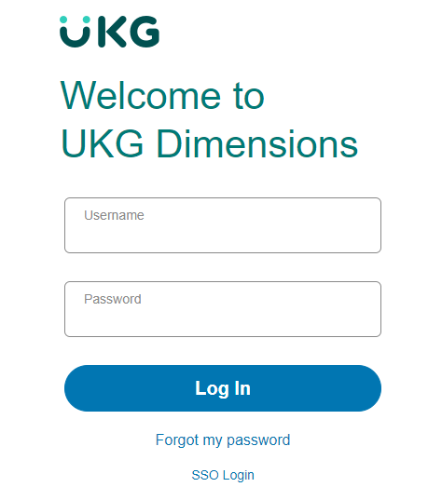
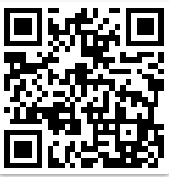
Desktop Login:
Using Chrome as your browser, log into https://indianastate-sso.prd.mykronos.com/
Select the SSO Log In at the bottom of the page.
Also available as a Badge in ISU Portal.
QR Code for log in.

Slide 6
Mobile Login:
Launch the UKG Dimensions app from your mobile device.
Enter the following in the Tenant URL field:
https://IndianaState-prd.npr.mykronos.com
Tap Ok.
Select SSO Login.
Log in with your university email and password.

Slide 7
Accessing Timecards
Home Page, Manager View
Your home page will display with various tiles. Tiles can be used as a quick way to access various items such as your employee timecards, leave balances and notifications.
Employee View & Access
Hourly employees enter in and out times on their timecards or track time via proximity readers.
Pay Codes are used to indicate an absence.
Employee approvals are required for all full-time staff.
Assist employees as needed with the new system.
Your employee timecards can be accessed multiple ways:
Manage Timecards tile on the home page
Employee Summary Dataview
Timecards Dataview
Pay Period Close Actual Dataview

Slide 8
Timecard Reviews and Edits Staff Timecards
Review for missed punches and long intervals using ISU Exceptions dataview.
Add comments as needed.

Slide 11
Timecard Reviews and Edits Staff Timecards
Review each week for minimum of 37.5 hours – Shortfall populates Dock Pay

Slide 12
Timecard Reviews and Edits Staff Timecards
Employee Schedules must be updated in Dimensions if employee changes shifts.
Timecard will not calculate time correctly if schedule is not accurate
Totals, Data Source & Accruals visible on bottom of timecard
Able to view location where time was entered/clocked
Time Audit Dataview
Approve each timecard from any of the previously mentioned dataviews. Approve timecards as a group from the Employee Summary dataview

Slide 13
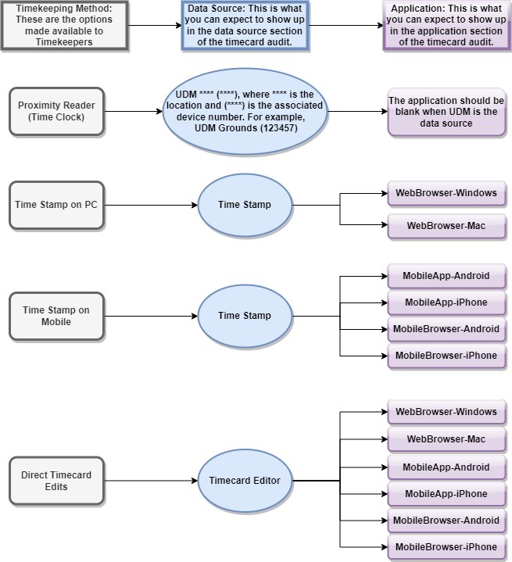
Audit Methods Web Map

Slide 14
Student Timecards
New transfer codes display department and job title
All punches must have transfer codes
New Audit – In Punch Transfer Check dataview
How to add a transfer code as a manager
How to add a transfer code as a student
Transfer box will indicate the student’s primary location.

Slide 15
Student Timecards
Manager approvals – now using Multiple Approvers
Requires all hours to be approved before sign off can be applied
How to view unapproved hours: Totals > Check ‘Show Only Unapproved Totals’ box

Slide 16
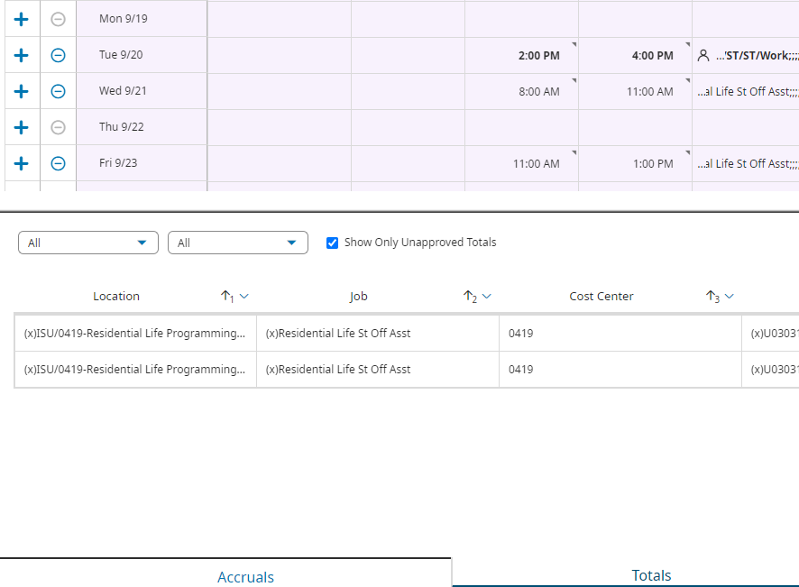
Student Timecards

Slide 17
Student Timecards
Long Intervals –mark as reviewed shifts of 8 hours or more.
Running Employee Hours by Org report

Slide 18
Mobile Application – UKG Dimensions
The mobile application has many of the features the desktop application has.
The Mobile app has a timestamping option that can be audited by the timekeepers.

Slide 19
Mobile Application – Logging In
Launch the UKG Dimensions App from your phone.
Enter the following URL in the tenant field, or scan the QR code.
https://IndianaState-sso.prd.mykronos.com

Slide 20
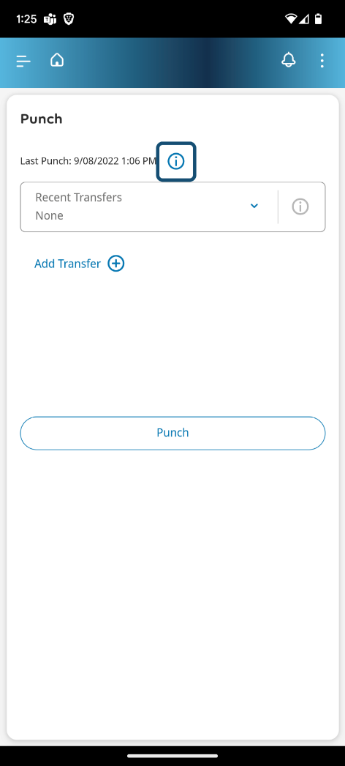
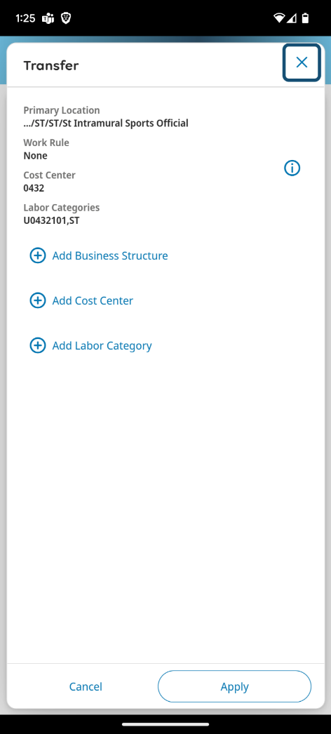
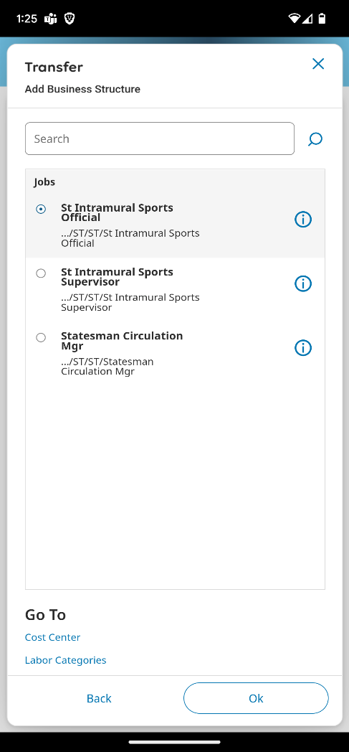
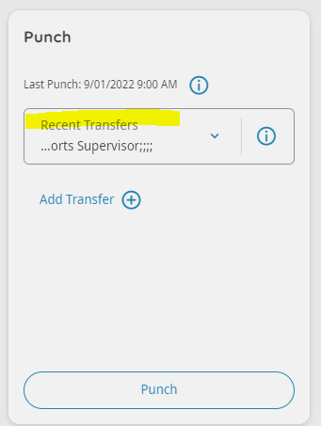
Mobile Application – Timestamping

